Slide 1
TCHS Band – Renfroe Era 1980’s
by Geoffrey Price

Slide 2
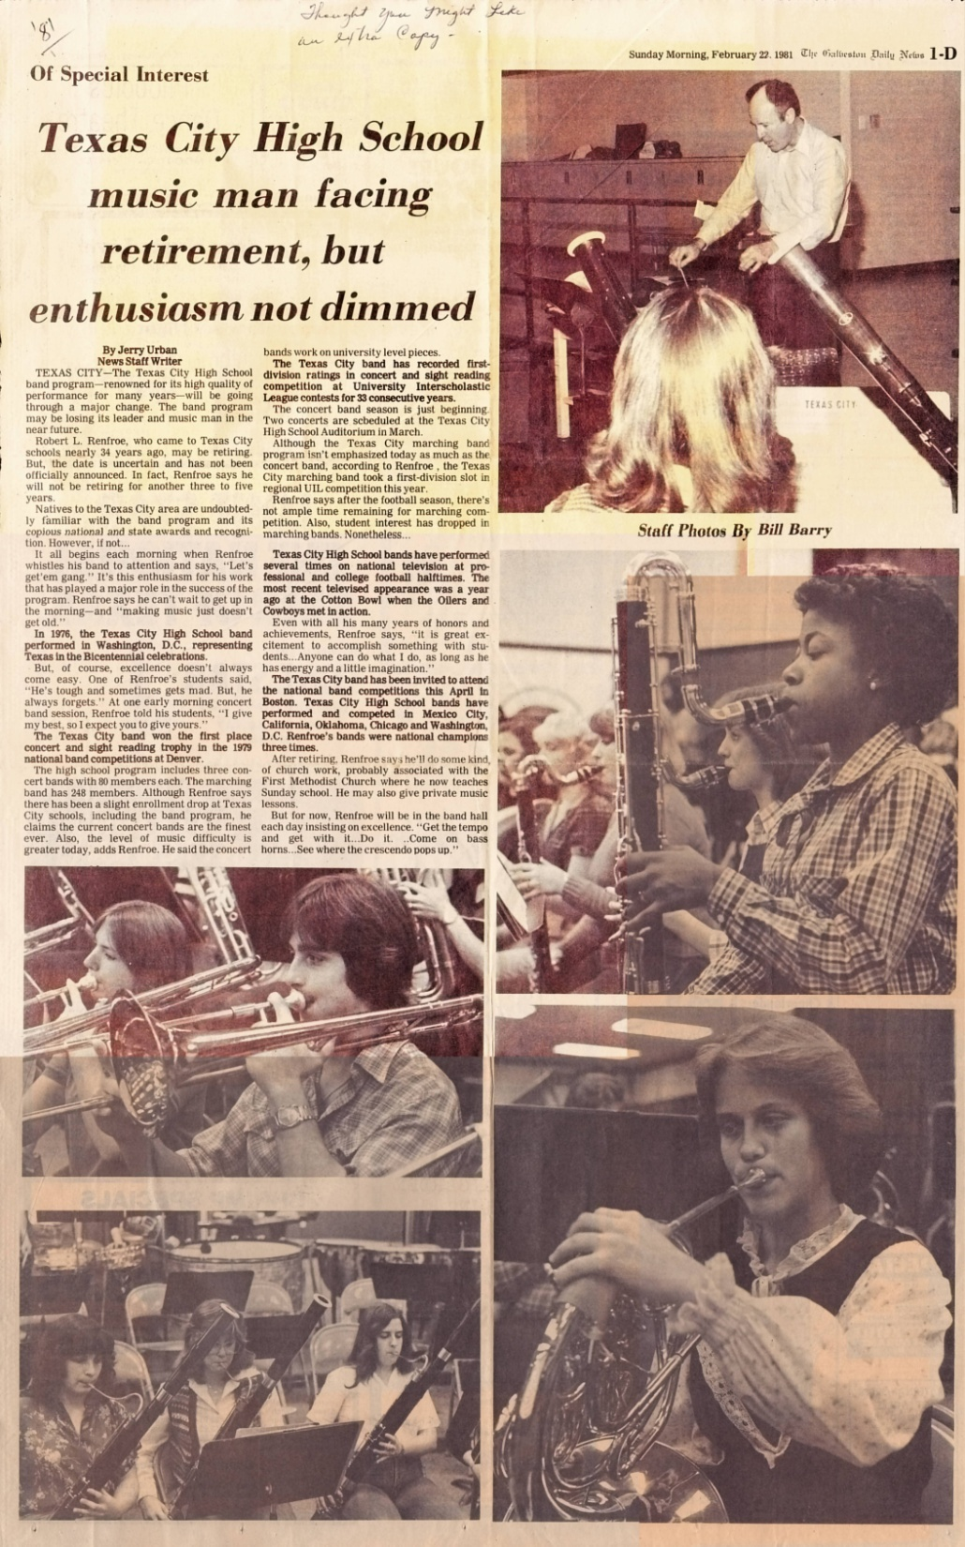
Link to Picture

Slide 3
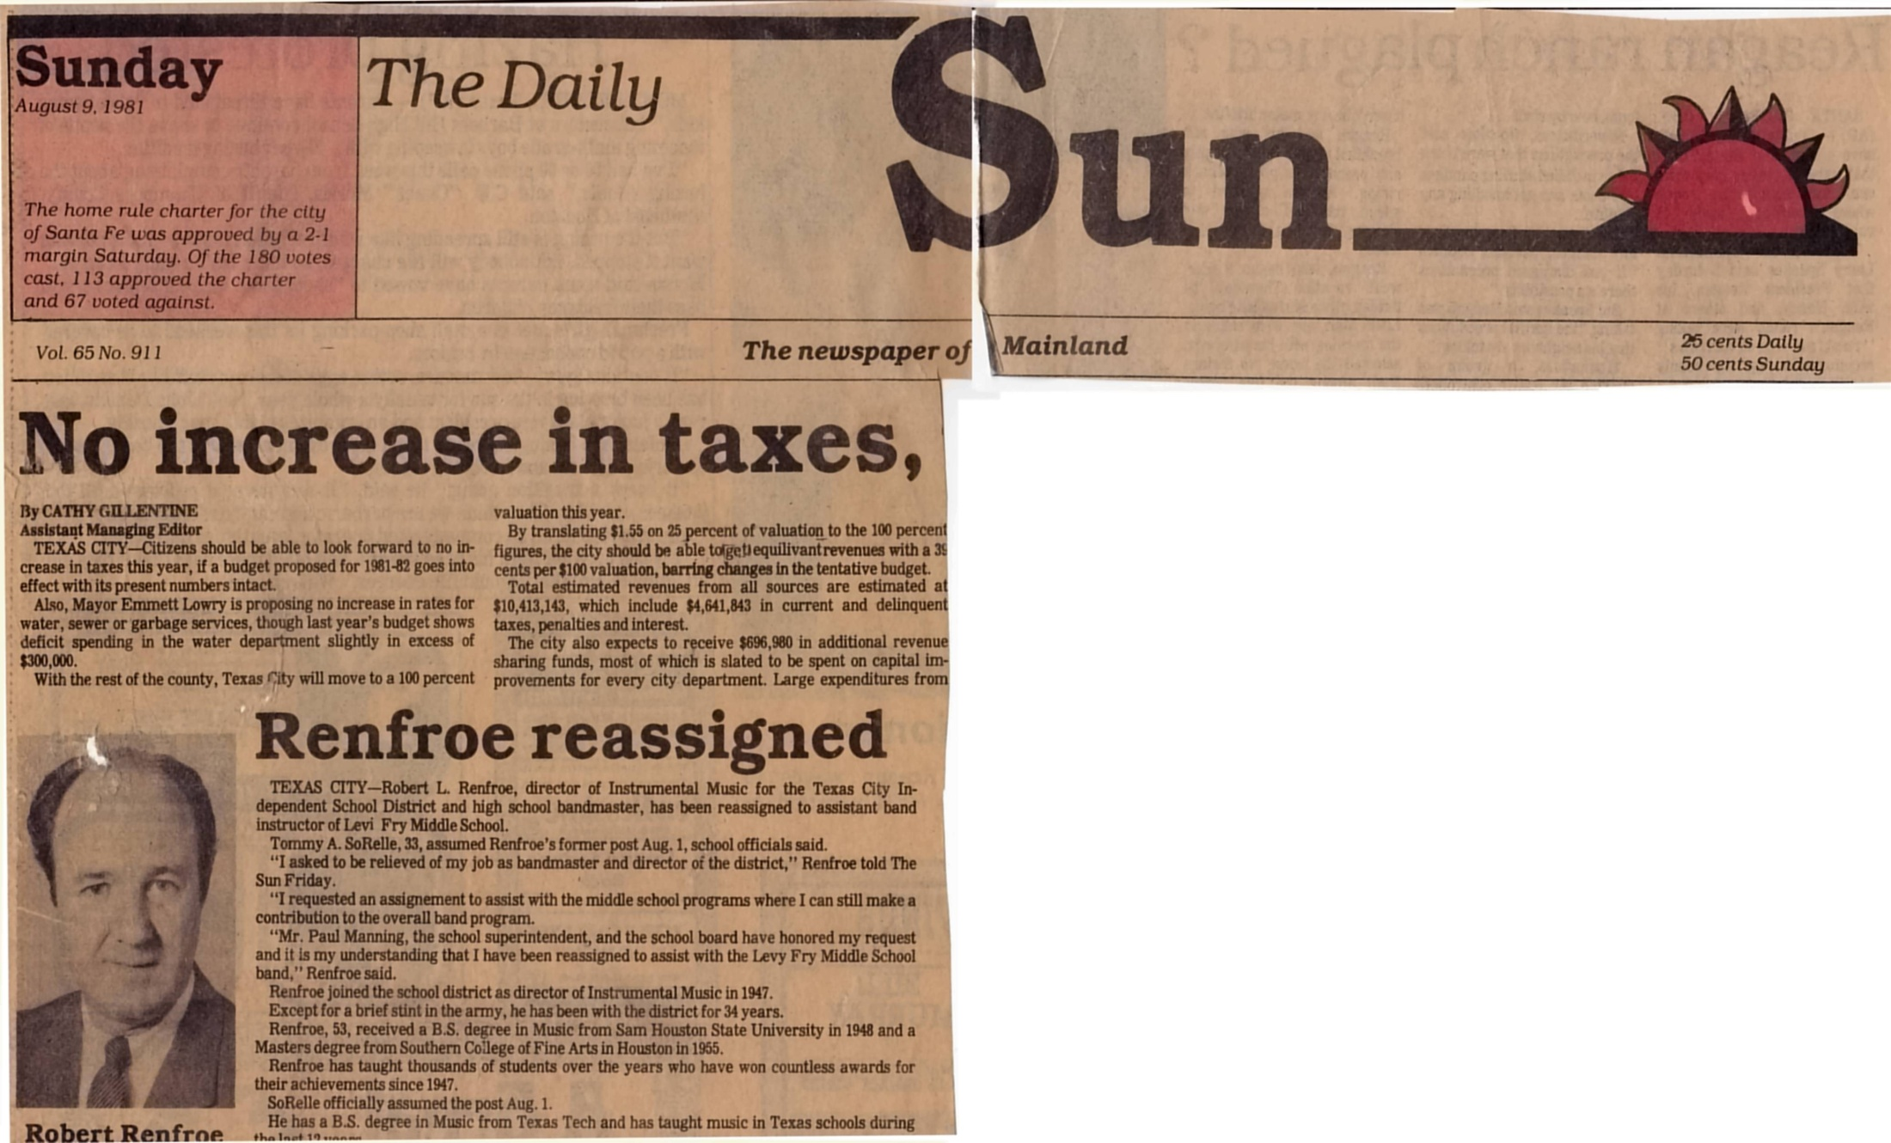
Link to Picture

Slide 4
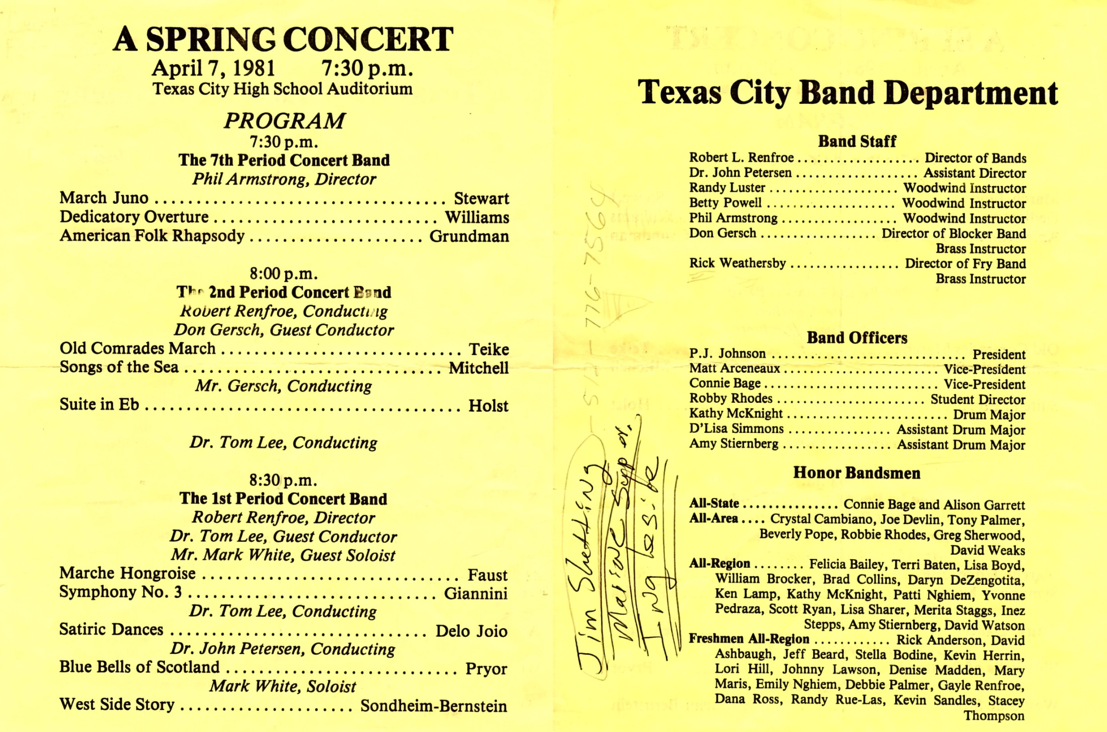
Link to Picture

Slide 5
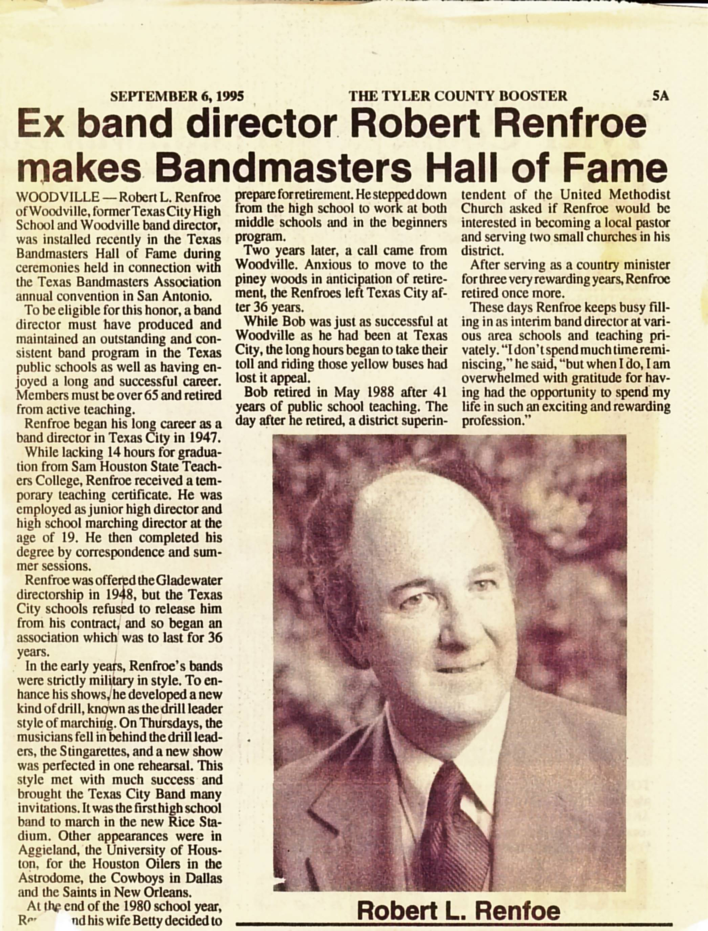
Link to Picture

Slide 6
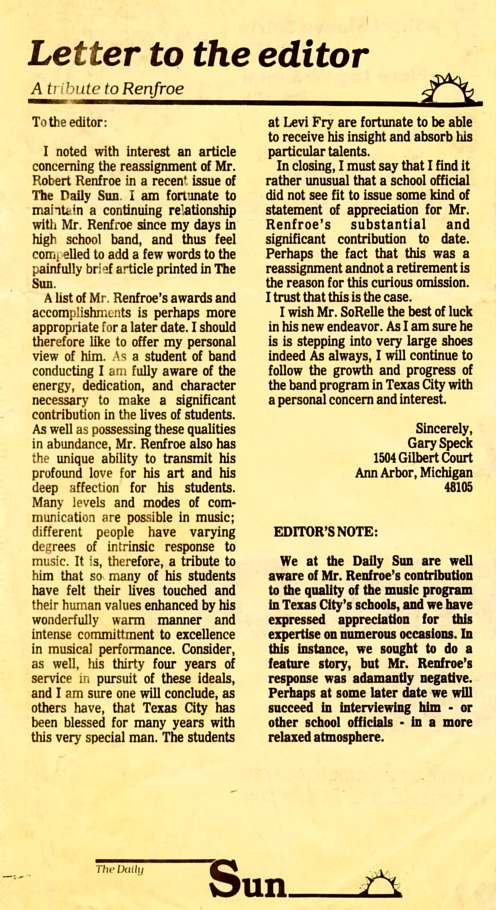
Link to Picture

Slide 7
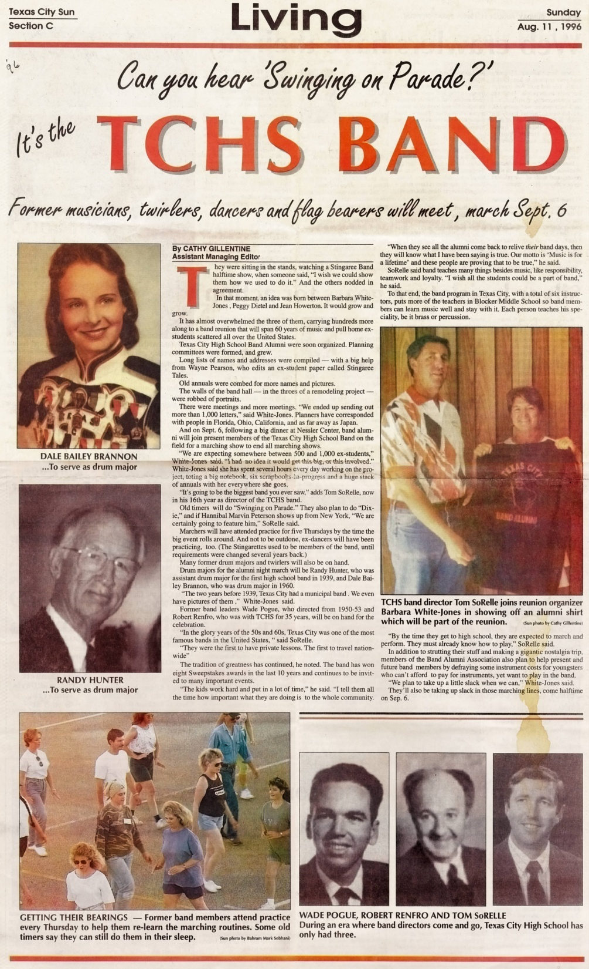
Link to Picture

