Slide 1
TCHS Band – Renfroe Era 1960’s
by Geoffrey Price

Slide 2
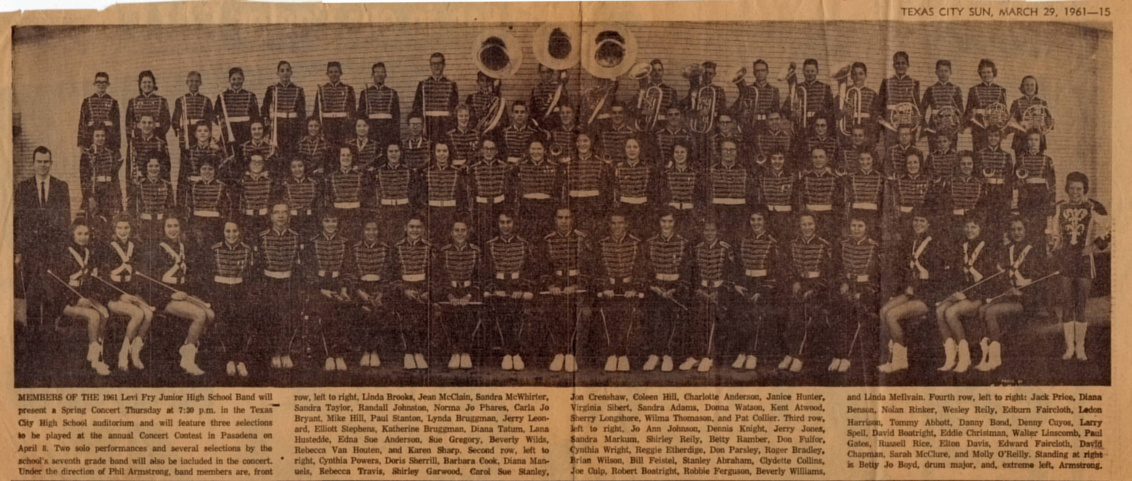
Link to Picture

Slide 3
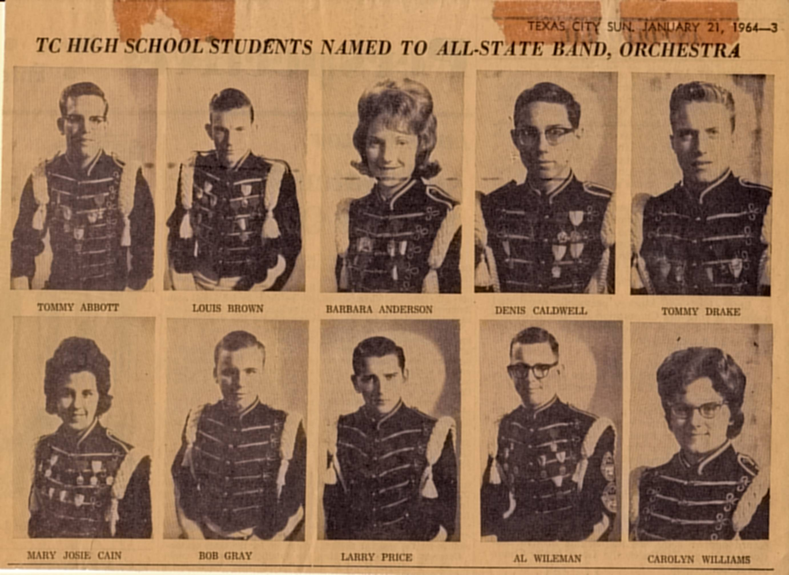
Link to Picture

Slide 4
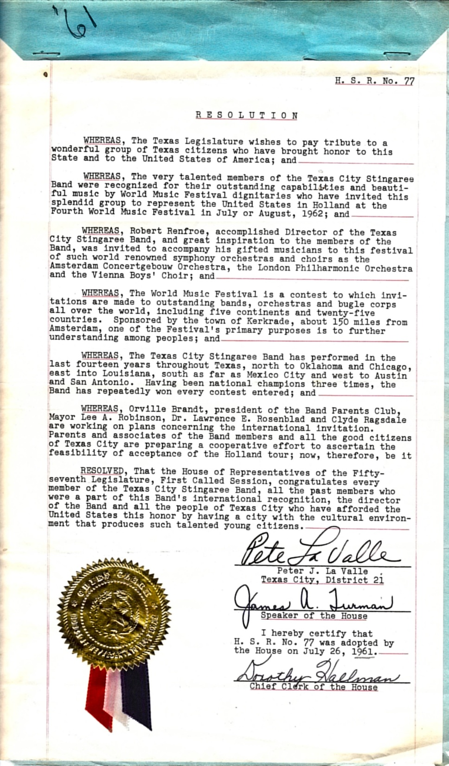
Link to Picture

Slide 5
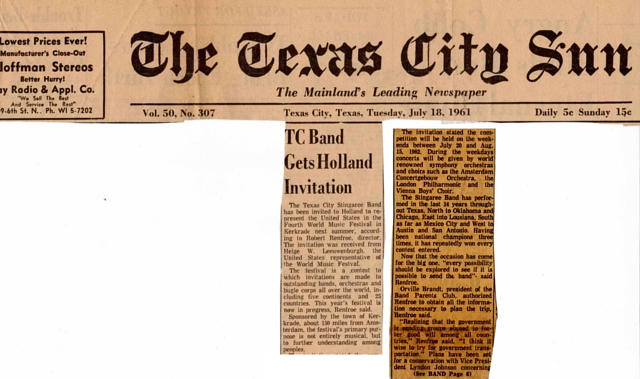
Link to Picture

Slide 6
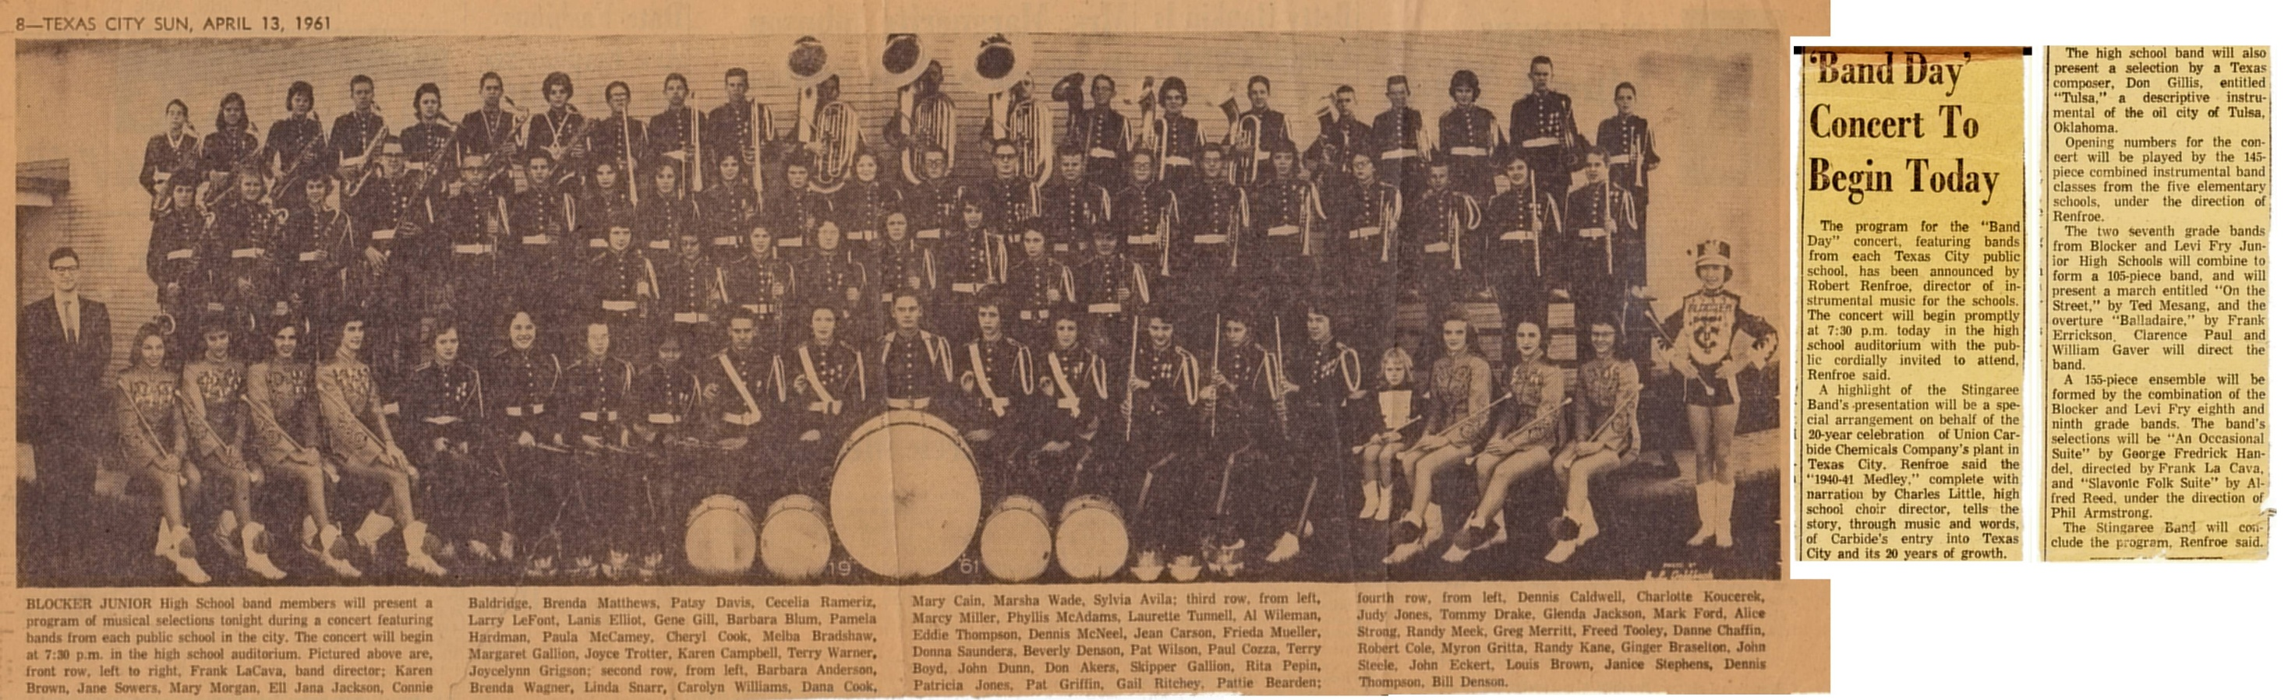
Link to Picture

Slide 7
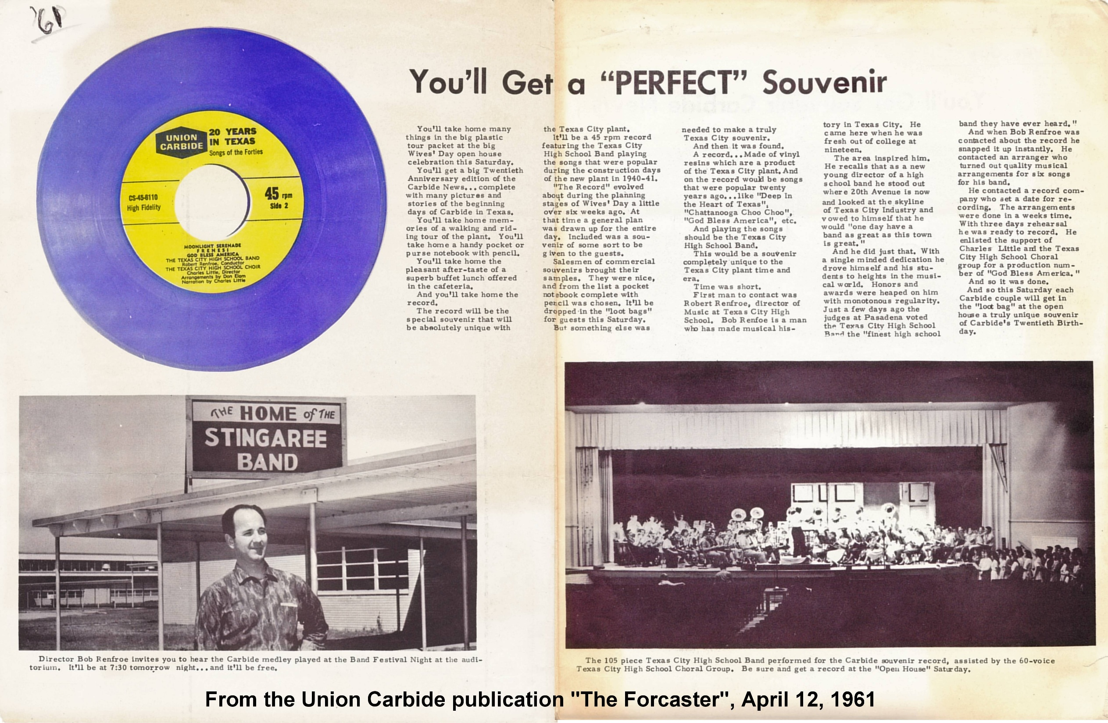
Link to Picture

Slide 8
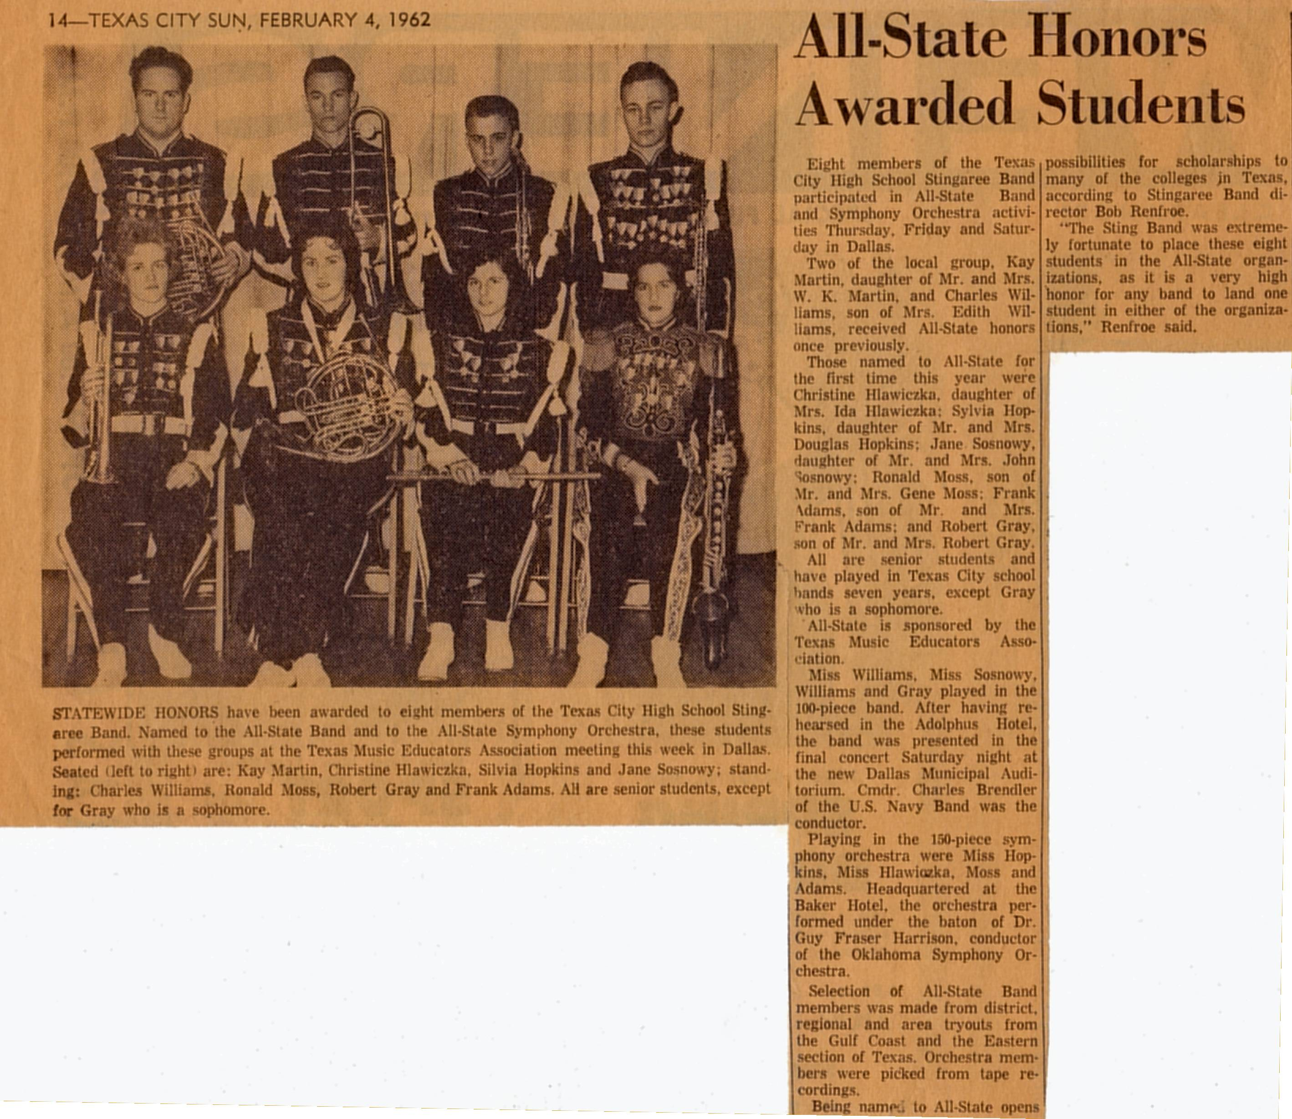
Link to Picture

Slide 9
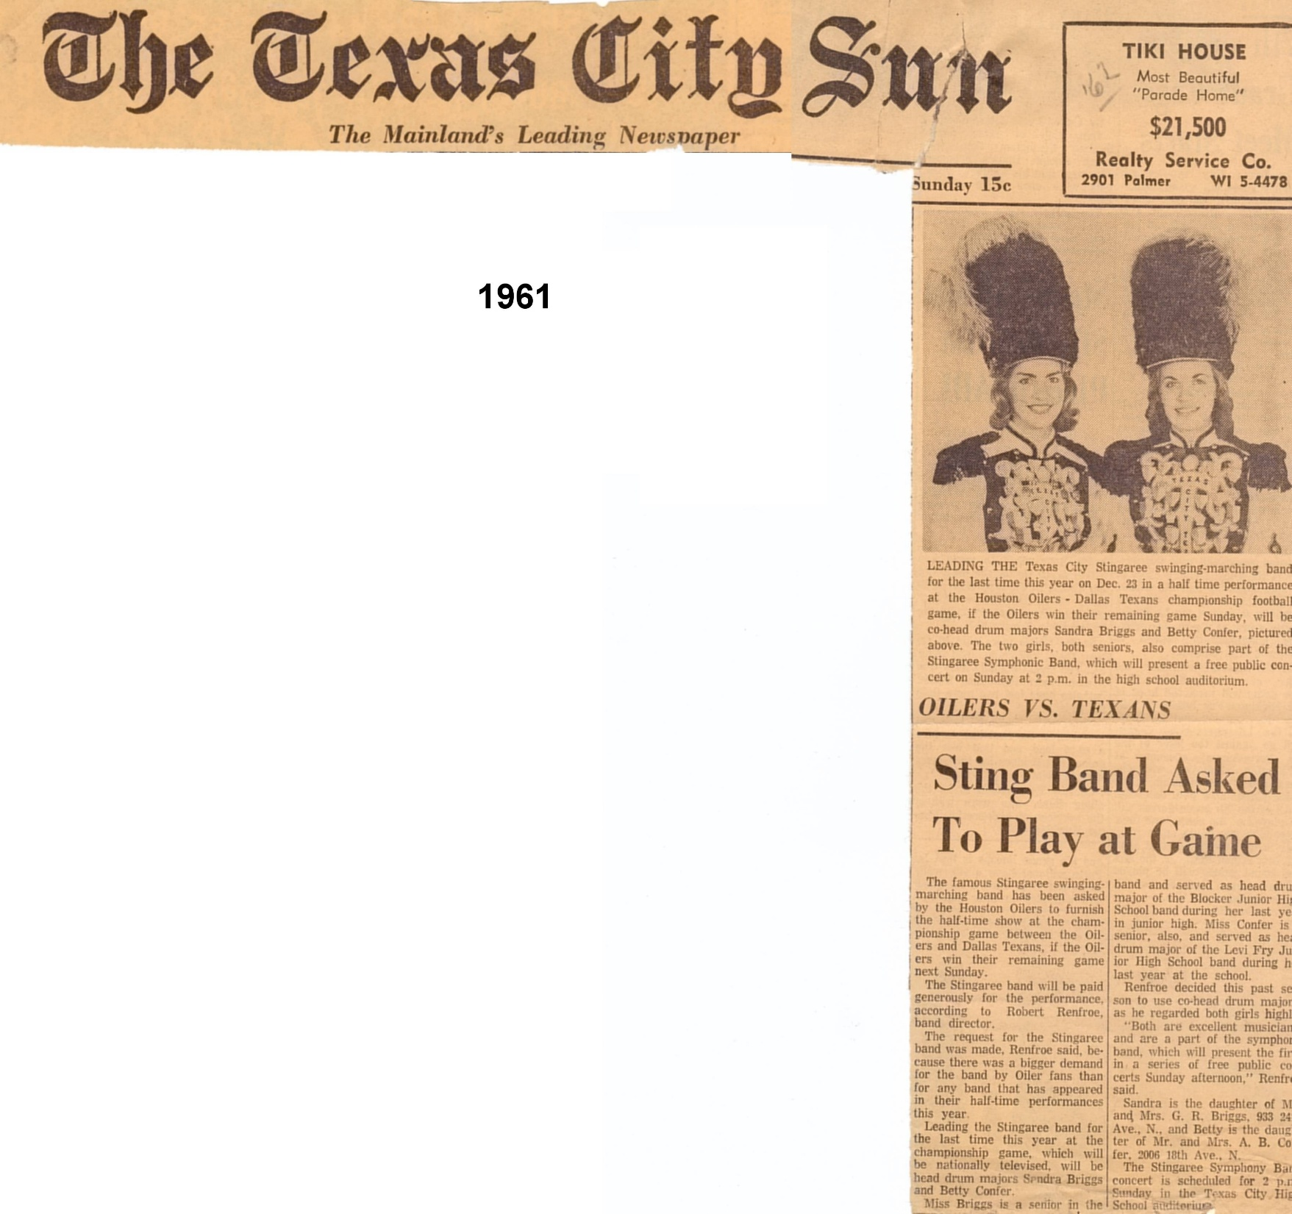
Link to Picture

Slide 10
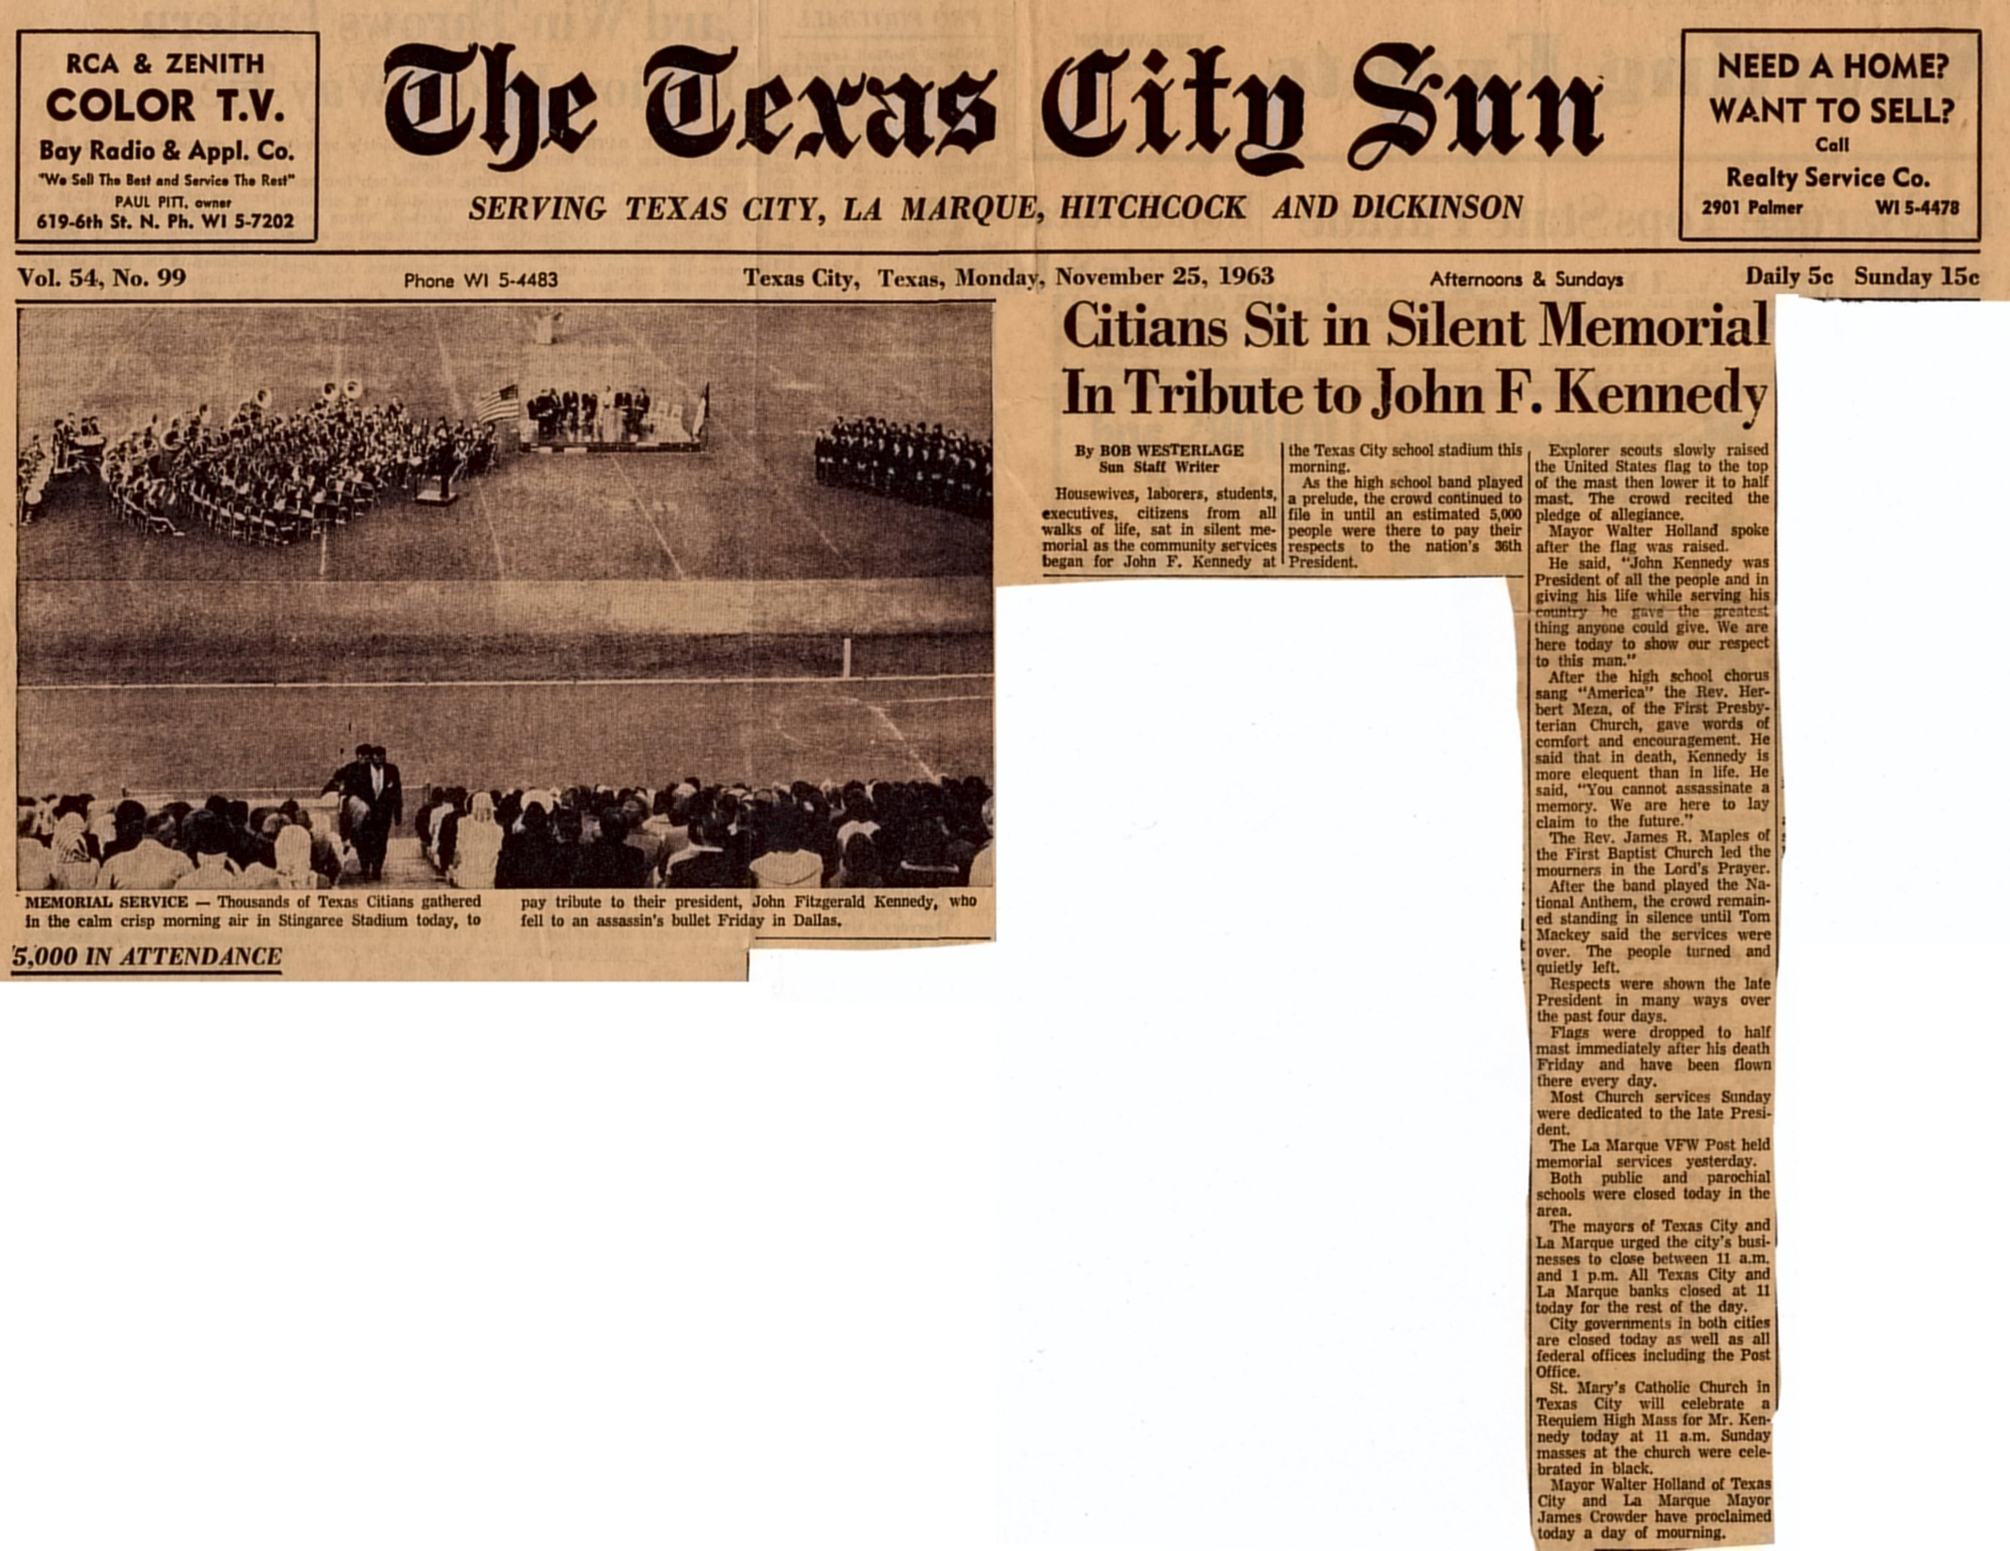
Link to Picture

Slide 11
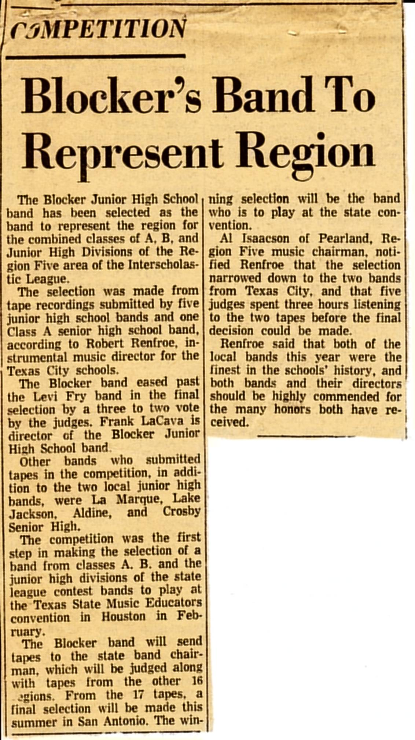
Link to Picture

Slide 12
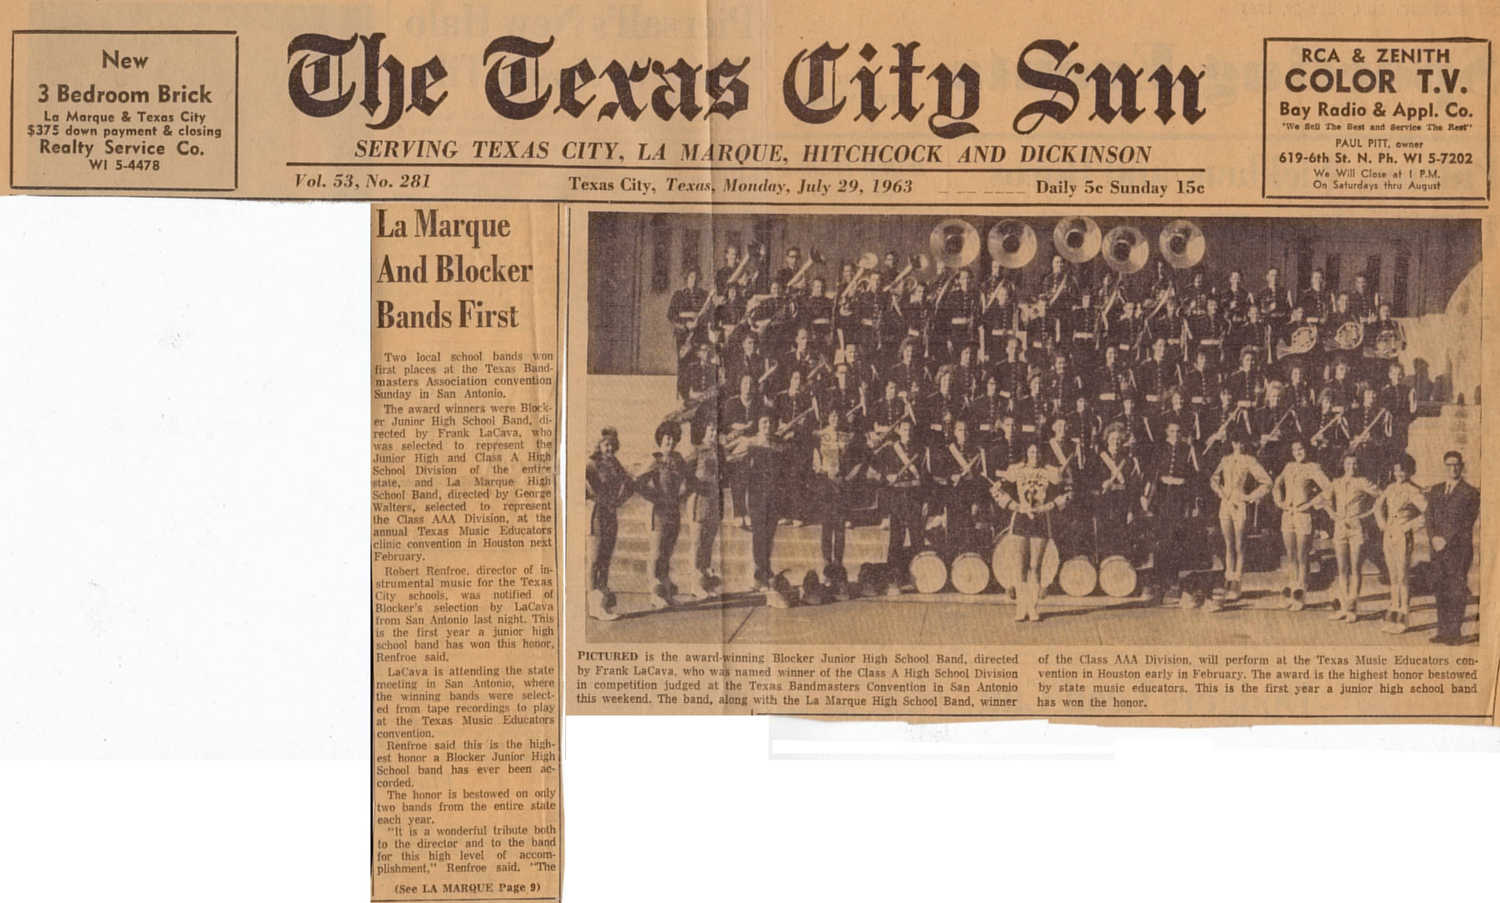
Link to Picture

Slide 13
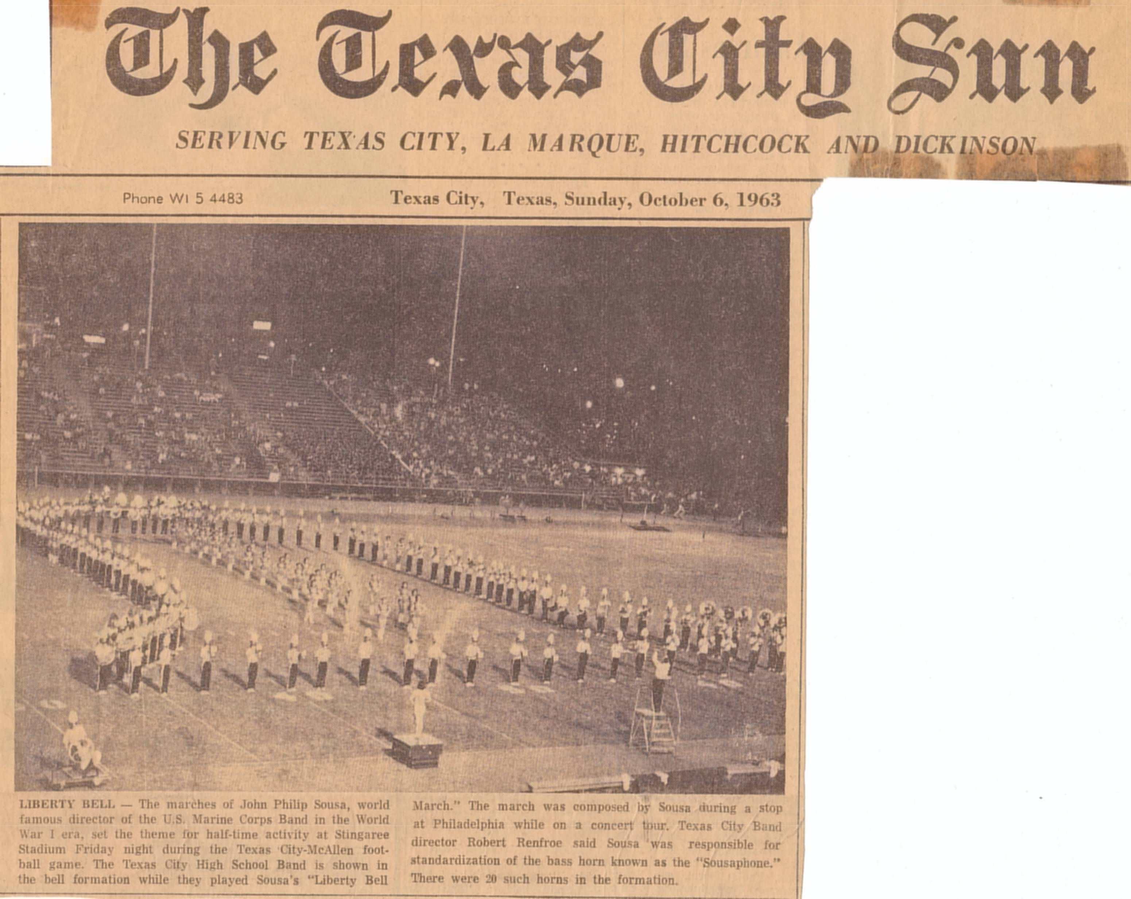
Link to Picture

Slide 14
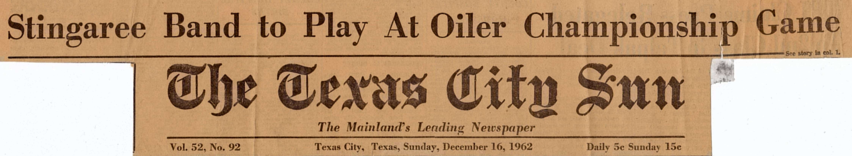
Link to Picture

Slide 15
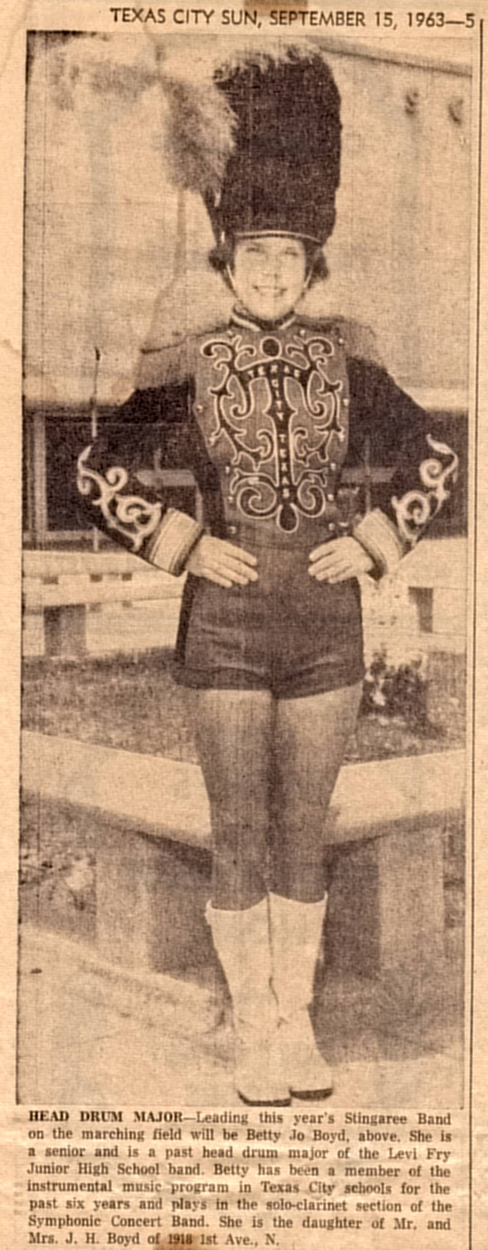
Link to Picture

Slide 16
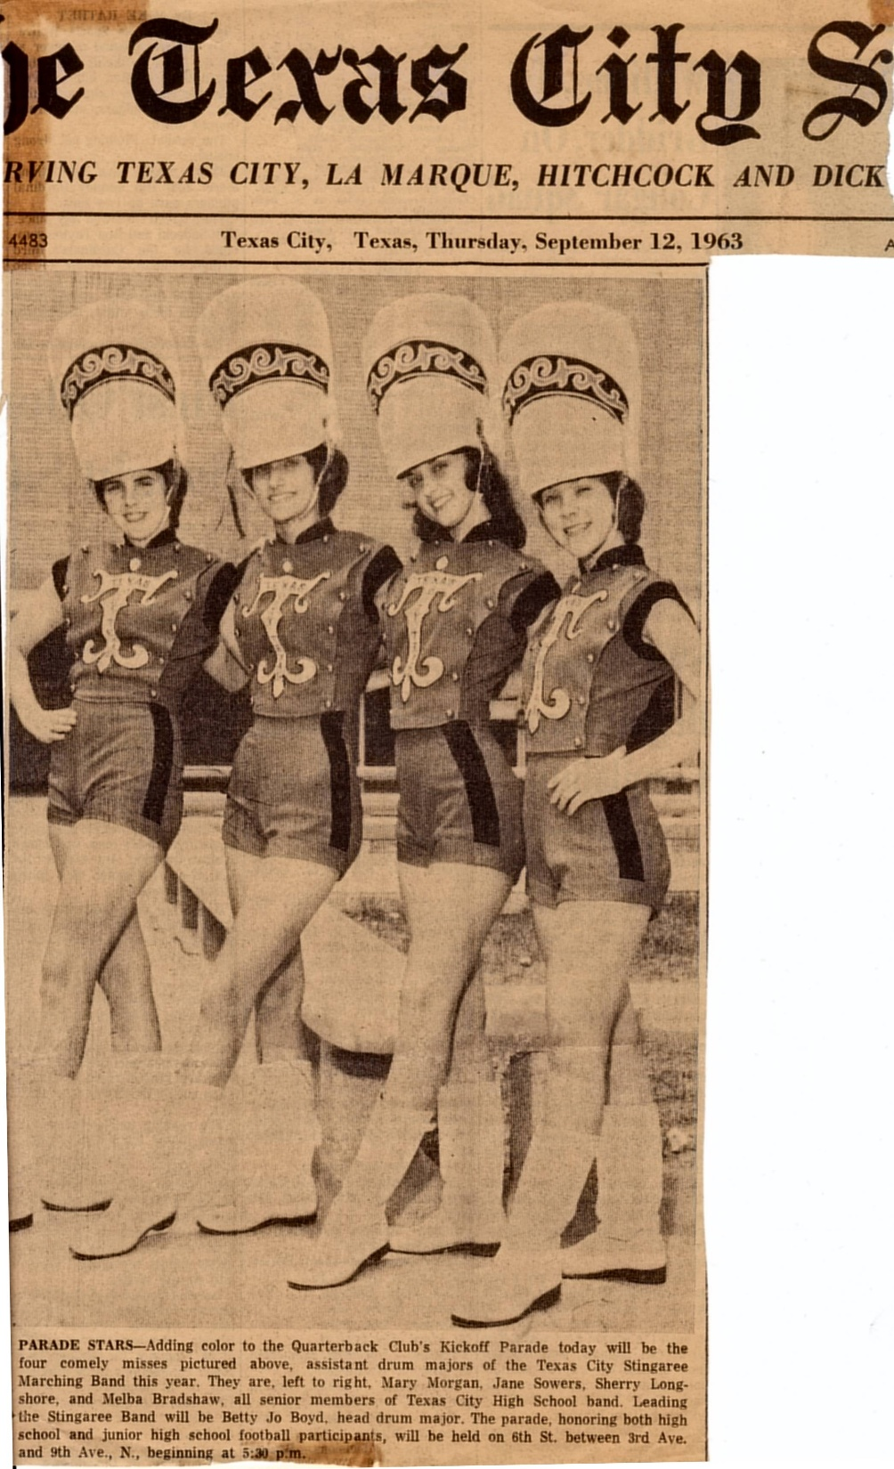
Link to Picture

Slide 17
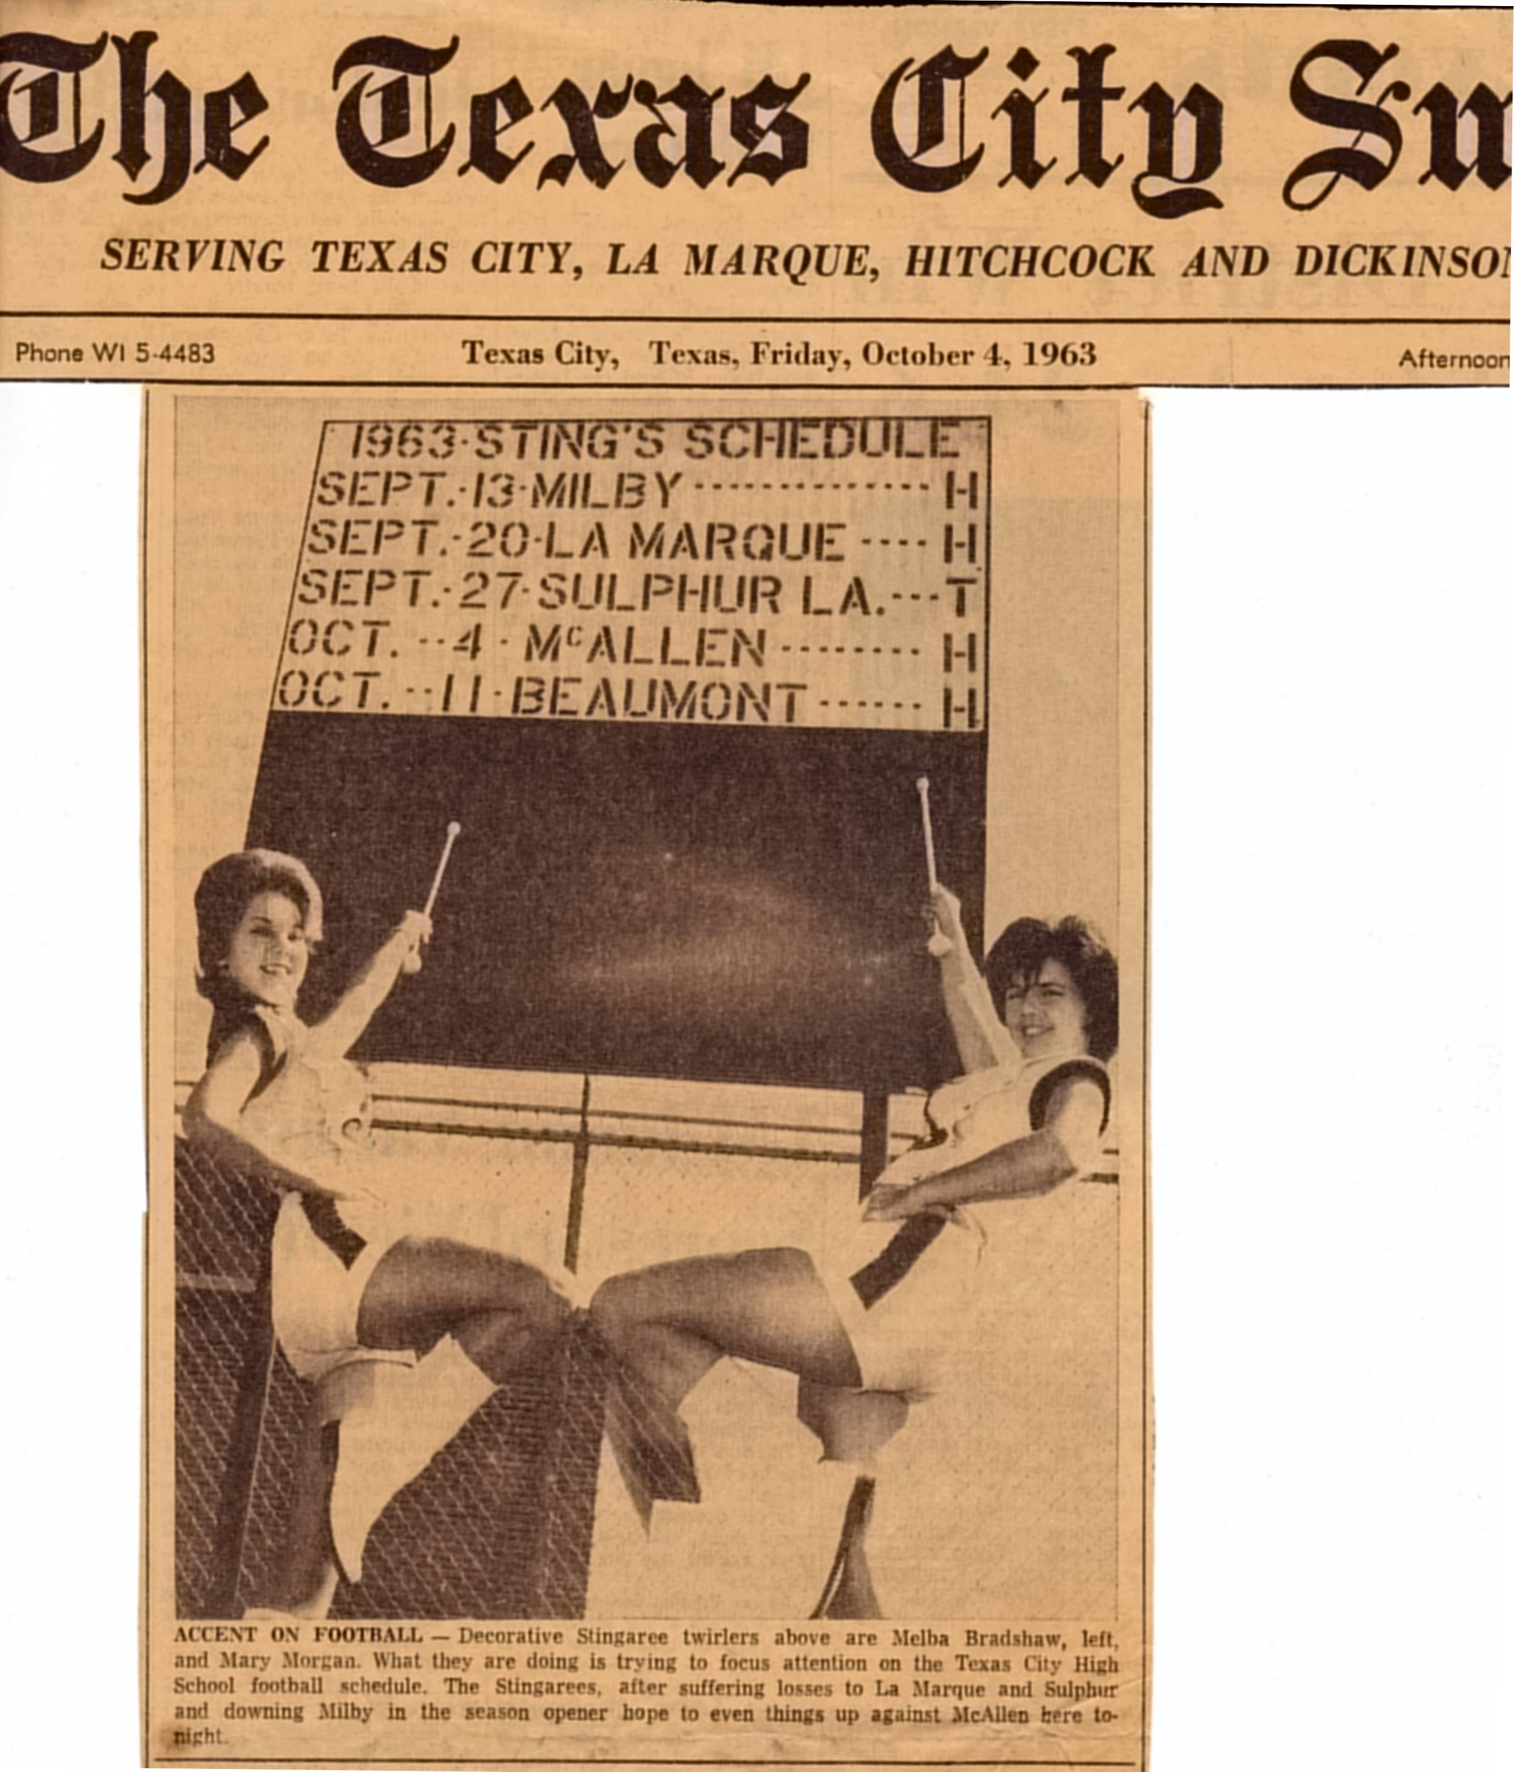
Link to Picture

Slide 18
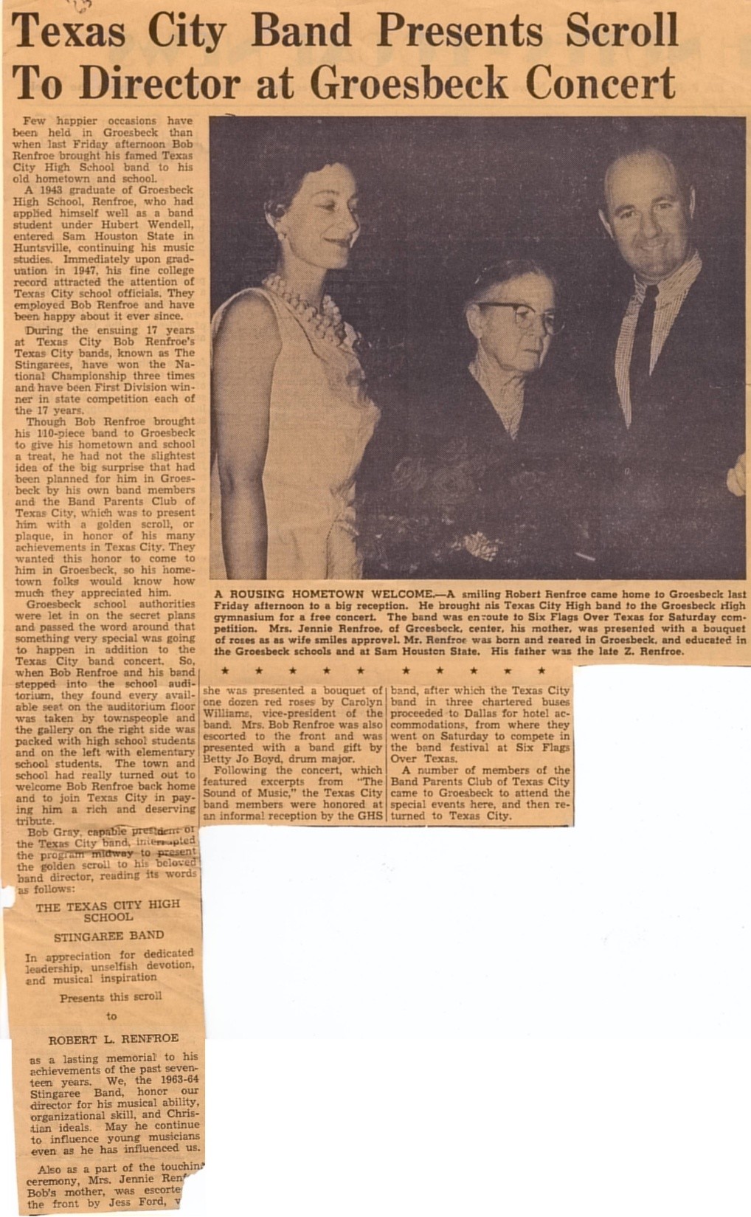
Link to Picture

Slide 19
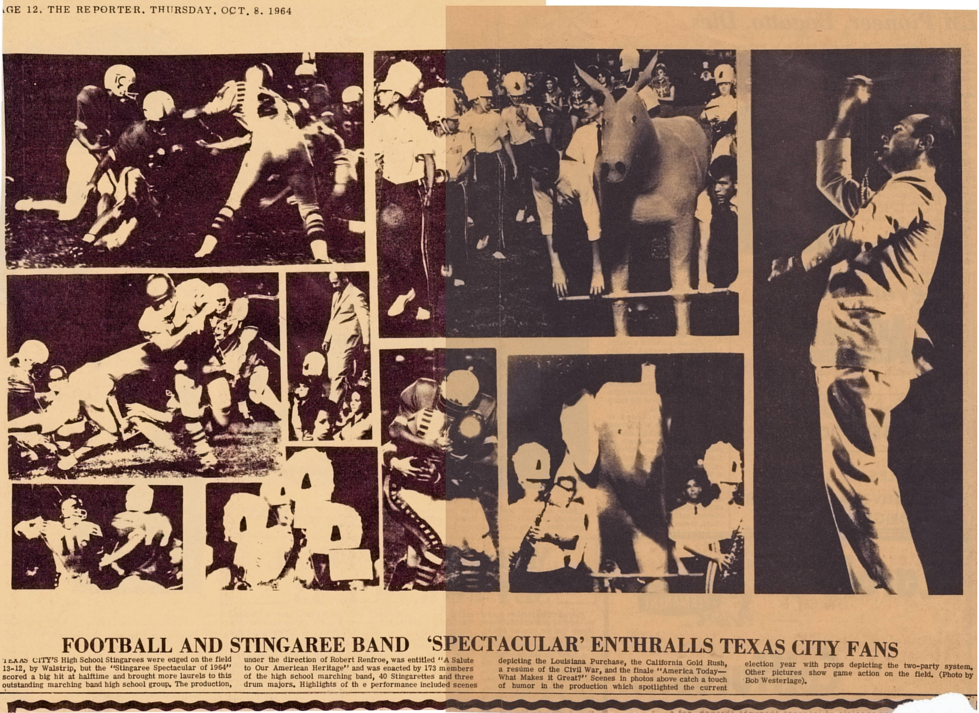
Link to Picture

Slide 20
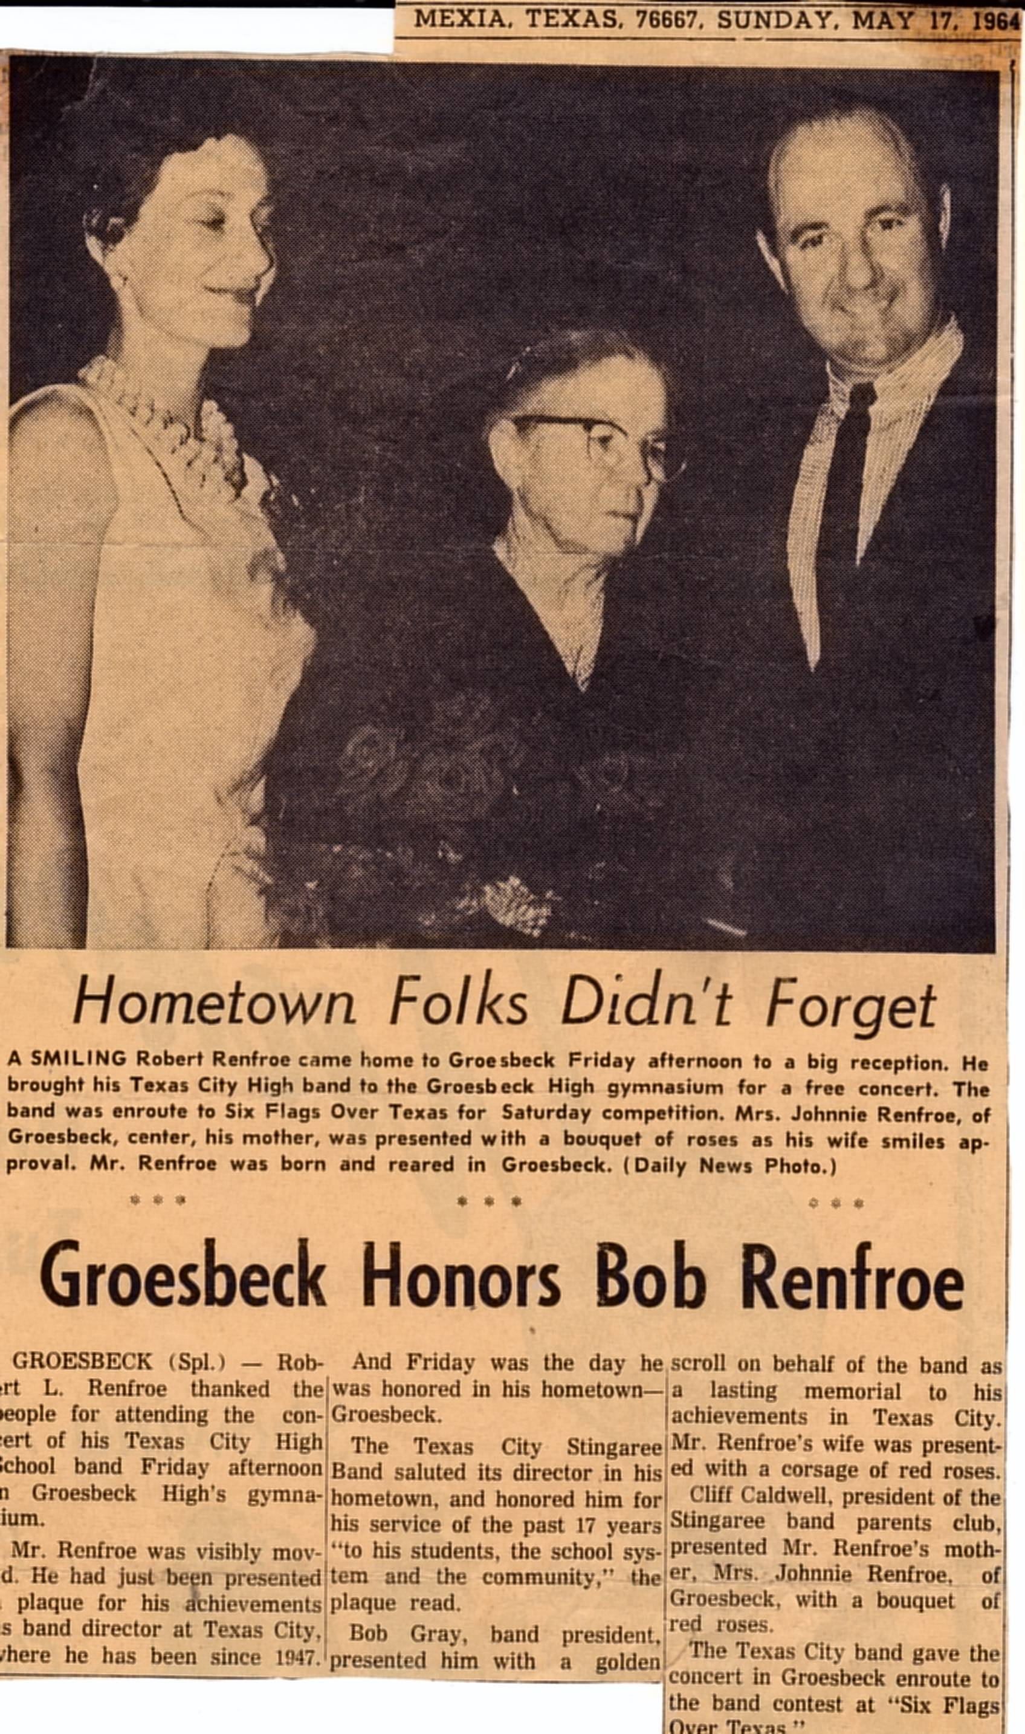
Link to Picture

Slide 21
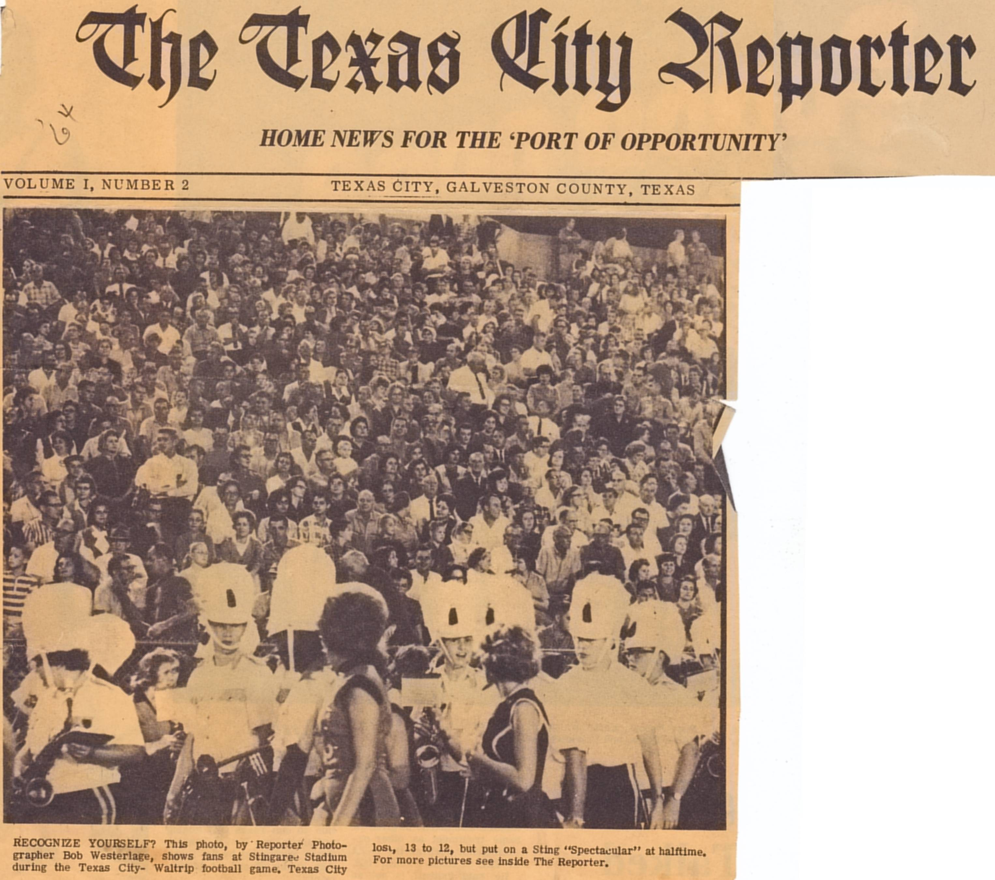
Link to Picture

Slide 22
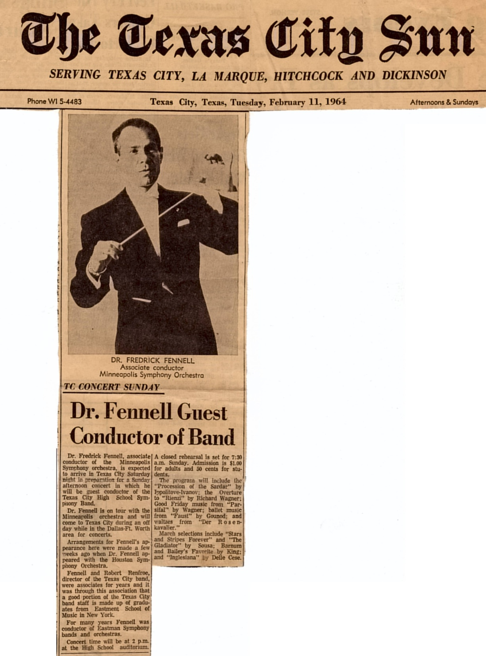
Link to Picture

Slide 23
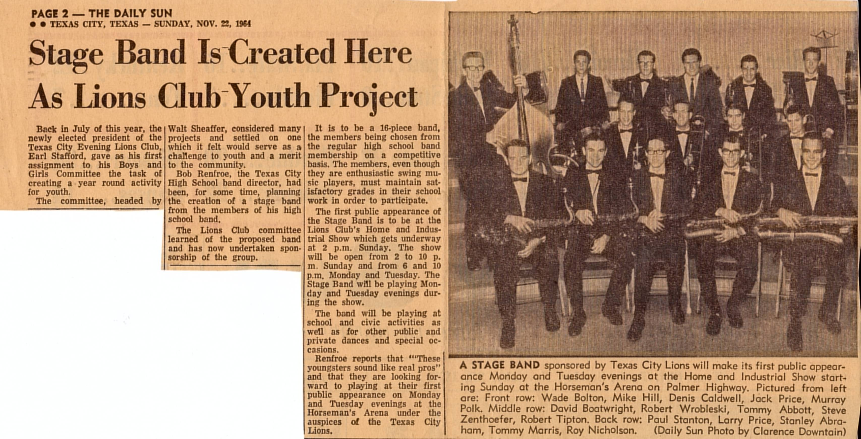
Link to Picture

Slide 24
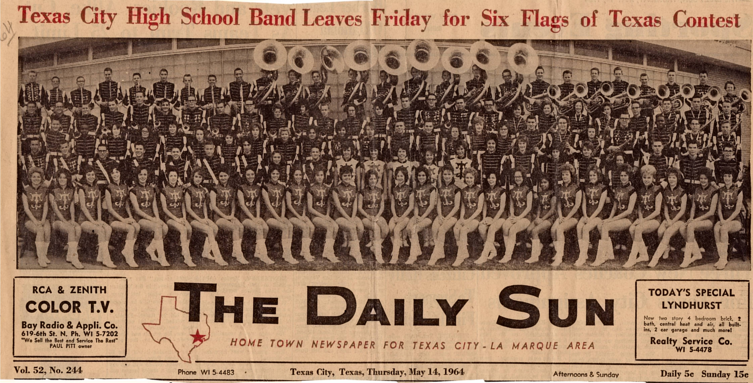
Link to Picture

Slide 25
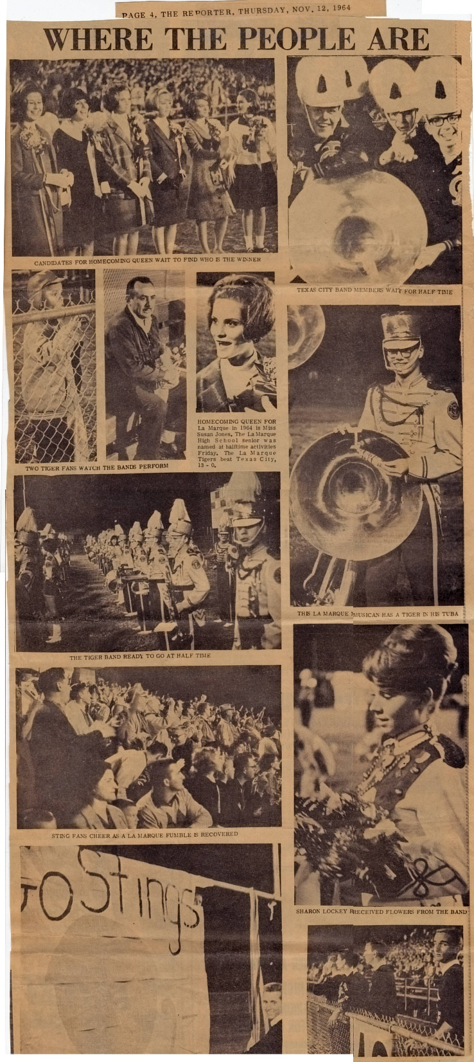
Link to Picture

Slide 26
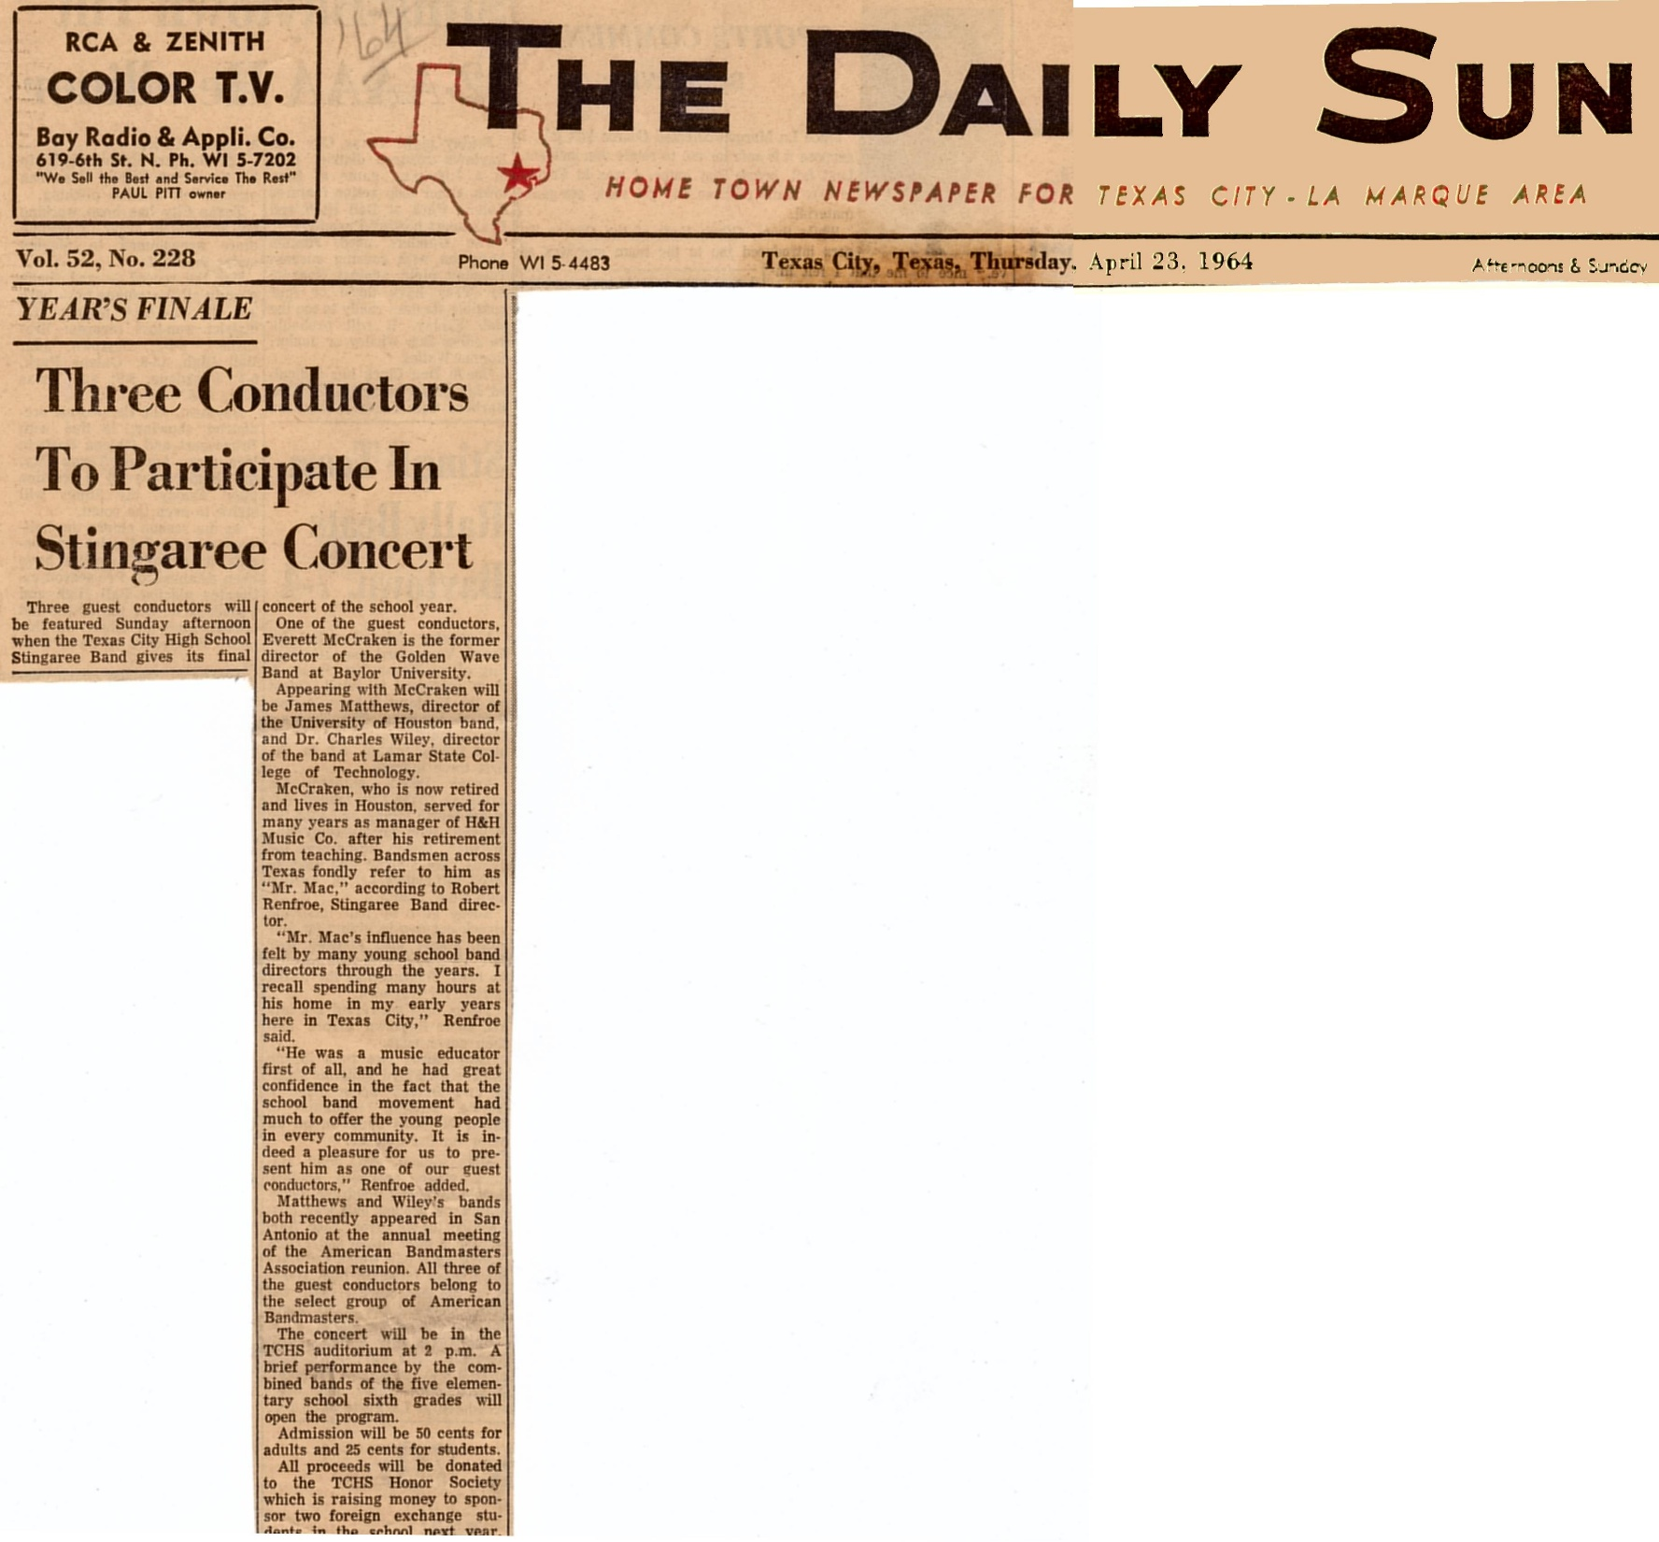
Link to Picture

Slide 27
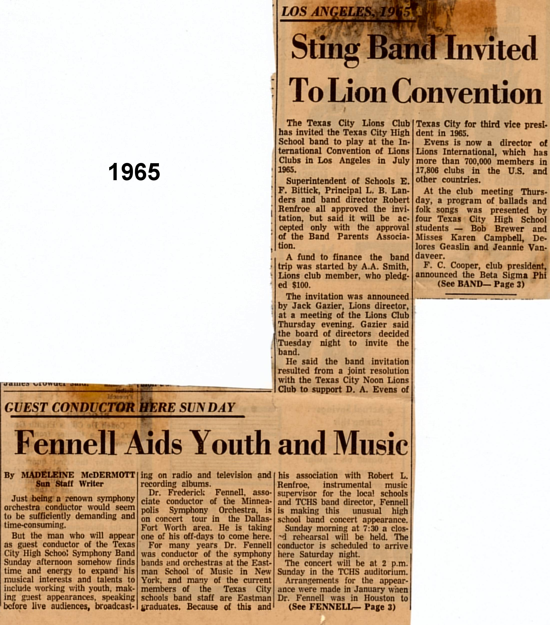
Link to Picture

Slide 28
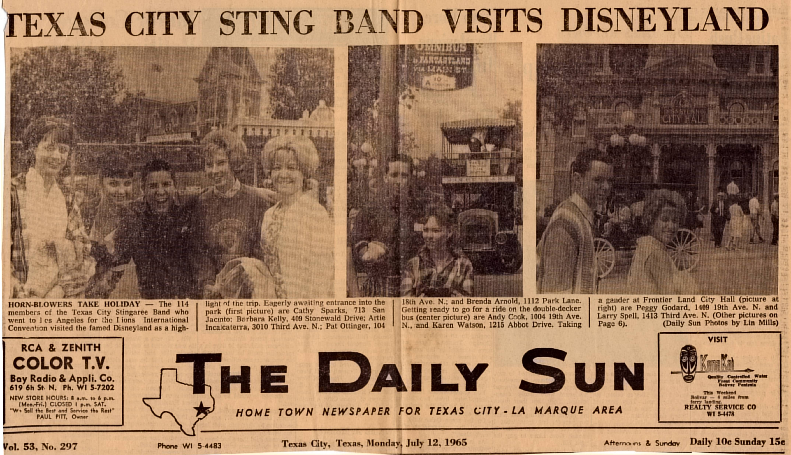
Link to Picture

Slide 29
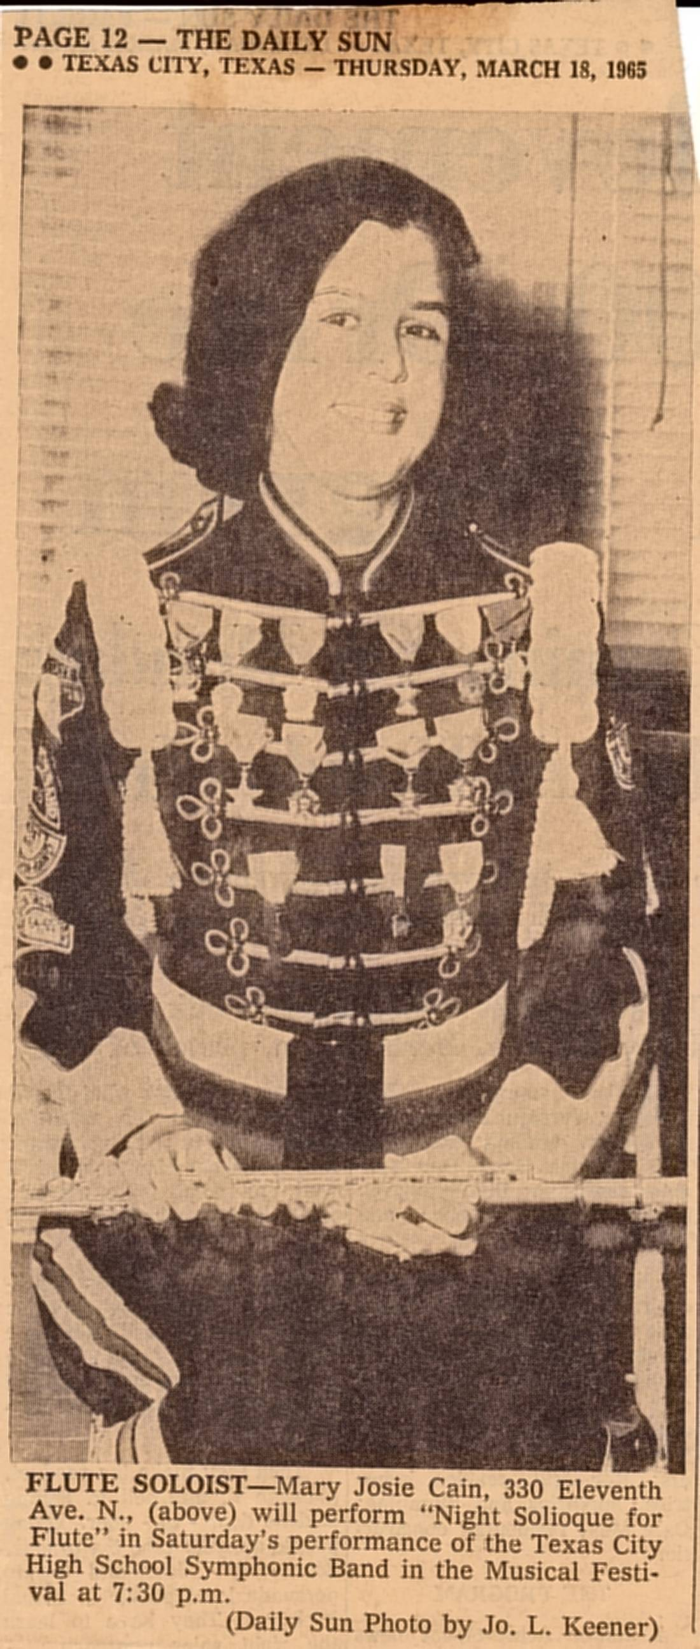
Link to Picture

Slide 30
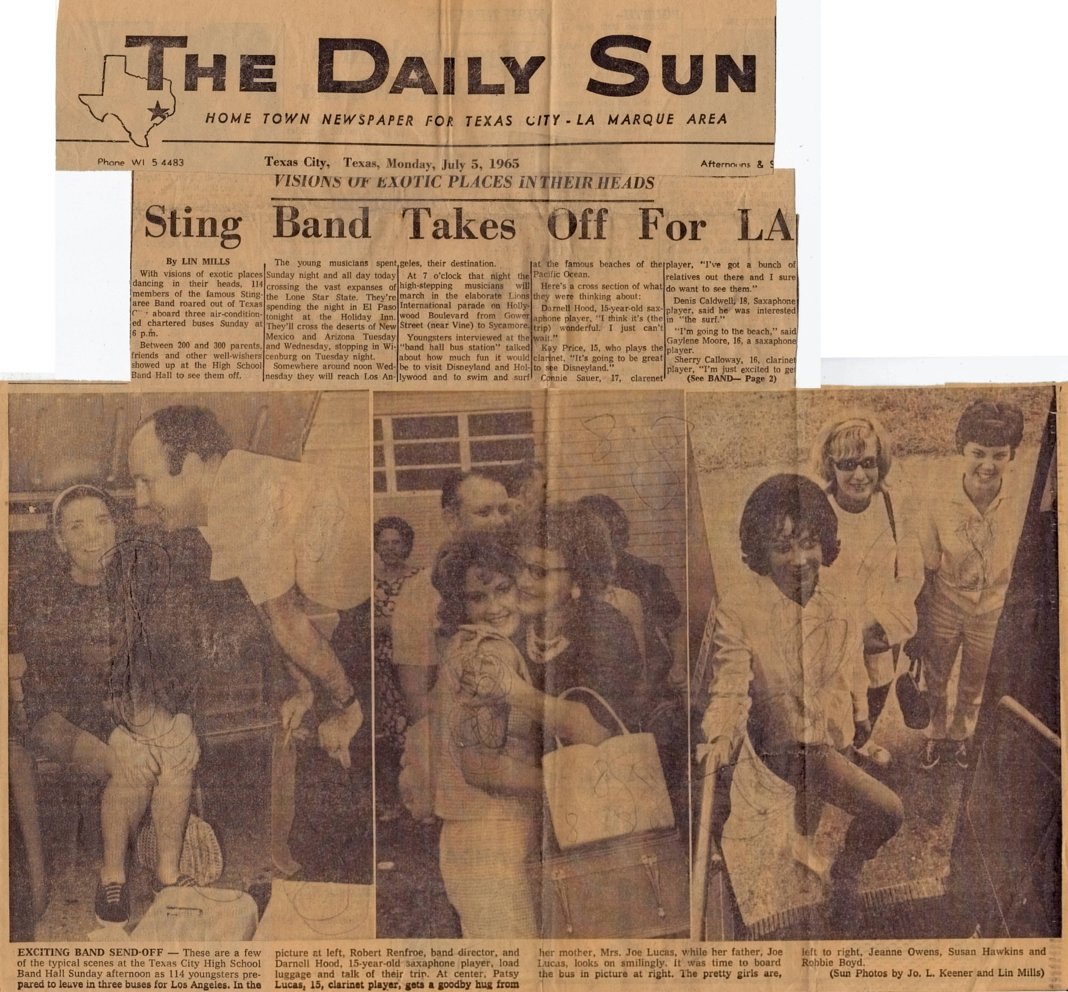
Link to Picture

Slide 31
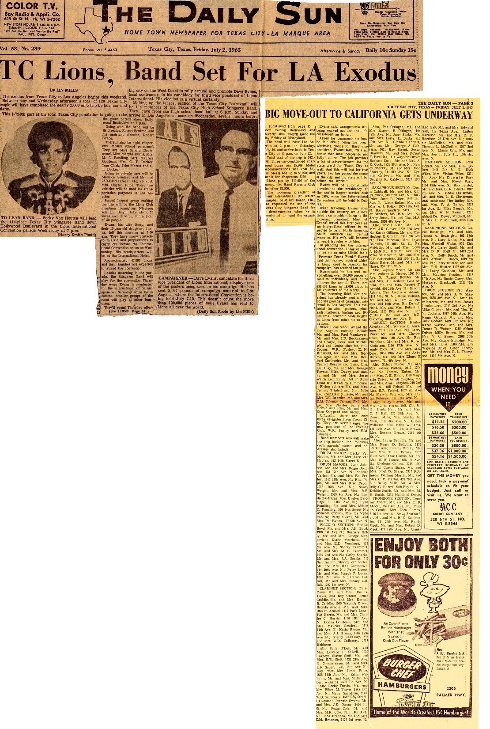
Link to Picture

Slide 32
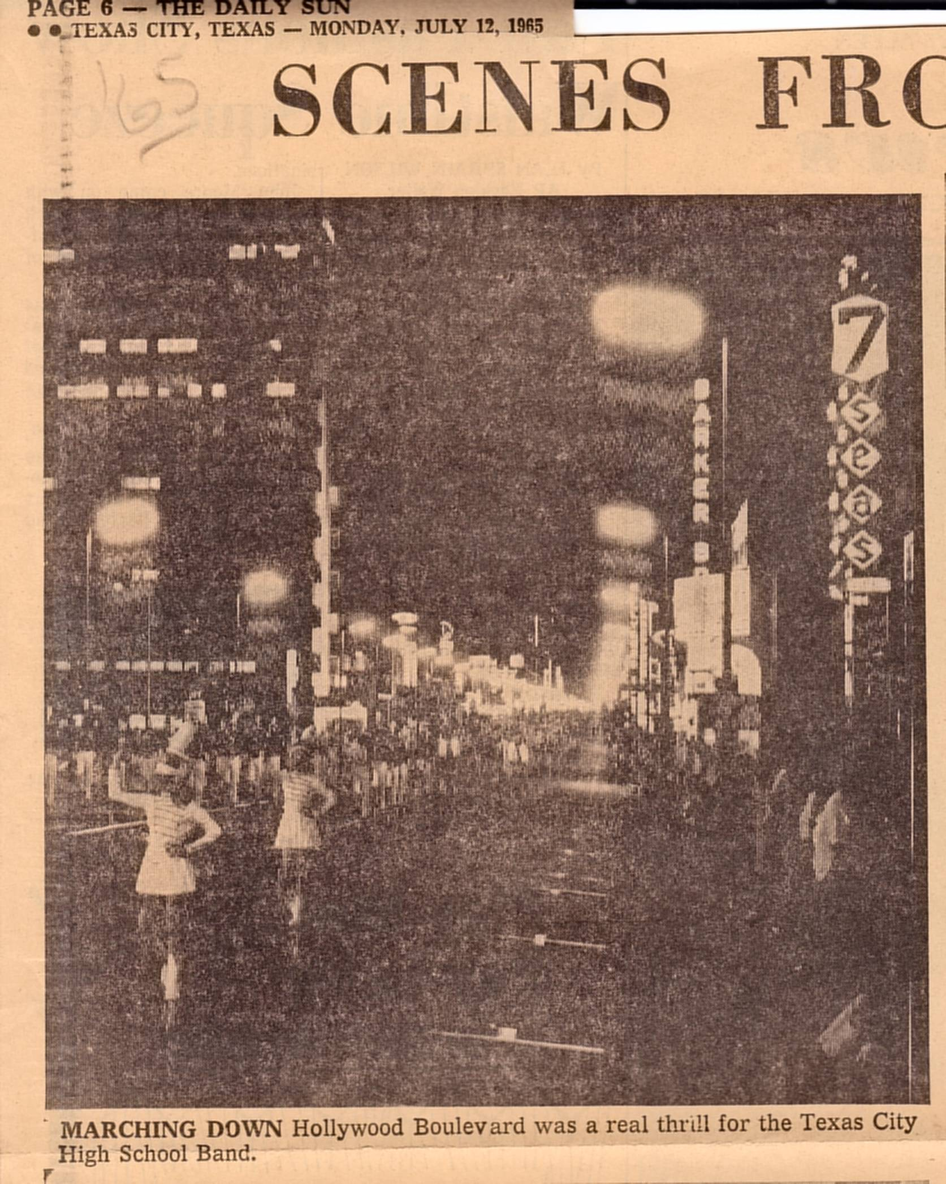
Link to Picture

Slide 33
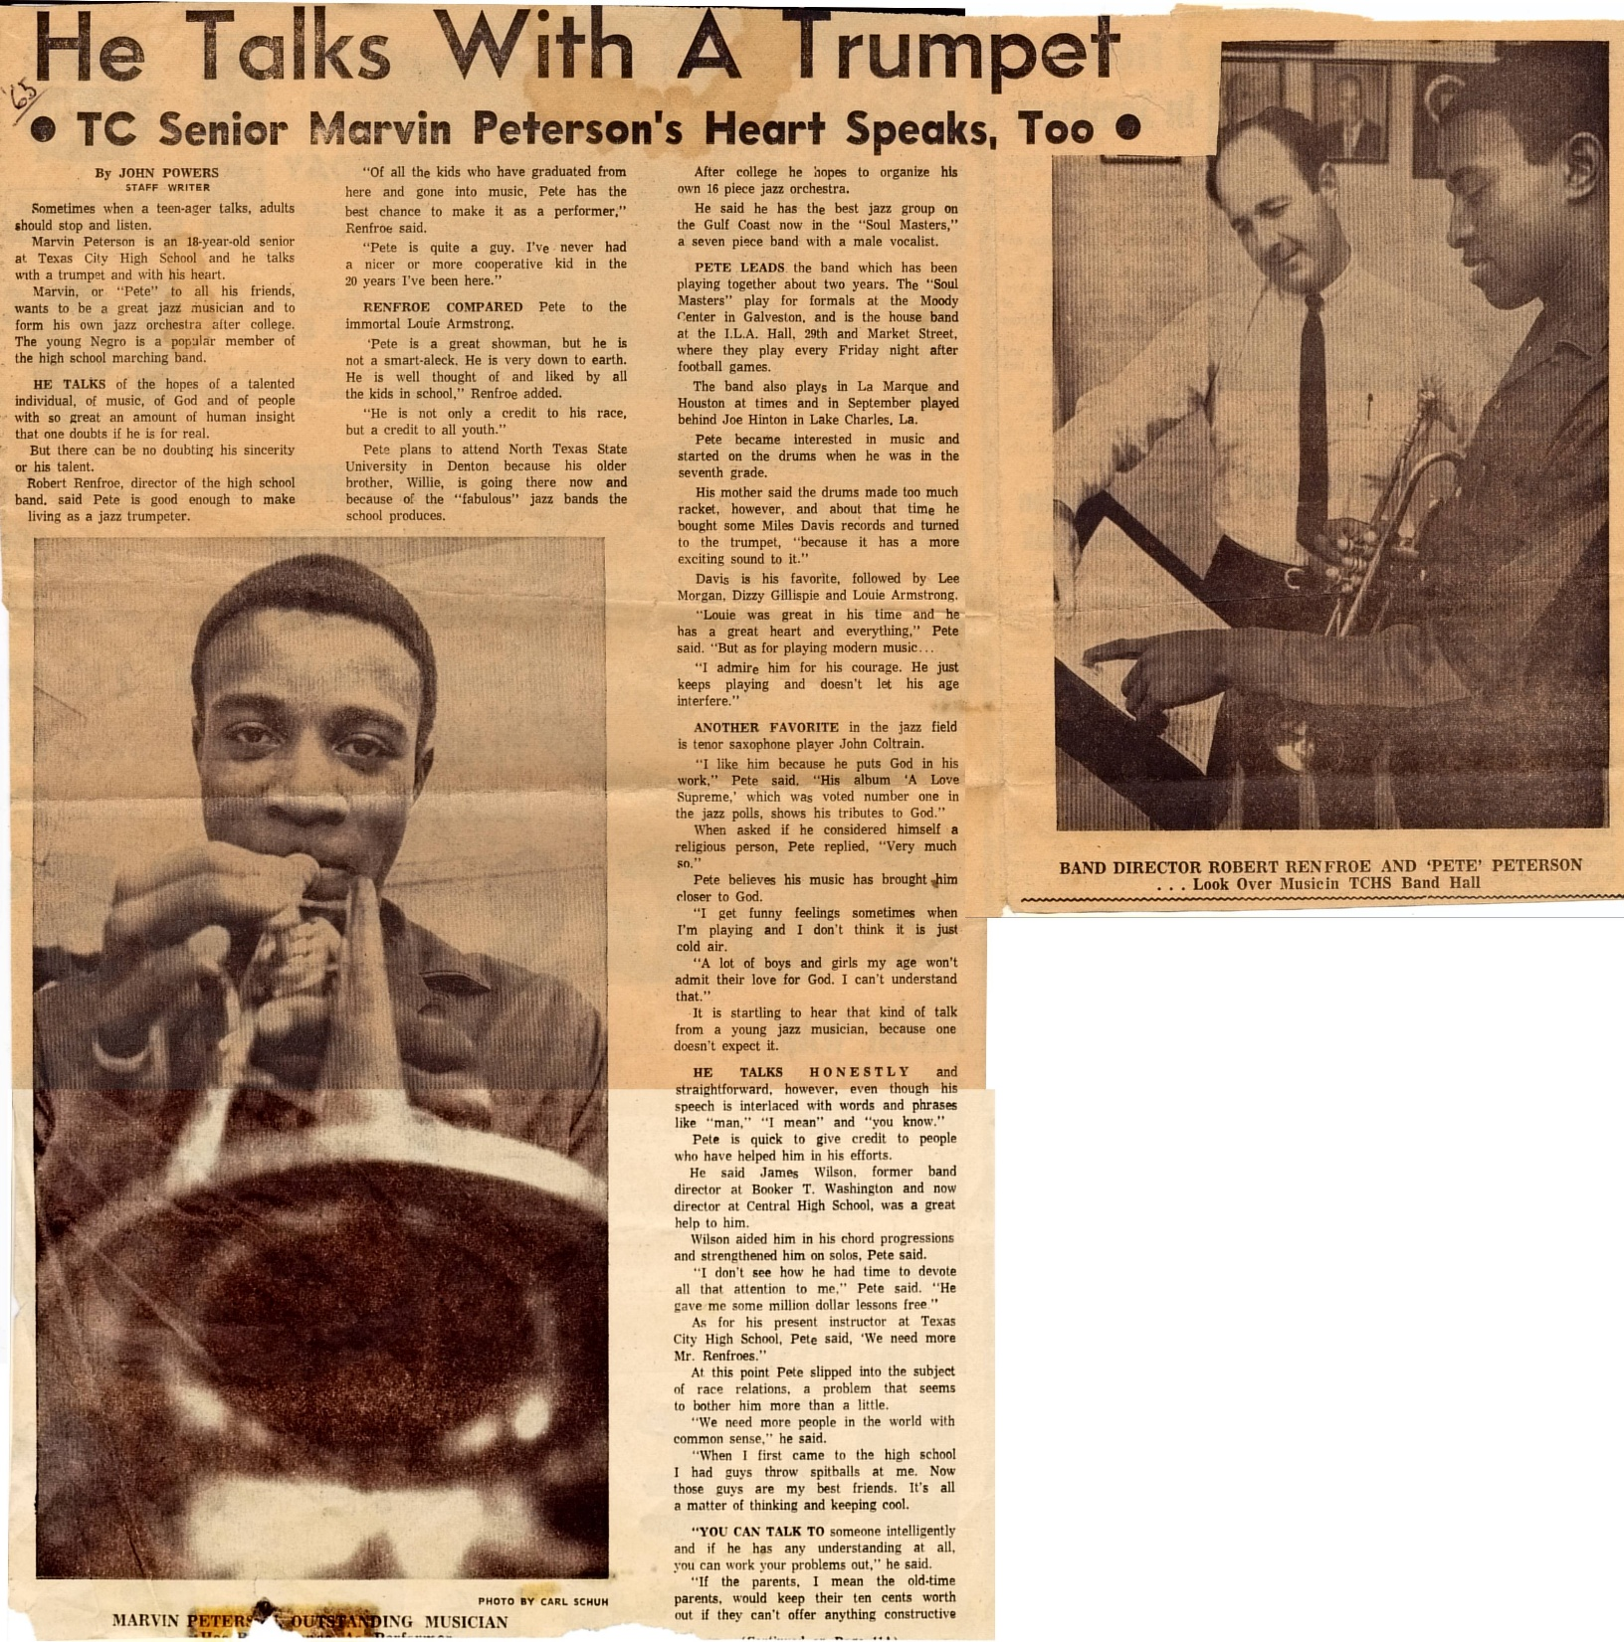
Link to Picture

Slide 34
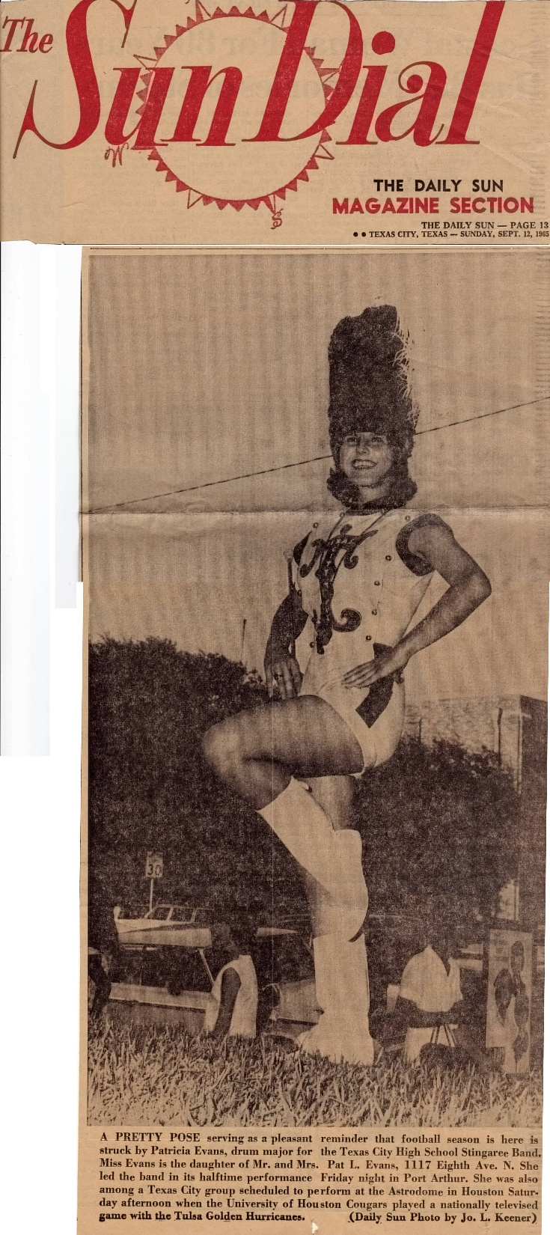
Link to Picture

Slide 35
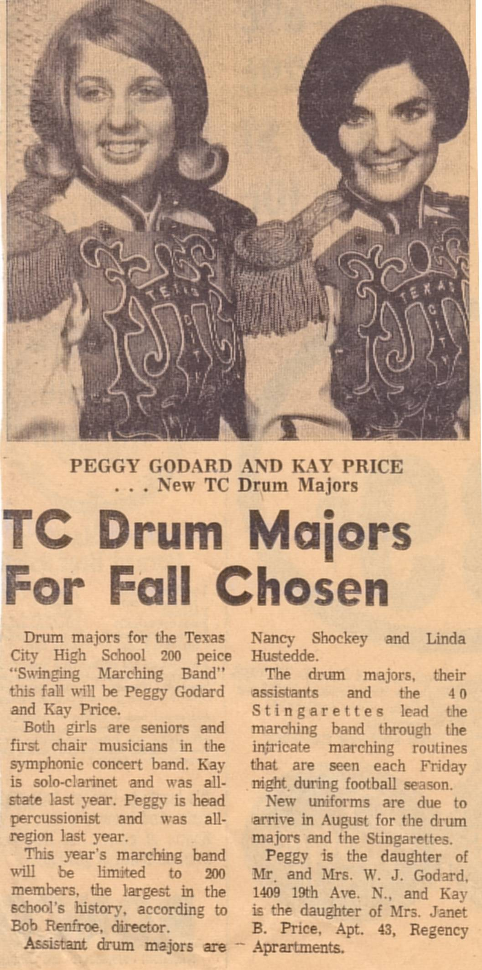
Link to Picture

Slide 36
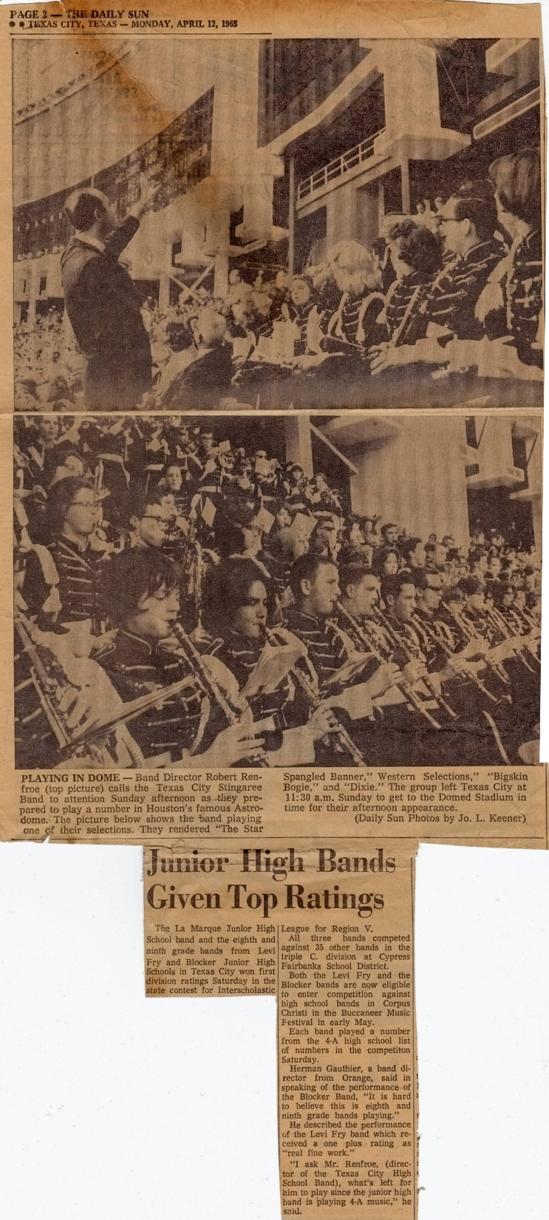
Link to Picture

Slide 37
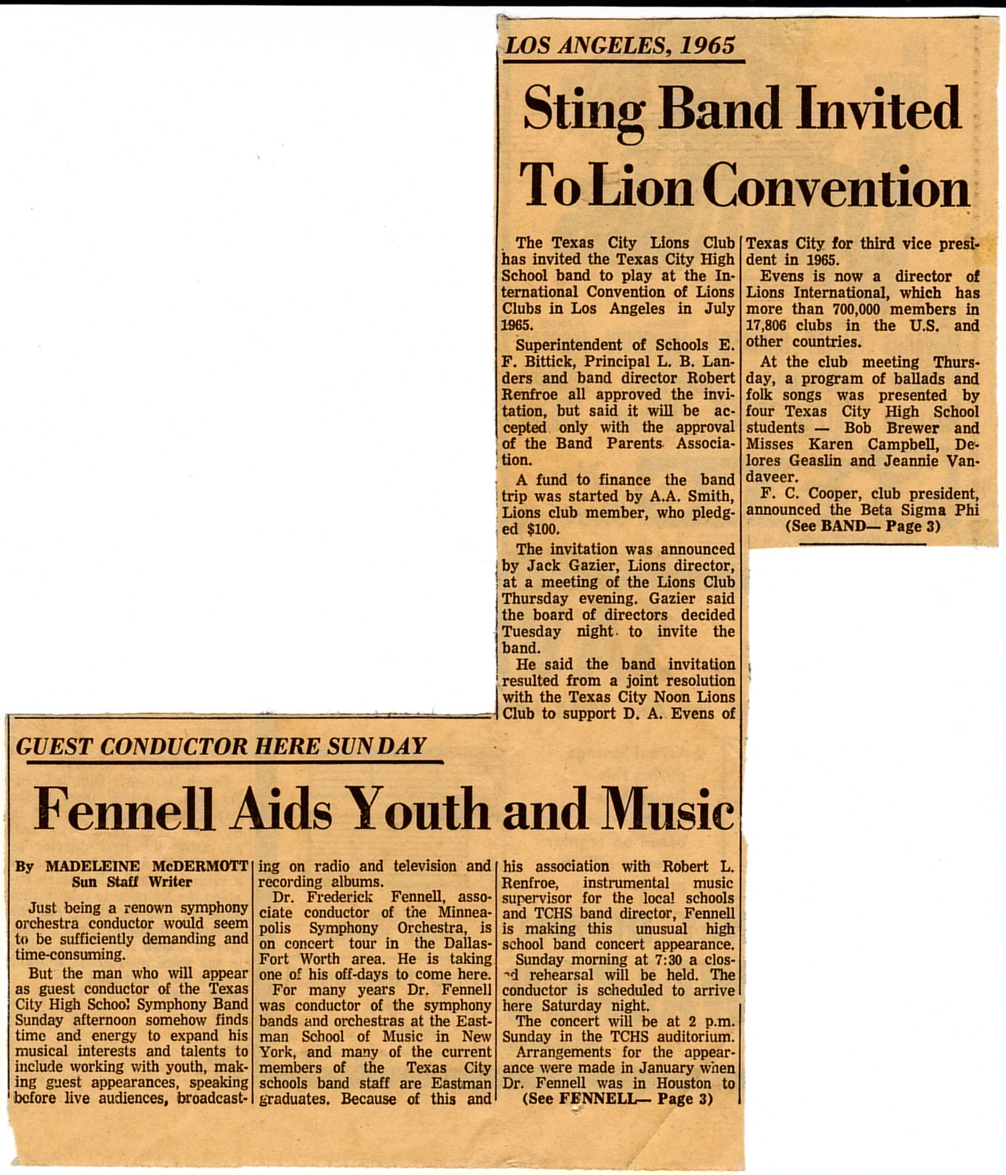
Link to Picture

Slide 38
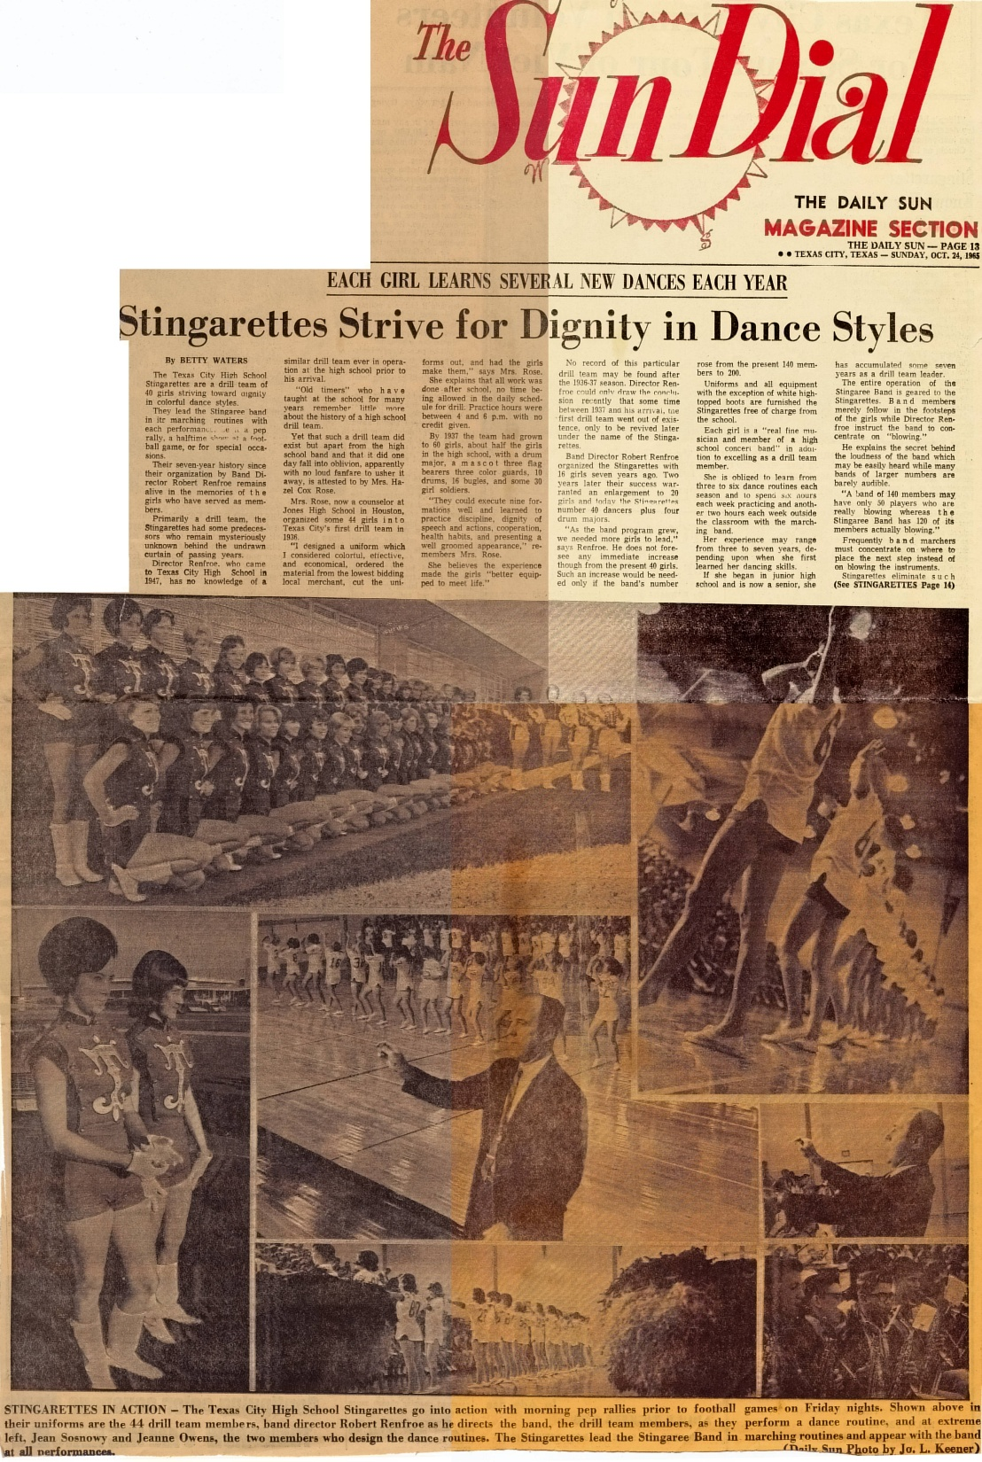
Link to Picture

Slide 39
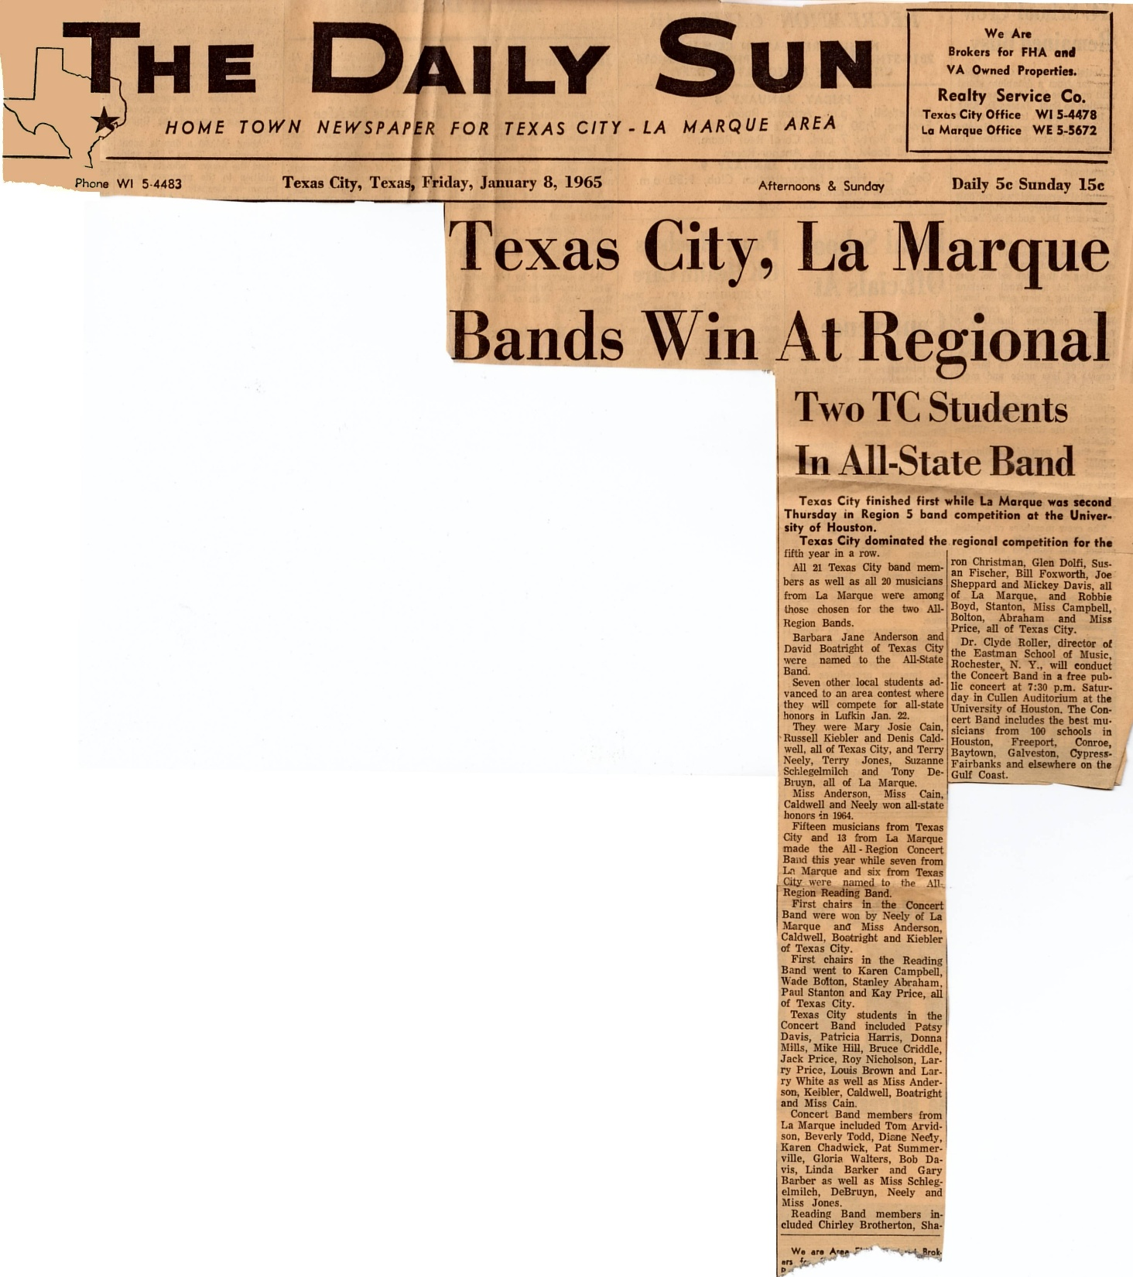
Link to Picture

Slide 40
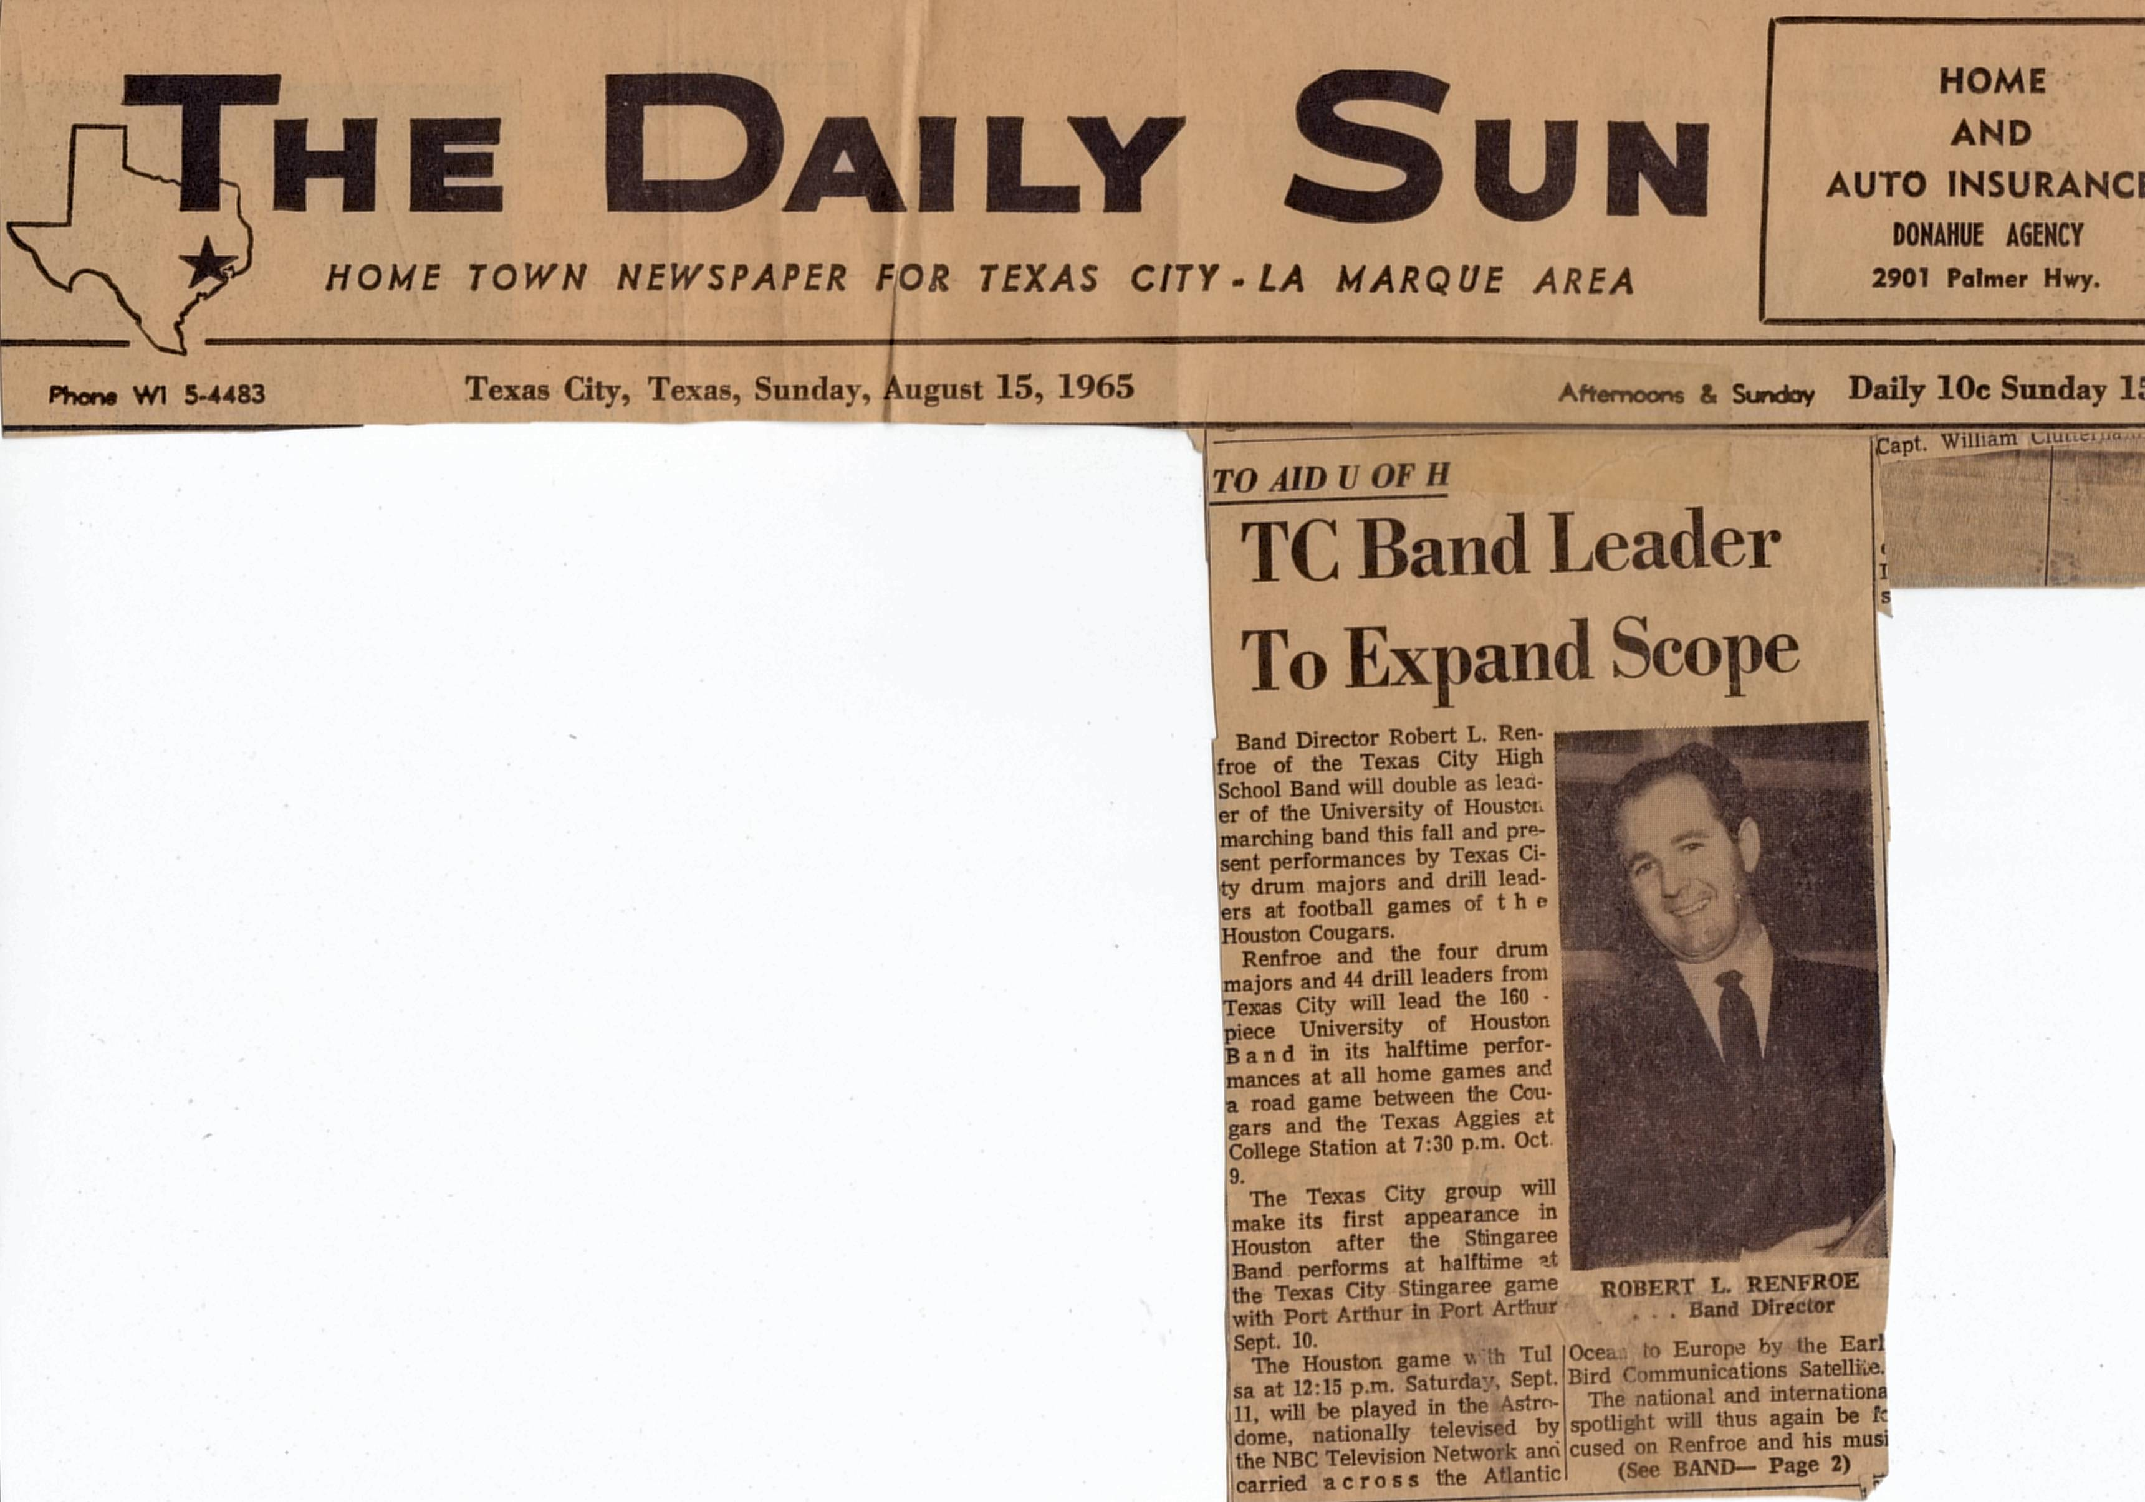
Link to Picture

Slide 41
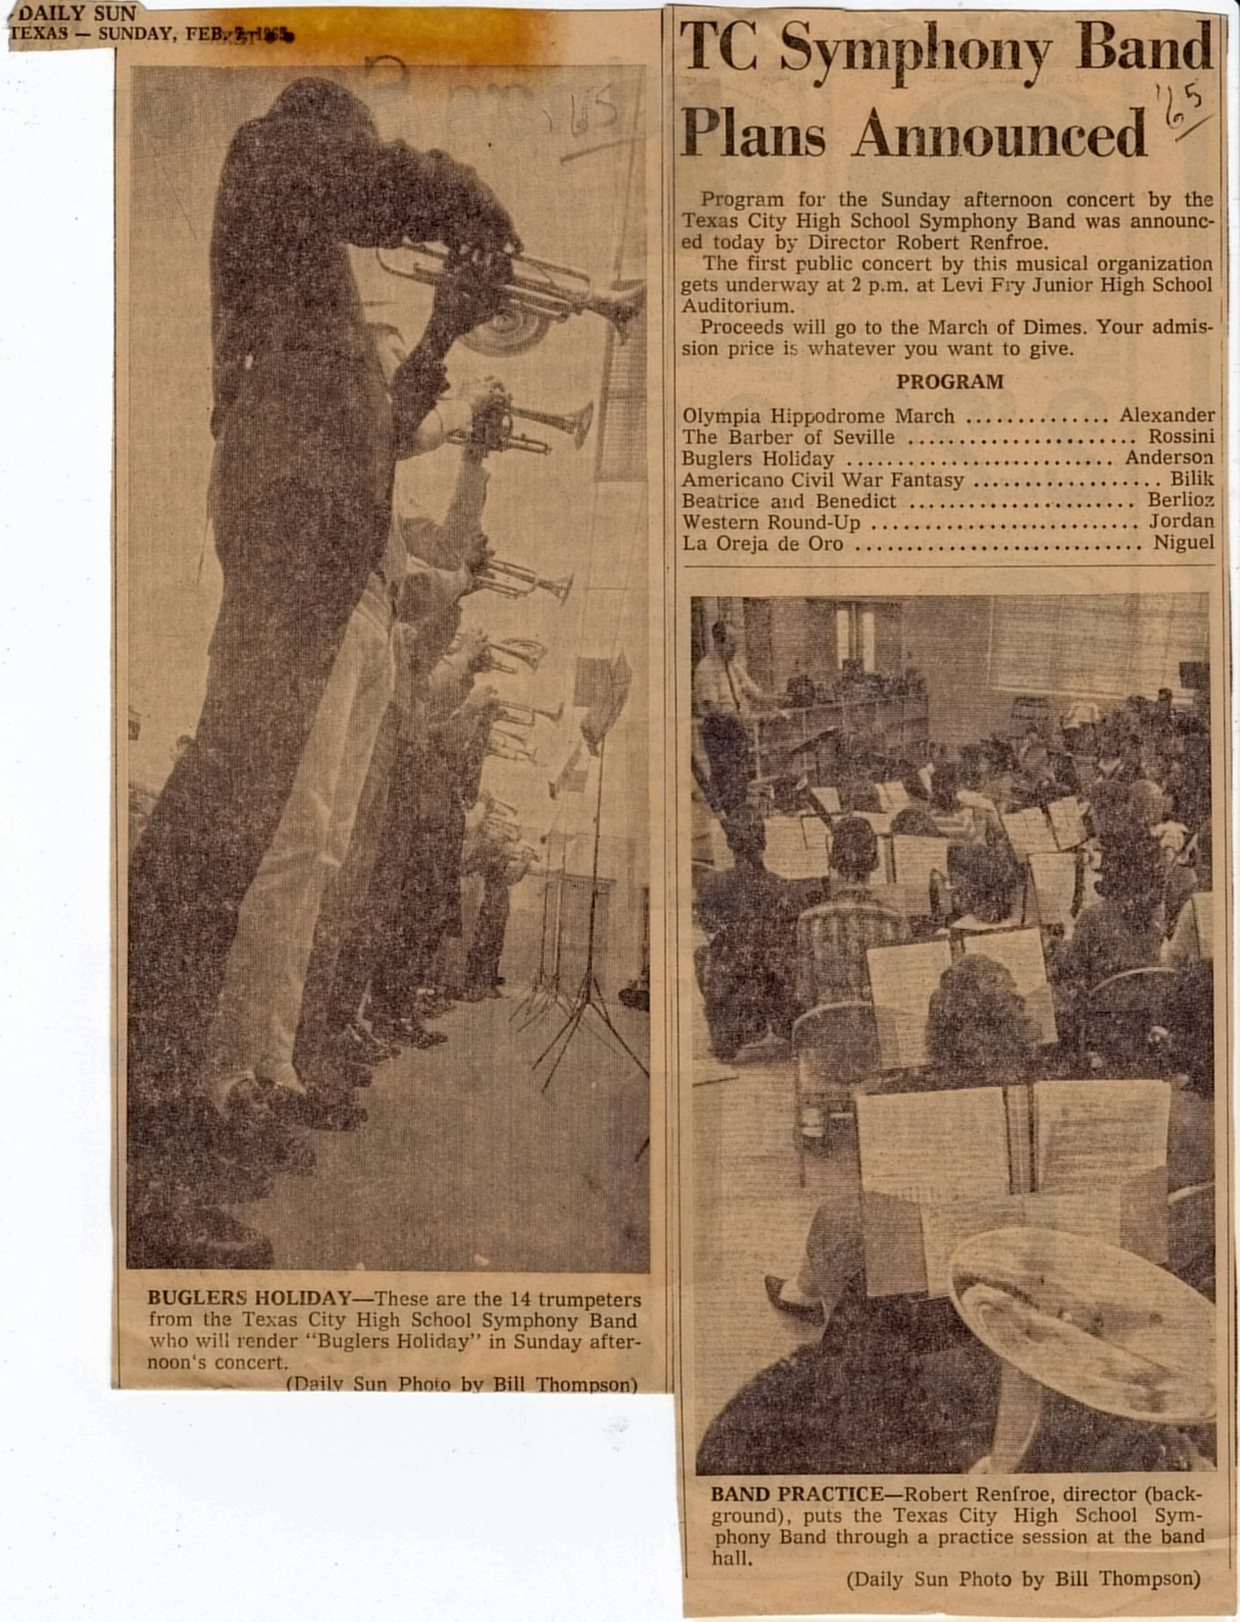
Link to Picture

Slide 42
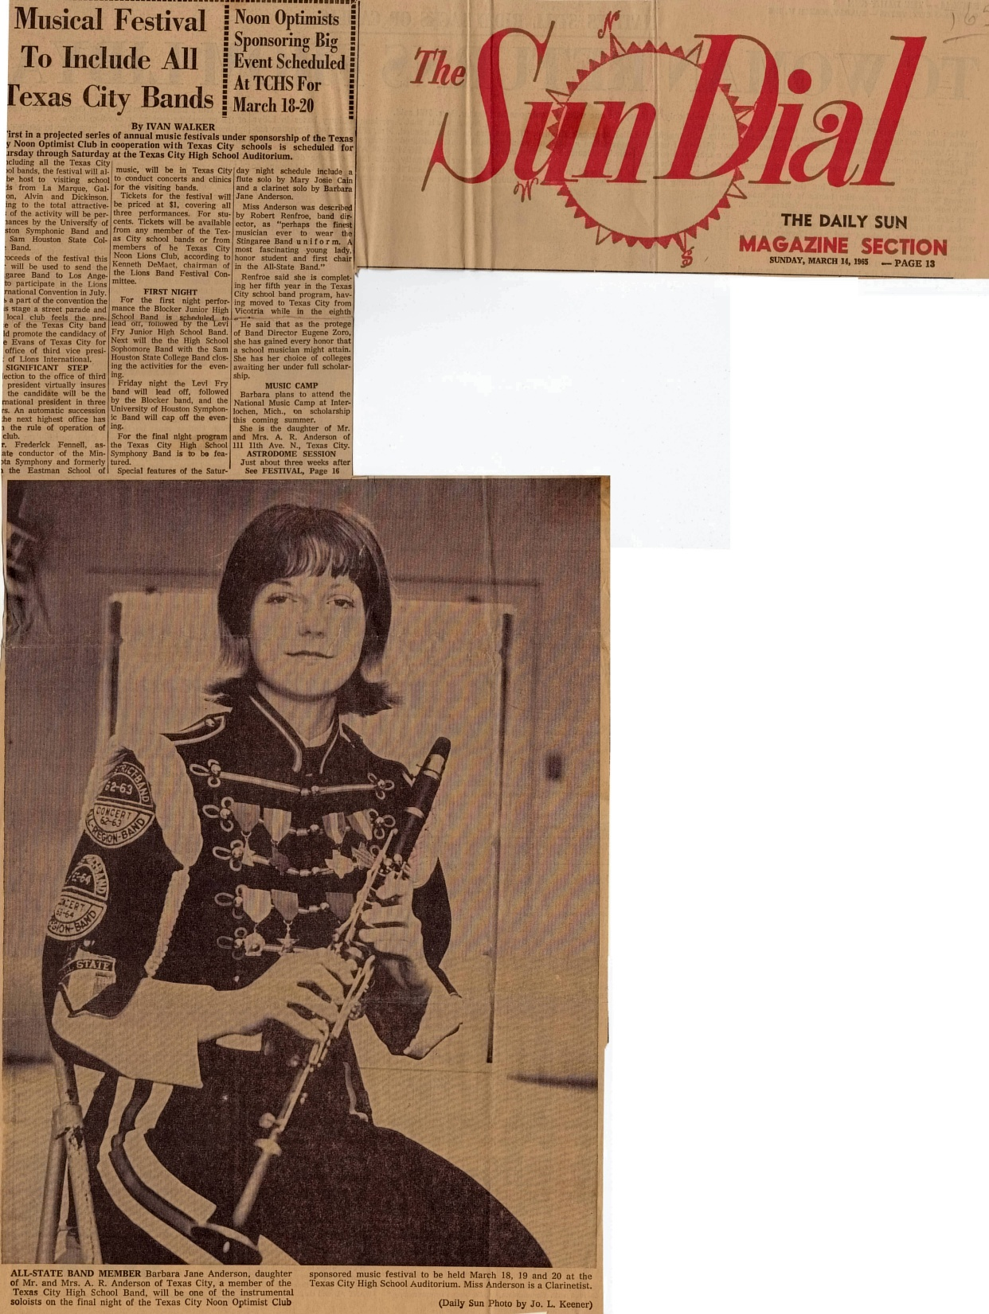
Link to Picture

Slide 43
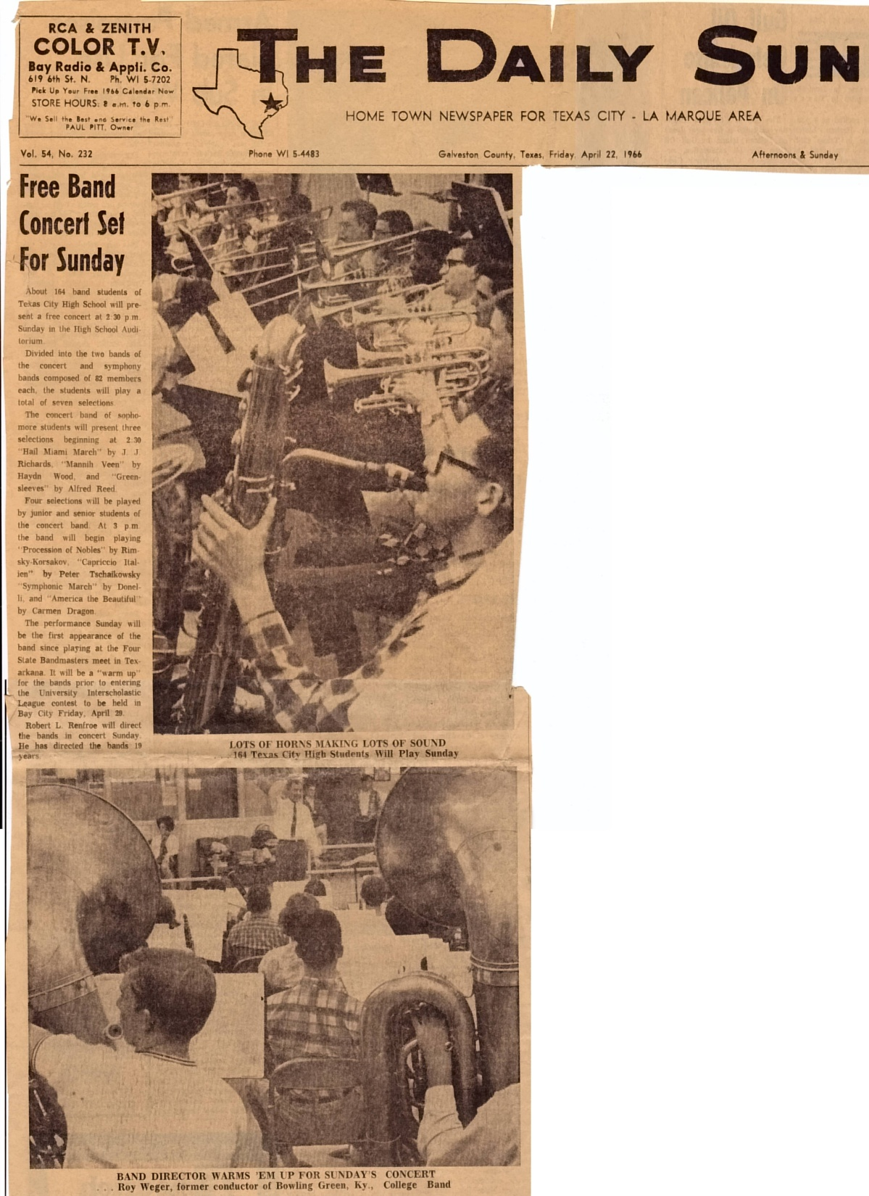
Link to Picture

Slide 44
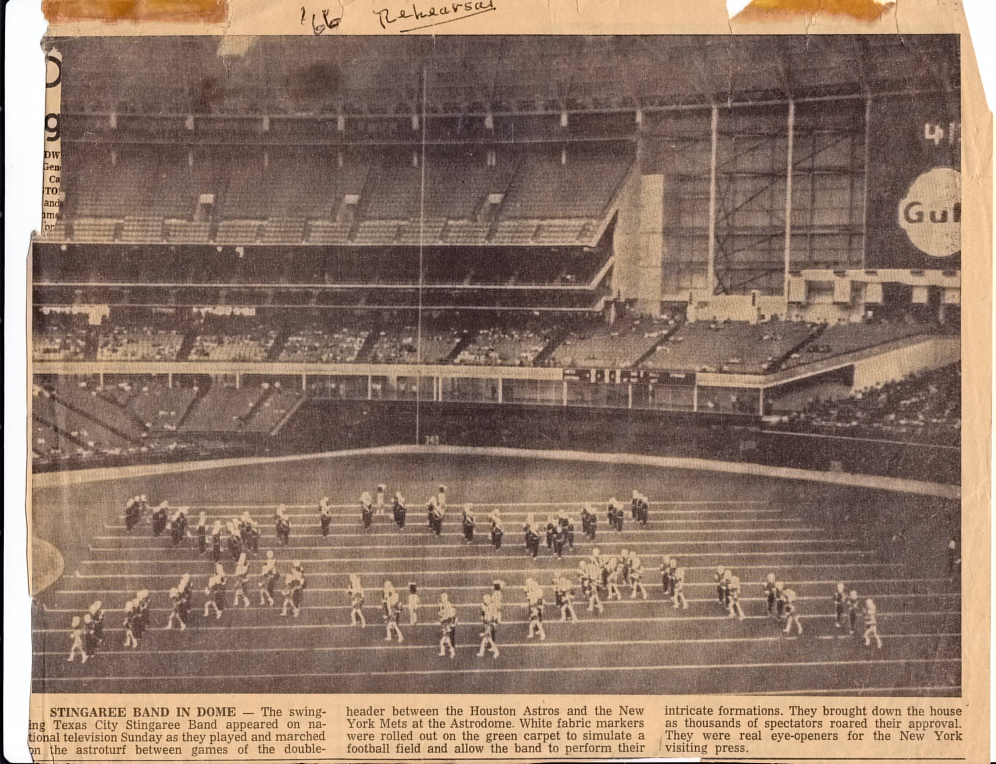
Link to Picture

Slide 45
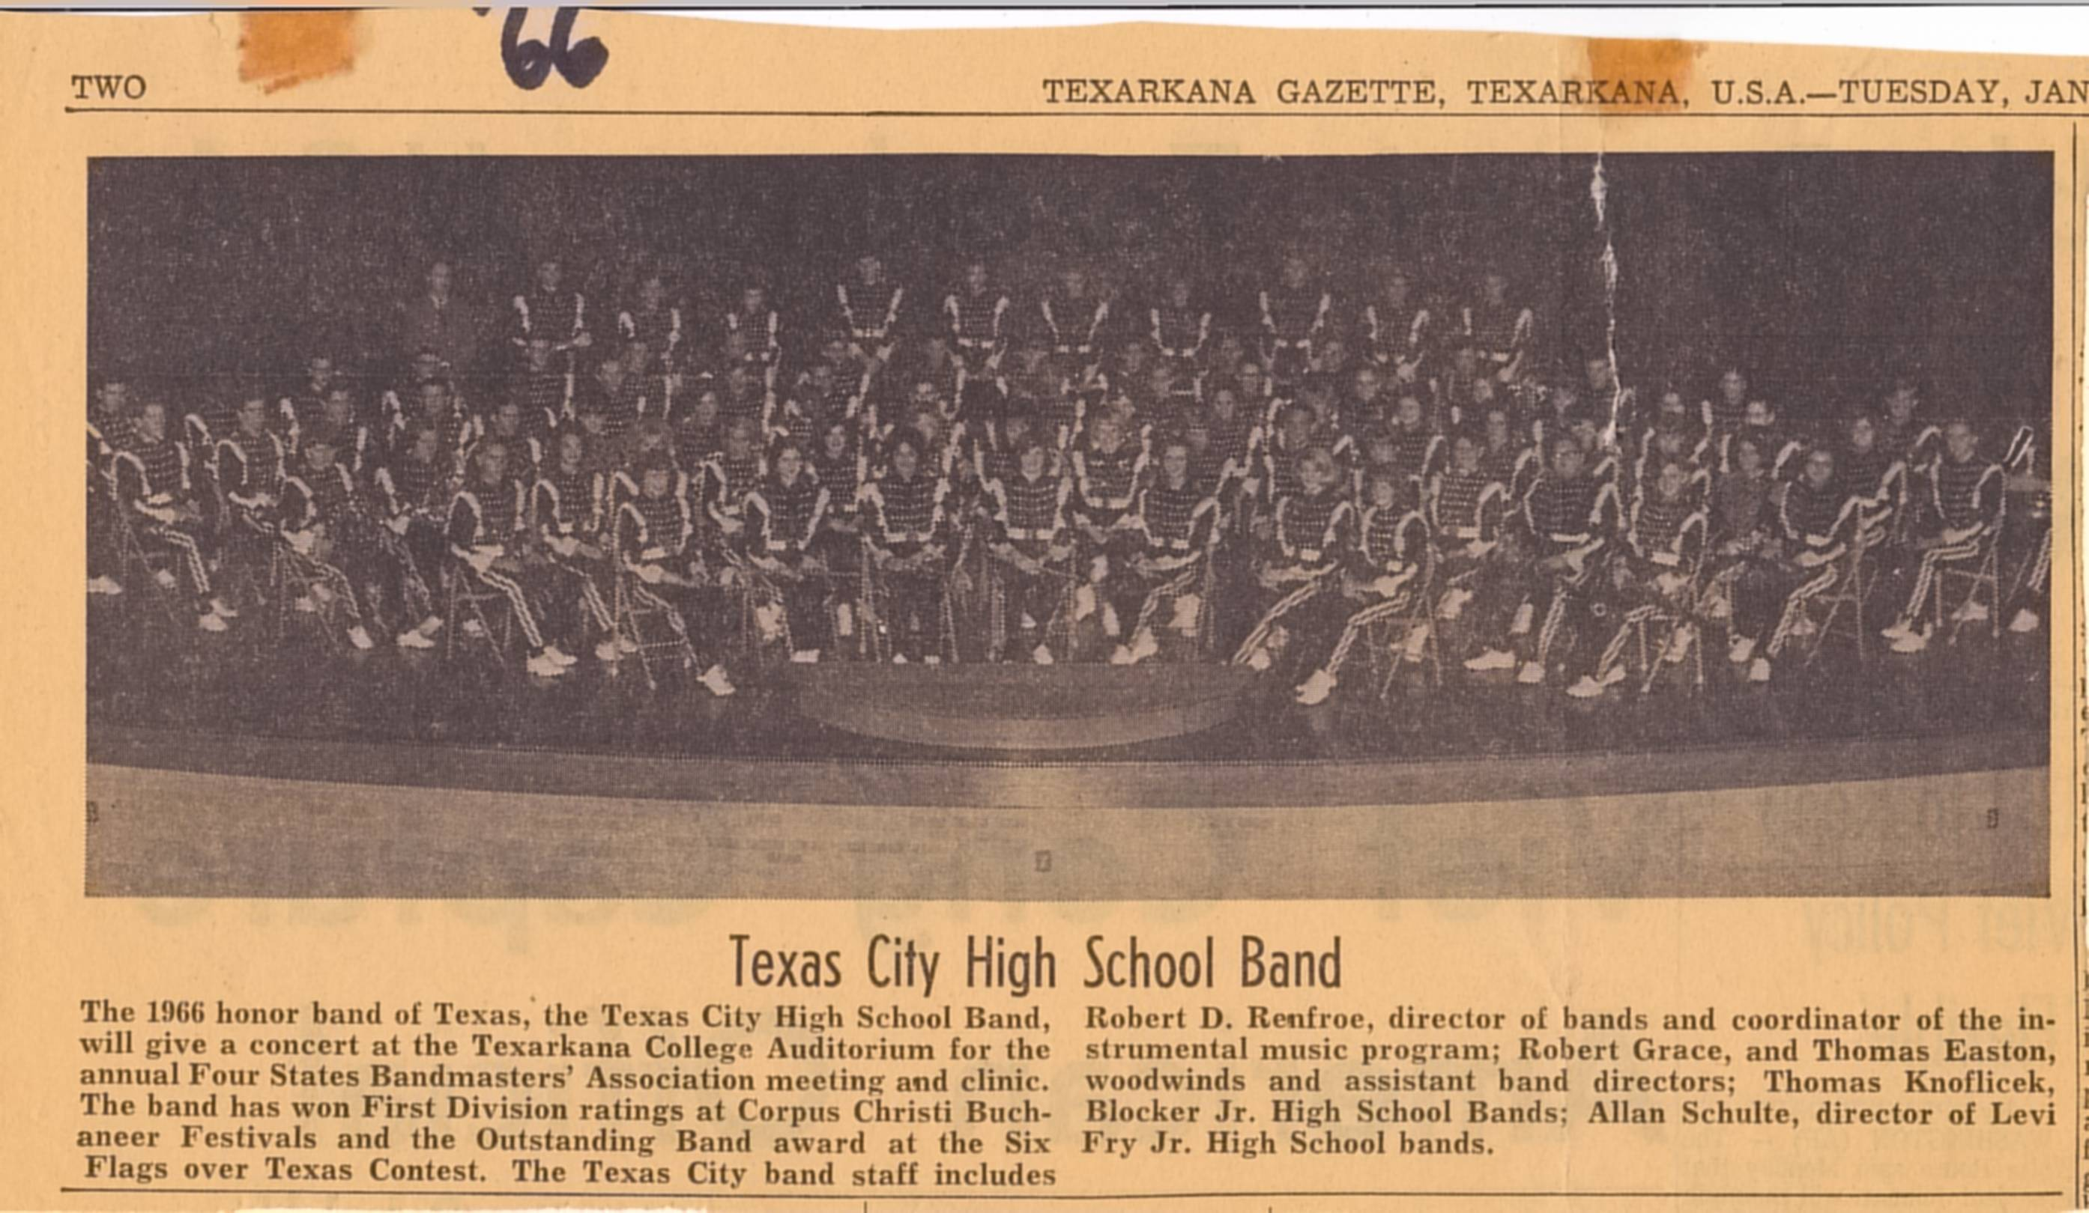
Link to Picture

Slide 46
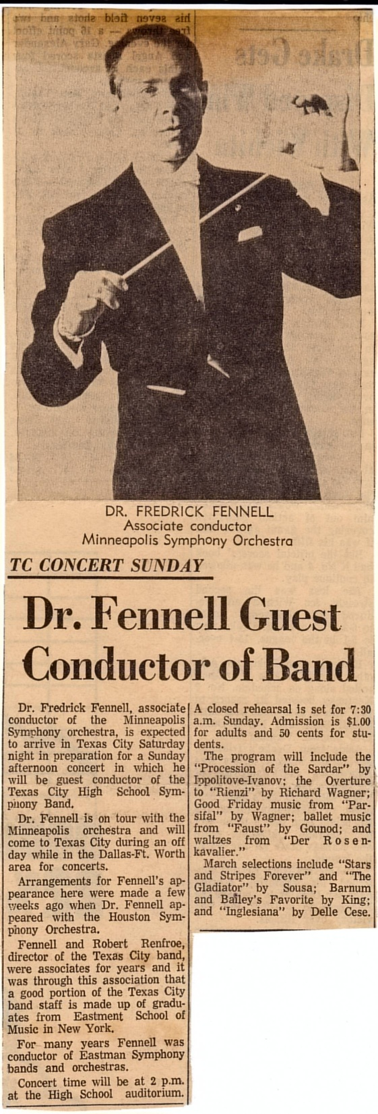
Link to Picture

Slide 47
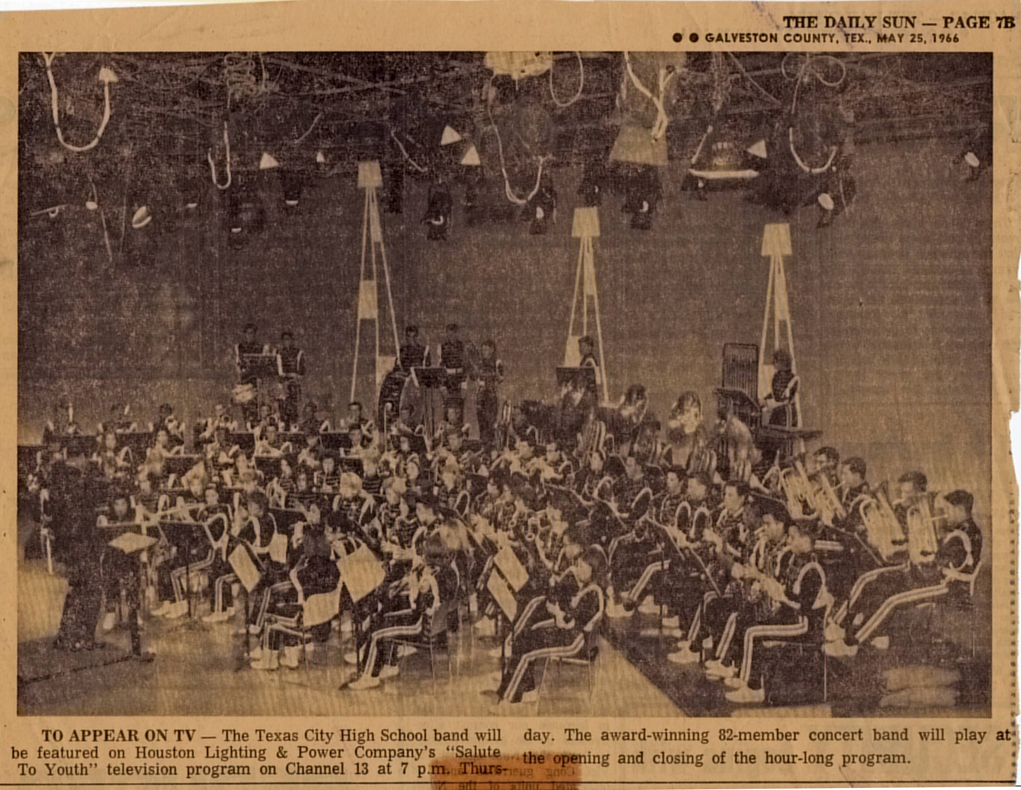
Link to Picture

Slide 48
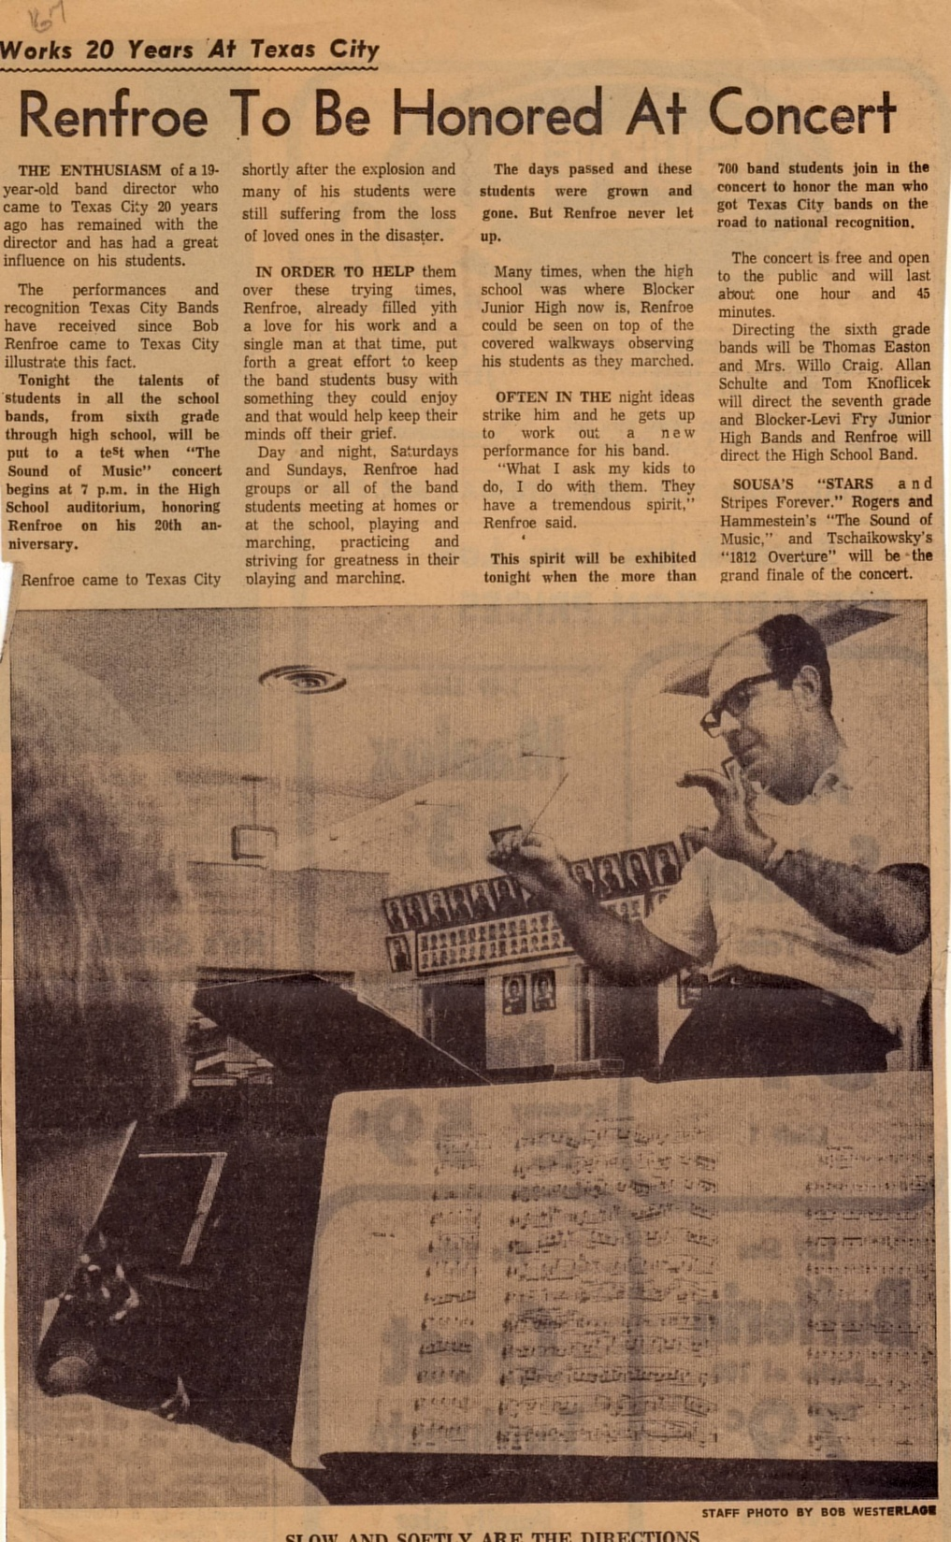
Link to Picture

Slide 49
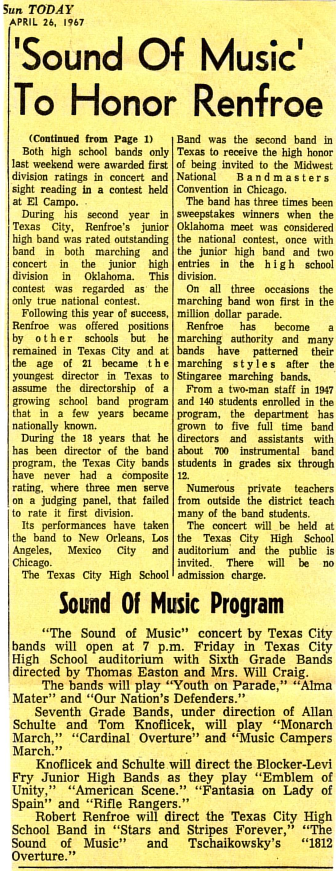
Link to Picture

Slide 50
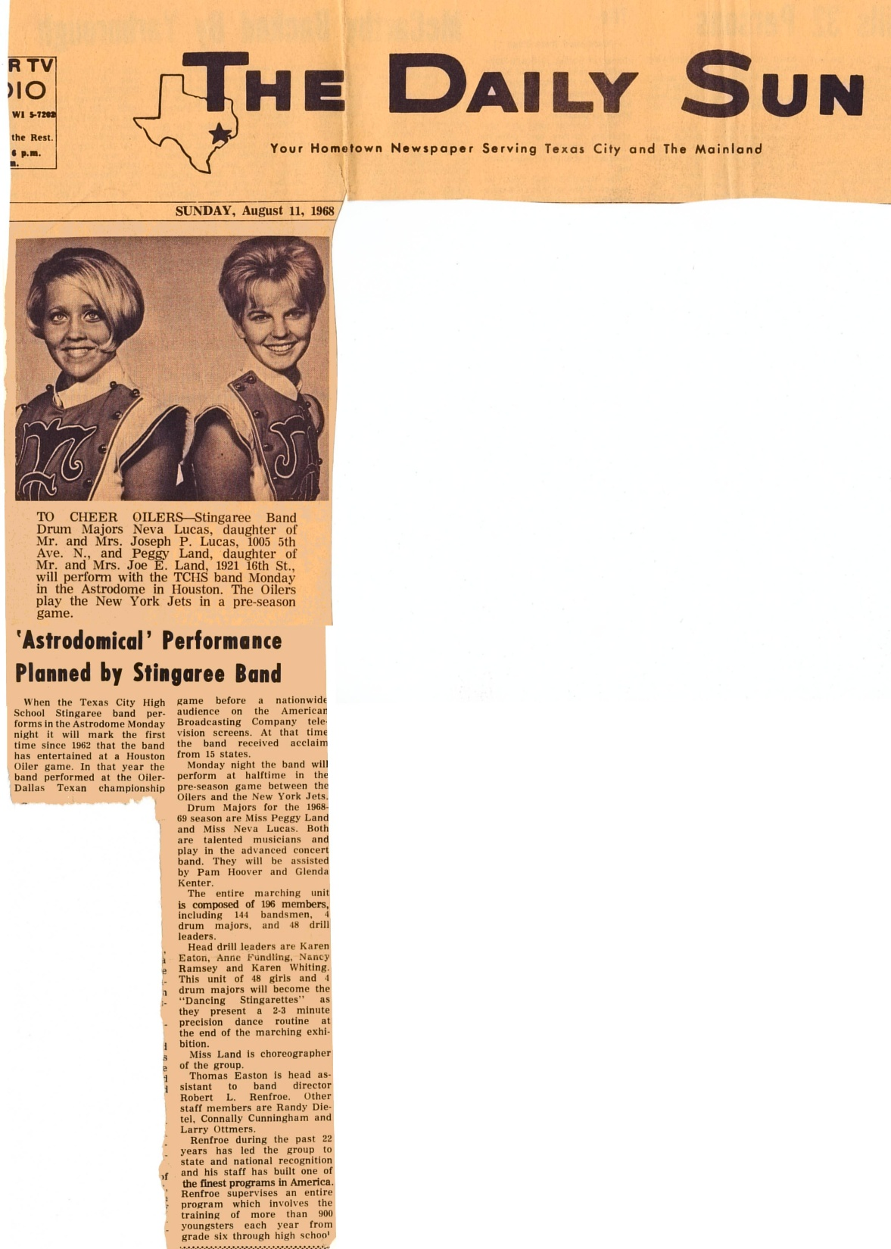
Link to Picture

Slide 51
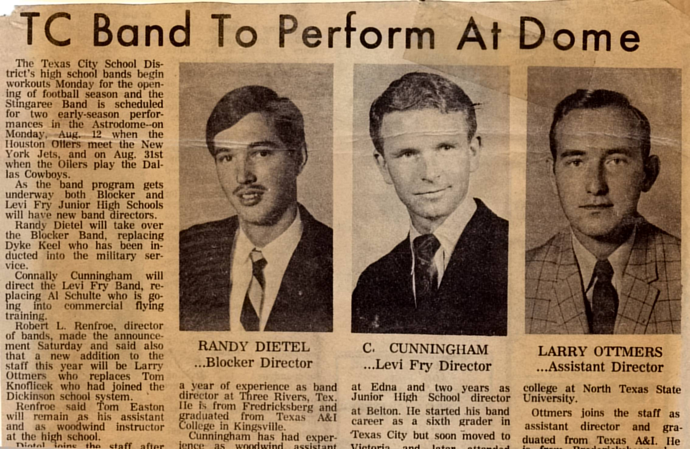
Link to Picture

Slide 52

Link to Picture

Slide 53

Link to Picture

Slide 54

Link to Picture

Slide 55

Link to Picture

Slide 56

Link to Picture

Slide 57

Link to Picture

Slide 58

Link to Picture

Slide 59

Link to Picture

Slide 60

Link to Picture

Slide 61

Link to Picture

Slide 62

Link to Picture

Slide 63

Link to Picture

Slide 64

Link to Picture

