Slide 1
ES 3053
Thermodynamics
All lecture slides

Slide 2
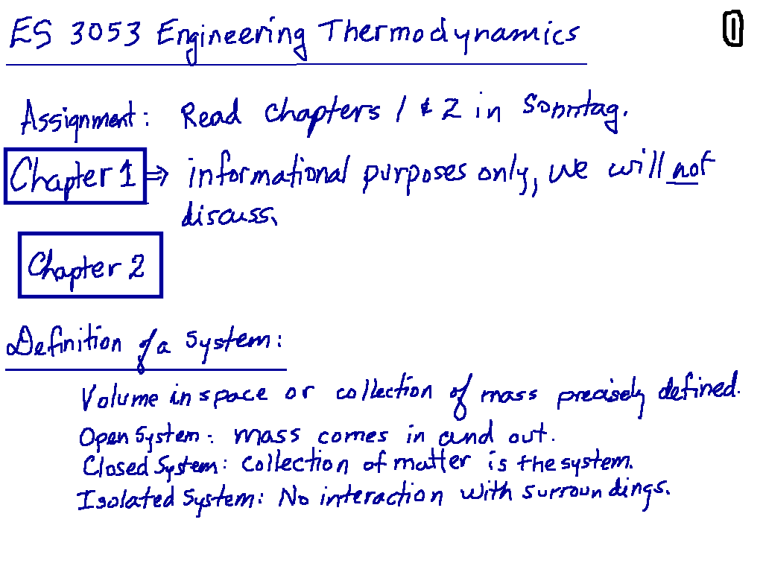
Chapter 1 and 2, Cengel – Students can read. Introductory material, we will focus here over the next few days

Slide 3
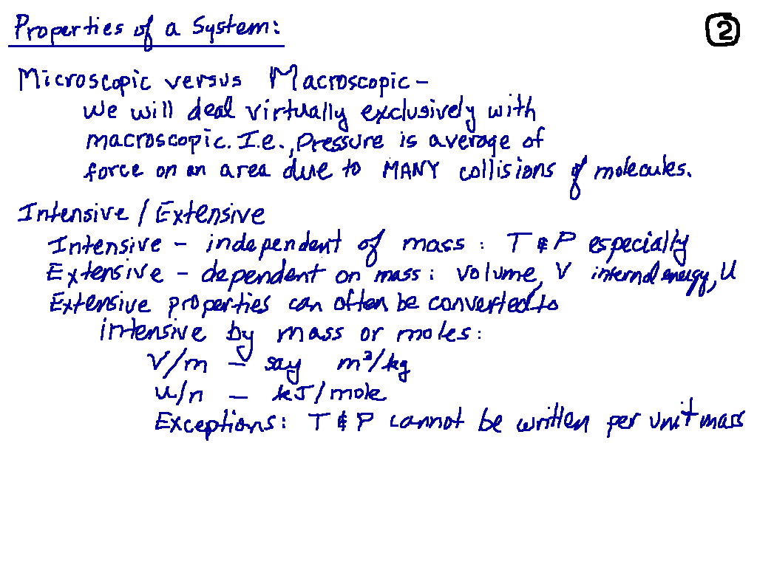
Cengel, page 12

Slide 4
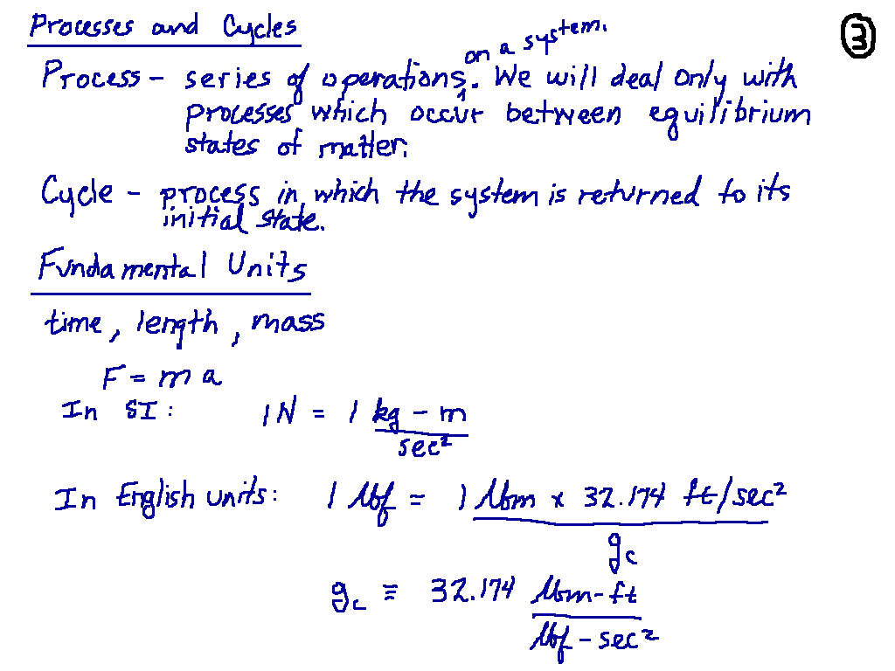
Cengel, page 15
Cengel, page 6

Slide 5
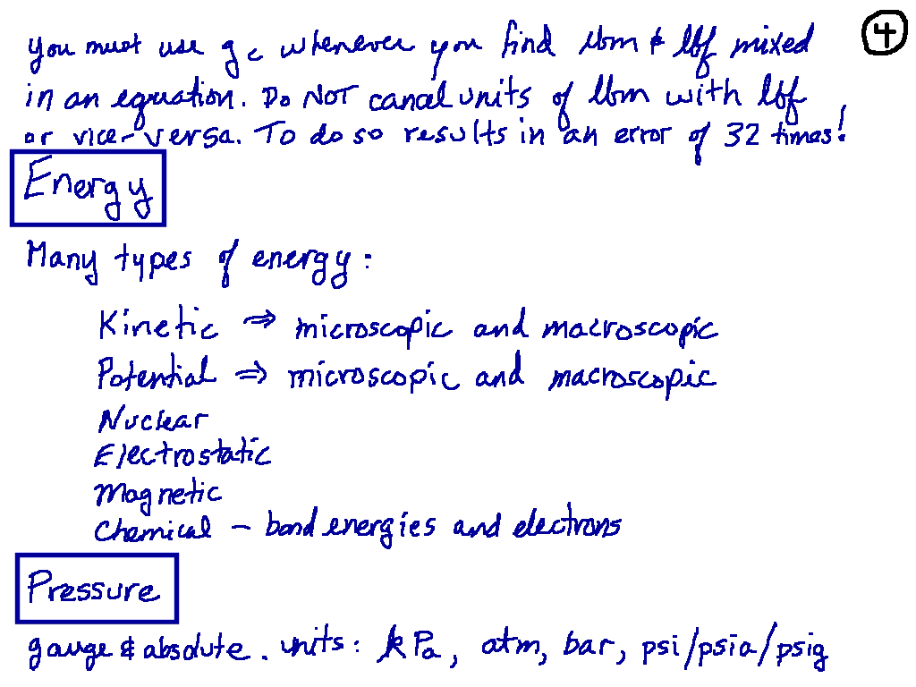
Cengel, Chapter 2

Slide 6
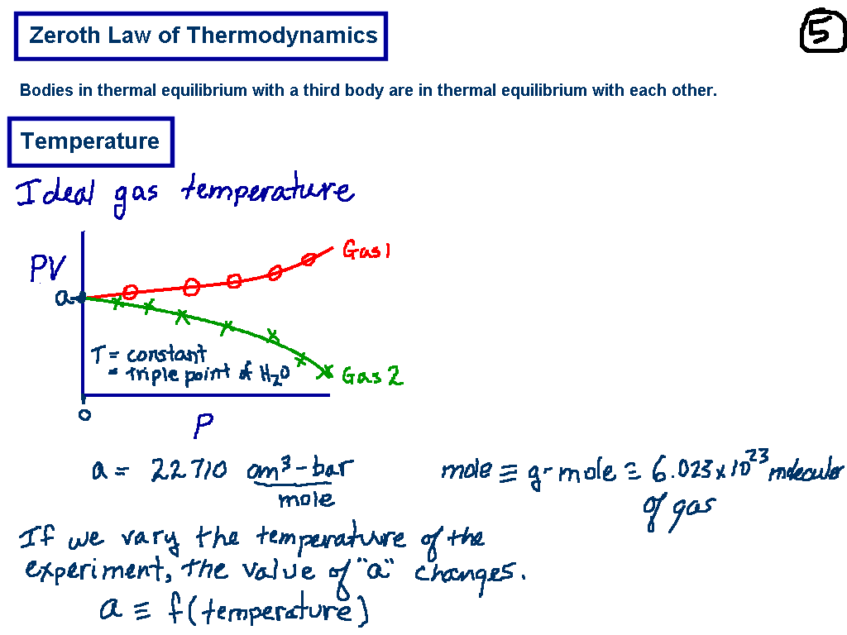
Cengel, page 17

Slide 7
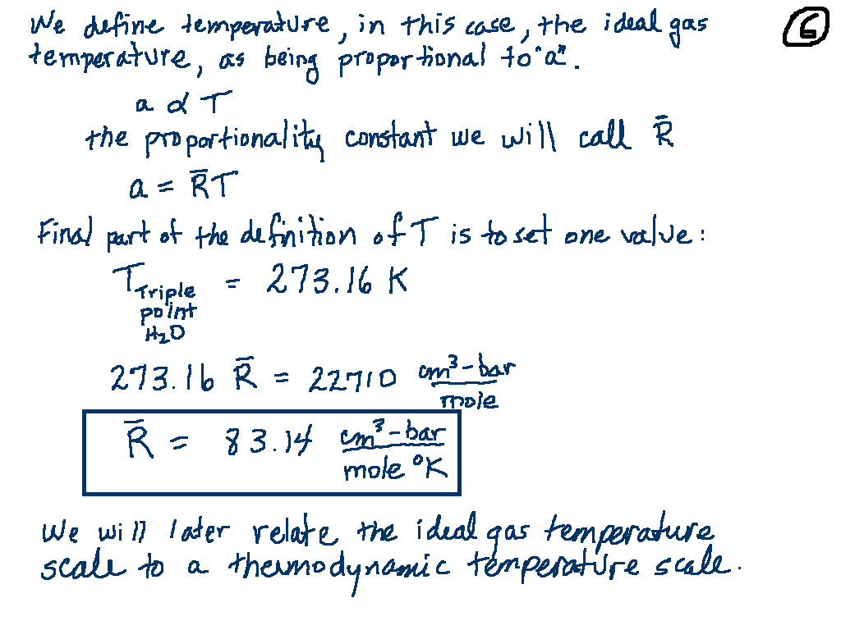
Cengel calls “ R “ R_{u} instead

Slide 8
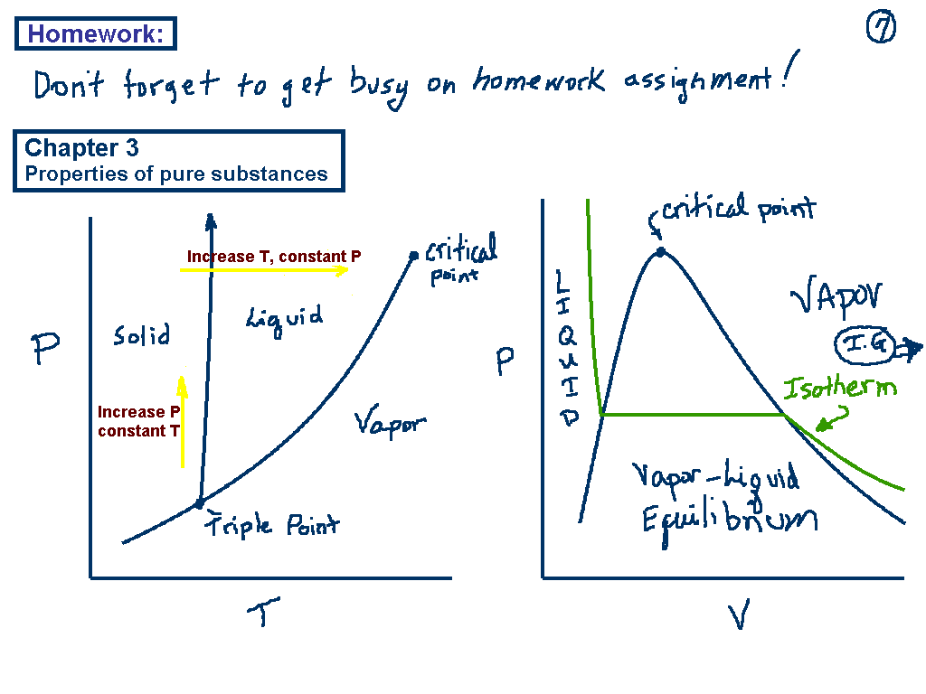
Cengel Chapter 3

Slide 9
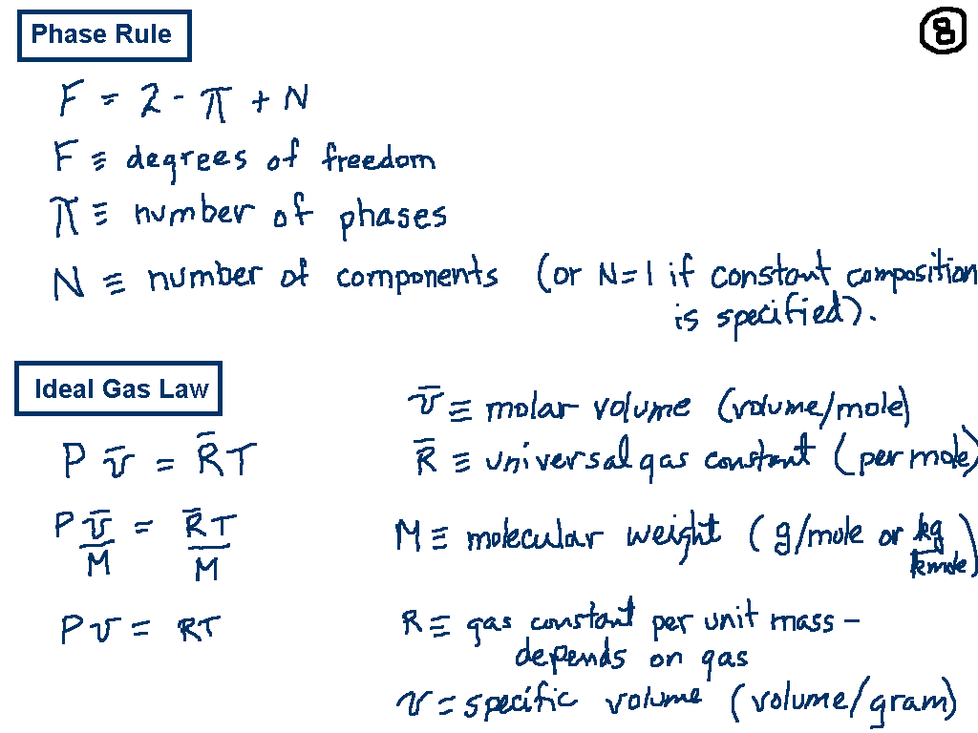
(This is called R_{u} in Cengel)
Equation 3.10 in Cengel

Slide 10
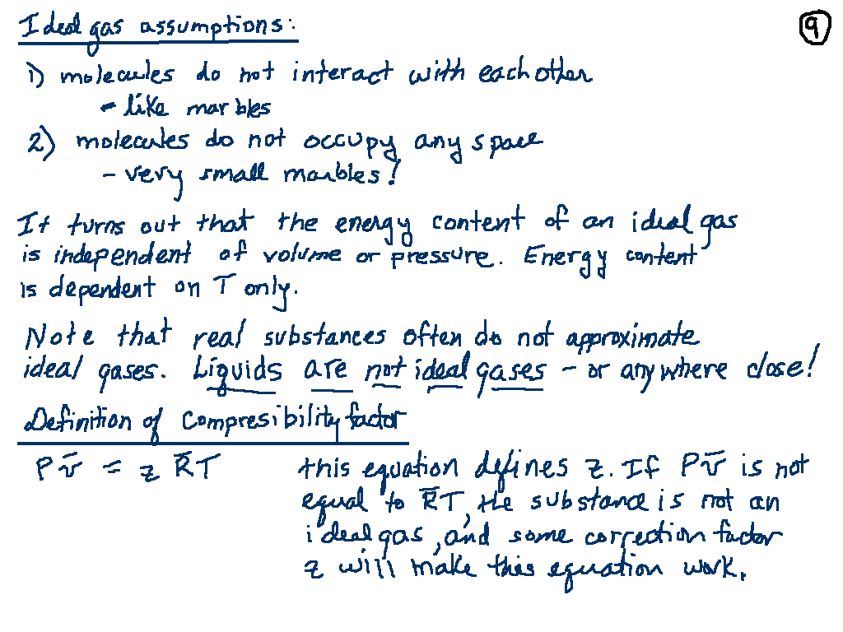

Slide 11
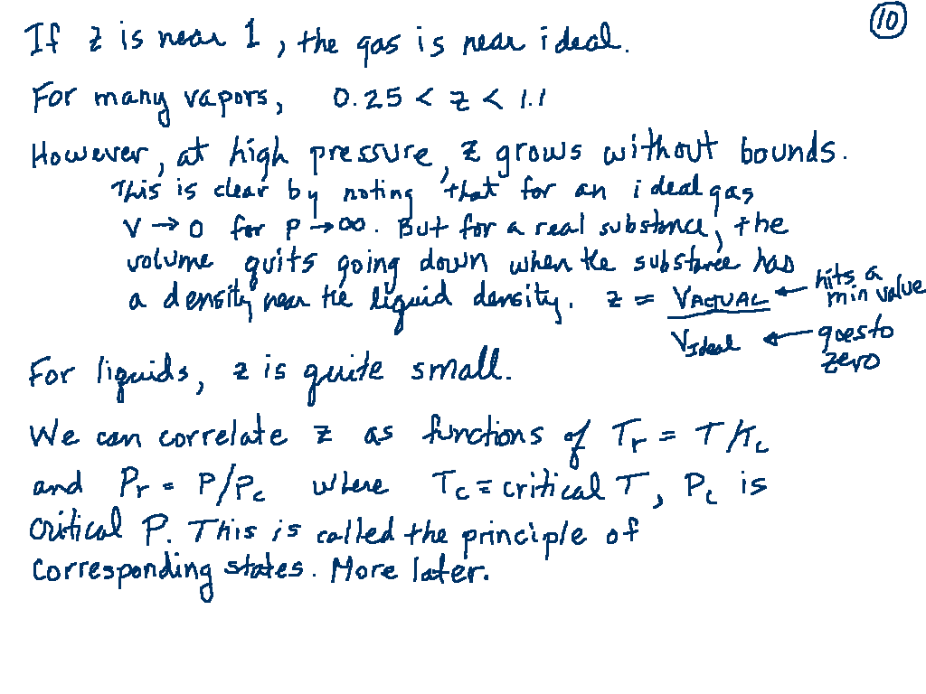

Slide 12
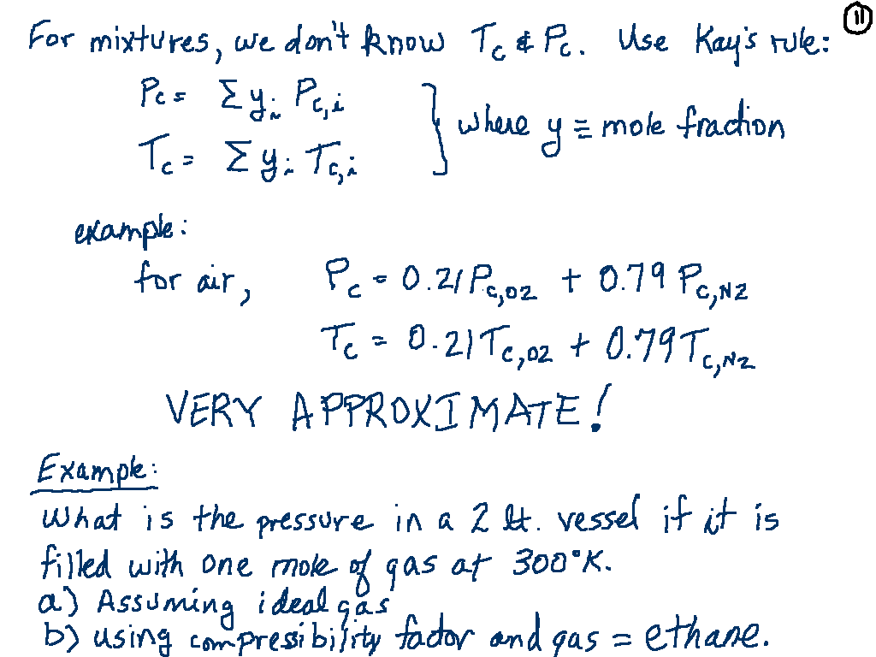

Slide 13
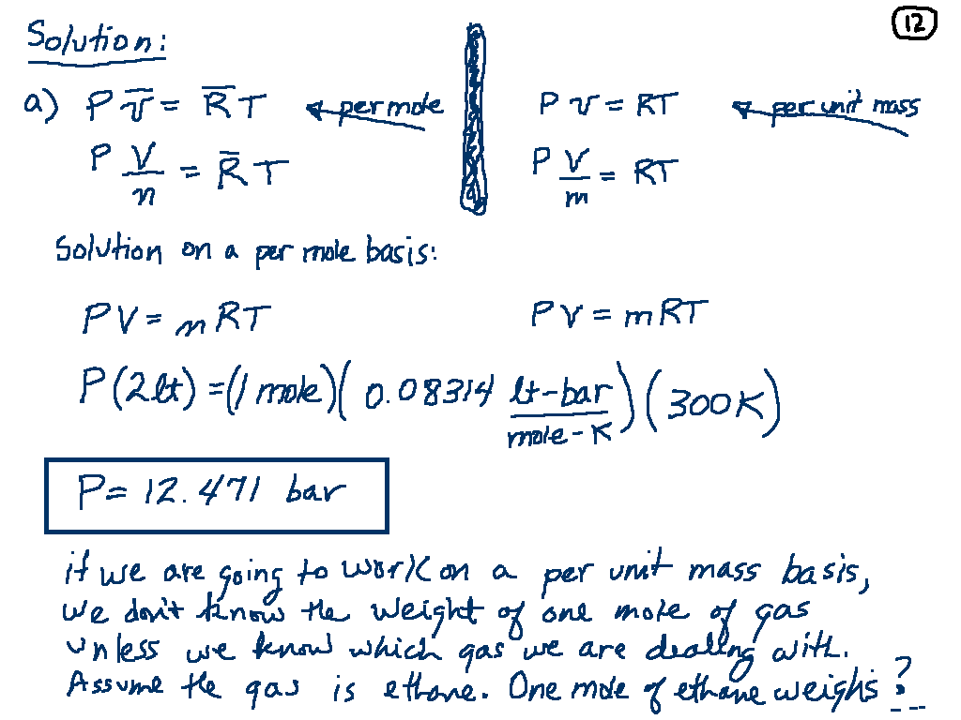

Slide 14
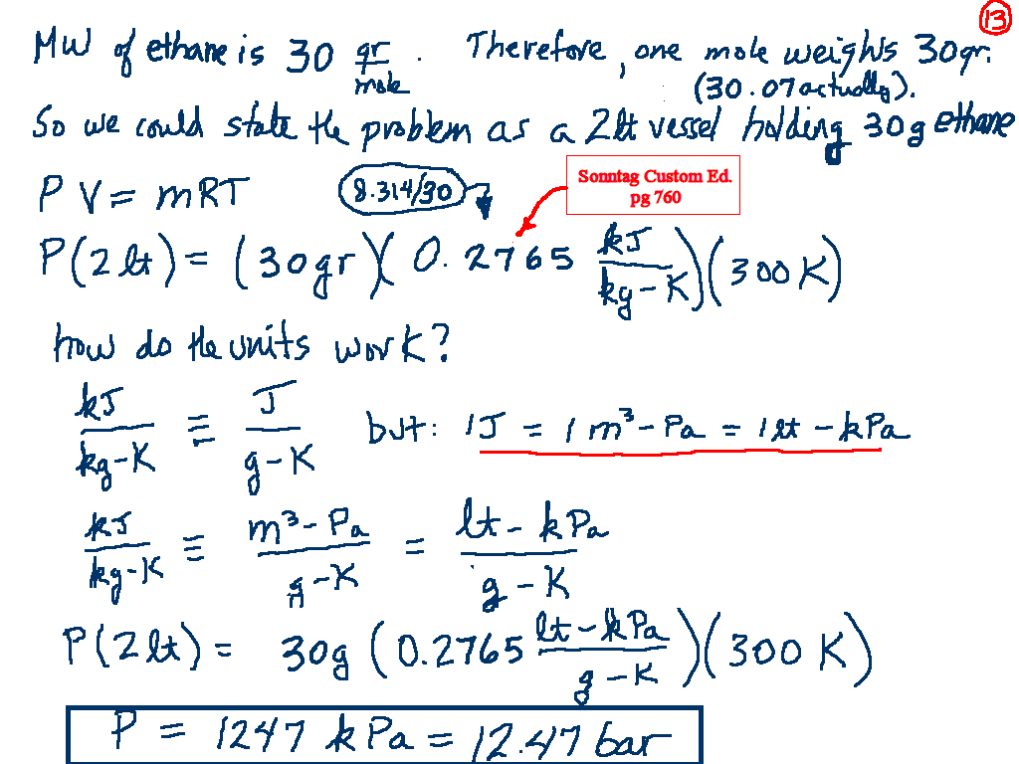
Cengel, page
883

Slide 15
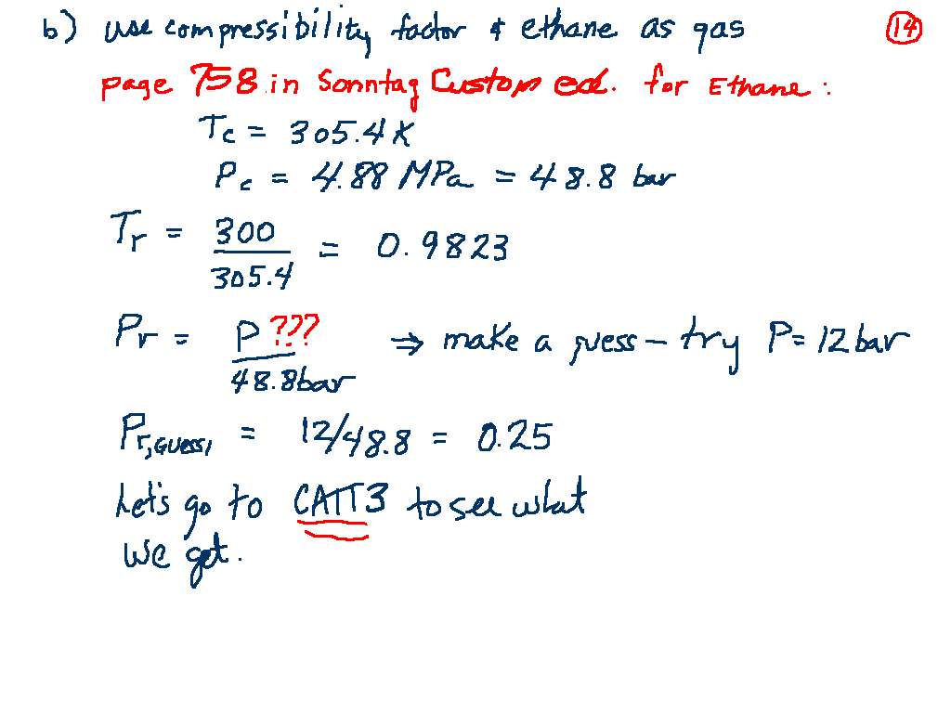
Cengel, page 882

Slide 16
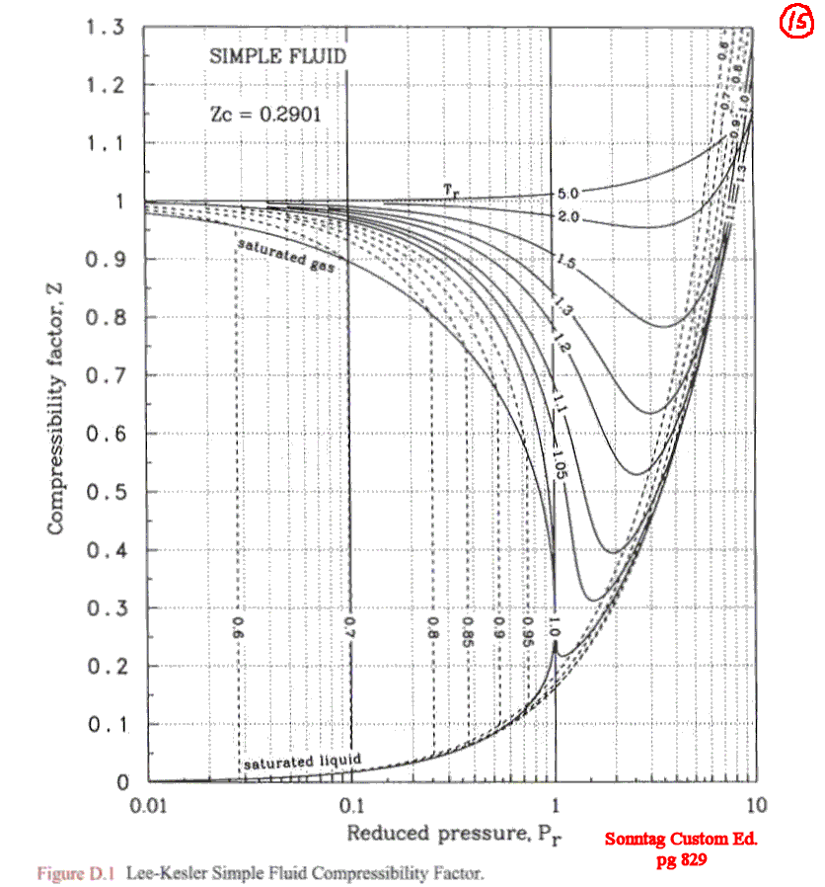
Cengel, pg 137

Slide 17
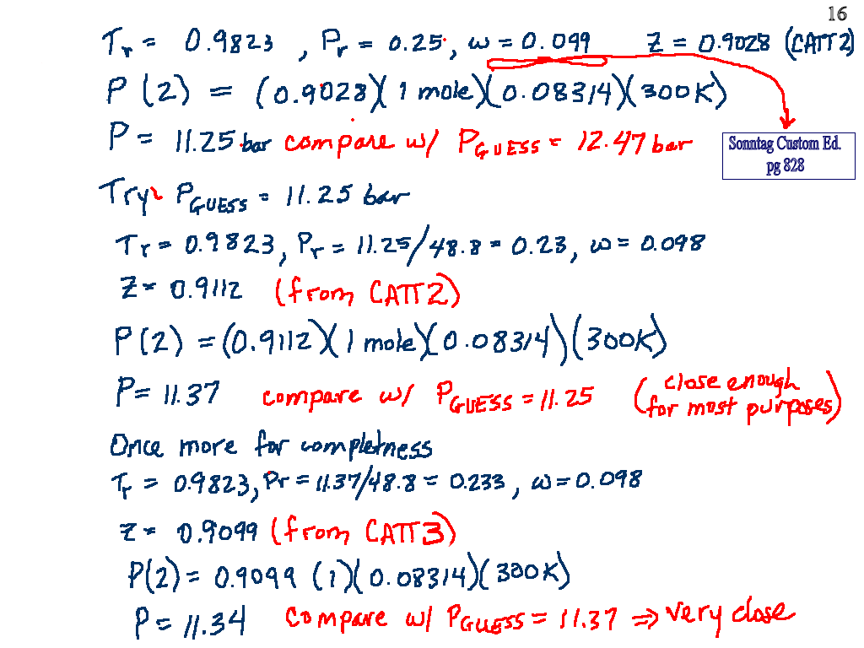
Acentric Factor
Look it up
From CATT3

Slide 18
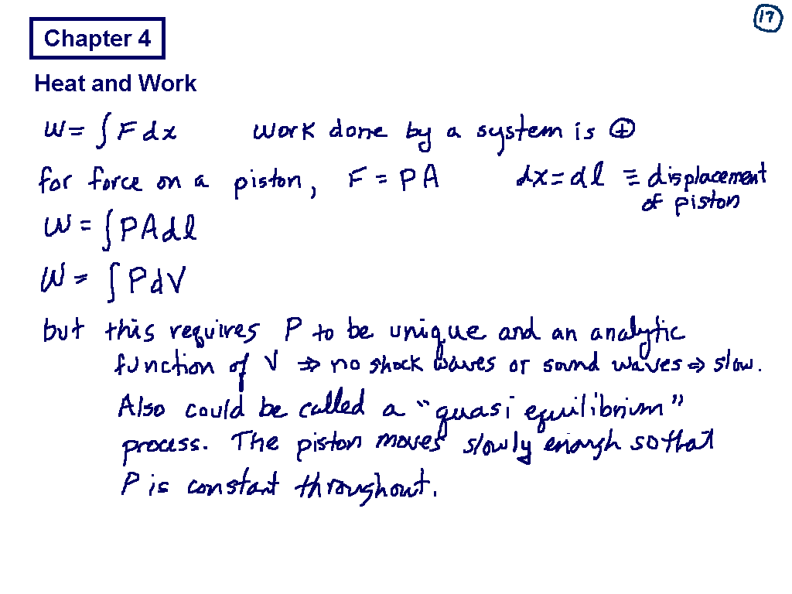
Cengel Chapter 2

Slide 19
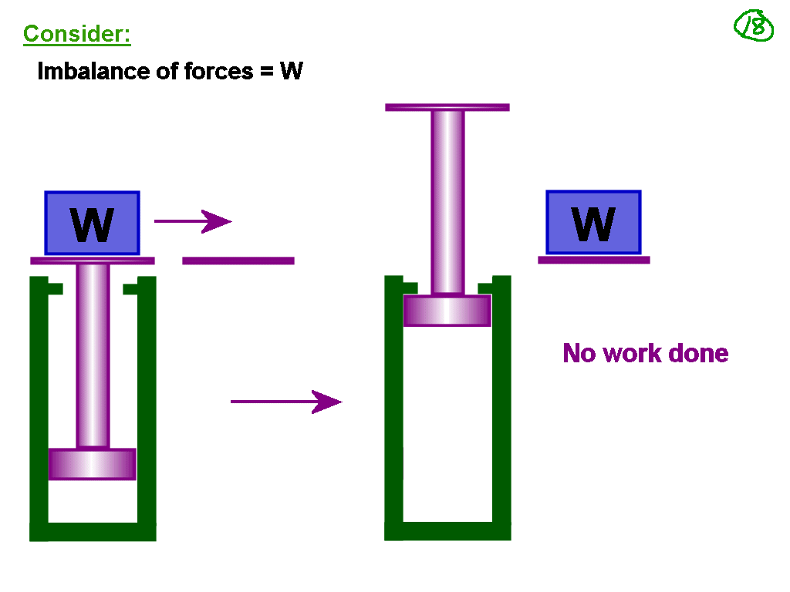
Reversible and Irreversible Processes, Cengel
Page 288

Slide 20
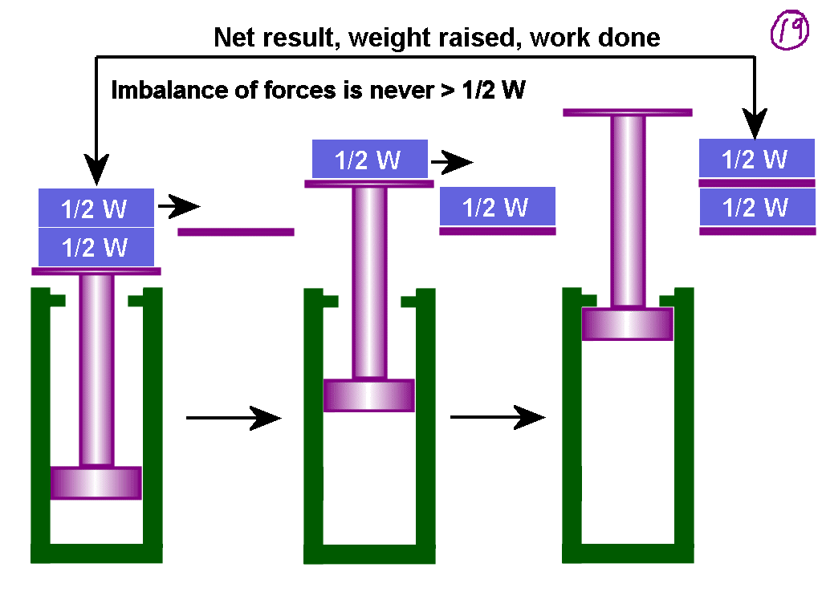

Slide 21
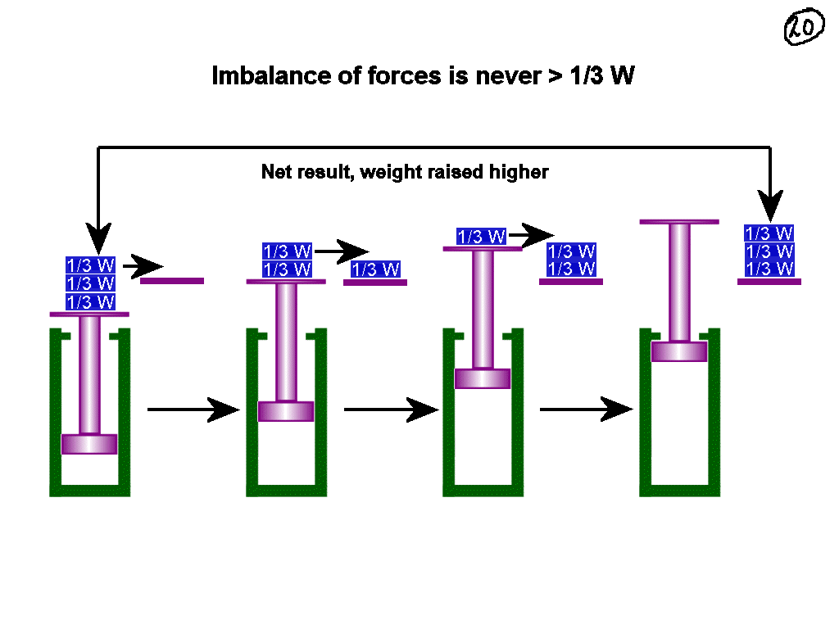

Slide 22
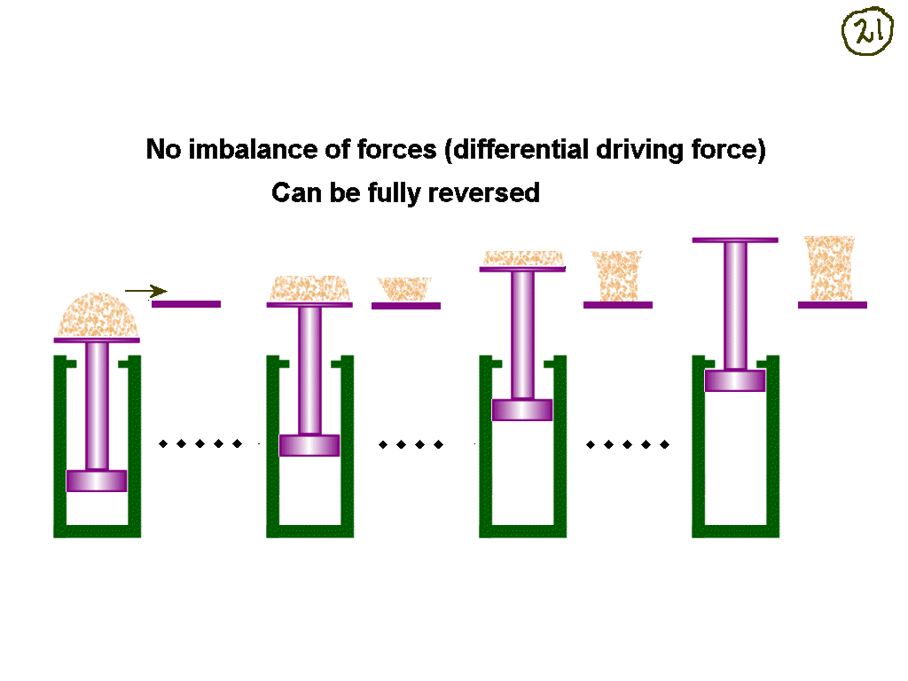

Slide 23
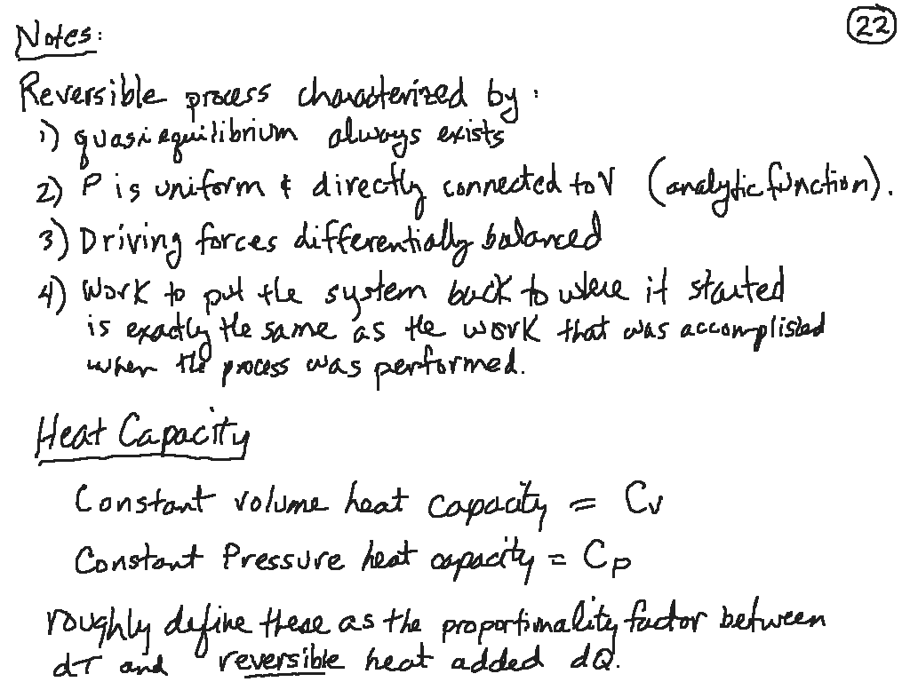

Slide 24
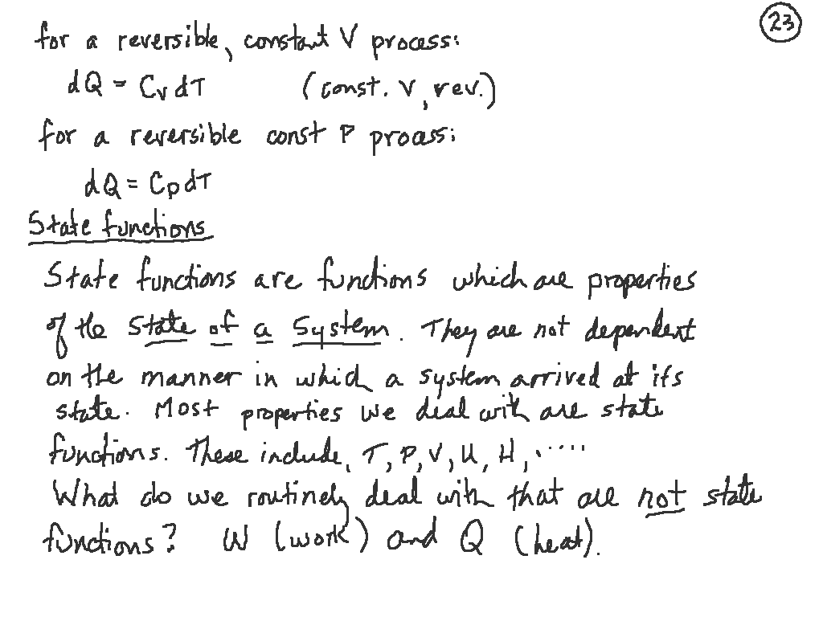

Slide 25
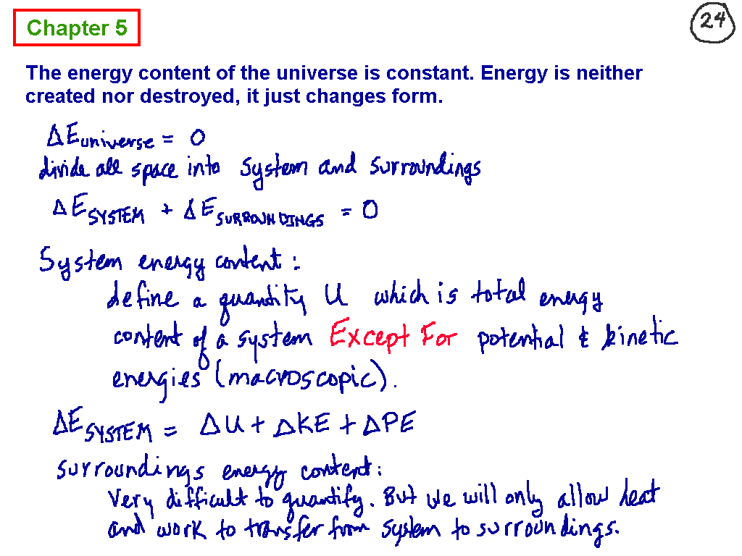
Cengel Chapter 2, First Law of Thermodynamics

Slide 26
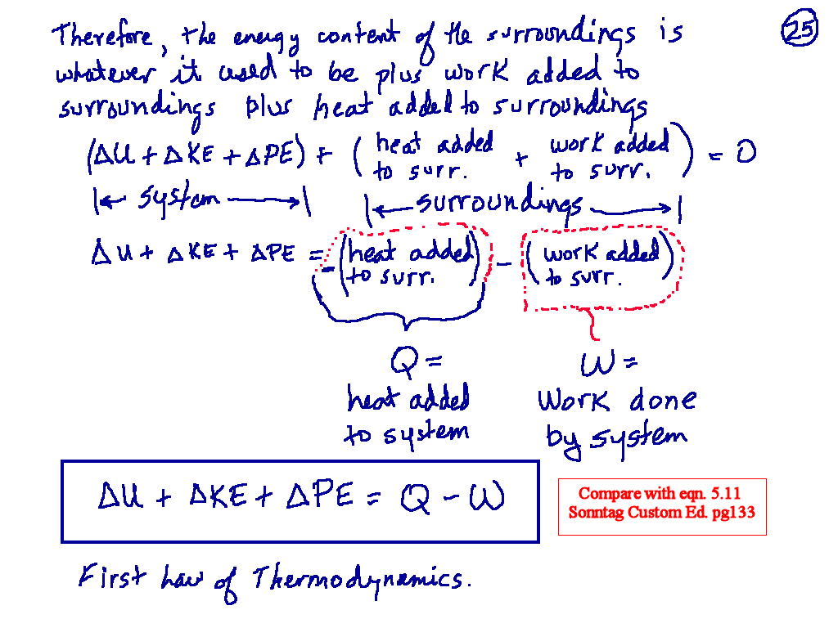

Slide 27
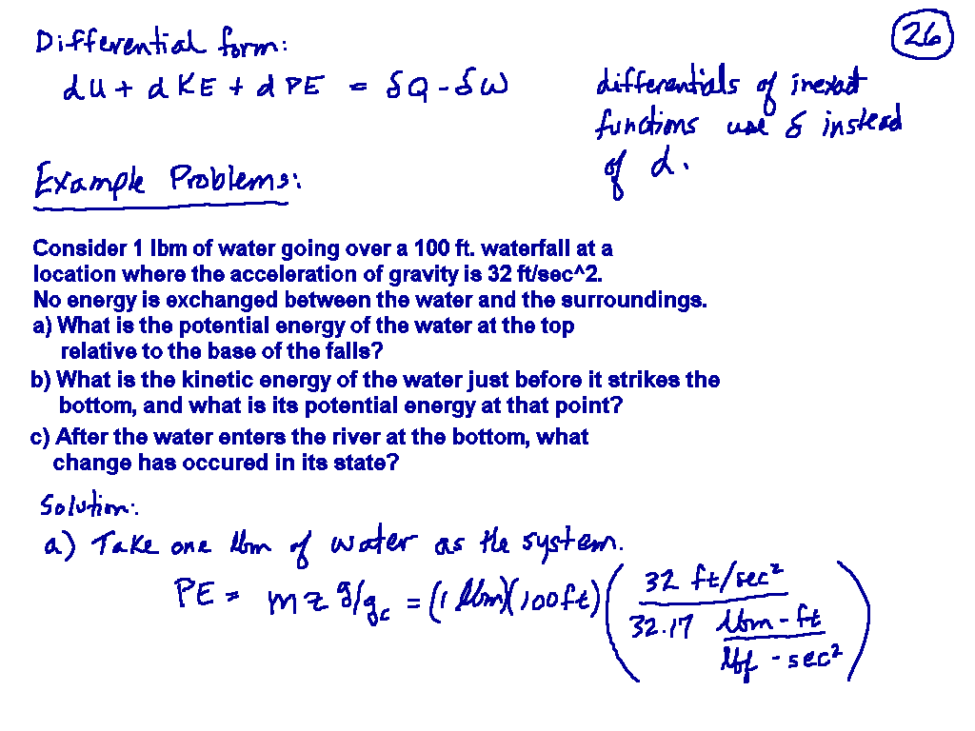

Slide 28
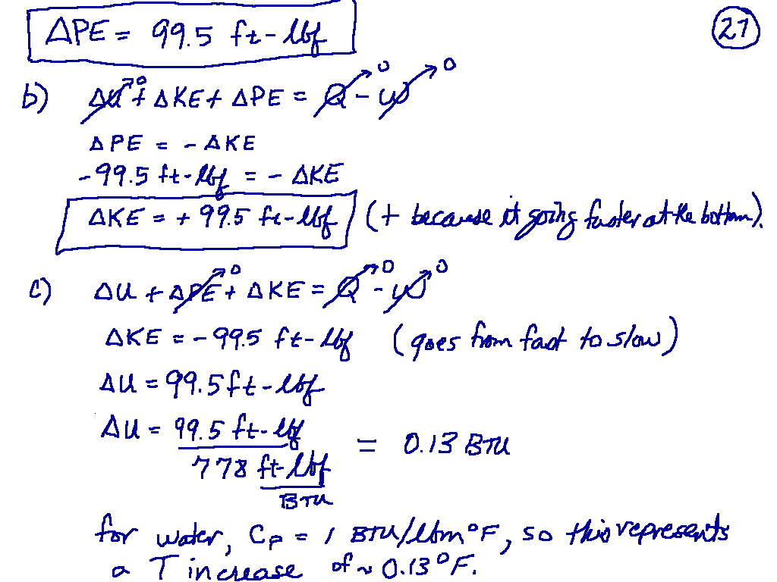

Slide 29
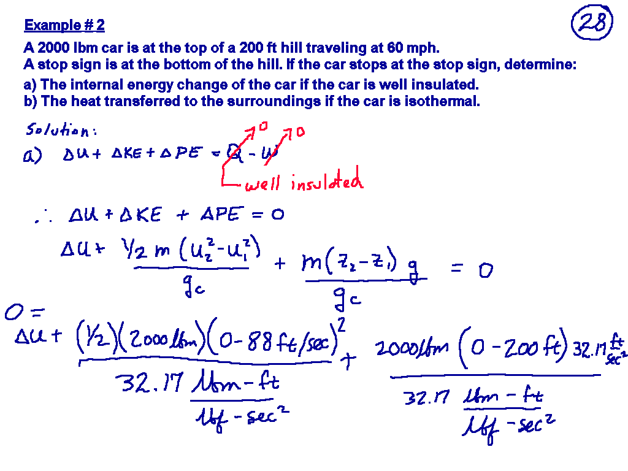

Slide 30
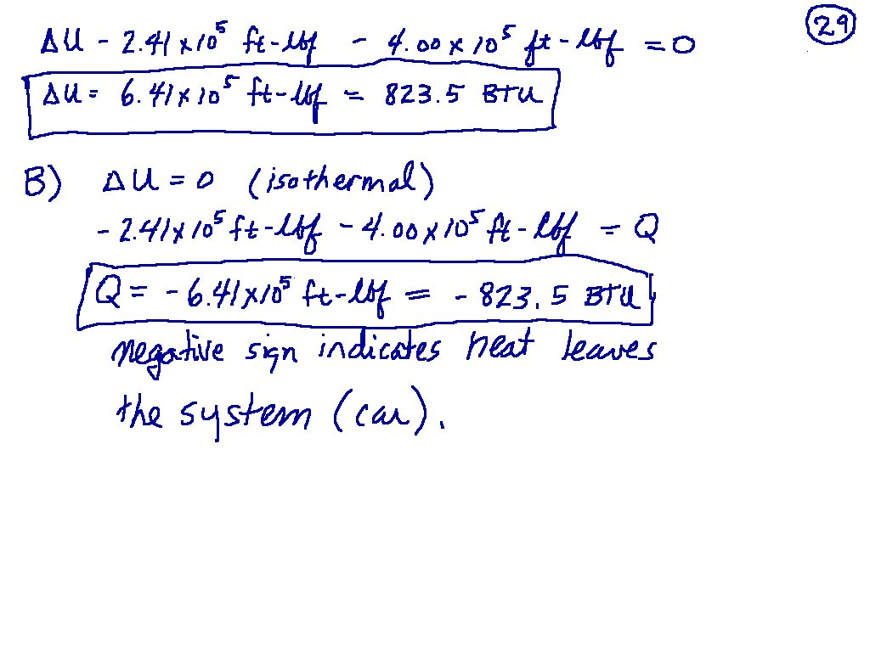

Slide 31
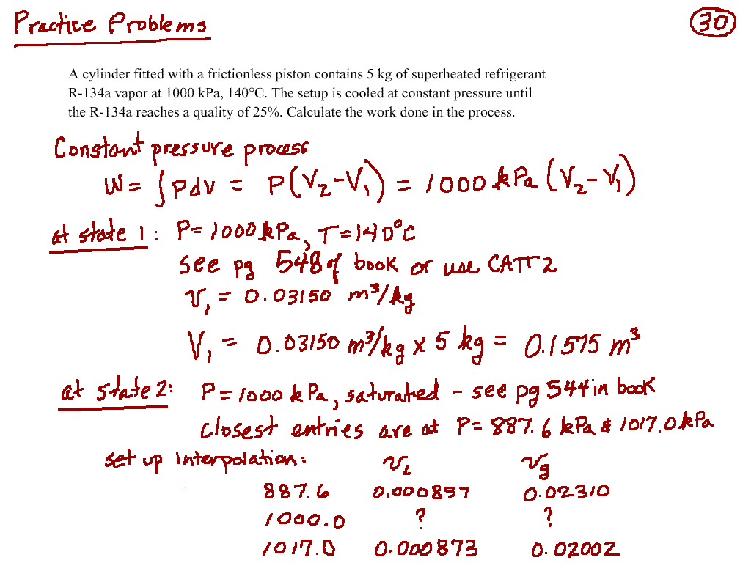

Slide 32
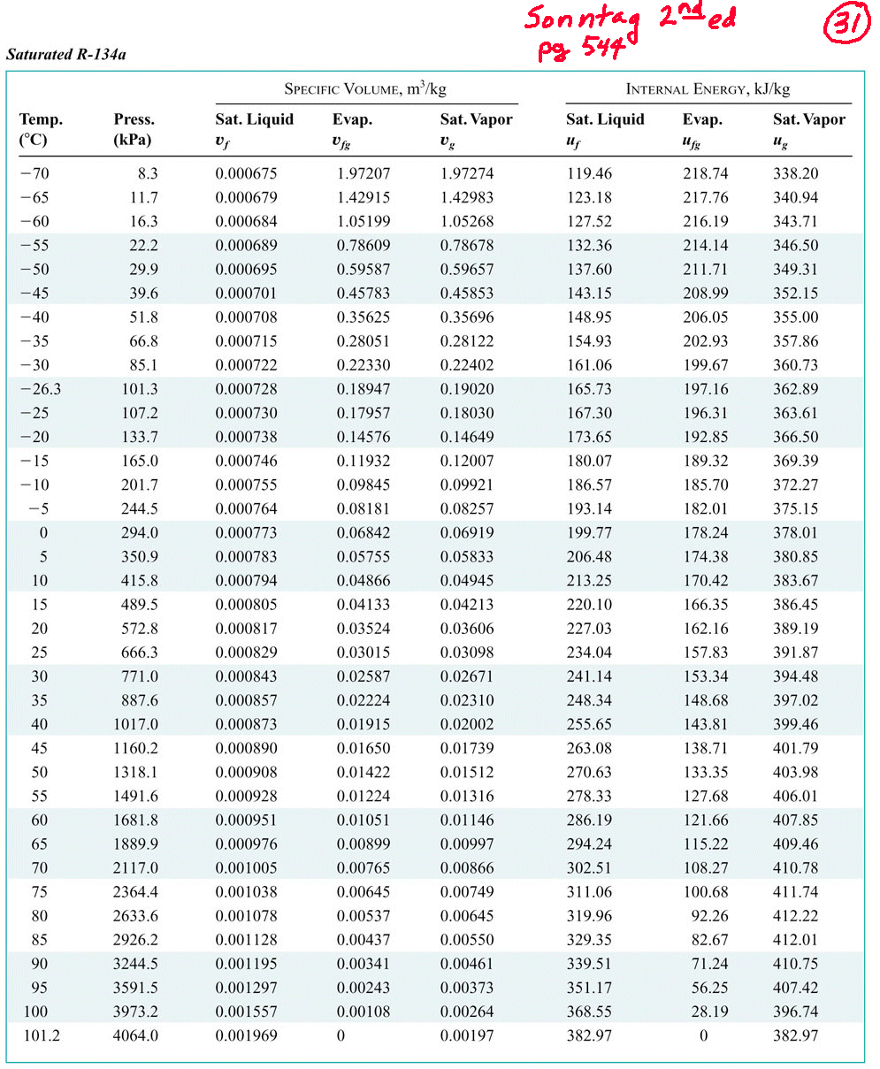

Slide 33
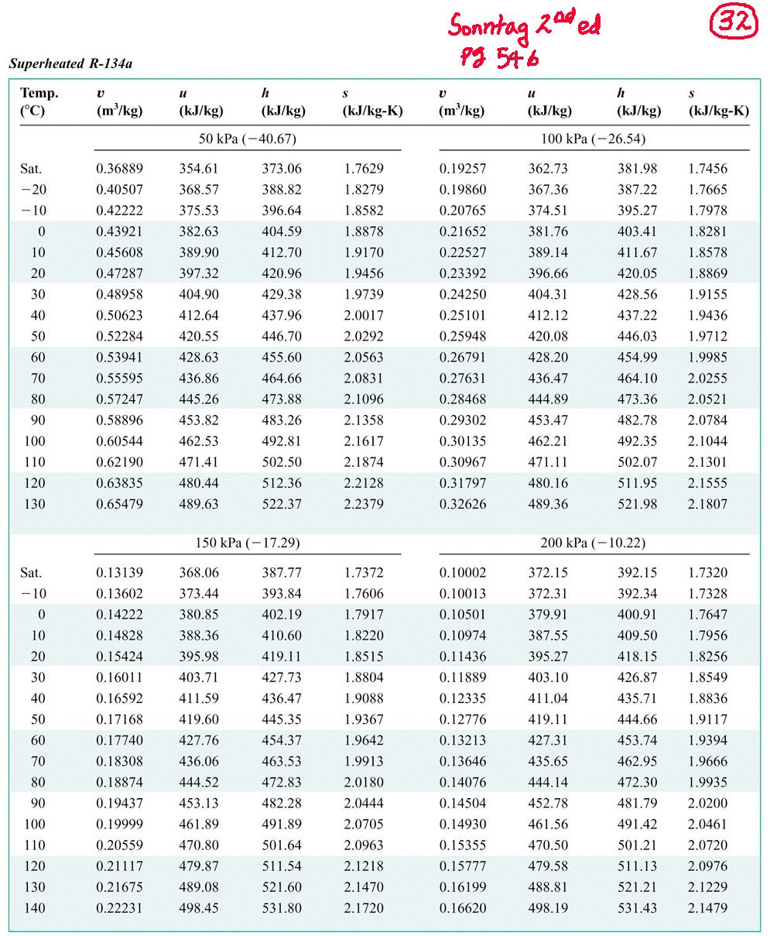

Slide 34
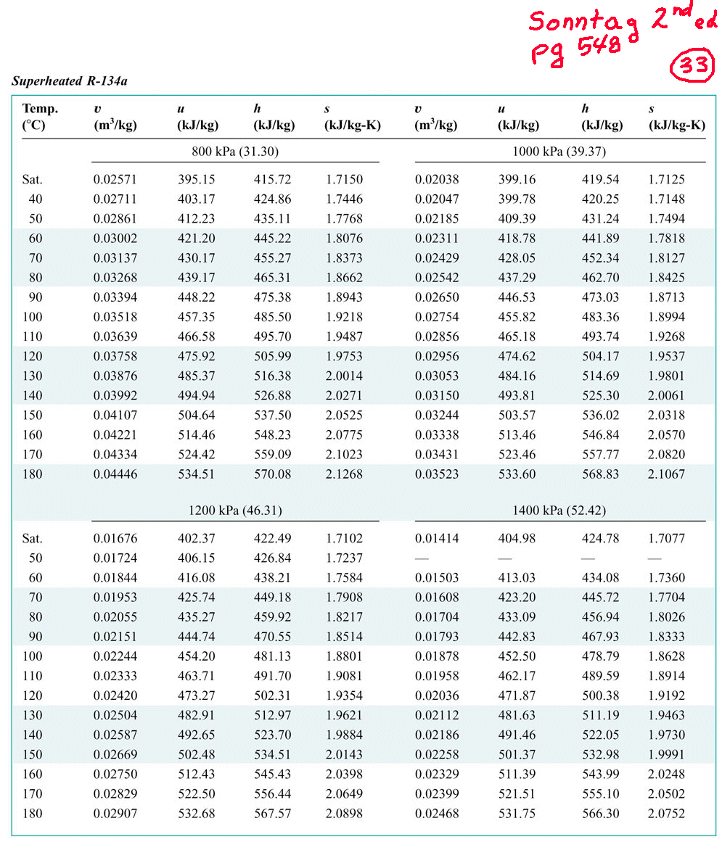

Slide 35
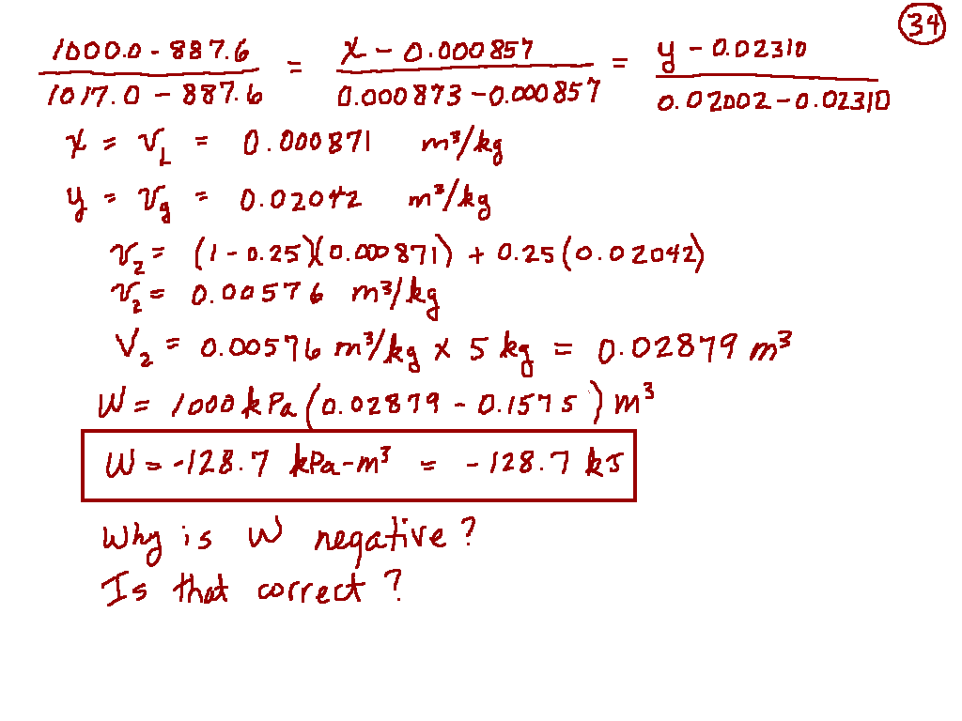

Slide 36
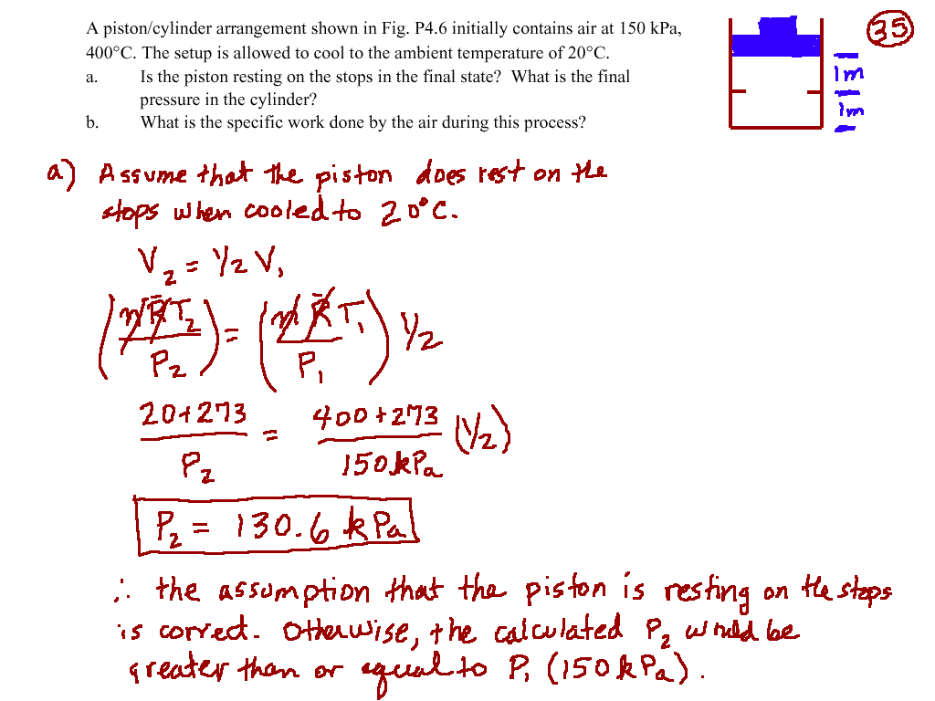

Slide 37
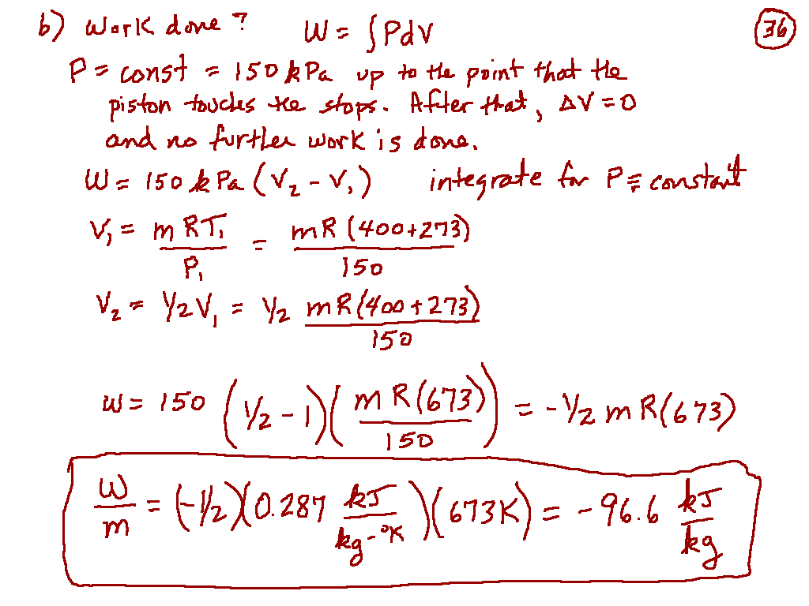

Slide 38
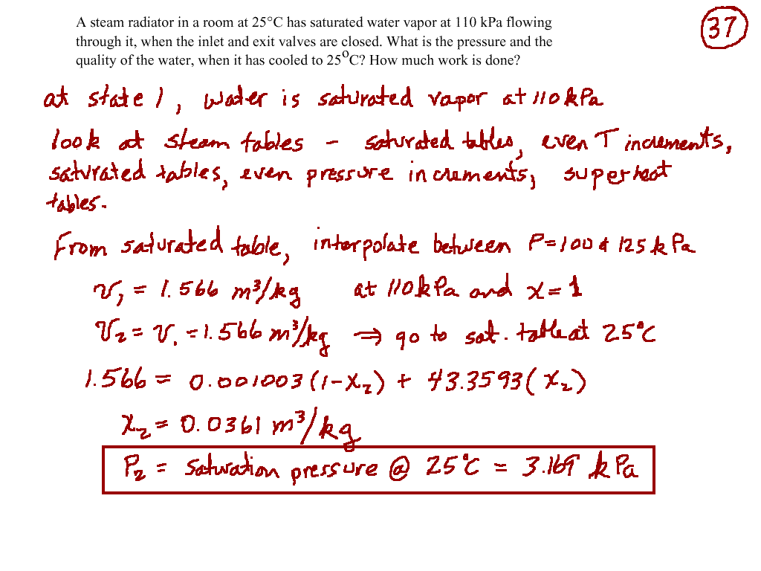

Slide 39
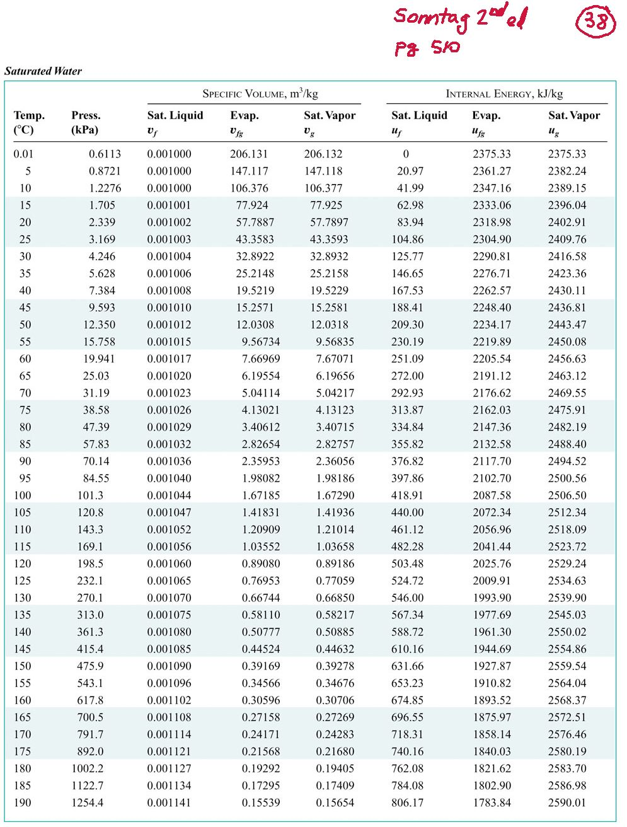

Slide 40
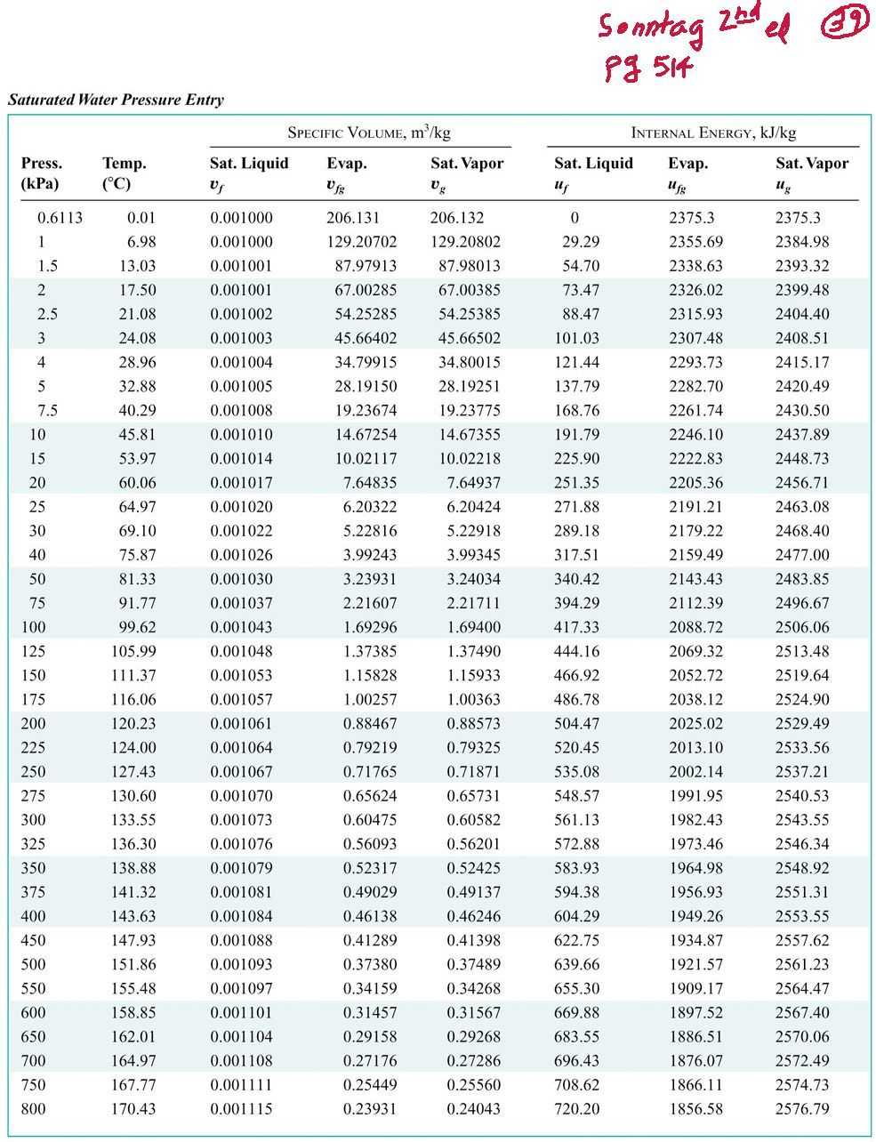

Slide 41
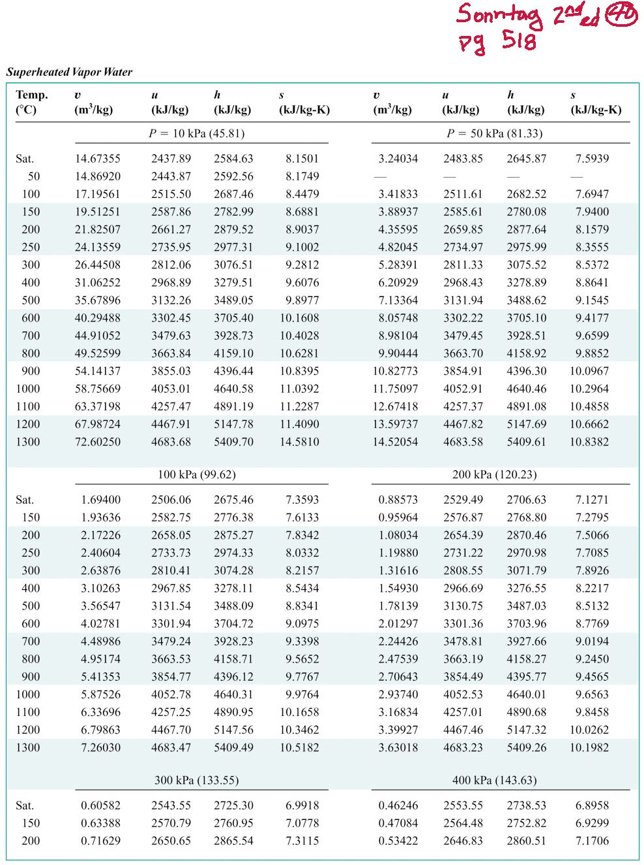

Slide 42
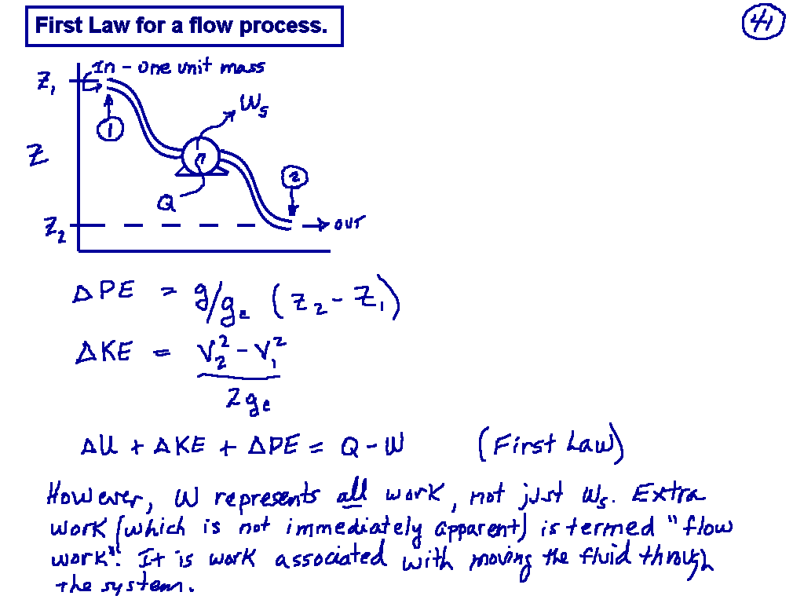
Cengel Chapter 5
Page 222

Slide 43
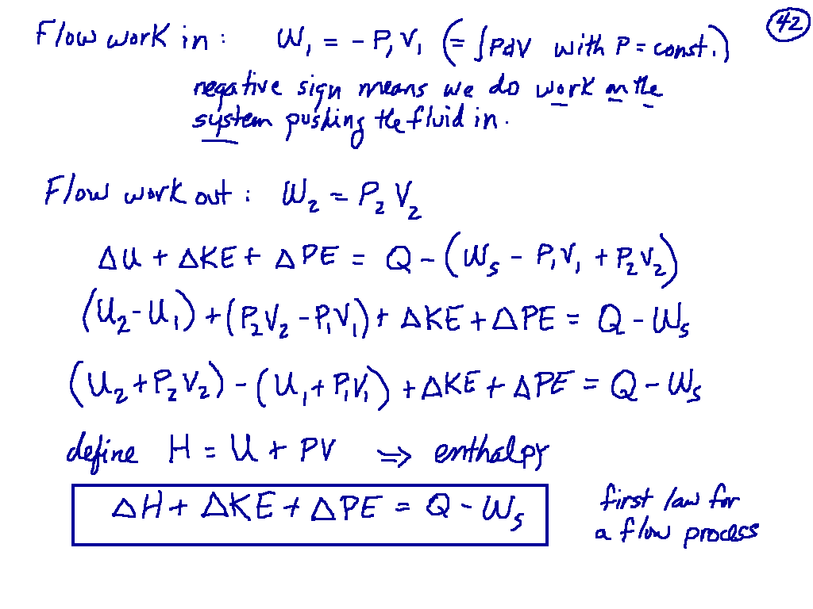
Cengel Equation 5-40
Page 224

Slide 44
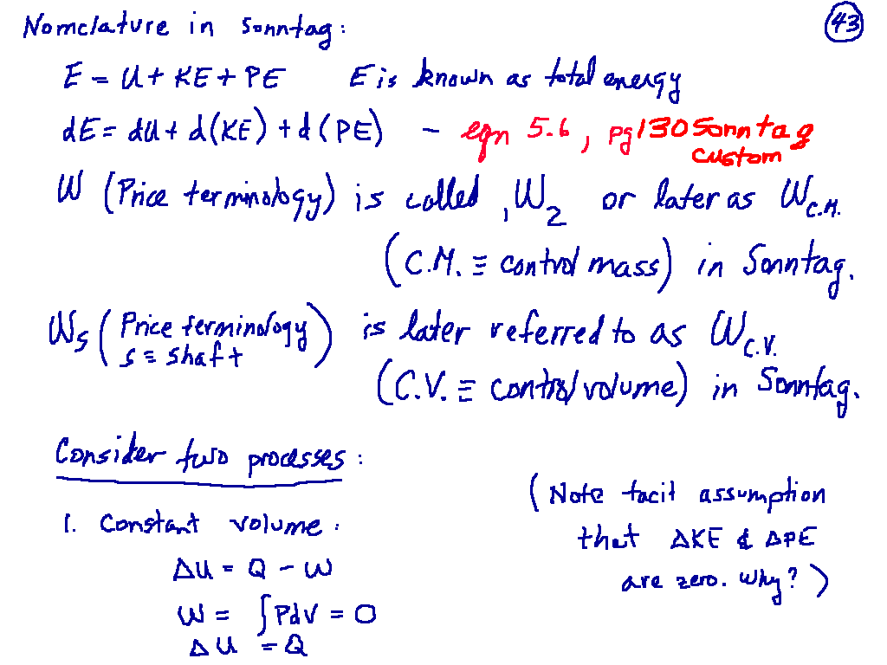

Slide 45
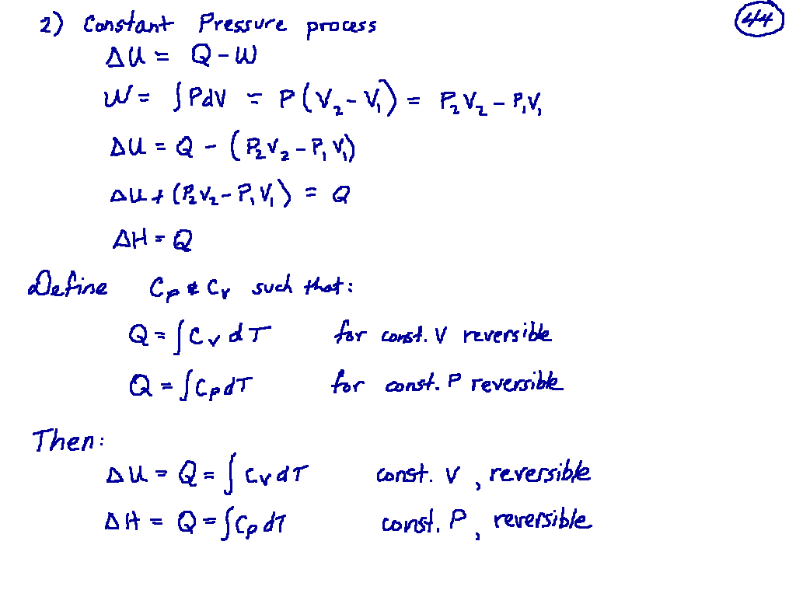

Slide 46
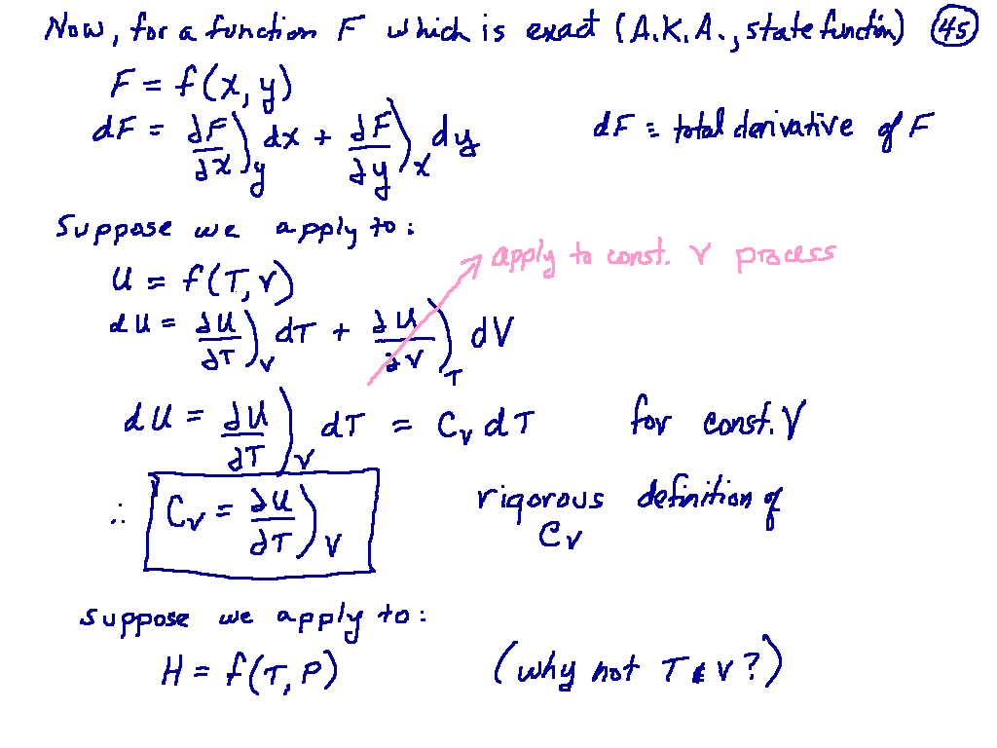

Slide 47
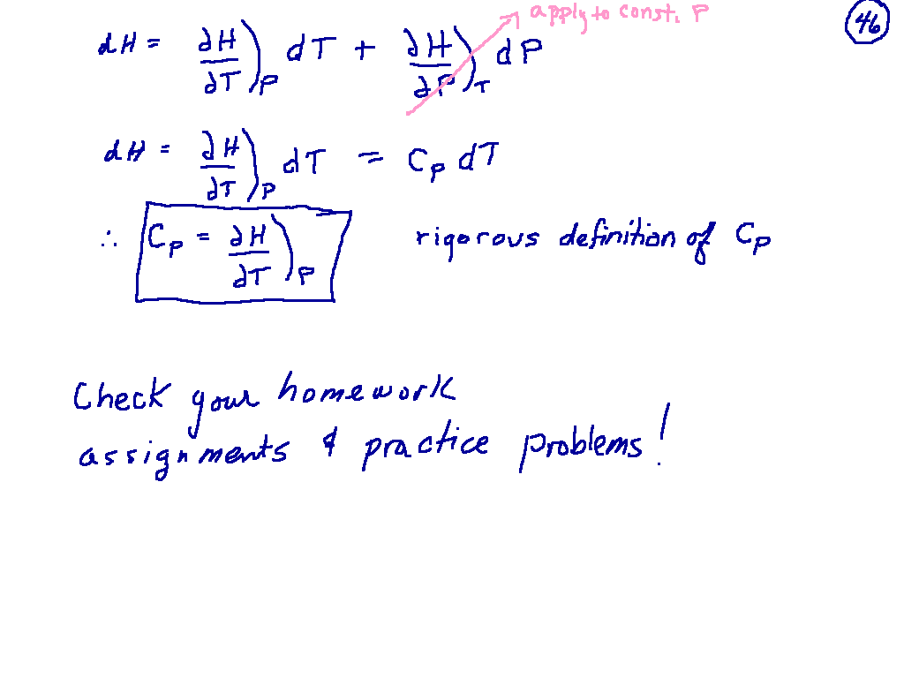

Slide 48
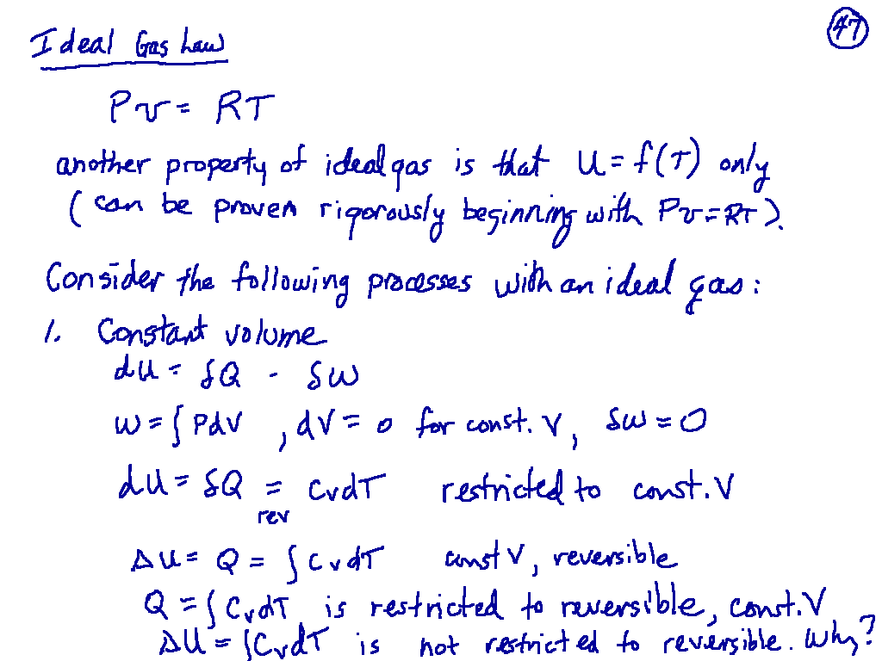

Slide 49
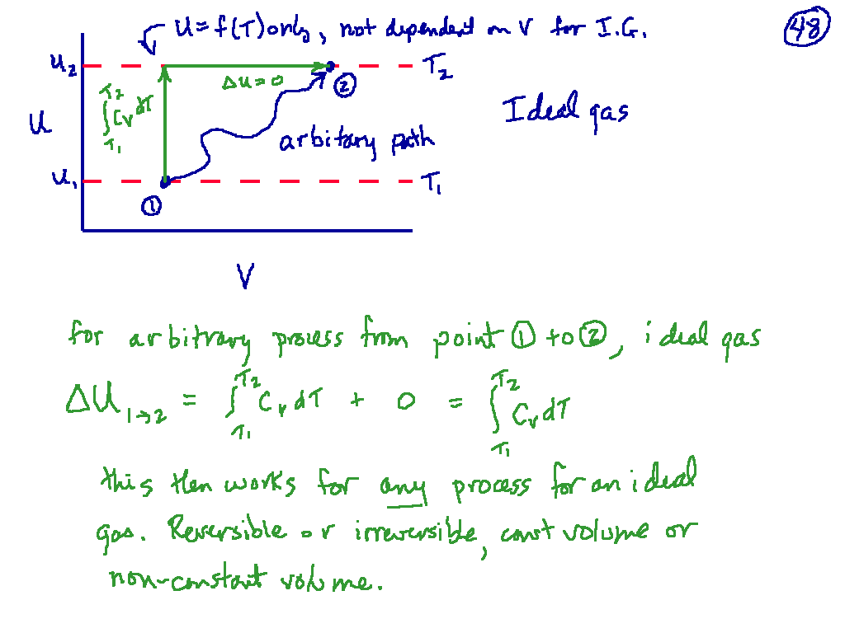

Slide 50
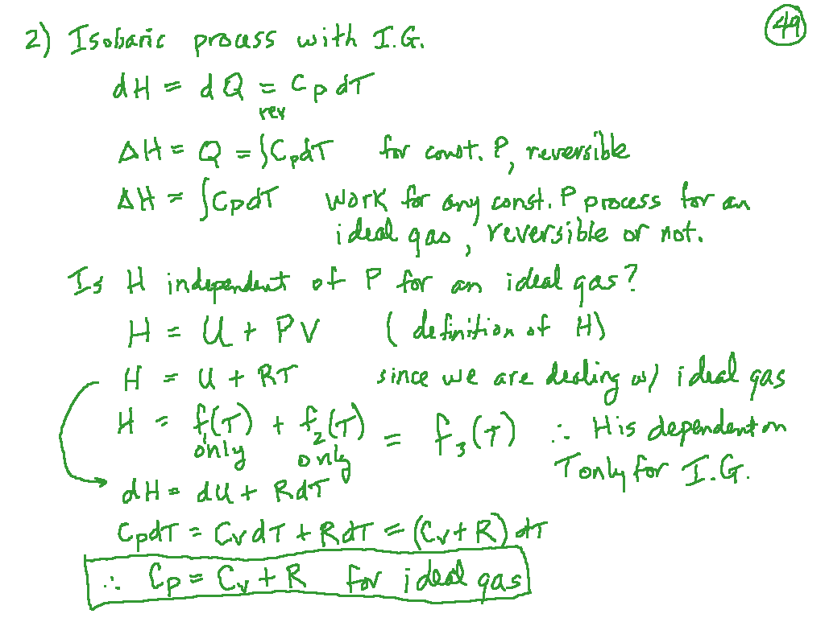

Slide 51
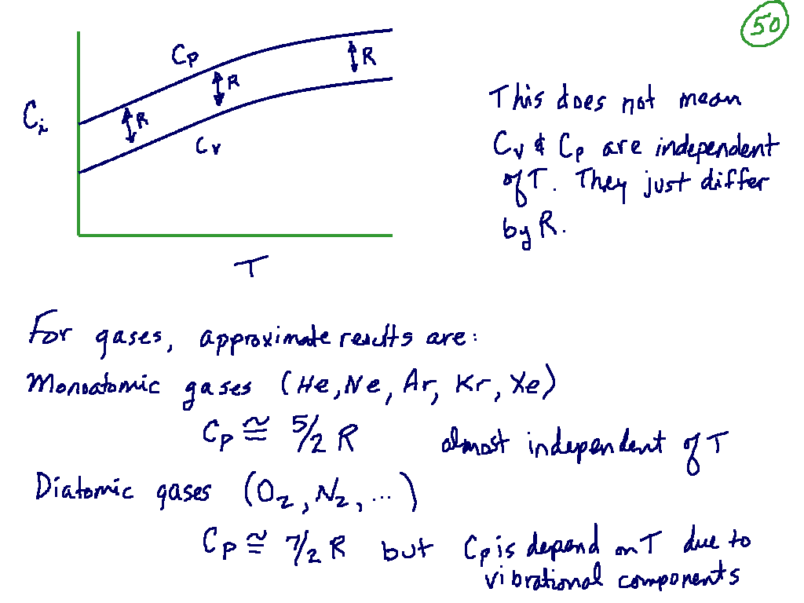

Slide 52


Slide 53


Slide 54


Slide 55


Slide 56


Slide 57


Slide 58


Slide 59

Cengel Chapter 5

Slide 60


Slide 61


Slide 62


Slide 63


Slide 64


Slide 65


Slide 66


Slide 67


Slide 68


Slide 69


Slide 70

Similar stuff in Cengel, page 885

Slide 71

Similar stuff in Cengel, page 885

Slide 72


Slide 73


Slide 74


Slide 75


Slide 76


Slide 77


Slide 78


Slide 79


Slide 80

Cengel Chapters 6 and 7

Slide 81


Slide 82


Slide 83


Slide 84


Slide 85


Slide 86


Slide 87


Slide 88


Slide 89


Slide 90

Cengel Chapter 6, page 274

Slide 91


Slide 92


Slide 93


Slide 94


Slide 95


Slide 96


Slide 97


Slide 98


Slide 99


Slide 100


Slide 101


Slide 102


Slide 103


Slide 104


Slide 105


Slide 106


Slide 107


Slide 108


Slide 109


Slide 110


Slide 111


Slide 112


Slide 113


Slide 114


Slide 115


Slide 116


Slide 117


Slide 118


Slide 119


Slide 120


Slide 121


Slide 122


Slide 123


Slide 124

Be sure to keep up with your homework
Read Chapters 6 and 7
Start looking at the first part of the project
Read about refrigerants

Slide 125


Slide 126


Slide 127


Slide 128


Slide 129


Slide 130


Slide 131


Slide 132


Slide 133

Cengel Chapter 7 page 346
Equation 7.31 Cengel
Equation 7.32
Cengel

Slide 134


Slide 135


Slide 136


Slide 137


Slide 138


Slide 139


Slide 140


Slide 141


Slide 142


Slide 143


Slide 144


Slide 145


Slide 146


Slide 147


Slide 148


Slide 149


Slide 150


Slide 151


Slide 152


Slide 153


Slide 154


Slide 155


Slide 156


Slide 157


Slide 158


Slide 159


Slide 160


Slide 161


Slide 162


Slide 163


Slide 164


Slide 165


Slide 166


Slide 167


Slide 168


Slide 169


Slide 170


Slide 171


Slide 172


Slide 173


Slide 174


Slide 175


Slide 176


Slide 177


Slide 178


Slide 179


Slide 180


Slide 181


Slide 182


Slide 183


Slide 184


Slide 185


Slide 186


Slide 187


Slide 188


Slide 189


Slide 190


Slide 191


Slide 192


Slide 193


Slide 194


Slide 195


Slide 196


Slide 197


Slide 198


Slide 199


Slide 200


Slide 201


Slide 202


Slide 203


Slide 204


Slide 205


Slide 206


Slide 207


Slide 208


Slide 209


Slide 210


Slide 211


Slide 212


Slide 213


Slide 214


Slide 215


Slide 216


Slide 217


Slide 218


Slide 219


Slide 220


Slide 221


Slide 222


Slide 223


Slide 224


Slide 225


Slide 226


Slide 227


Slide 228


Slide 229


Slide 230


Slide 231


Slide 232


Slide 233

Cengel chapter 8

Slide 234


Slide 235


Slide 236


Slide 237


Slide 238


Slide 239


Slide 240


Slide 241


Slide 242


Slide 243


Slide 244


Slide 245


Slide 246


Slide 247


Slide 248


Slide 249


Slide 250


Slide 251


Slide 252


Slide 253


Slide 254


Slide 255


Slide 256


Slide 257


Slide 258


Slide 259


Slide 260


Slide 261


Slide 262


Slide 263


Slide 264


Slide 265

Cengel chapter 12

Slide 266


Slide 267


Slide 268


Slide 269


Slide 270


Slide 271


Slide 272


Slide 273


Slide 274


Slide 275


Slide 276


Slide 277


Slide 278


Slide 279


Slide 280


Slide 281


Slide 282


Slide 283


Slide 284


Slide 285


Slide 286


Slide 287


Slide 288


Slide 289


Slide 290


Slide 291


Slide 292


Slide 293


Slide 294

Lee-Kesler
Charts are not
In Cengel

Slide 295


Slide 296


Slide 297


Slide 298


Slide 299


Slide 300


Slide 301


Slide 302


Slide 303


Slide 304


Slide 305


Slide 306


Slide 307

- Cengel

Slide 308


Slide 309


Slide 310


Slide 311


Slide 312


Slide 313


Slide 314


Slide 315


Slide 316


Slide 317


Slide 318


Slide 319


Slide 320


Slide 321

Chapter 10 - Cengel

Slide 322


Slide 323


Slide 324


Slide 325


Slide 326


Slide 327


Slide 328


Slide 329


Slide 330


Slide 331


Slide 332


Slide 333


Slide 334


Slide 335


Slide 336


Slide 337


Slide 338


Slide 339


Slide 340


Slide 341


Slide 342


Slide 343


Slide 344


Slide 345


Slide 346


Slide 347

Chapter 9 - Cengel
See Otto engine flash

Slide 348


Slide 349


Slide 350


Slide 351


Slide 352


Slide 353


Slide 354


Slide 355


Slide 356


Slide 357

See Diesel Engine flash

Slide 358


Slide 359


Slide 360


Slide 361


Slide 362


Slide 363


Slide 364


Slide 365


Slide 366


Slide 367


Slide 368


Slide 369


Slide 370


Slide 371


Slide 372


Slide 373


Slide 374


Slide 375


Slide 376


Slide 377


Slide 378


Slide 379


Slide 380


Slide 381


Slide 382


Slide 383


Slide 384


Slide 385


Slide 386


Slide 387


Slide 388


Slide 389


Slide 390


Slide 391


Slide 392


Slide 393


Slide 394


Slide 395


Slide 396


Slide 397


Slide 398


Slide 399


Slide 400


Slide 401

Cengel Chapter 13

Slide 402


Slide 403


Slide 404


Slide 405


Slide 406


Slide 407


Slide 408


Slide 409


Slide 410


Slide 411


Slide 412


Slide 413


Slide 414


Slide 415


Slide 416


Slide 417


Slide 418


Slide 419


Slide 420


Slide 421


Slide 422


Slide 423


Slide 424


Slide 425


Slide 426


Slide 427


Slide 428


Slide 429


Slide 430


Slide 431


Slide 432


Slide 433


Slide 434


Slide 435


Slide 436


Slide 437


Slide 438

15

Slide 439


Slide 440


Slide 441


Slide 442


Slide 443


Slide 444


Slide 445


Slide 446


Slide 447


Slide 448


Slide 449


Slide 450


Slide 451


Slide 452


Slide 453


Slide 454


Slide 455


Slide 456


Slide 457


Slide 458


Slide 459


Slide 460


Slide 461


Slide 462


Slide 463


Slide 464


Slide 465


Slide 466


Slide 467


Slide 468


Slide 469


Slide 470


Slide 471


Slide 472


Slide 473


Slide 474


Slide 475


Slide 476


Slide 477


Slide 478


Slide 479


Slide 480


Slide 481


