Slide 1
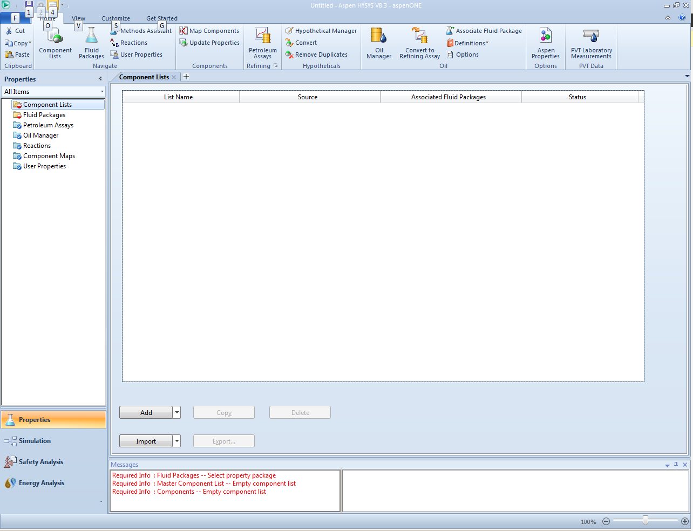

Slide 2
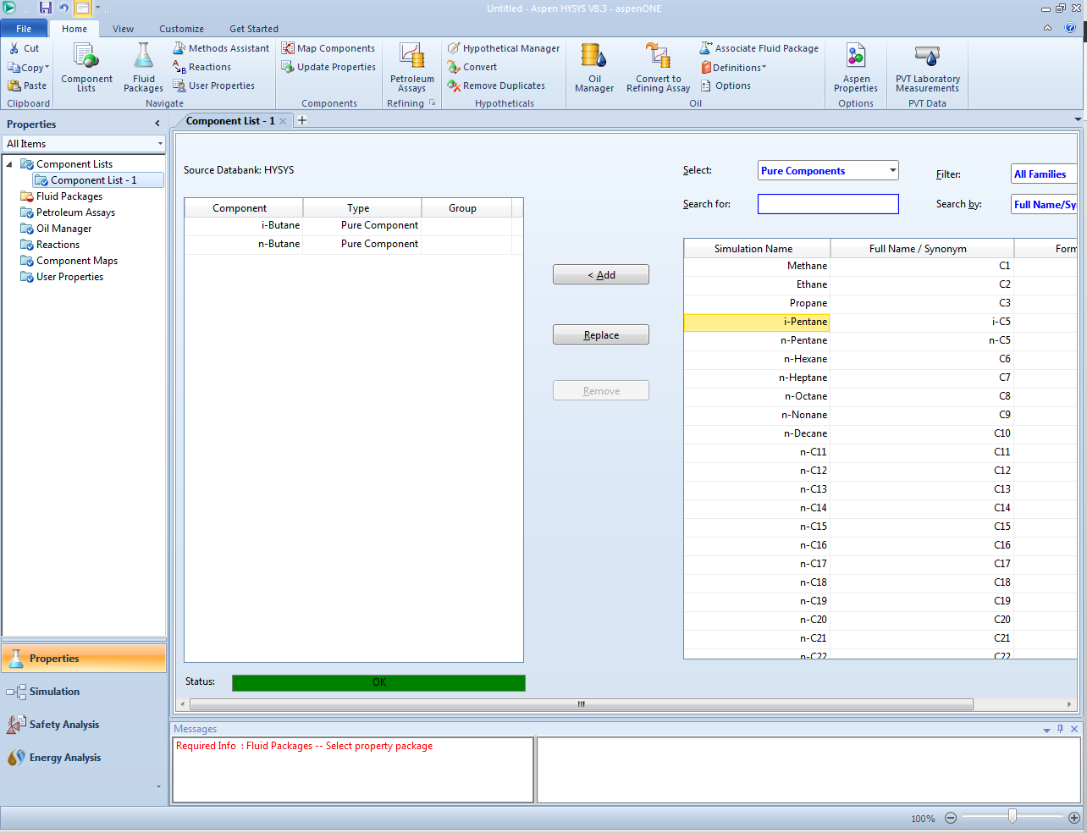
Second
First

Slide 3
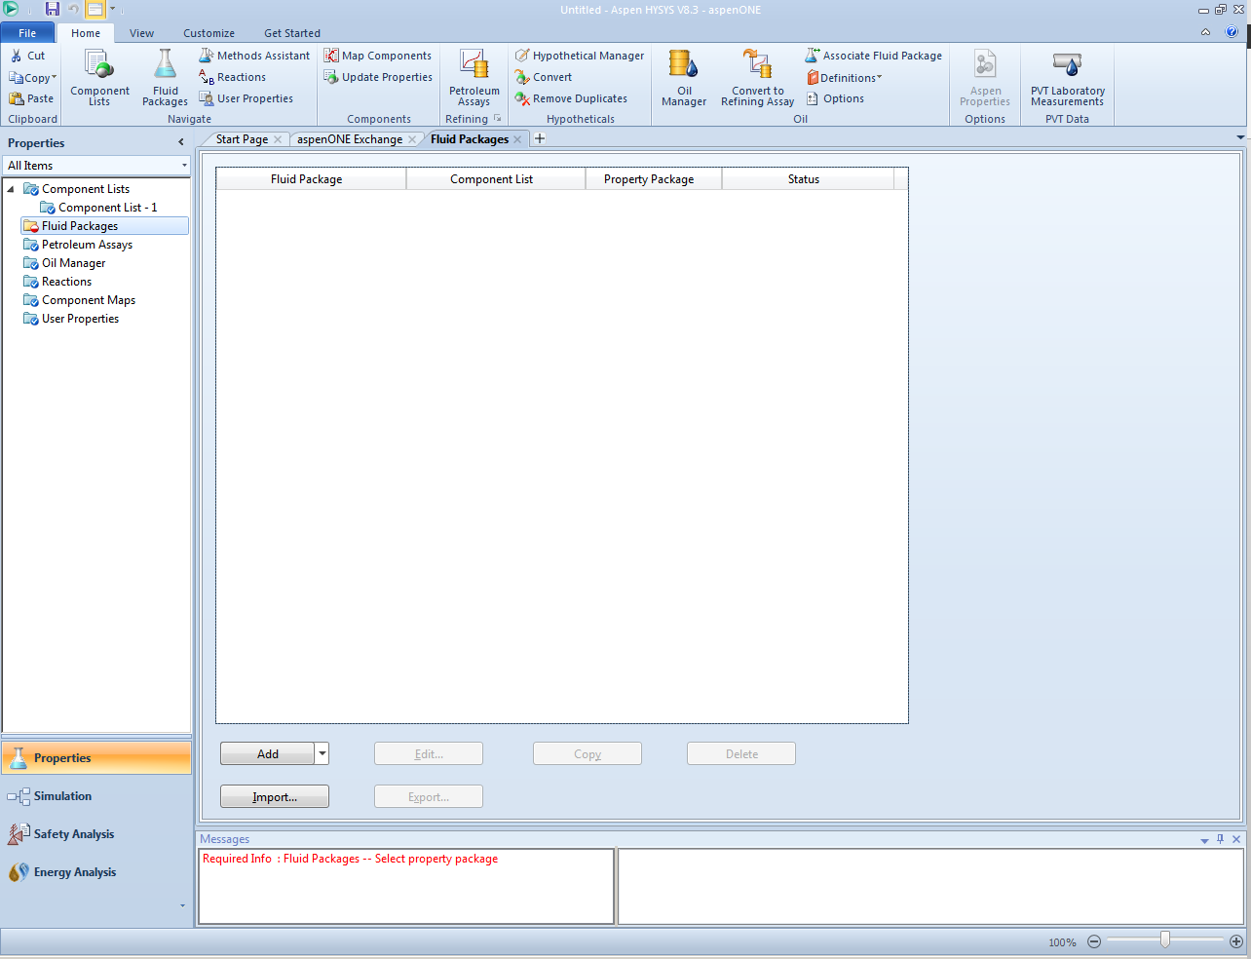
first

Slide 4
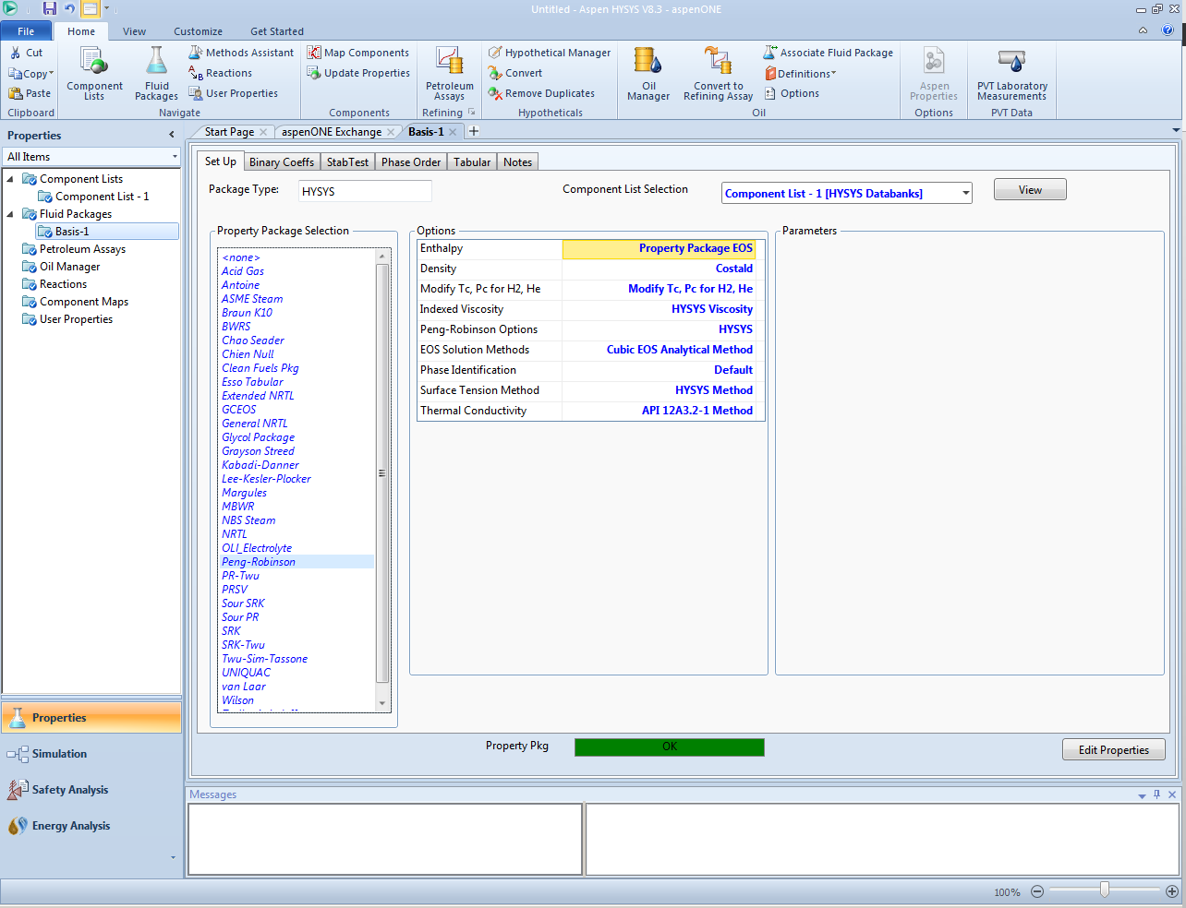
second
first

Slide 5
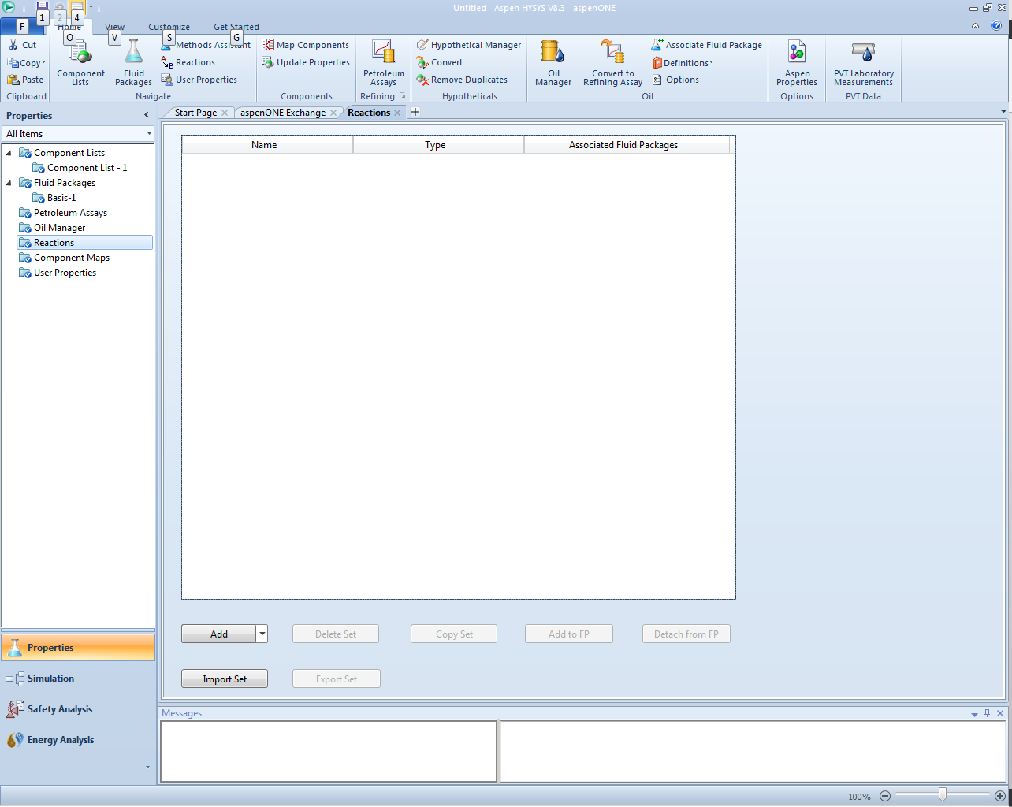

Slide 6
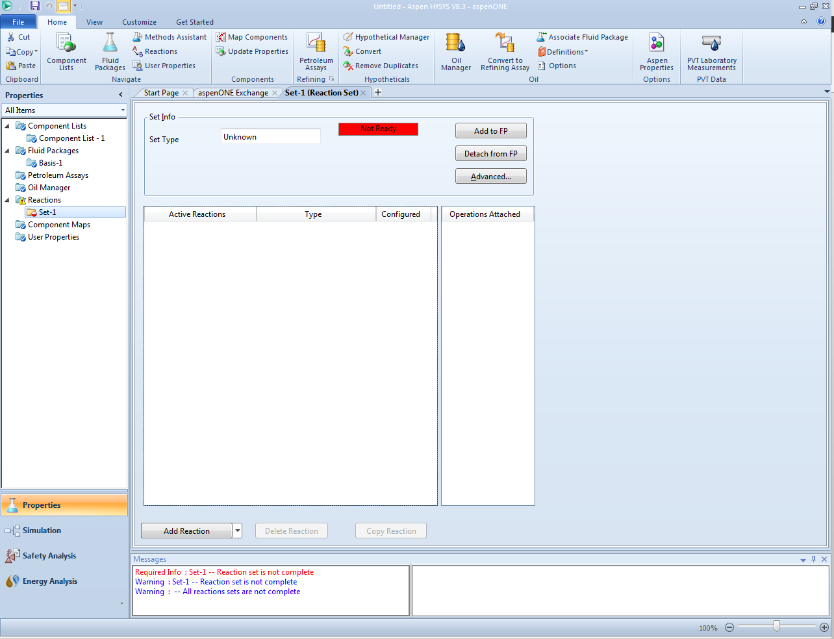
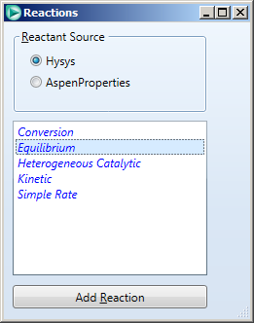
fourth
second
third
first

Slide 7
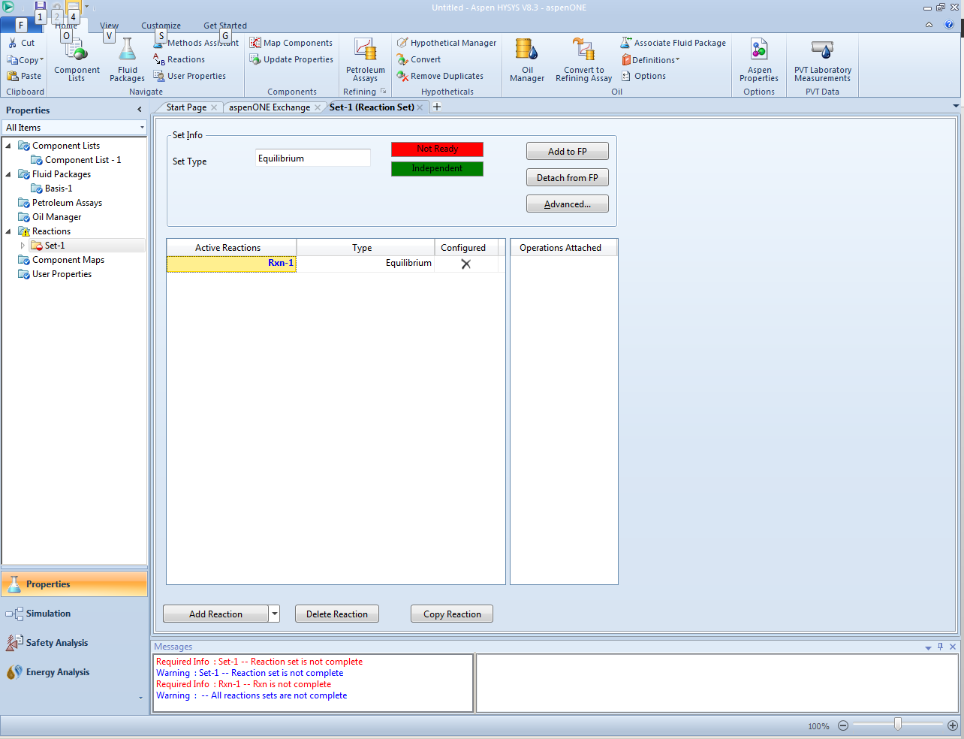
Double click

Slide 8
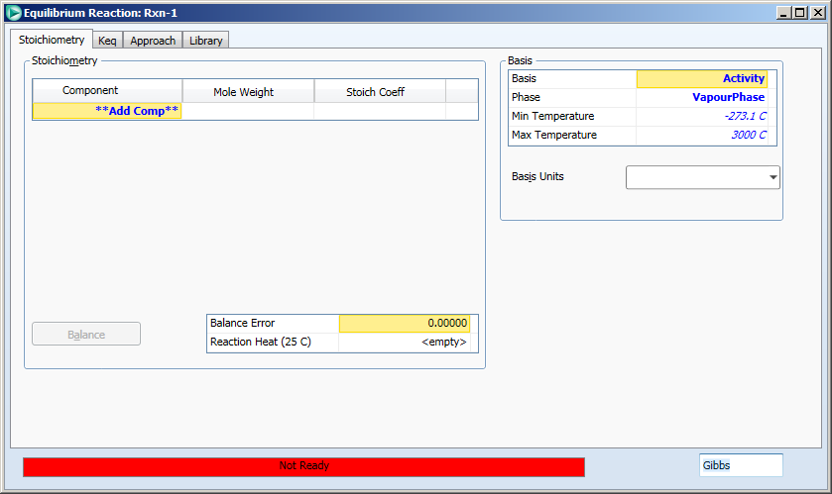

Slide 9
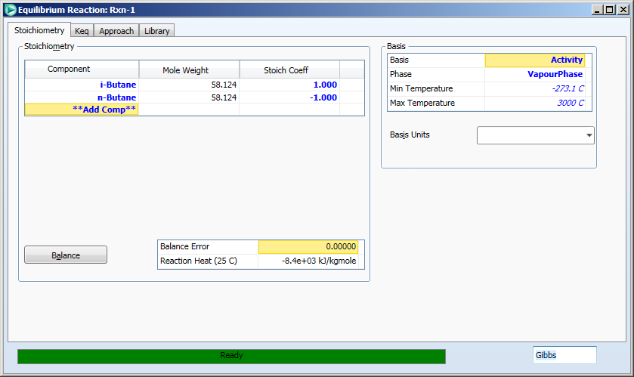
5
1
2
3
4

Slide 10
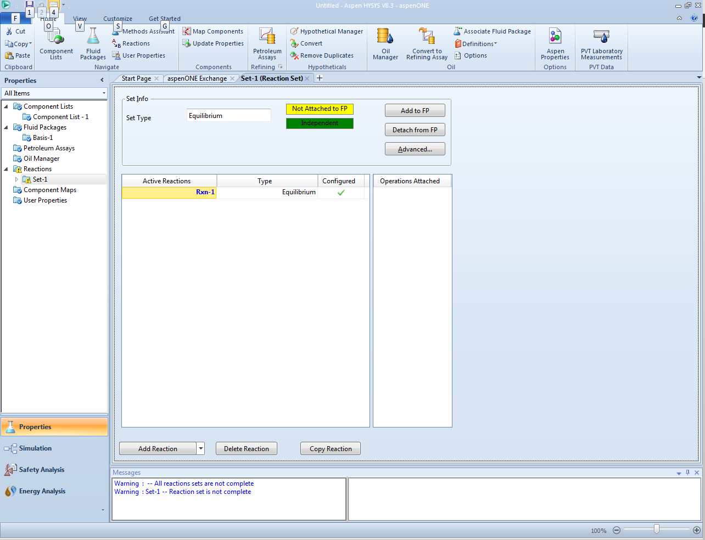

Slide 11
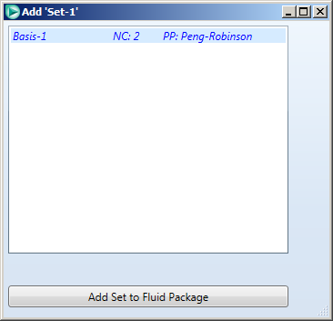

Slide 12
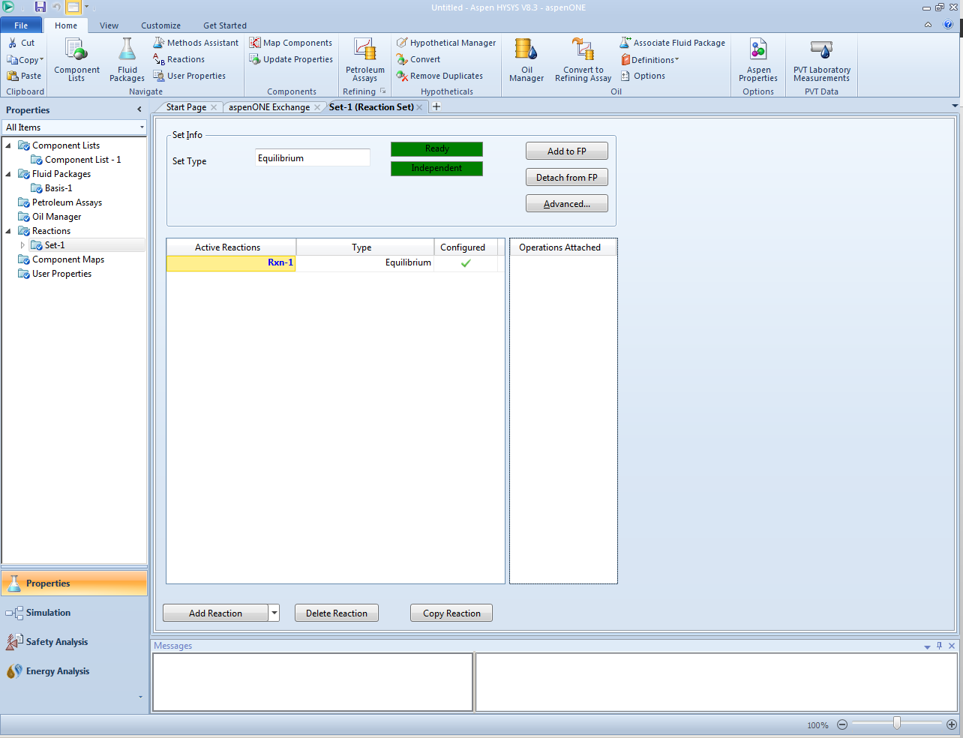

Slide 13
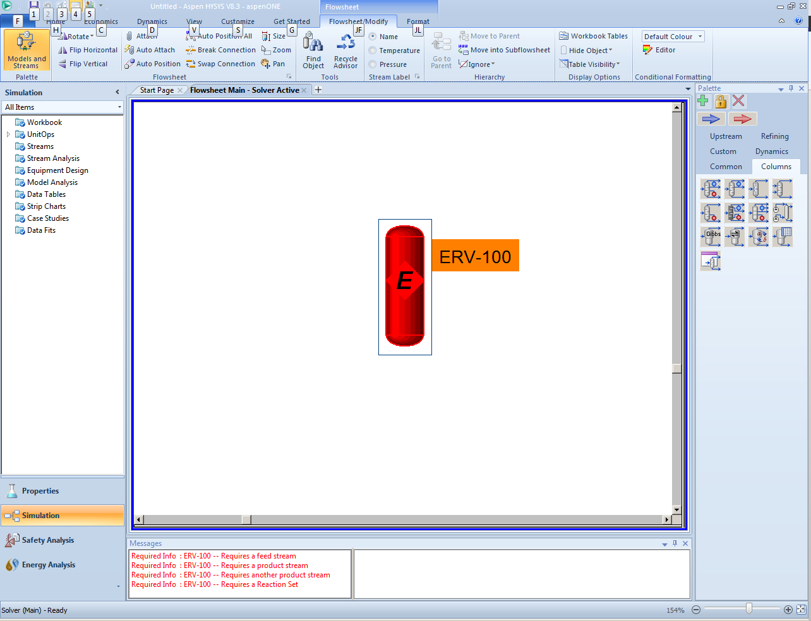
1
3 – place on simulation sheet
4 – double click
2 – choose “equilibrium reactor”

Slide 14
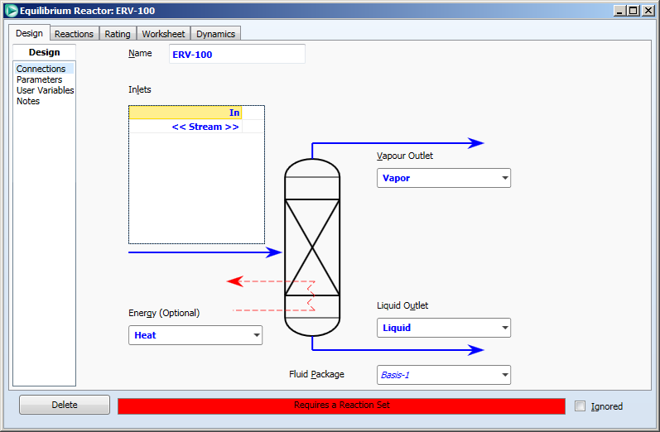
last
Name an inlet stream
Name a vapor stream
Name an energy stream
Name a liquid (stream

Slide 15
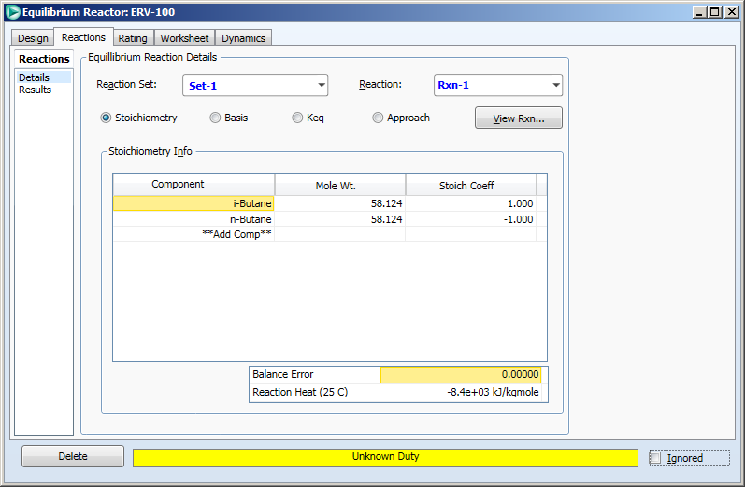
last
Designate the reaction(s) that takes place in the reactor

Slide 16
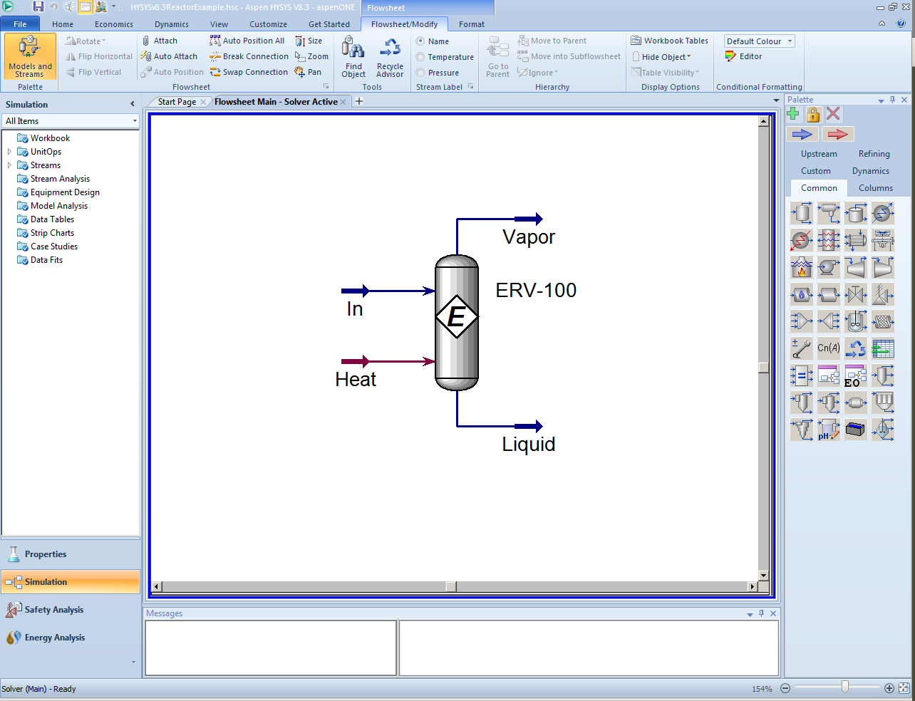
Set conditions on in/out streams: T, P, flow in (use some basis like 1 kgmole/hr), composition in. Set T and P out. HYSYS will compute the compositions for “Vapor”.

Slide 17
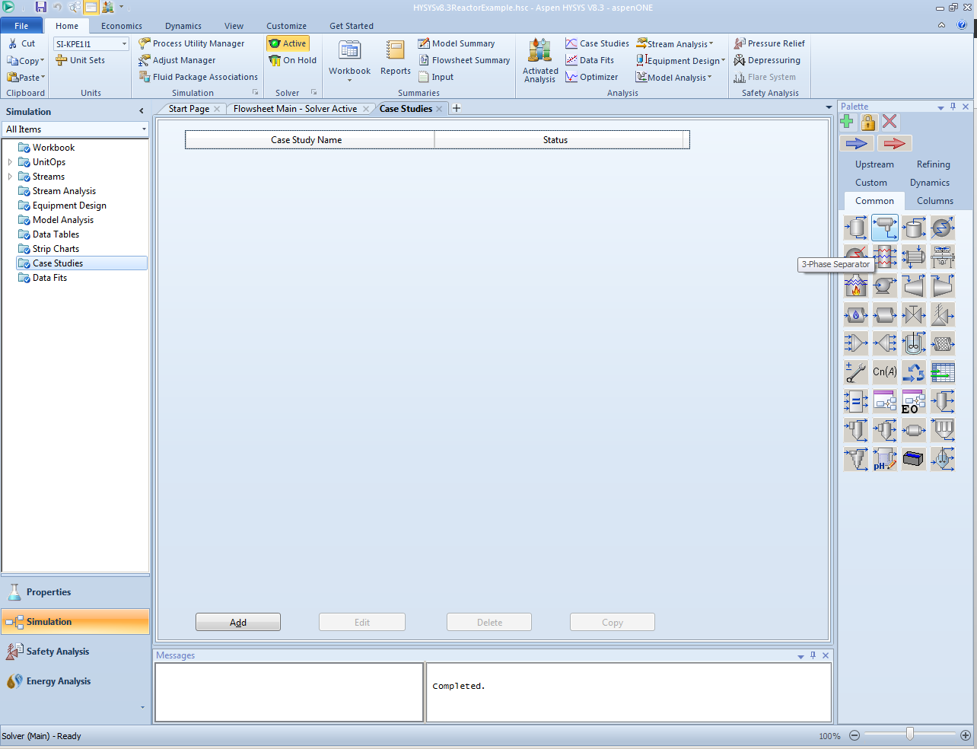
1
2

Slide 18
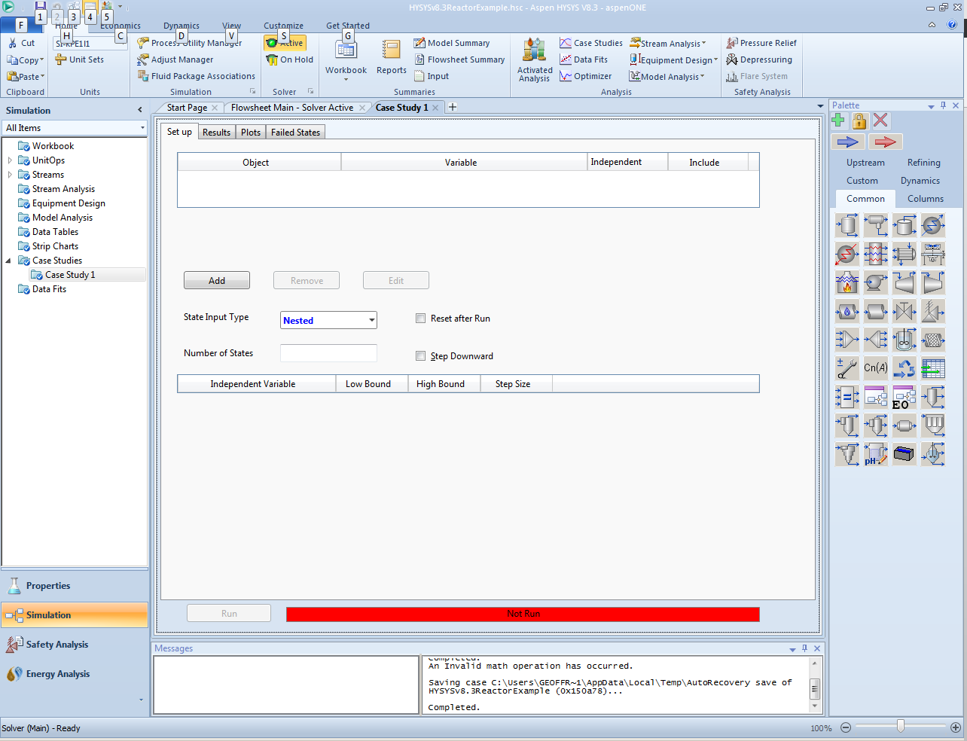
We are going to add variables to a case study. With a case study, we can have HYSYS change to variables and repeatedly do the calculations to see the effect of the variable on the process.

Slide 19
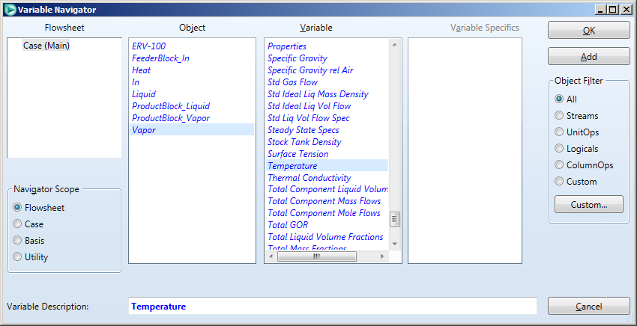
3
1
2
Click on “Vapor” then scroll down to “Temperature” then click “Add”. Similarly, find “Master Comp Mole Frac” in the same list as “Temperature”, then choose both components: i-butane/add; then n-butane/add. Close the window.

Slide 20
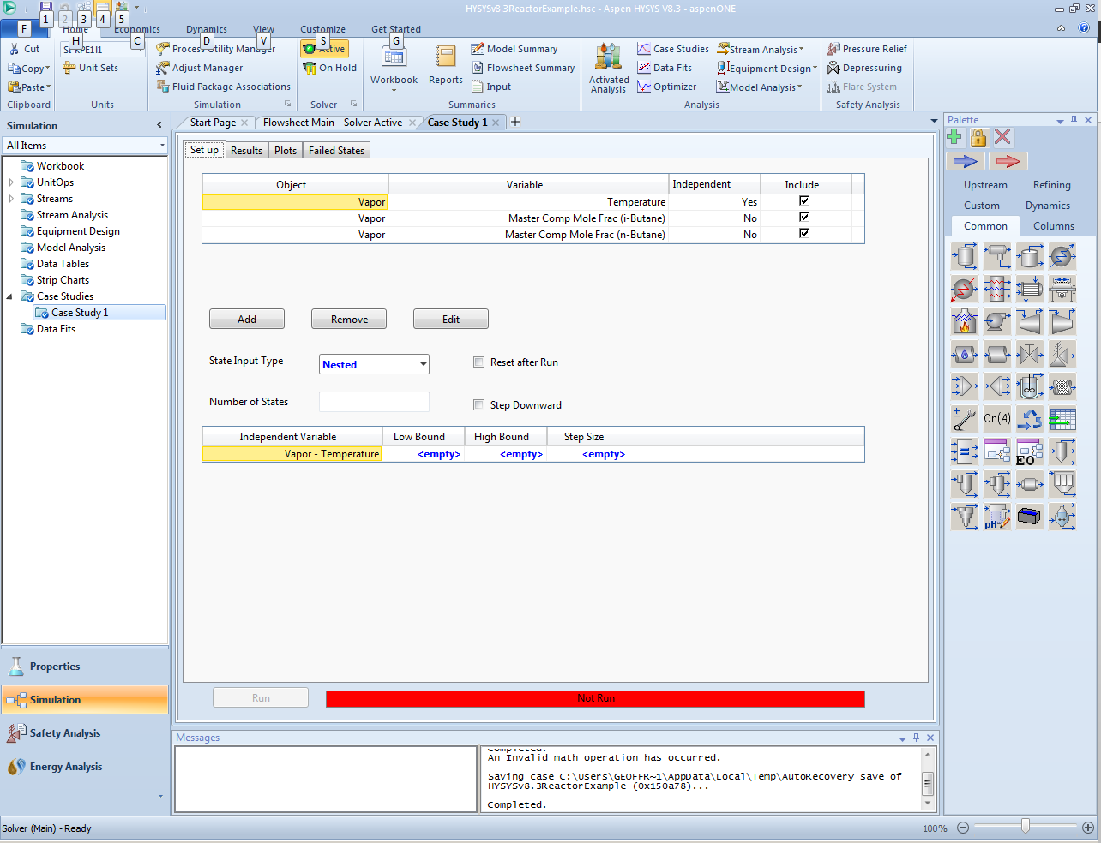
last
We would also like to add the equilibrium constant which is reported in the reactor properties, but it turns out that this variable is not accessible directly in the case study variables list. So, here’s what we have to do: 1) create a spreadsheet on the PFD, 2) open the spreadsheet and the reactor properties at the same time, 3) drag the equilibrium constant into the spreadsheet, and 4) return to the case study and find the equilibrium constant in the spreadsheet. The next slides show how to do this. Begin by switching back to the “Flowsheet Main” tab.

Slide 21
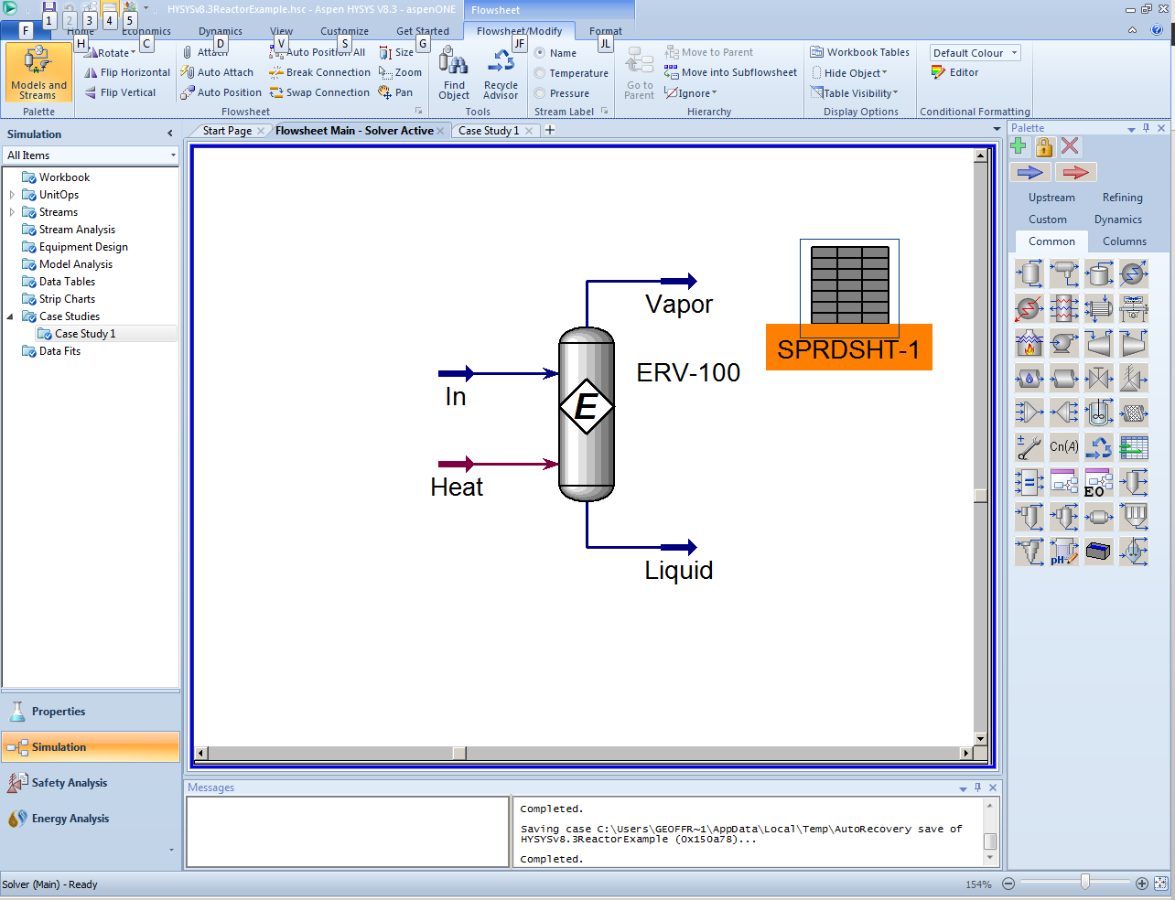
2 double click
1
3 double click
Click on the Spreadsheet icon and drop it on the Flowsheet. Next, double click on the spreadsheet to open it then on the reactor (ERV-100) to open it.

Slide 22
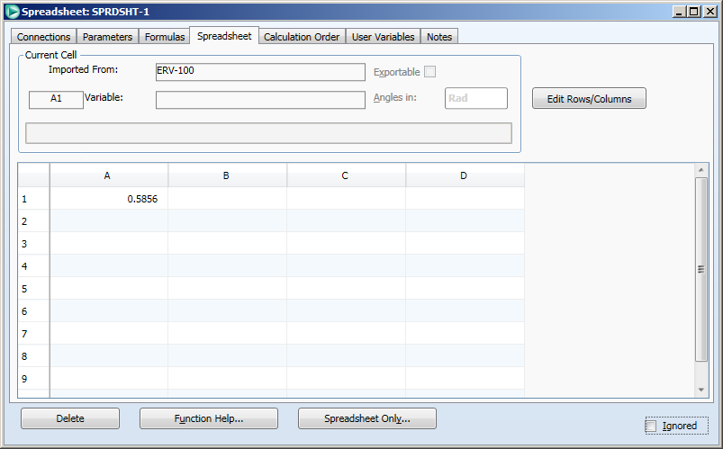
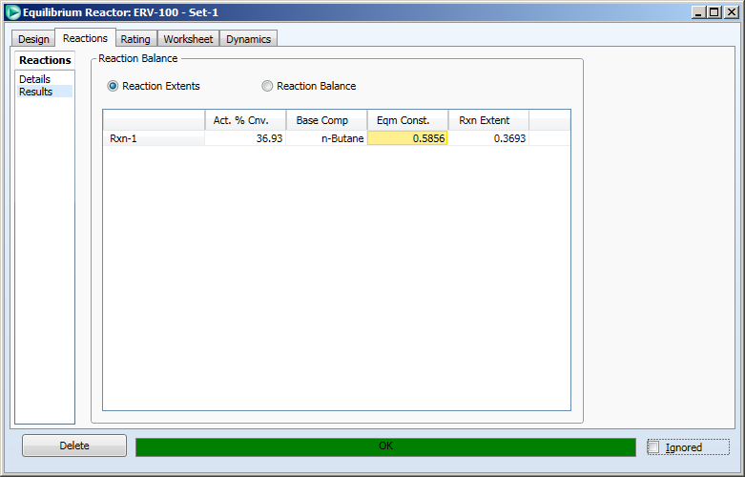
drag
1

Slide 23
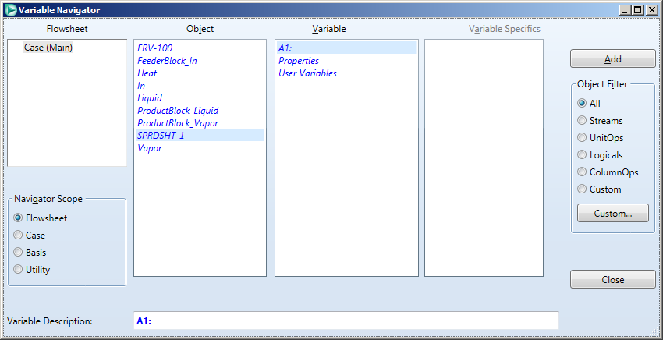
Go back to the case study page, and click “Add” to add another variable. The spreadsheet now appears in the list of objects, so highlight that and choose the cell you want: A1 (or wherever you dropped the equilibrium constant value from the reactor), click “Add”. Close the “Variable Navigator” page.

Slide 24

You should now have something like this. We are going to run the “case study” to study the effect of temperature on the equilibrium composition. We are interested in the 200 – 400ºC range, so enter 200 in “Low Bound”, 400 in “High Bound”, and let’s use a step size of 10ºC.

Slide 25
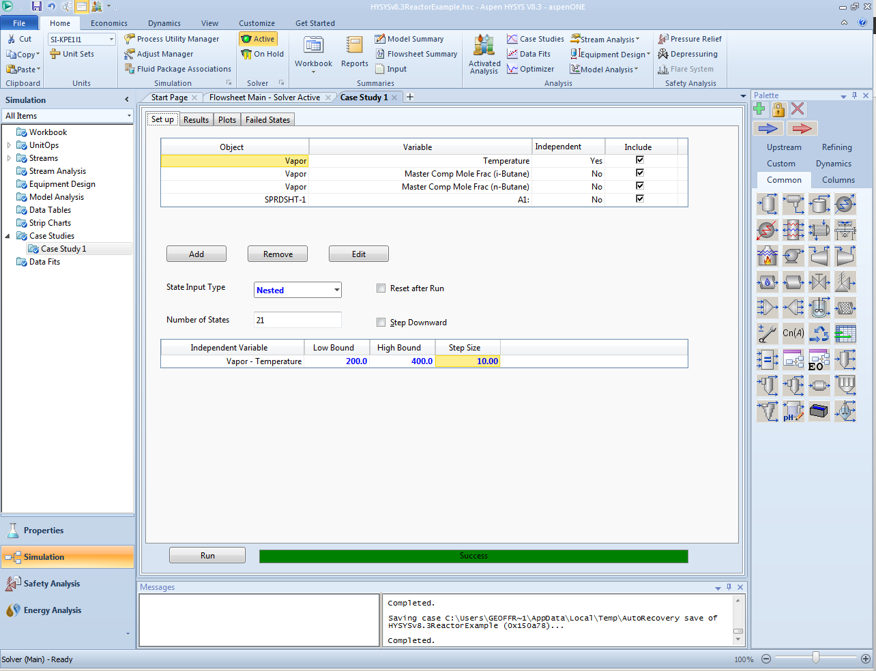
2
1

Slide 26
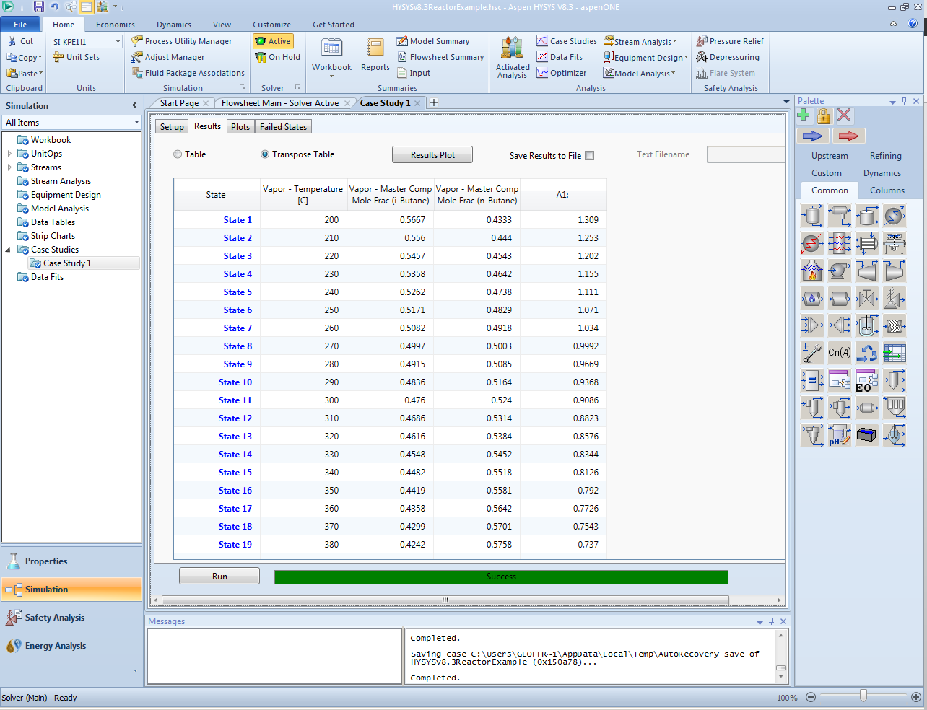
The transposed table is especially useful. Click/Drag to highlight/Copy just like Excel, then you can paste to Excel. Remember that the column labeled “A1” is the cell A1 in the spreadsheet and is the equilibrium constant.

