Slide 1
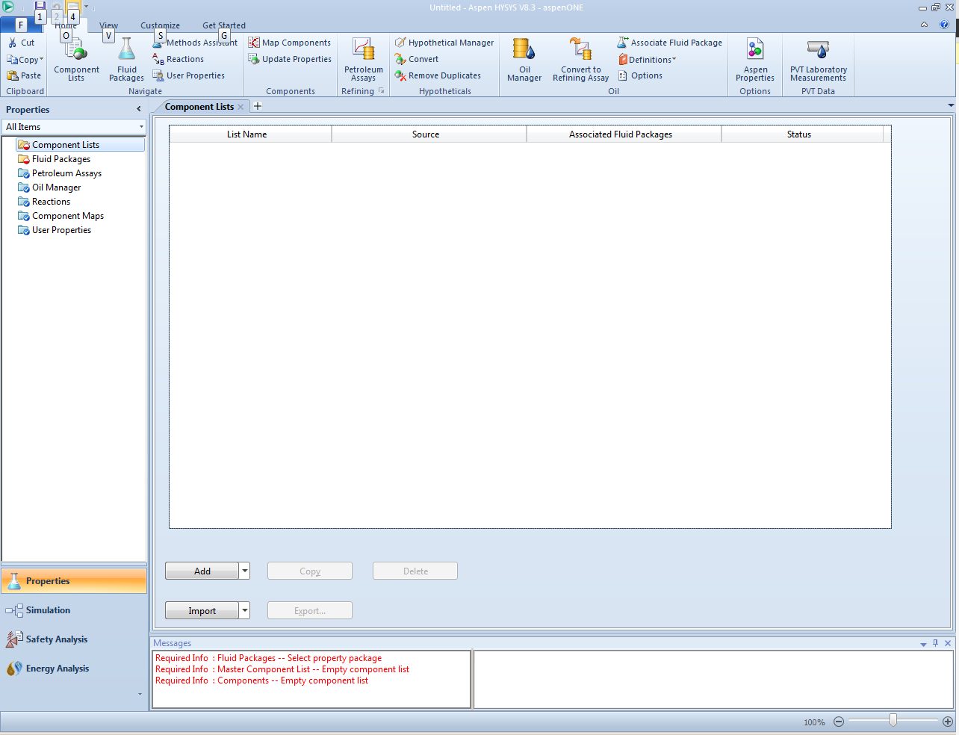

Slide 2
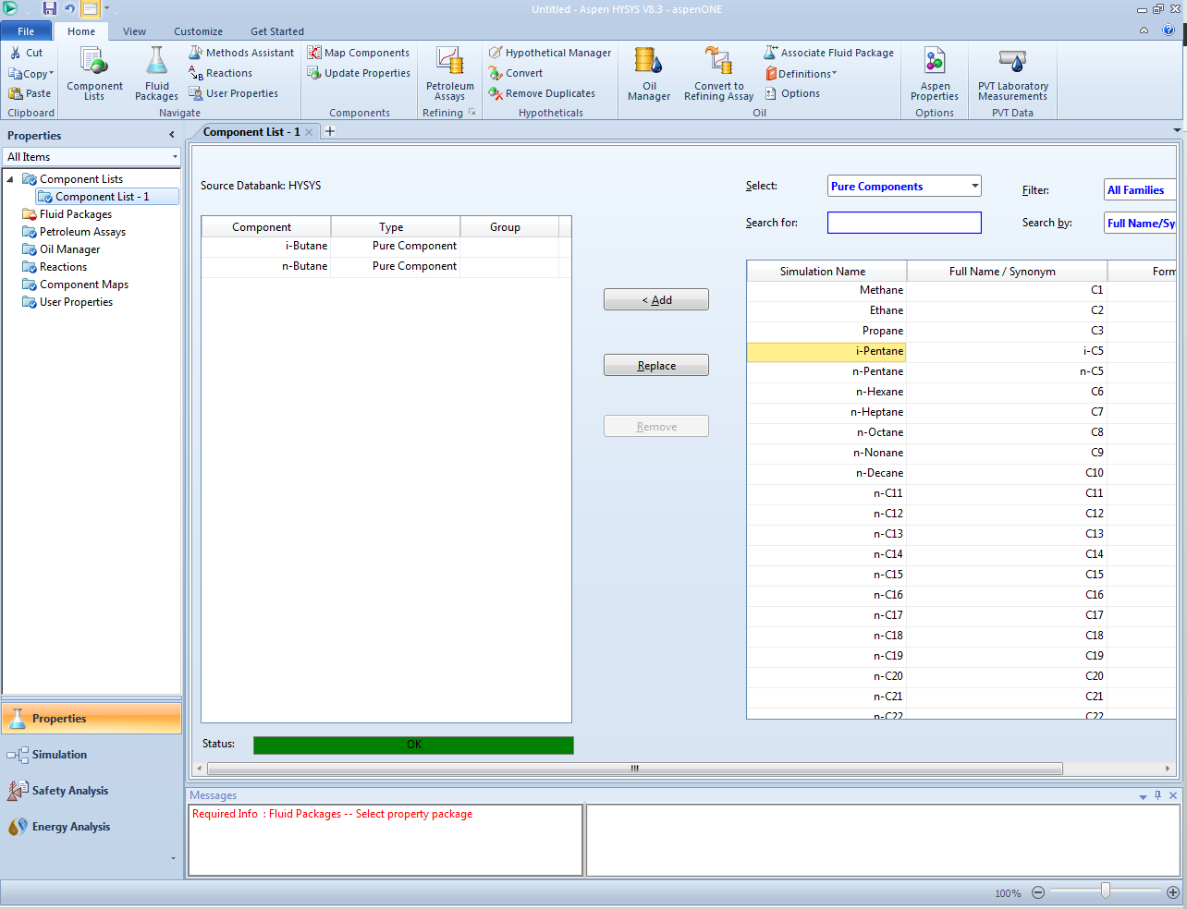
Second
First

Slide 3
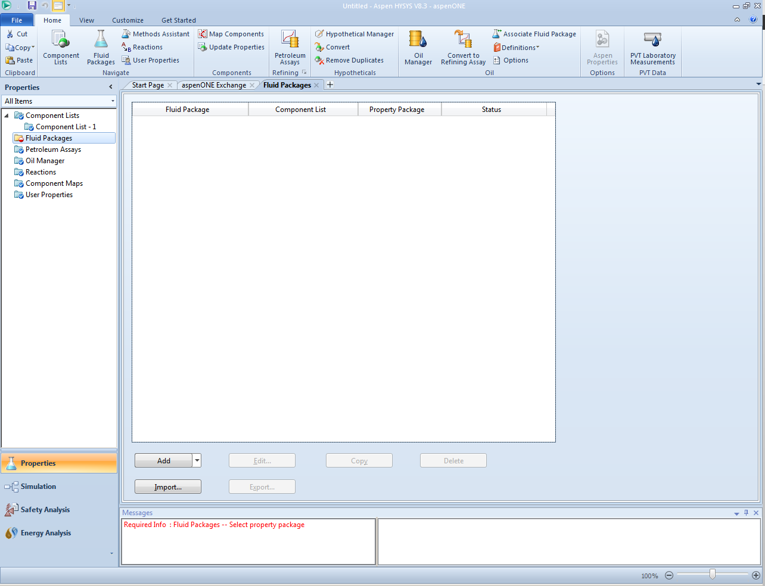
first

Slide 4
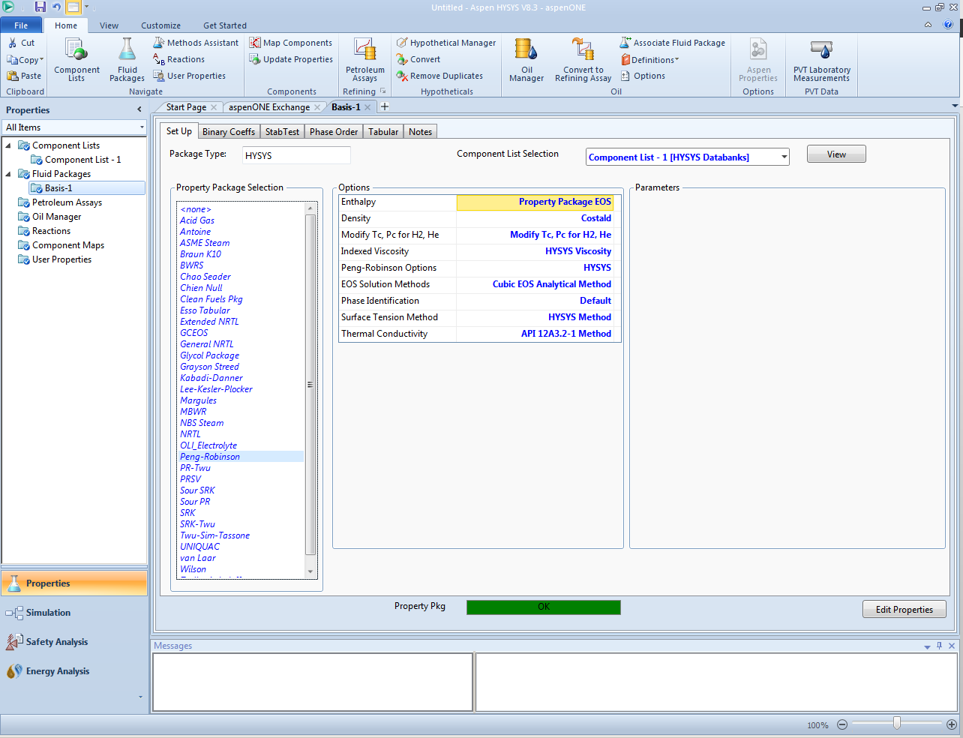
second
first

Slide 5
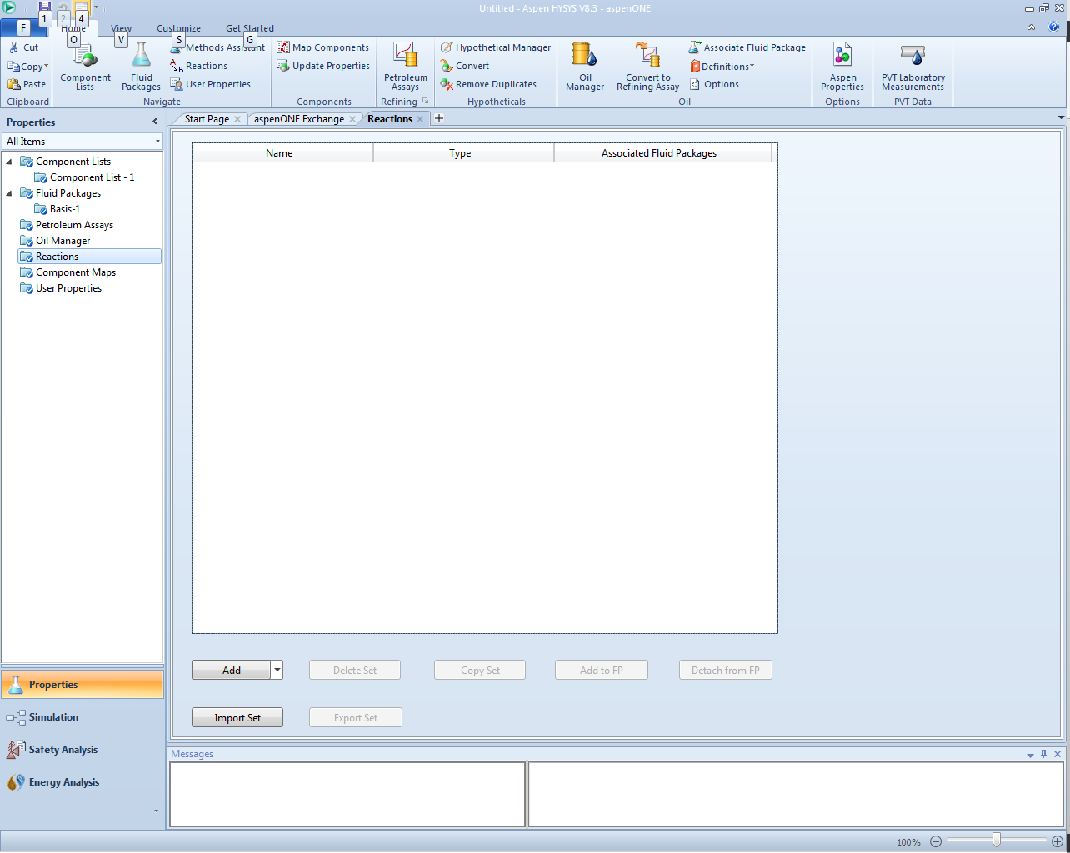

Slide 6
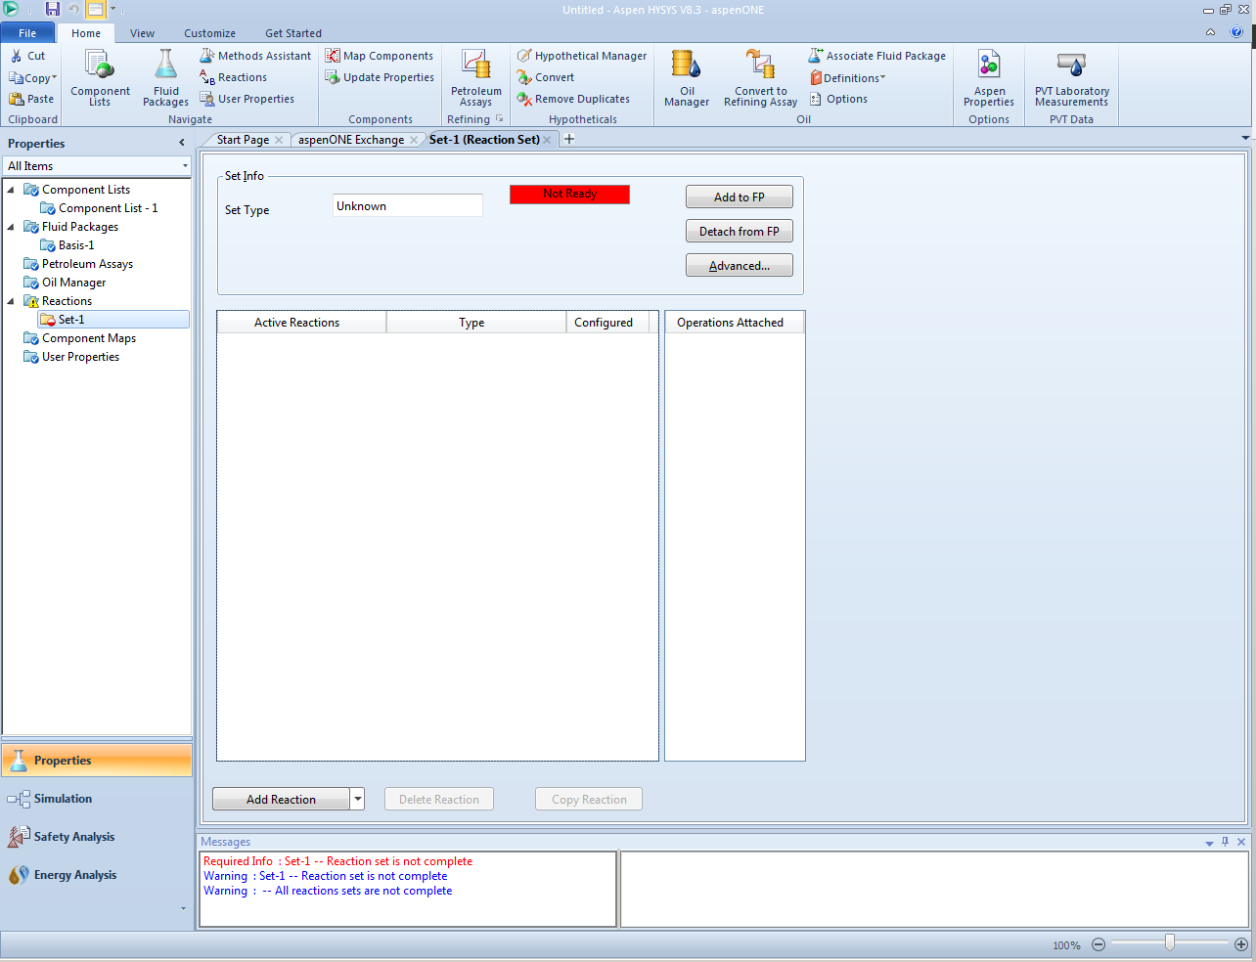
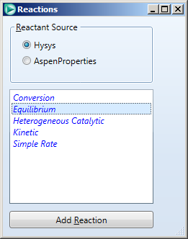
fourth
second
third
first

Slide 7
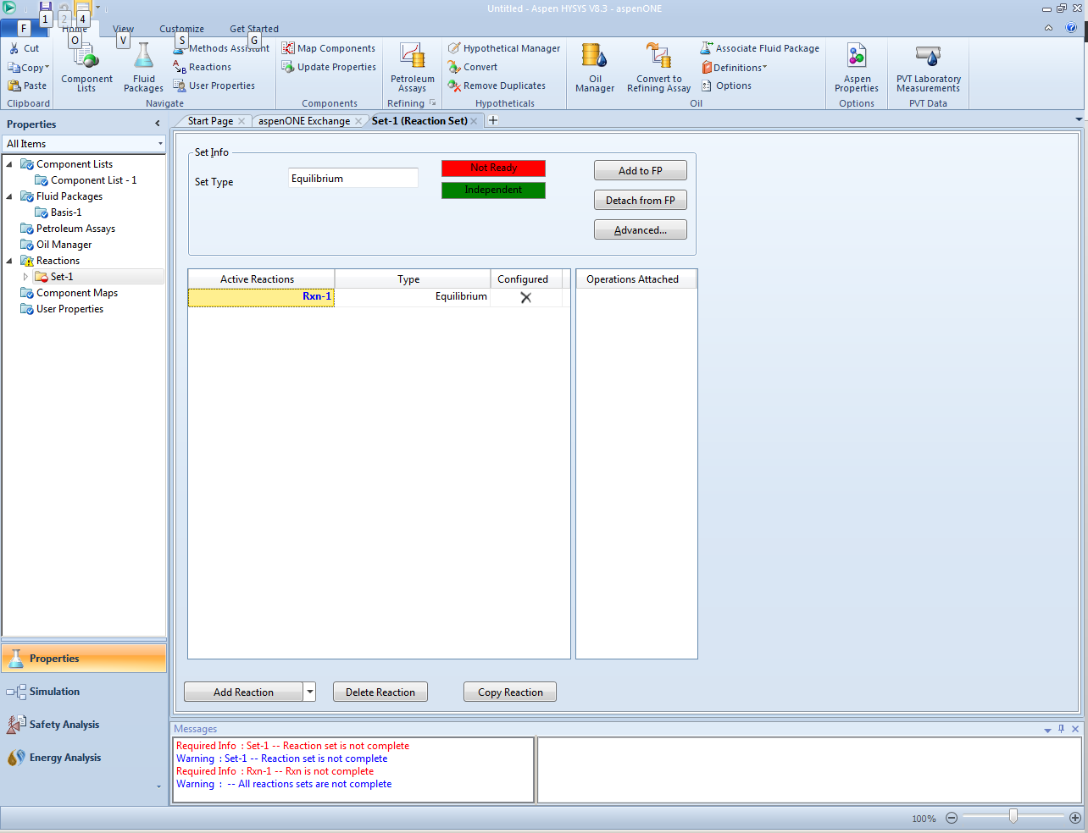
Double click

Slide 8
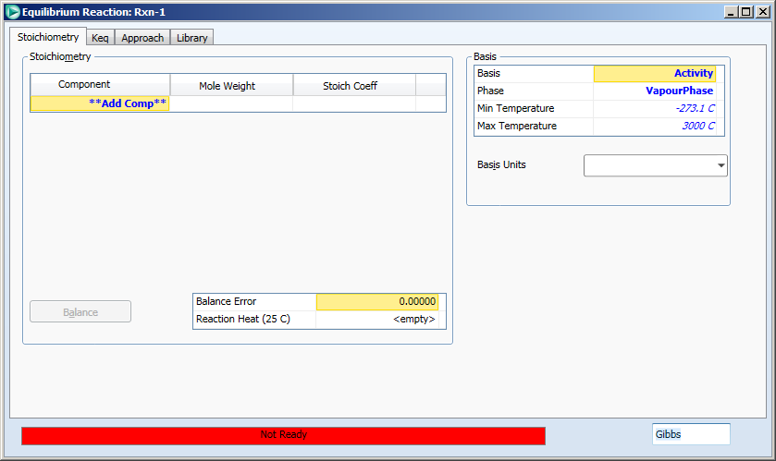

Slide 9
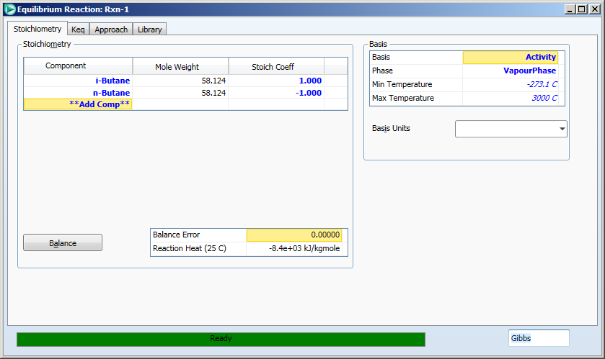
5
1
2
3
4

Slide 10
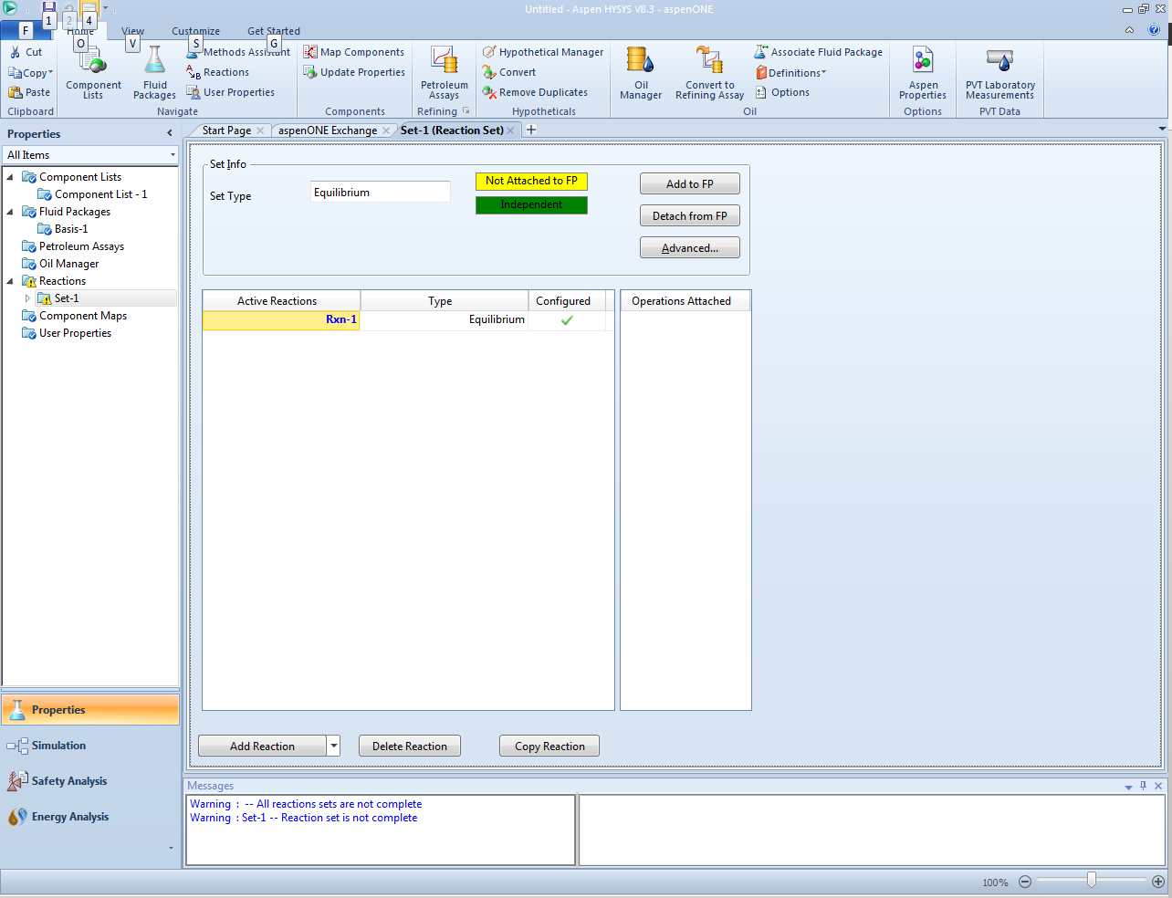

Slide 11
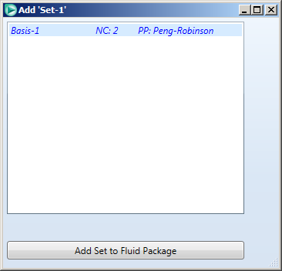

Slide 12
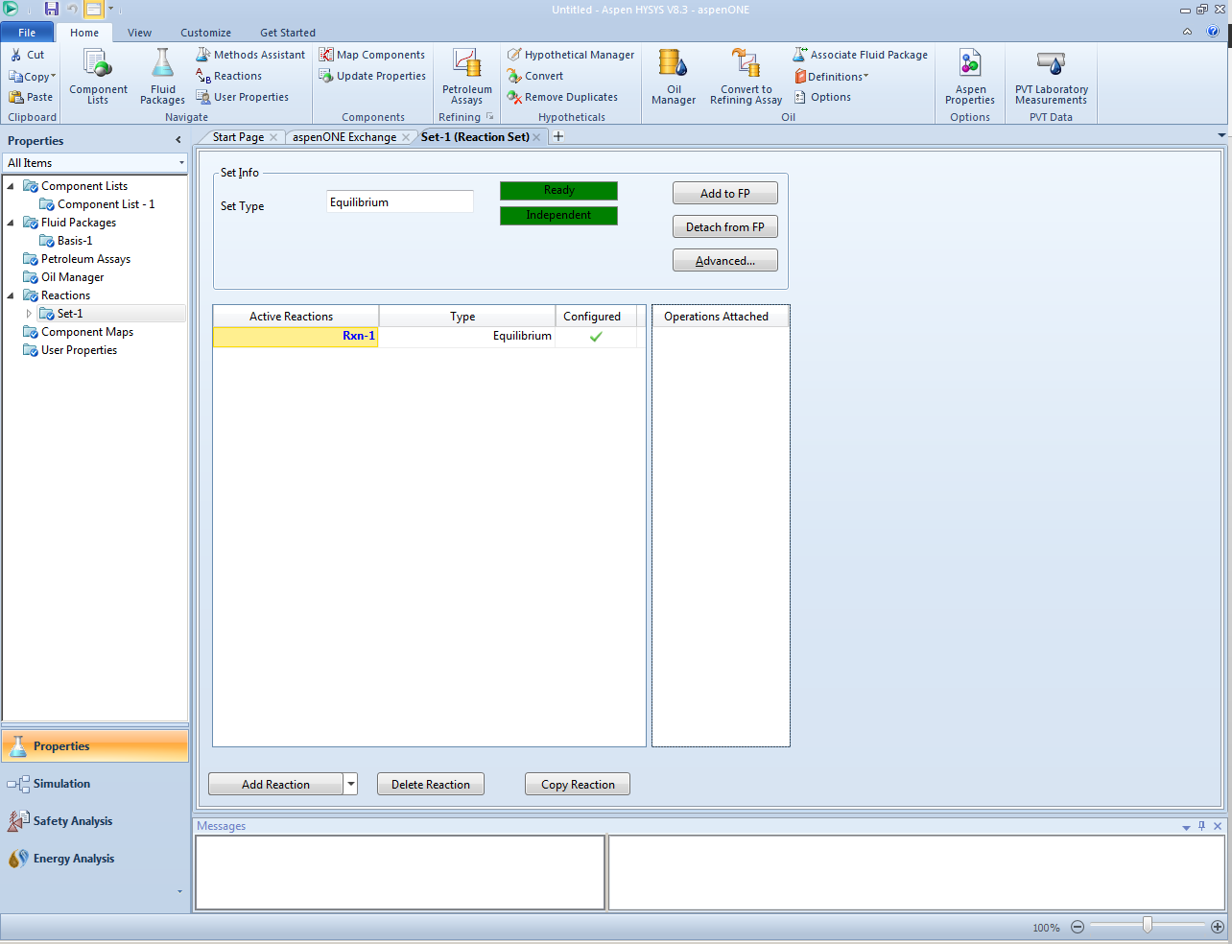

Slide 13
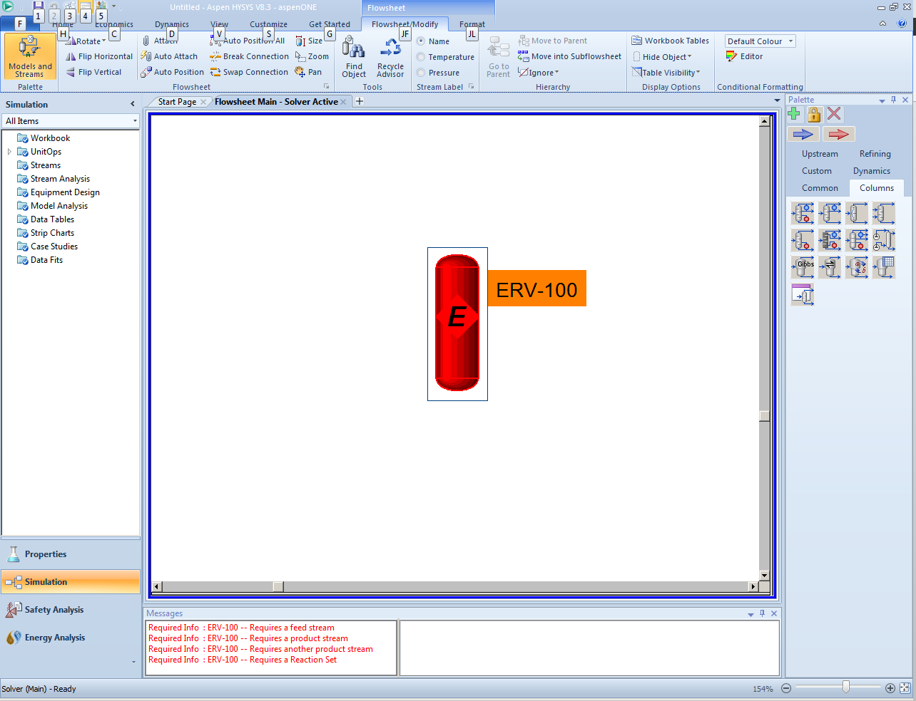
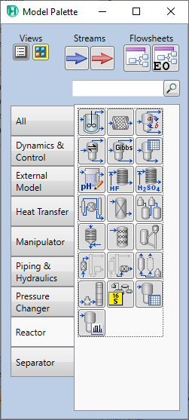
2 – choose “equilibrium reactor”
3 – place on simulation sheet
4 – double click
1

Slide 14
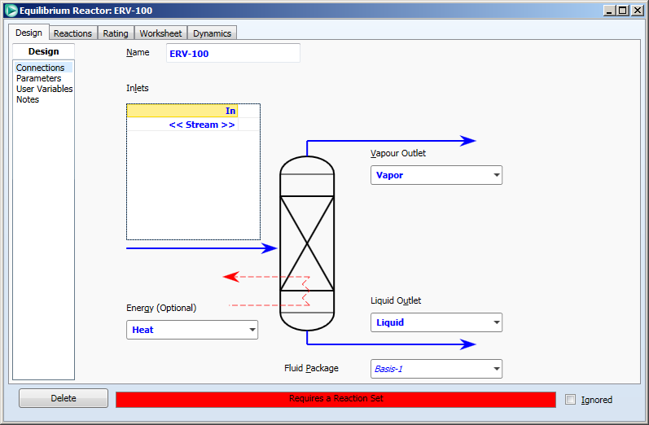
last
Name an inlet stream
Name a vapor stream
Name an energy stream
Name a liquid (stream

Slide 15
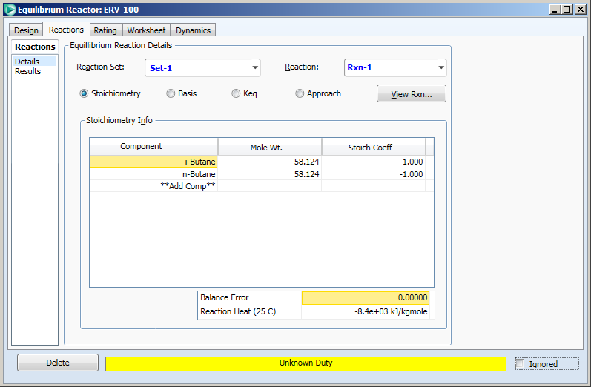
last
Designate the reaction(s) that takes place in the reactor

Slide 16
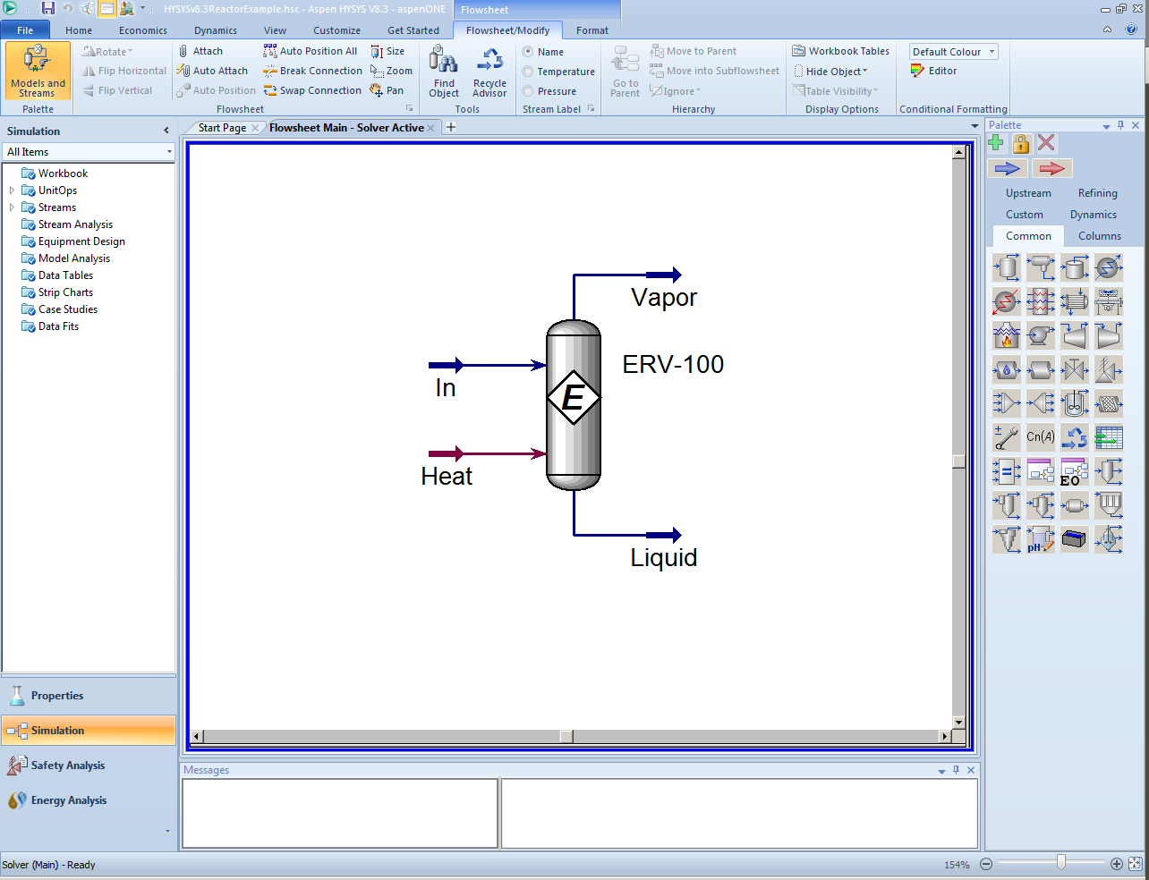
Set conditions on in/out streams: T, P, flow in (use some basis like 1 kgmole/hr), composition in. Set T and P out. HYSYS will compute the compositions for “Vapor”.

Slide 17
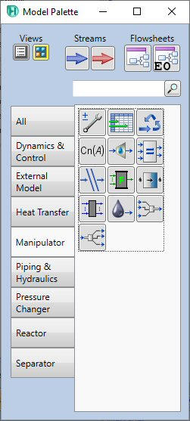
2 – choose “spreadsheet”
1

Slide 18
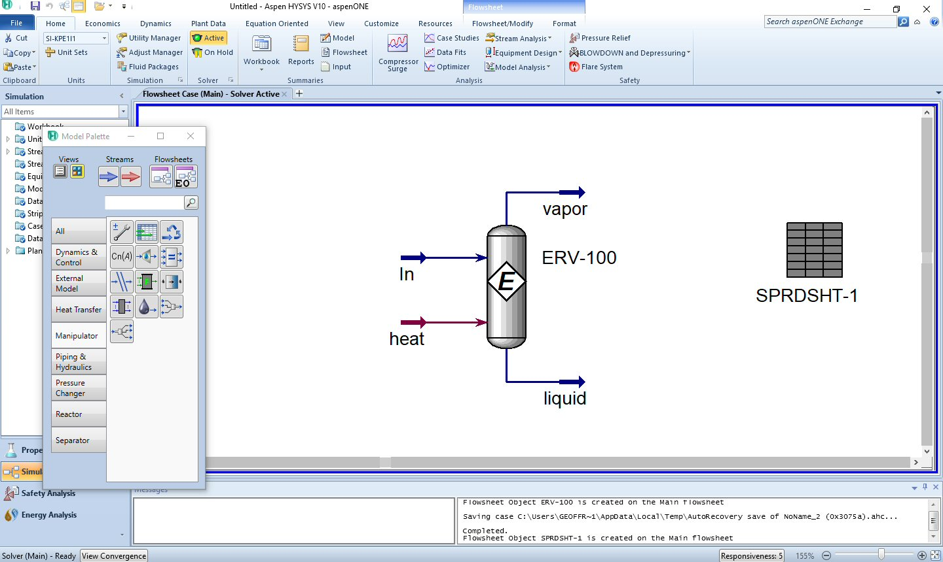

Slide 19
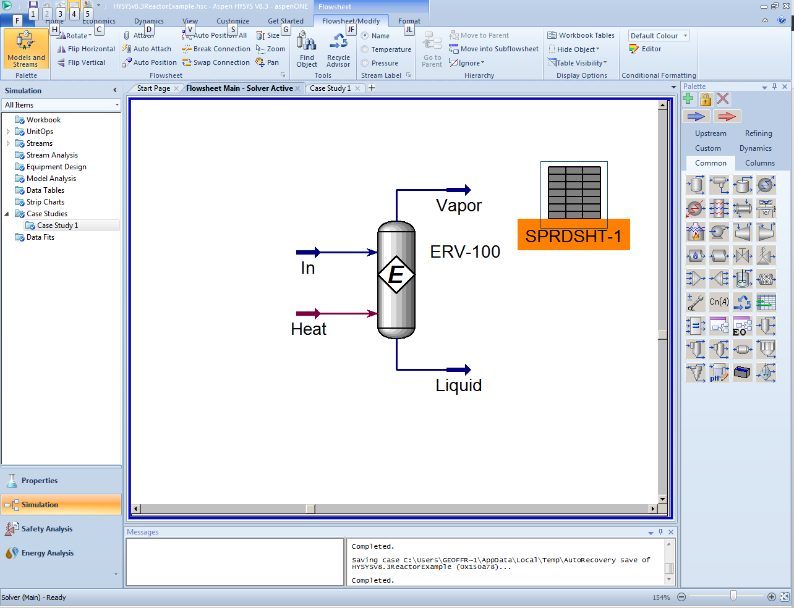
2 double click
1
3 double click
Click on the Spreadsheet icon and drop it on the Flowsheet. Next, double click on the spreadsheet to open it then on the reactor (ERV-100) to open it.

Slide 20
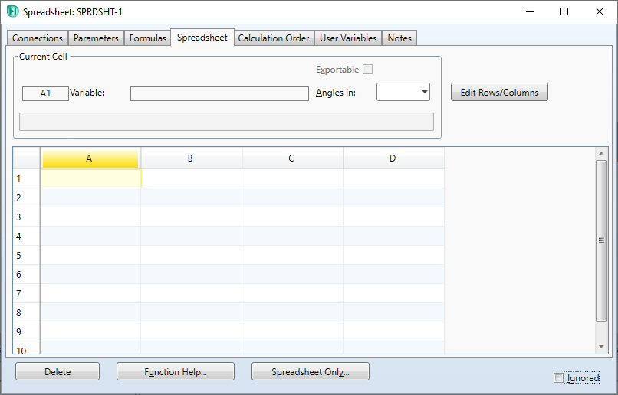

Slide 21
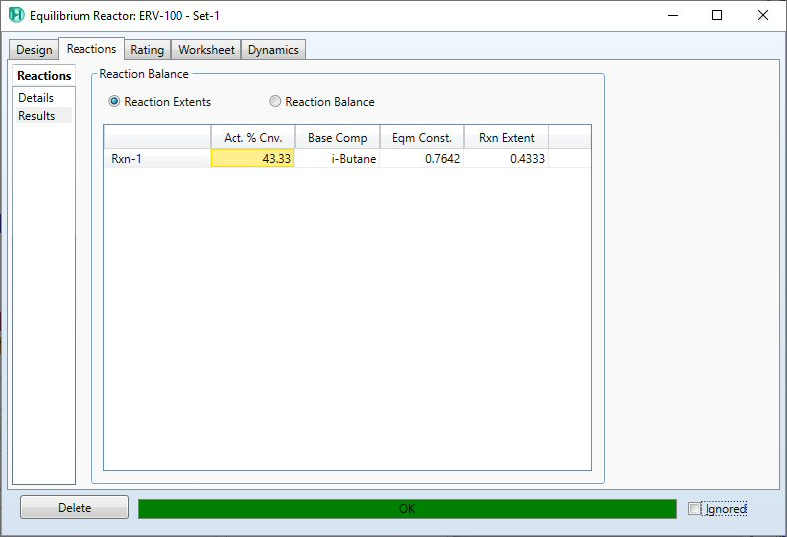

Slide 22
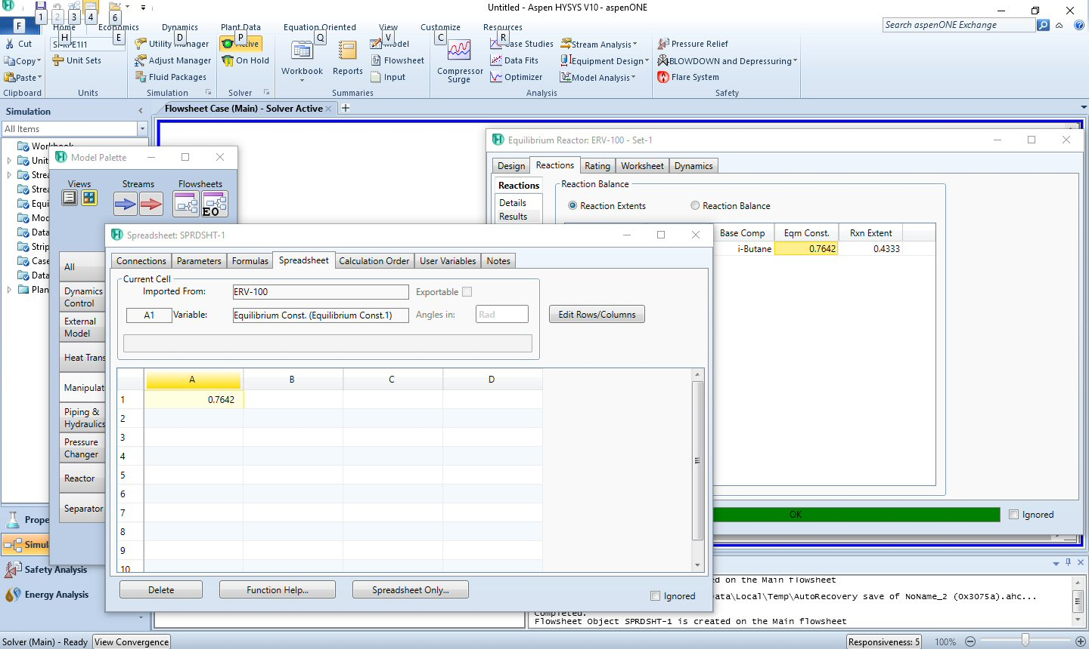
drag

Slide 23
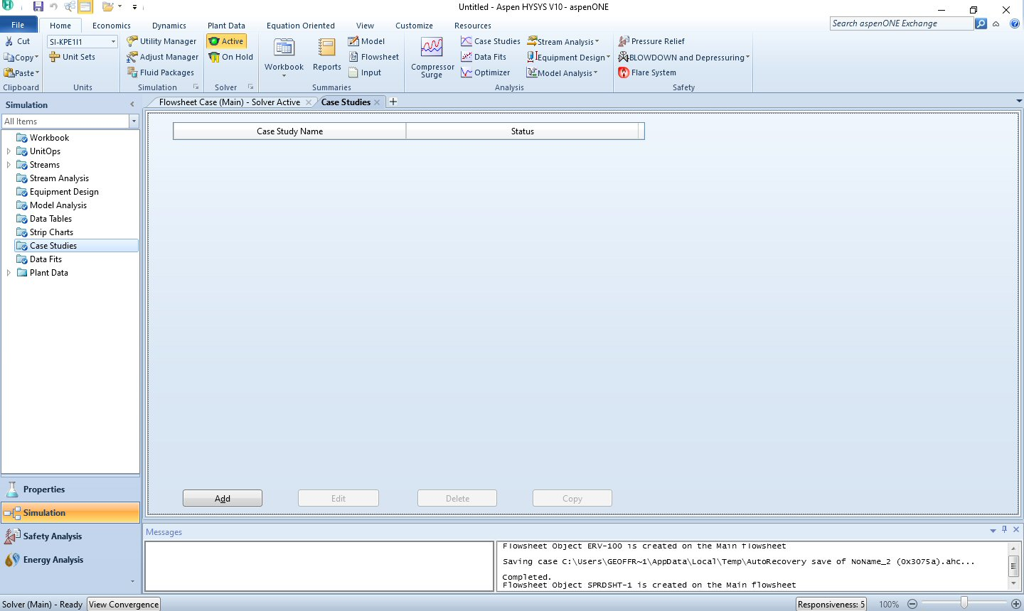
1
2

Slide 24
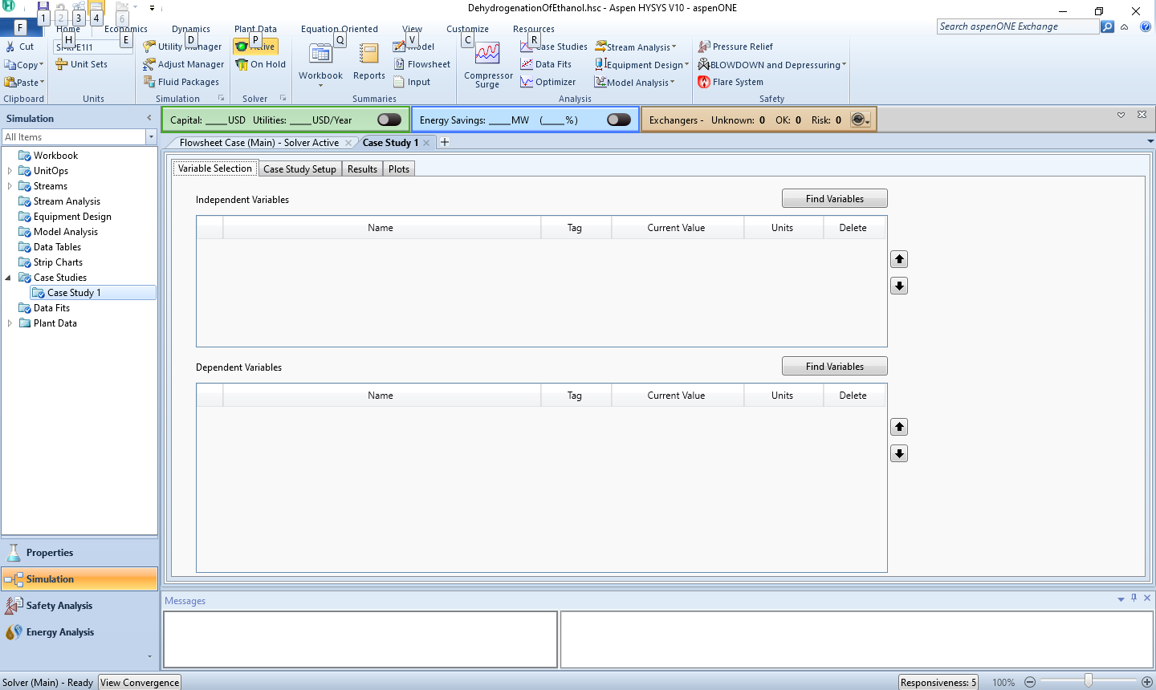
1
2
We are going to add variables to a case study. With a case study, we can have HYSYS change to variables and repeatedly do the calculations to see the effect of the variable on the process.

Slide 25
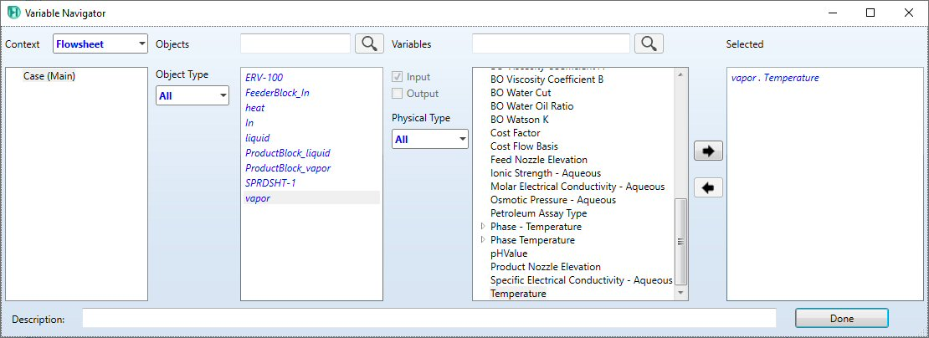
3
1
2
For the independent variable, click on “Vapor” then scroll down to “Temperature” then click add button.

Slide 26
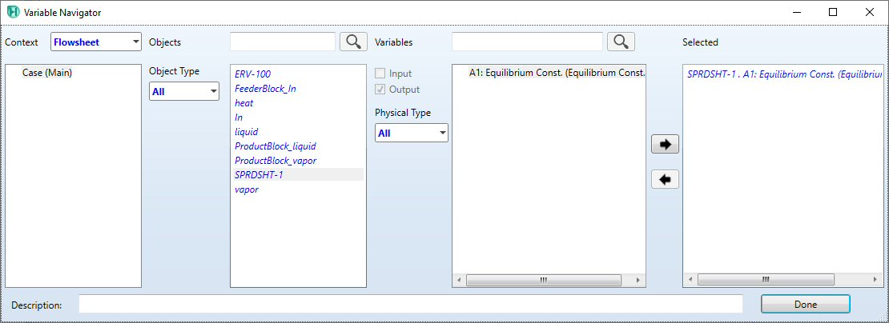
2
3
1
For the dependent variable, click on “SPRDSHT-1” then “A1” then add. Remember that the equilibrium constant is in cell A1 of the spreadsheet. You could also choose mole fractions of species you are interested in (think project 3) by choosing “vapor” (which is the outlet of the reactor) and finding “Master Comp Mole Frac”.

Slide 27
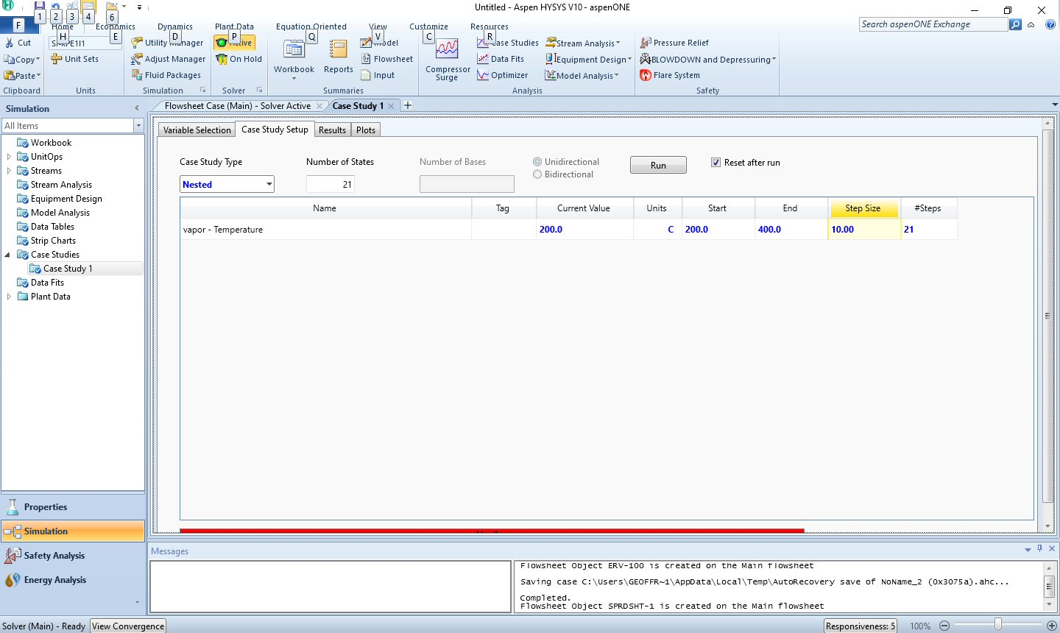
1
5
2
3
4
Now choose case study setup. Under “Start” choose the temperature you want the case study to start at – in this case 200 C. Then we want to end at 400 C, and we will choose an increment of 10 C. Finally, “Run”.

Slide 28
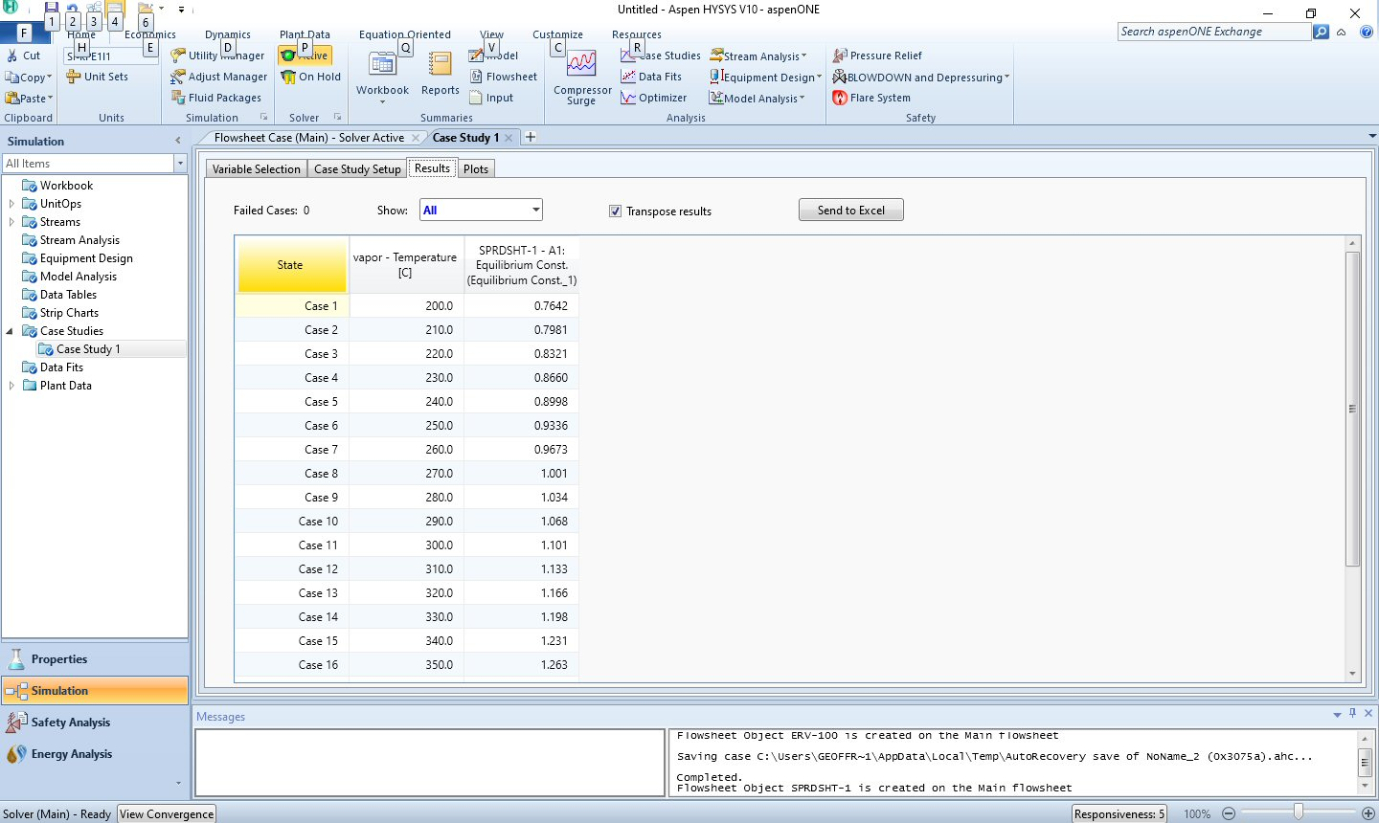
1
2
Choose “results”. The transposed table is especially useful.

