Slide 1
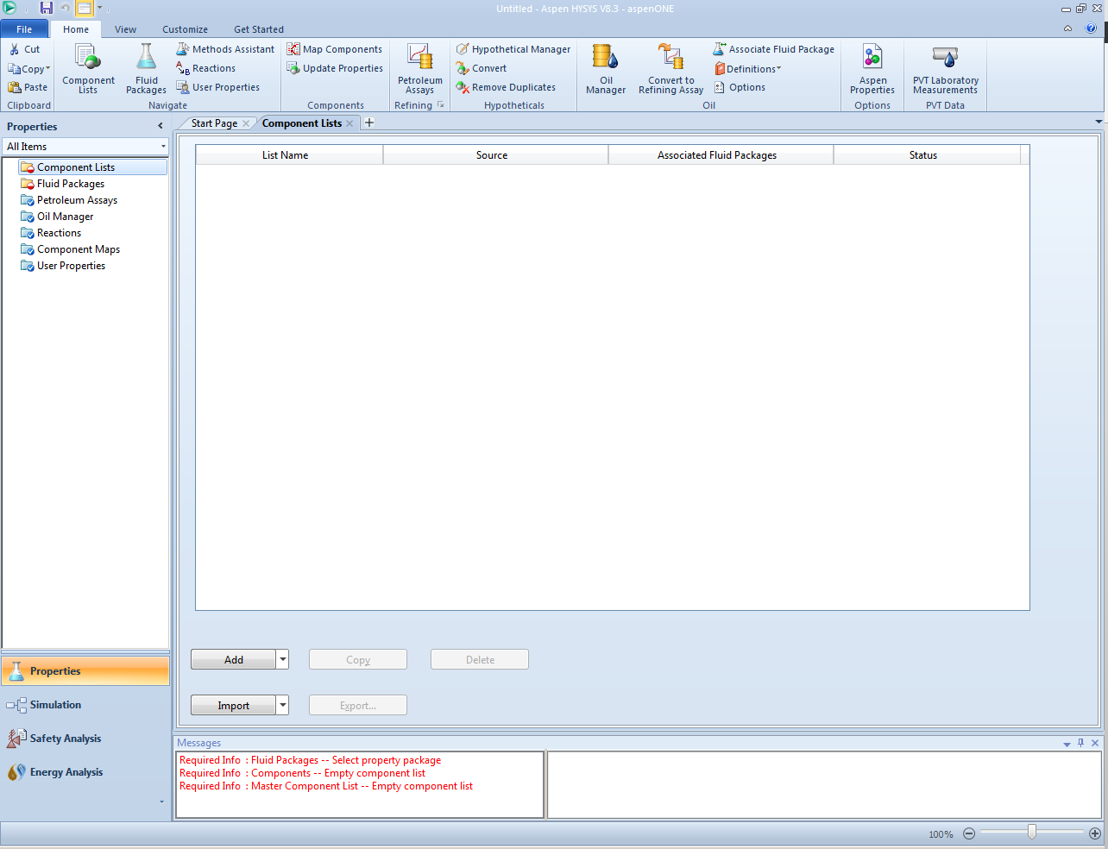

Start HYSYS then choose “File, New, Case”. On this screen which opens, which is called the “Basis Environment”, click on the “Components” tab on the left panel, then choose “Add”.

Slide 2
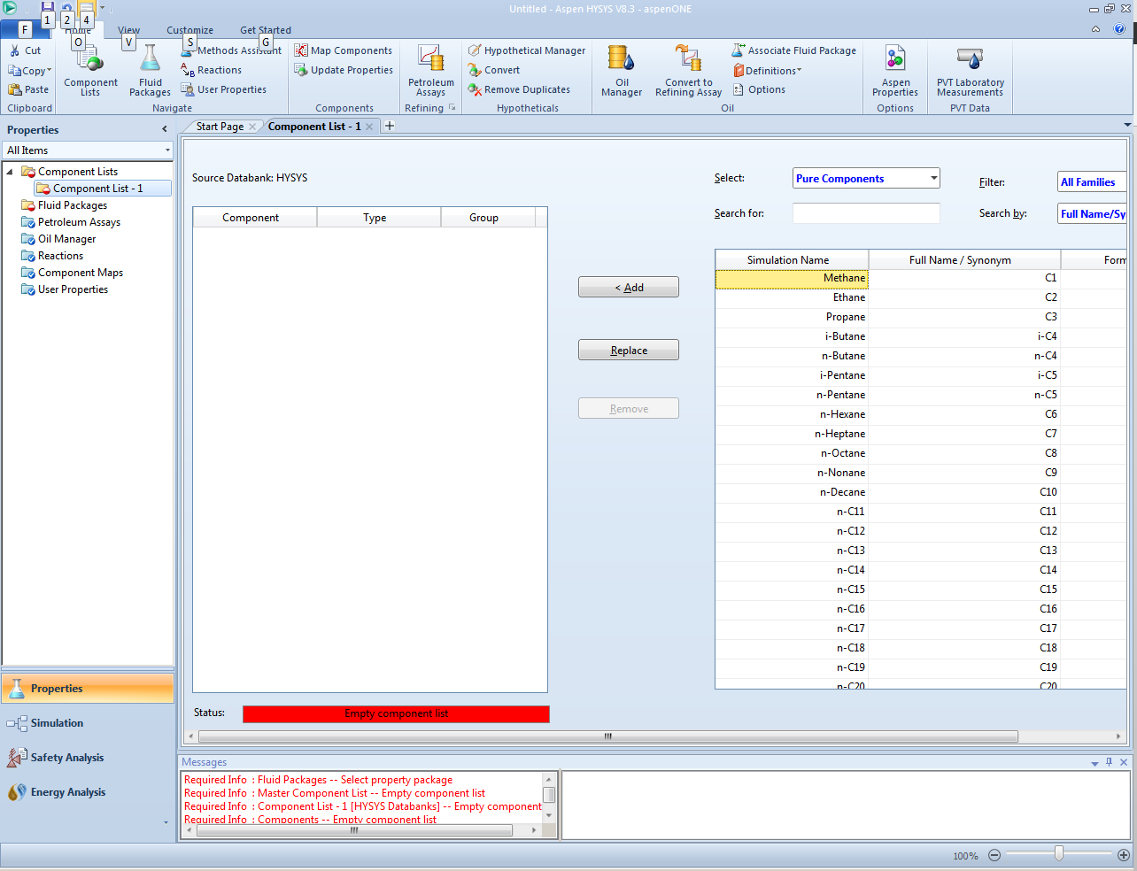
After selecting “Add”, the screen above opens where you can add components to the project. HYSYS has a wide range of build-in components, but you must specify which components you will be using. In this case, we are going to use the C₁ – C₅ paraffins, so we begin choosing them and using the “Add” button”.

Slide 3
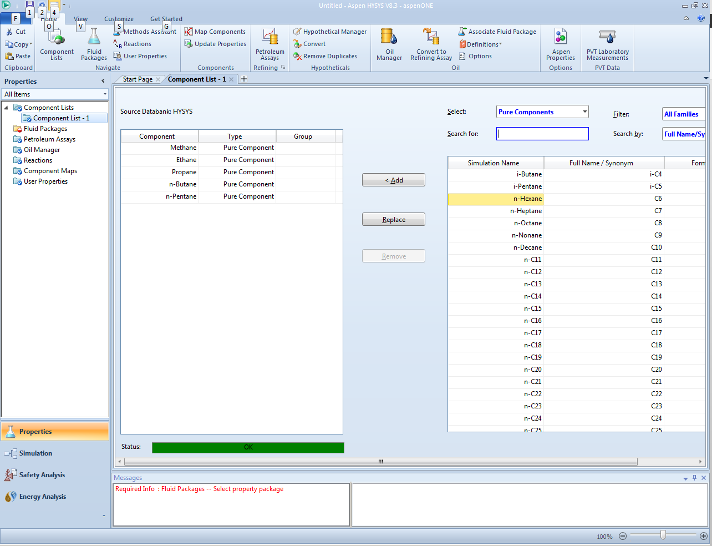
last
After highlighting the component you want, click the “Add Pure” button”. Repeat to add all the C₁ – C₅ normal paraffins. You can use the default name “Component List-1”. If you make a mistake, use the “Delete” button to remove the component. When you are done, go to the “Fluid Packages” link in the left panel.

Slide 4
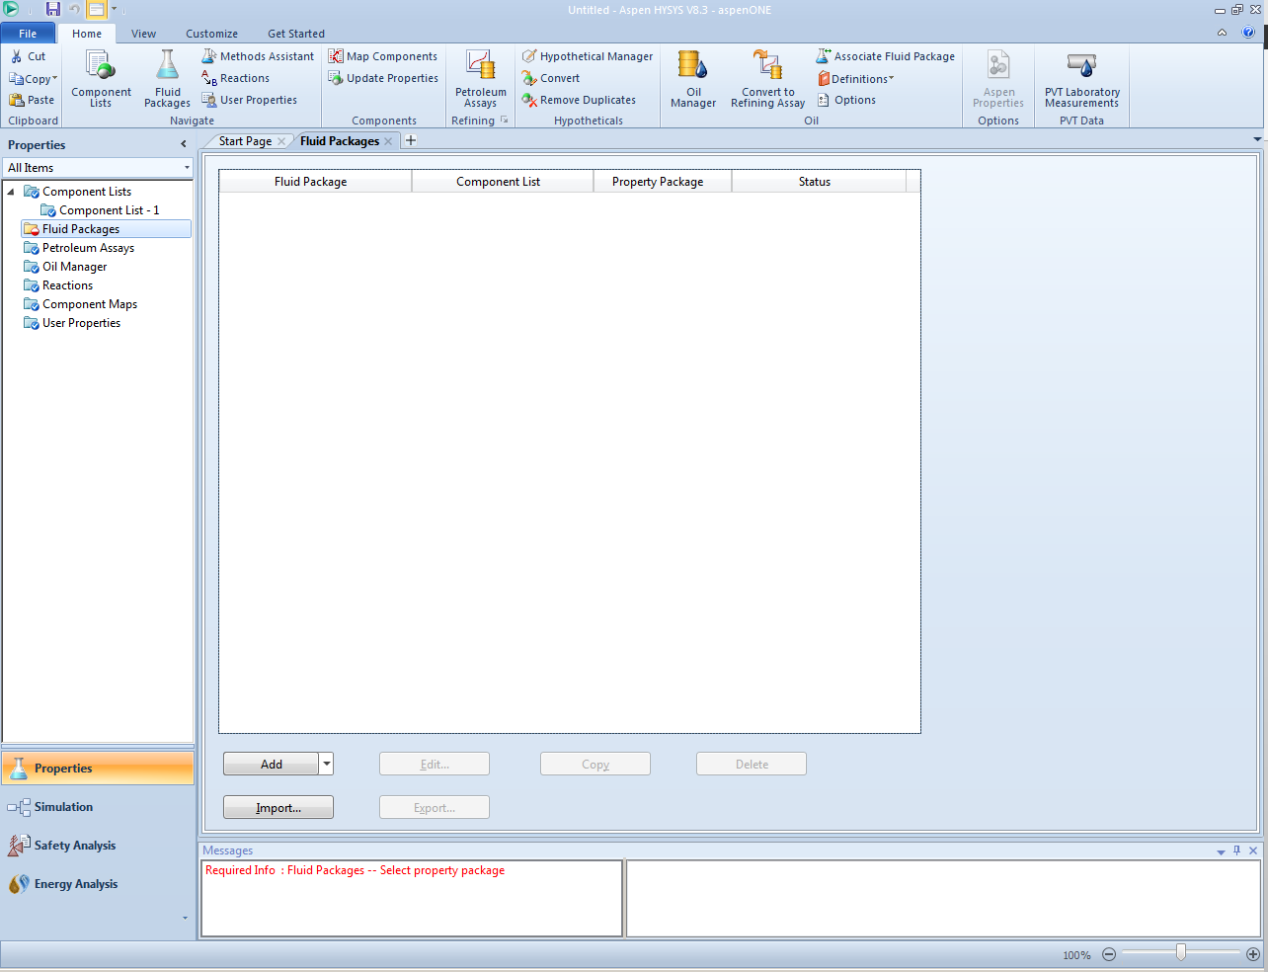
On the “Fluid Packages” page, click “Add”. You use “Fluid Packages” to specify the thermodynamics modelling module to be used.

Slide 5
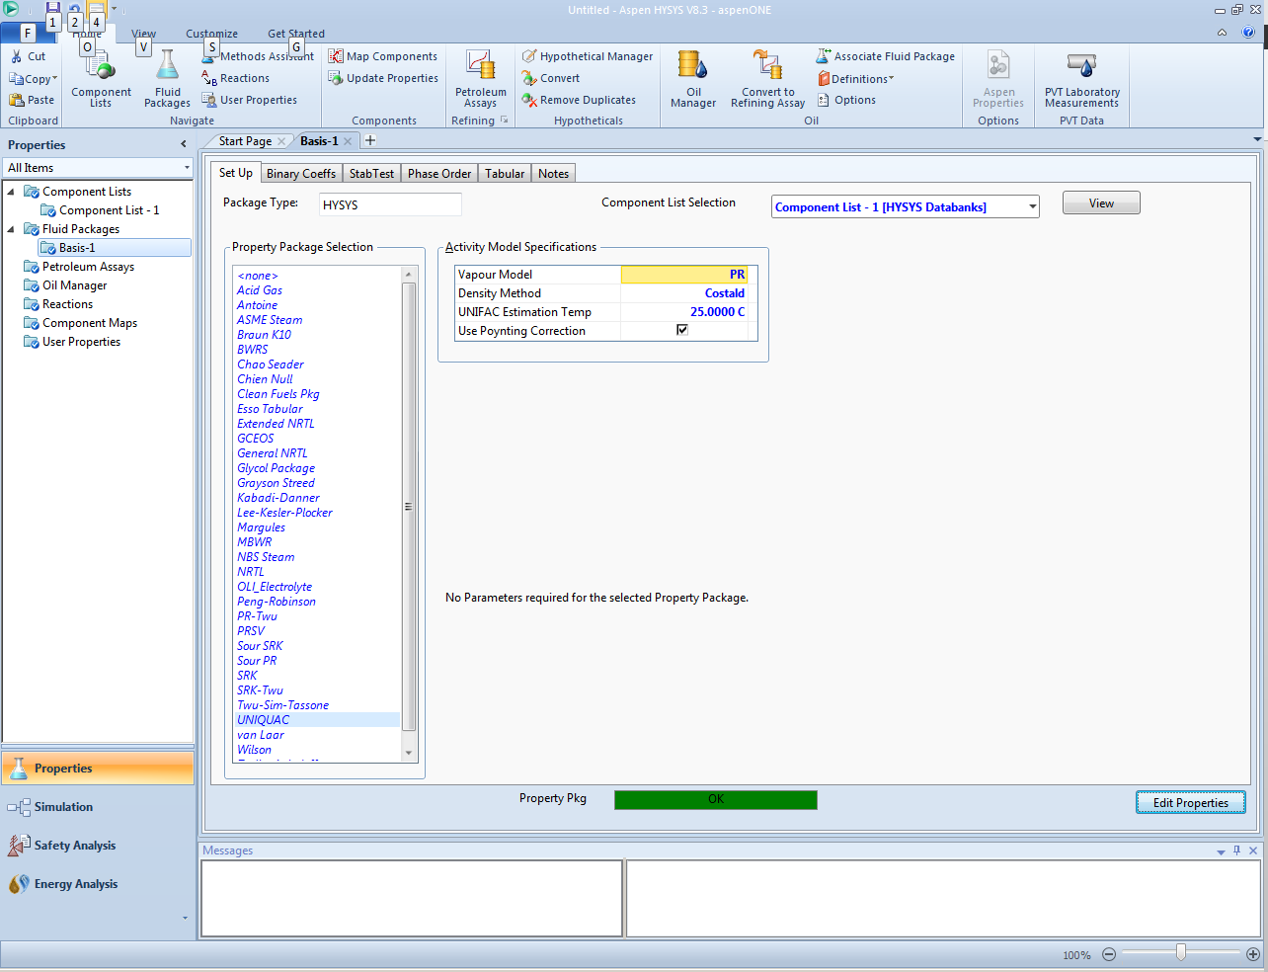
window
first
In the “Fluid Package: Basis -1” window (above), look down the “Property Package Selection” window toward the left and choose “UNIQUAC”. You can choose other models, but choose wisely, not indiscriminately. Note that a small window opens to the right. This window has some of the main assumptions to be used in the calculation. Since UNIQUAC primarily simulates the liquid phase, one of the options is the Vapour Model to be used, which is ideal gas by default. Switch that to “PR”.

Slide 6

window
last
The “Density Method, by default, is Costald. What does your textbook recommend for liquid densities? S&VN cover the Rackett equation. If you use the dropdown menu on Density Method, you will find “Rackett” so let’s use that. When you are done, click on the “Simulation” link in the lower left sidebar. You may get some warnings, but just take OK and move on.

Slide 7
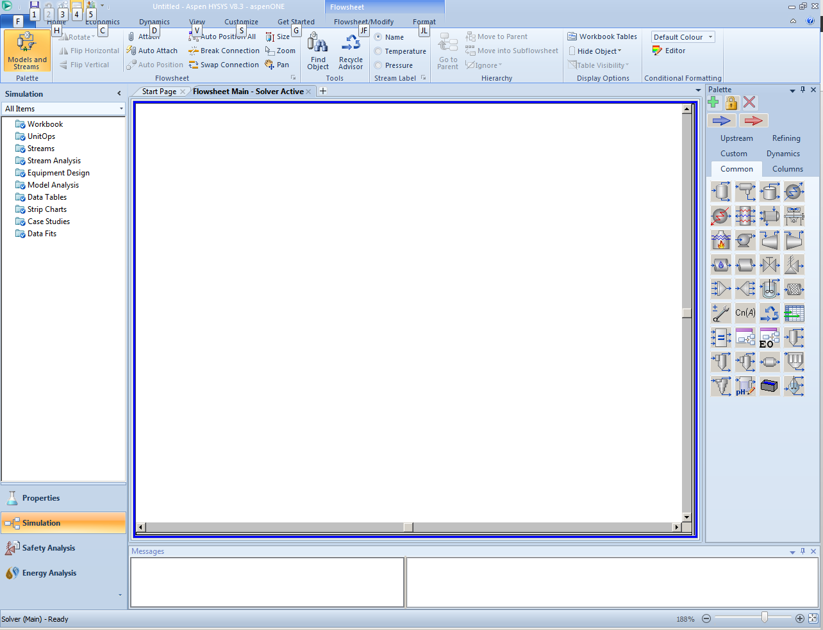
This is the simulation environment where the process is built. The first time you start HYSYS, the palette of items that I have docked to the right may be floating. You can dock them if you wish, or leave them. Now, on the palette, rollover the blue arrow near the upper left corner. It should popup the message “material stream”. One click on the arrow will grab it, then you rollover to the blank main page and drop with another click.

Slide 8
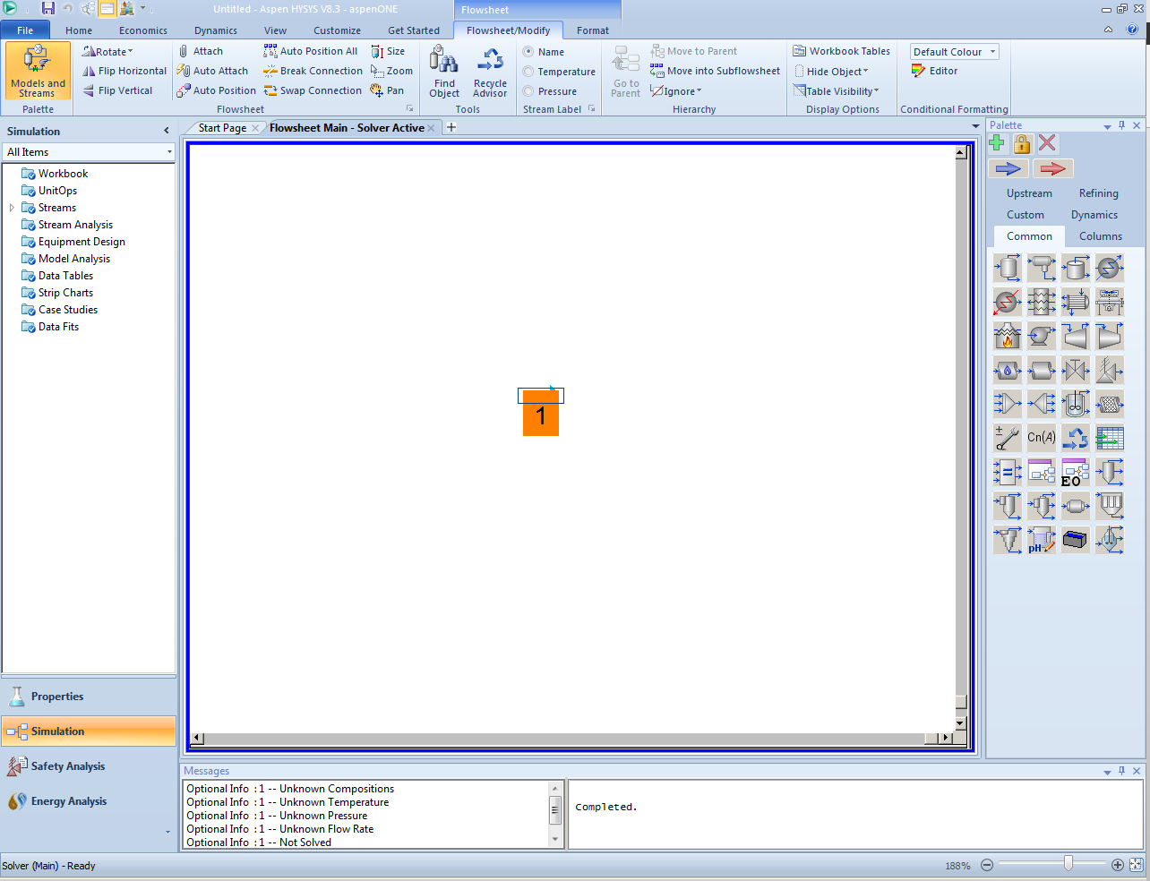
The arrow is labeled “1” by default and is a flow stream. In many instances, HYSYS will calculate properties of streams, but we also have the ability to specify properties. Always be cognizant of the fact that the phase rule limits the number of properties you can specify. In this case, we are beginning with an inlet stream to the PFD, and we want to tell HYSYS what the properties are. To do this, begin by double-clicking on the stream (the arrow). A new window will open.

Slide 9
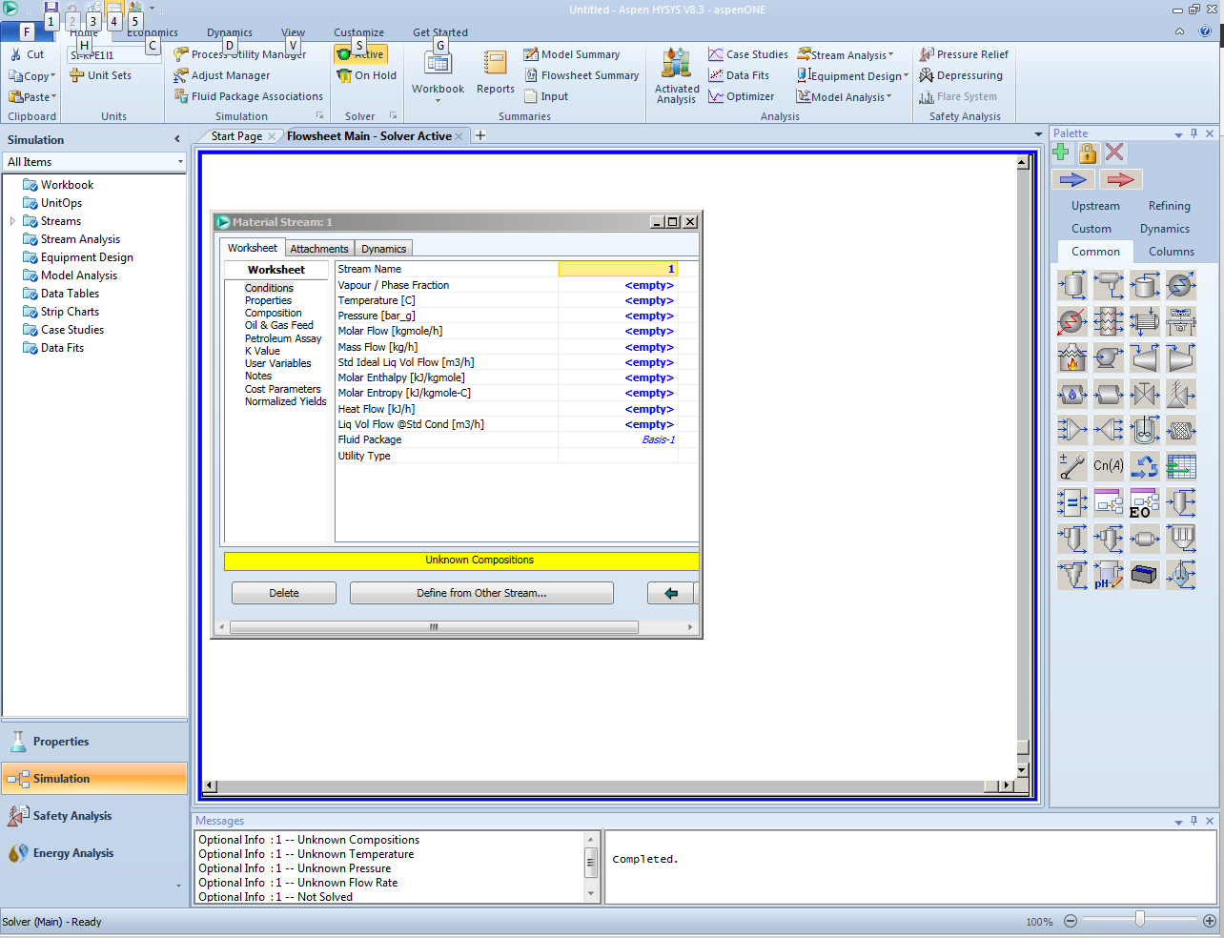
We are going to specify the composition of this feedstream. With a specified composition, if the mixture is a single phase, we can also choose T and P to completely specify the thermodynamic properties. If it forms two phases, we can only specify T or P, not both. We will see how HYSYS handles this shortly. Click on “Composition” in the left window first.

Slide 10
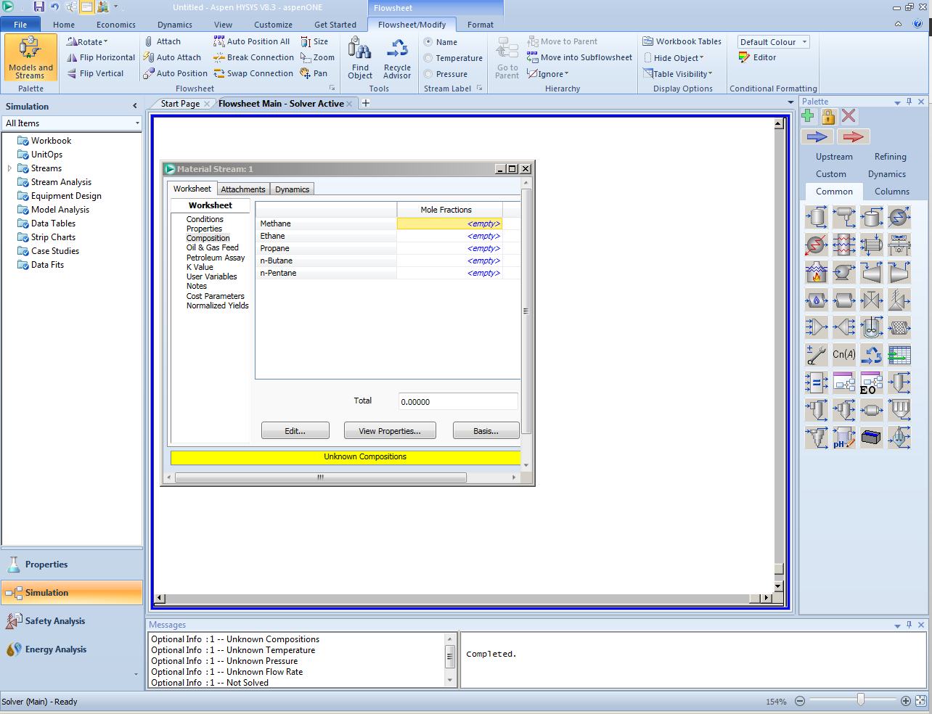
We can enter the composition of the stream many ways. HYSYS allows weight or mole fraction and other systems. Note that all the components you specified in the basis environment are in the table to the right. Below the table, find the “Edit” button and click on it to open a new window.

Slide 11
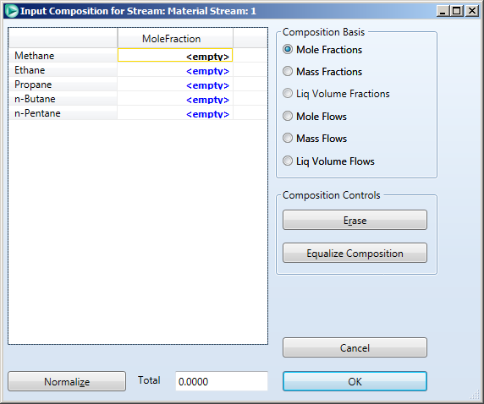
In this screen, we can choose the composition basis, but we want to stick with mole fractions. Highlight the methane mole fraction, and type “1” and press <enter>. The highlight moves to the Ethane row, then type “2”, followed on the next row by “3”, then “4” then “5”. You have specified 1 part methane, 2 parts ethane, 3 parts propane, etc. Next, click on “Normalize” to make these relative amounts into mole fractions. The screen then updates.

Slide 12
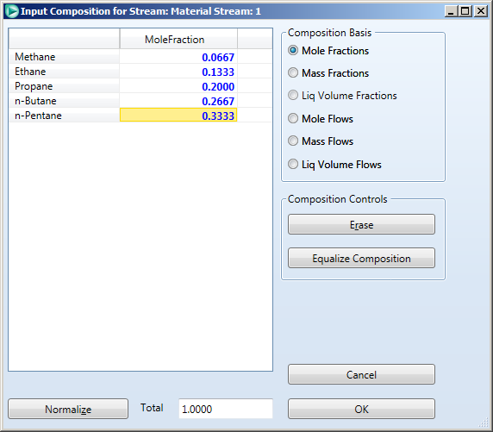
Your composition should look as given above. The “normalize” button makes the mole fractions add to 1 and saves you the trouble. Now click OK, and this screen for inputting composition will close.

Slide 13
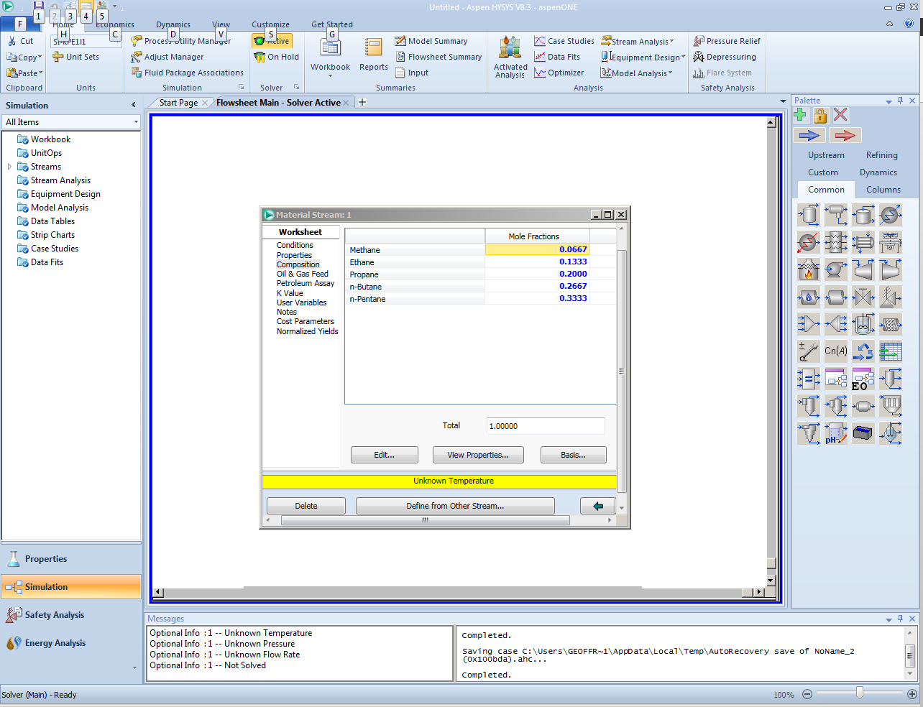
Notice now that the message in yellow is “Unknown Temperature”. HYSYS will keep informing you where it doesn’t have enough information. Click on the “Conditions” link over on the left-hand side of the worksheet, and we will see how to specify conditions.

Slide 14
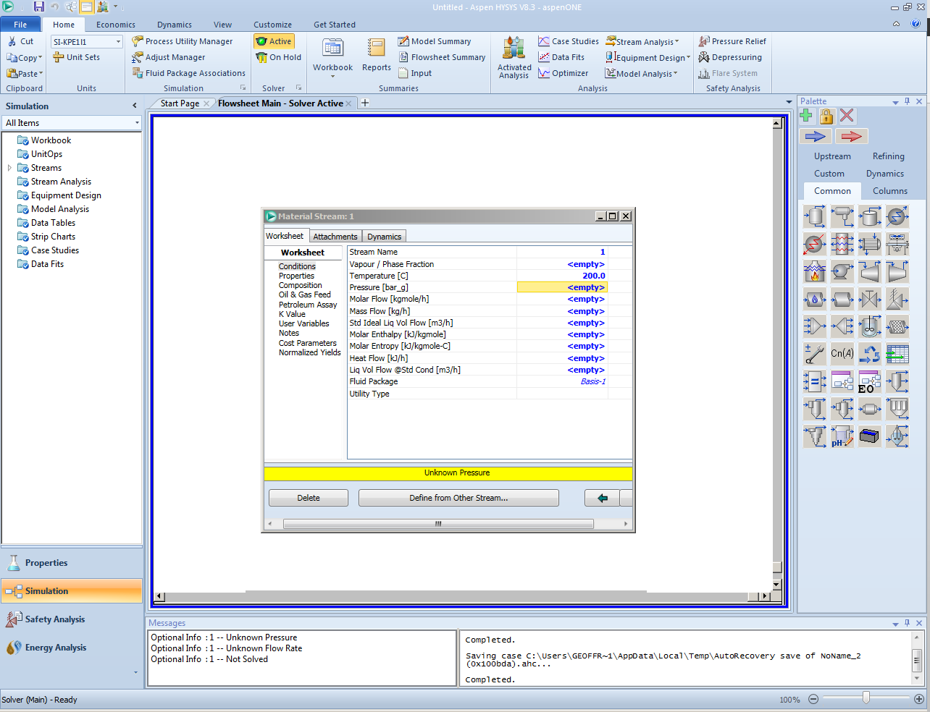
Highlight the box to the right of “Temperature (C)” and enter “50”. Note that as you type, a box to the left opens and displays the units “C”. When you press <enter>, you accept these default units. Alternatively, you could click on the dropdown arrow, and choose new units, but let’s practice that process with pressure rather than temperature, so just accept the default units.

Slide 15
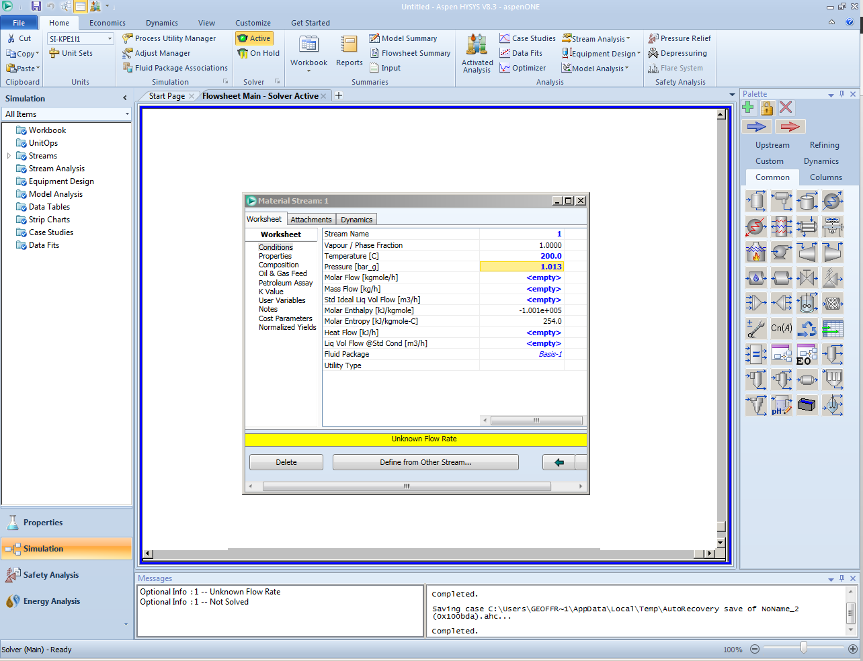
Note that the message now says “Unknown Pressure”. Highlight the input box for pressure, type “2”, then click on the pressure unit dropdown menu and choose “atm”. When you press <enter>, the pressure (2 atm) is converted to 1.013 bar_g and that will appear in the pressure box. Alternately, you could have entered “1.013” and taken the default units. The yellow message bar should now say “Unknown Flowrate”. Enter “1” in the “Molar Flow (kgmole/hr)” input box. Note that “bar_g” is “bars gauge”.

Slide 16
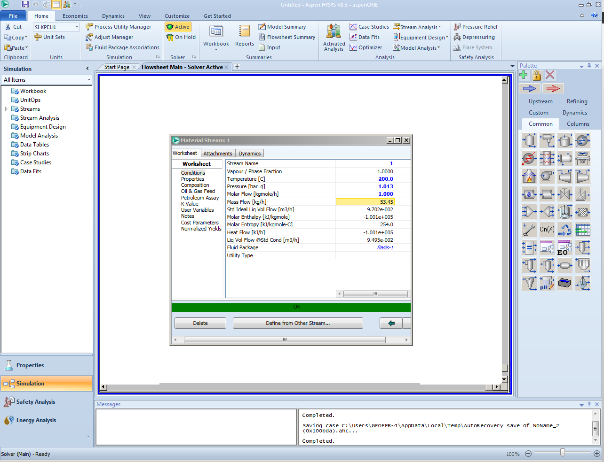
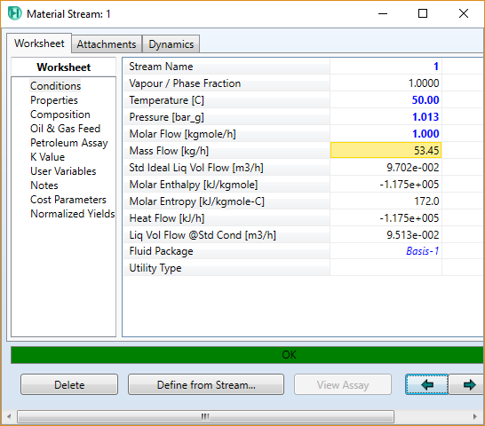
Once you have entered T, P, and a flowrate, the message bar should change to green and say “OK”. HYSYS computes all the remaining conditions. Note that the conditions you specified are in blue, those HYSYS computed are in black. Note especially the box “Vapour/Phase Fraction” which is computed to be 1.0000. This means the stream is all vapor, and in this case, the stream is actually superheated.

Slide 17
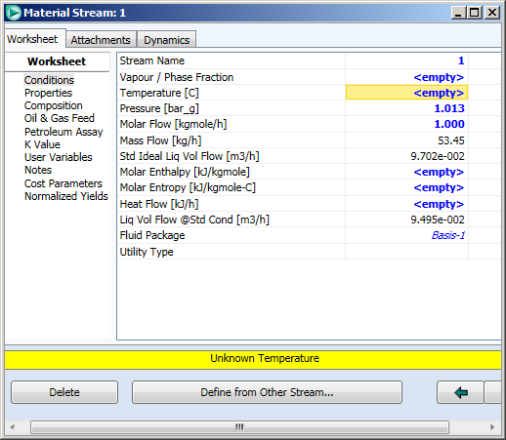
Next, let’s do a dewpoint calculation. Highlight the temperature input box and press the delete key. Highlight the “Vapour/Phase Fraction” input box, and enter “1”. Since you already specified the pressure, by specifying the vapor fraction to be 1, you are specifying two phases by telling HYSYS you want the dewpoint and that satisfies the phase rule. The two phases are a vapor phase and an infinitely small droplet of liquid phase.

Slide 18
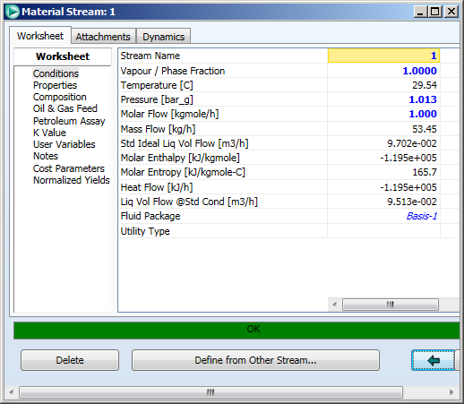
You should have the conditions given above. Note that the dewpoint is 29.54ºC at 1.013 bar_g. Note also that you are unable to highlight the temperature input box anymore, and the text in the box is now black. This is because temperature is a computed result. Now, how would you find the composition of the infinitely small liquid droplet in equilibrium with the vapor phase? Click on the “Composition” link in the left-hand box.

Slide 19
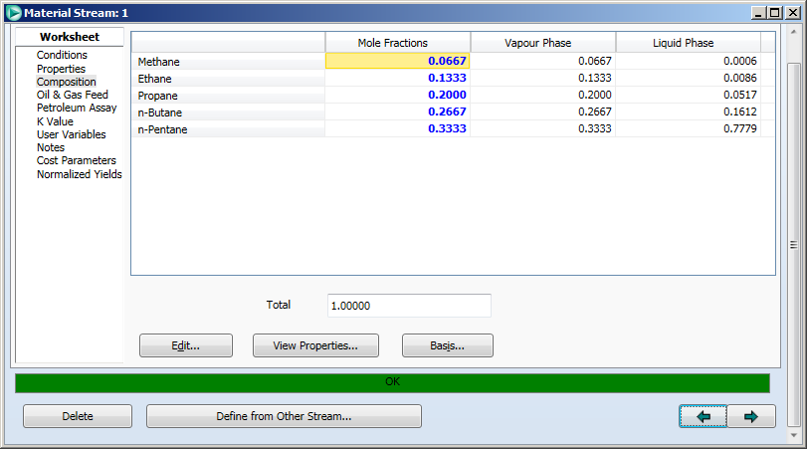
You will see the window where you originally entered the composition, and the composition you entered was the overall composition. Stretch the window to the right until you see the “Liquid Phase” heading on the table (or, you could scroll to the right). You will see the vapor phase composition to be identical to the overall composition (it is all vapor after all) and the composition of the infinitely small droplet of liquid is under “Liquid Phase”.

Slide 20
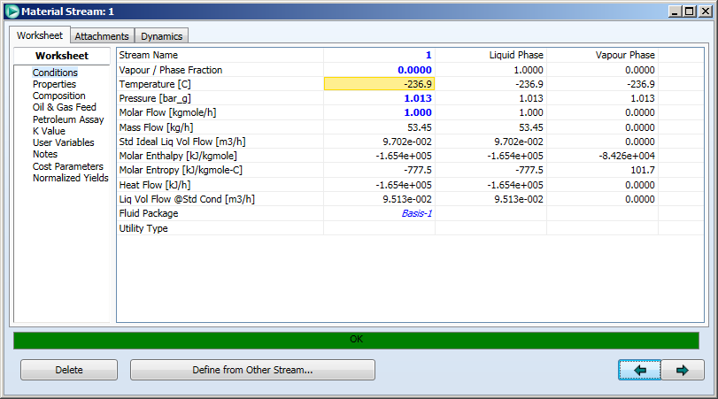
To do a bubble-point calculation, go back to the “Conditions” link, and enter “0” in the vapor fraction input box. You will have an infinitely small bubble of vapor in the liquid. Note that the bubble-point is -236.9ºC – quite cold because methane is very volatile.

Slide 21
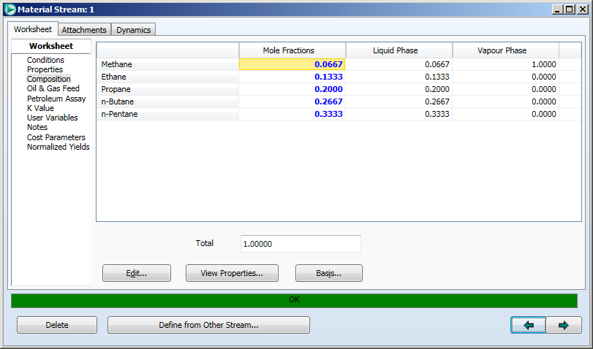
Go back to the “Composition” link, and check the vapor composition. It is 100% methane because of the very high relative volatility of methane at this temperature. If you want to see the K values, click on the “K Value” link in the left column and you will see that the methane K value is 15.00 while all the other components have K values smaller than 10⁻⁹.

Slide 22
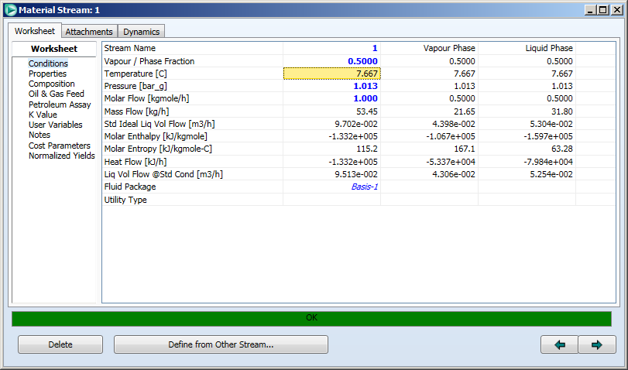
Finally, enter “0.5” for the vapor phase fraction on the “Conditions” link.

Slide 23

Check the “Composition” link to see the vapor and liquid compositions. You may need to expand the width of the window to see both the vapor and liquid compositions at the same time.

Slide 24
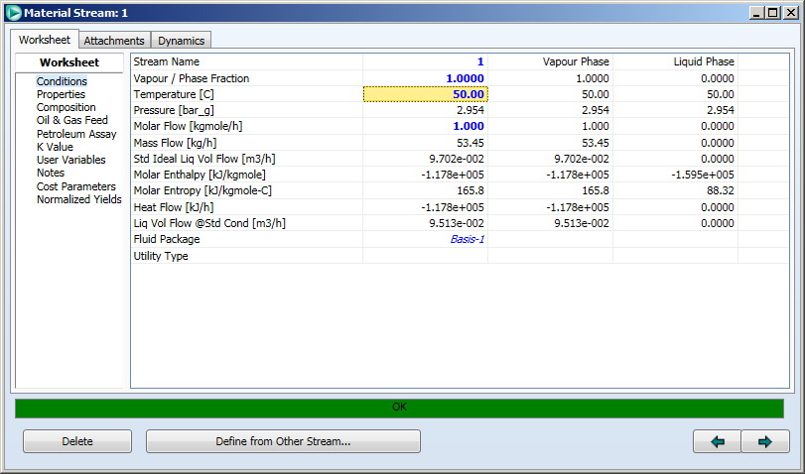
Similar calculations can be done fixing temperature, and computing dew-pressure and bubble-pressure. To do this, delete the pressure, and enter a fixed temperature – say 50ºC, then put in a vapor faction of 1, 0, and 0.5 in succession. The screen capture above shows a dew-pressure of 2.954 bar_g at 50ºC. An infinitesimally small droplet of liquid would be formed when a gaseous mixture at 50ºC is compressed at constant T to 2.954 bar_g.

Slide 25
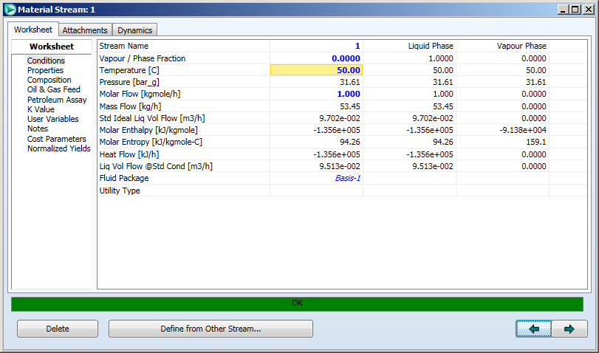
For a vapor faction of 0 at 50ºC, an infinitesimally small bubble of vapor would be formed when a liquid mixture at 50ºC is at 31.61 bar_g. Check the vapor composition and you will see it is 45.03% methane.

Slide 26
Practice Exercises
Find the pressure and vapor and liquid composition at T=50ºC, vapor fraction = 0.5
Repeat the calculations in this tutorial, but use the Peng-Robinson equation of state instead of UNIQUAC for the liquid phase as well as the gas phase. To change to Peng-Robinson:
  Go back to the basis environment by clicking on the beaker icon labelled “Properties” on the side lower left sidebar.
  Click the Fluid Packages/Basis-1 tab and choose Peng-Robinson from the Property Package Selection list. Choose “Rackett” for Density in the Options window that opens.
  Return to the Simulation – use the “Simulation link in the lower left sidebar.
Compare results of Peng-Robinson to UNIQUAC. Why are the results different but approximately the same?

